Slide 1
Chapter 6
Some Continuous Probability Distributions:

Slide 2
Continuous Uniform distribution
(Rectangular Distribution)
The probability density function of the continuous uniform random variable X on the interval [A, B] is given by:

Slide 3
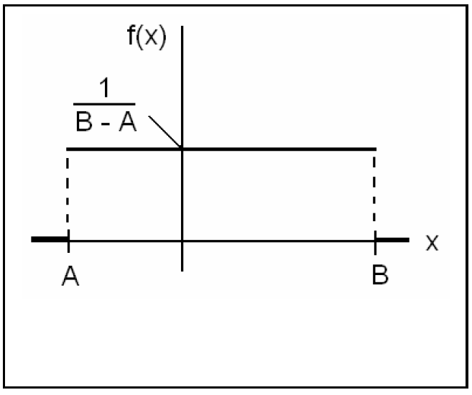

Slide 4
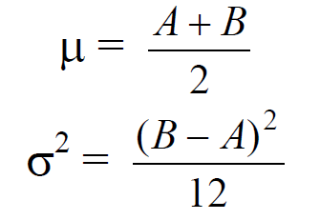
Theorem
The mean and the variance of the continuous uniform distribution on the interval [A, B] are:

Slide 5
Example
Suppose that, for a certain company, the conference time, X, has a uniform distribution on the interval [0,4] (hours).
(a) What is the probability density function of X?
(b) What is the probability that any conference lasts at least 3 hours?

Slide 6
Solution:

Slide 7
Normal Distribution (Gaussian distribution)
The normal distribution is one of the most important continuous distributions.
Many measurable characteristics are normally or approximately normally distributed, such as, height and weight.
The graph of the probability density function (pdf) of a normal distribution, called the normal curve, is a bell-shaped curve.

Slide 8
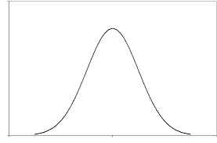
The normal distribution characteristics
1) $−∞<X<∞$
2) The density function of $X$, $f(x)$, has a bell-shaped curve
$$mean=μ$$
$$Varianve=σ^{2}$$
$$−∞$$
$$μ$$
$$+∞$$

Slide 9
3) The highest point of the curve of $f(x)$ at the mean $μ$
The curve of $f(x)$ is symmetric about the mean $μ$.
$μ$=mean = mode = median
4) The normal distribution depends on two parameters:
mean = $μ$ and variance = $σ^{2}$
(5) If the r.v. X is normally distributed with mean $μ$
and variance ${σ }^{2}$, we write:
X ~ Normal $\left(μ,σ^{2}\right)$or X ~ N$\left(μ,σ^{2}\right)$

Slide 10
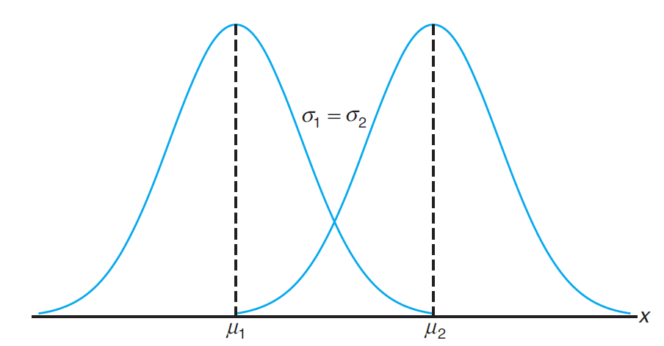
(6) The location of the normal distribution depends on $μ$
The shape of the normal distribution depends on $σ^{2}$

Slide 11
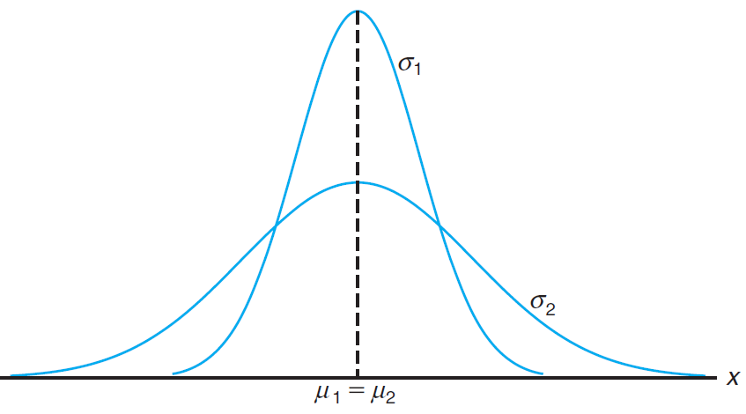

Slide 12
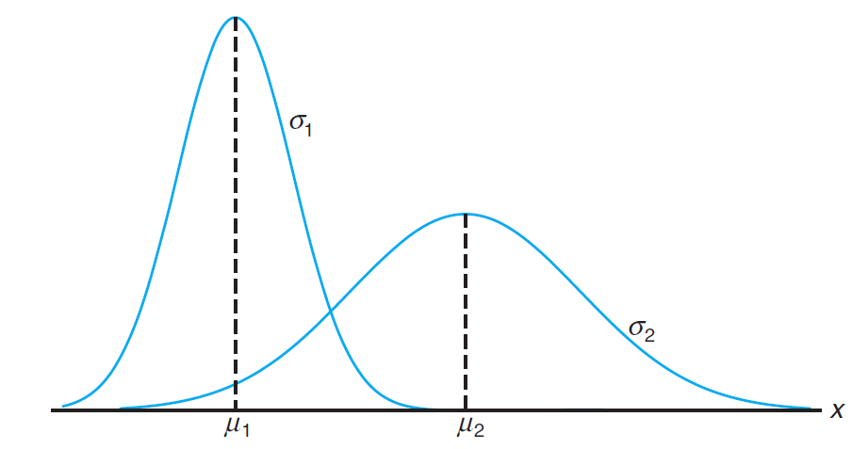

Slide 13
The pdf of $X \sim Normal(μ,σ)$is given by:

Slide 14
Some properties of the normal curve $f(x)$ of $N(μ,σ):$
1. $f(x)$ is symmetric about the mean μ.
2. $f(x)$ has two points of inflection at $x= μ±σ.$
3. The total area under the curve of $f(x)$ =1.
4. The highest point of the curve of $f(x)$ at the mean $μ.$

Slide 15
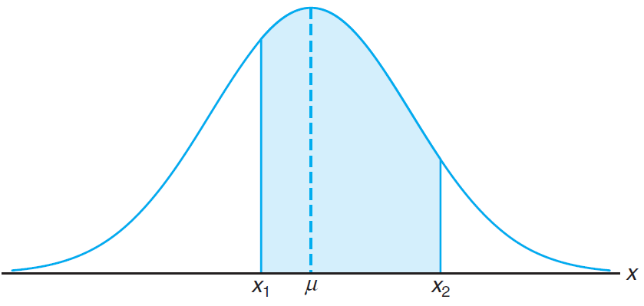
Areas Under the Normal Curve

Slide 16
Areas Under the Normal Curve
The Standard Normal Distribution:
• The normal distribution with mean μ=0 and variance σ²=1 is called the standard normal distribution and is denoted by Normal(0,1) or N(0,1). If the random variable Z has the standard normal distribution, we write Z~Normal(0,1) or Z~N(0,1).

Slide 17
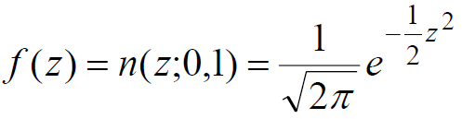
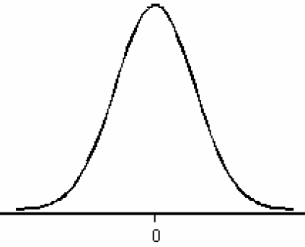
• The pdf of Z~N(0,1) is given by:

Slide 18
• The standard normal distribution, Z~N(0,1), is very important because probabilities of any normal distribution can be calculated from the probabilities of the standard normal distribution.
• Probabilities of the standard normal distribution Z~N(0,1) of the form P(Z≤a) are tabulated.

Slide 19
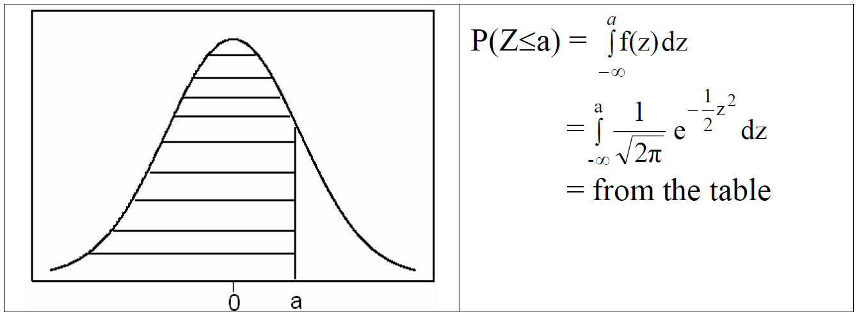

Slide 20
• We can transfer any normal distribution X~N(μ,σ) to the standard normal distribution, Z~N(0,1) by using the following result.

Slide 21
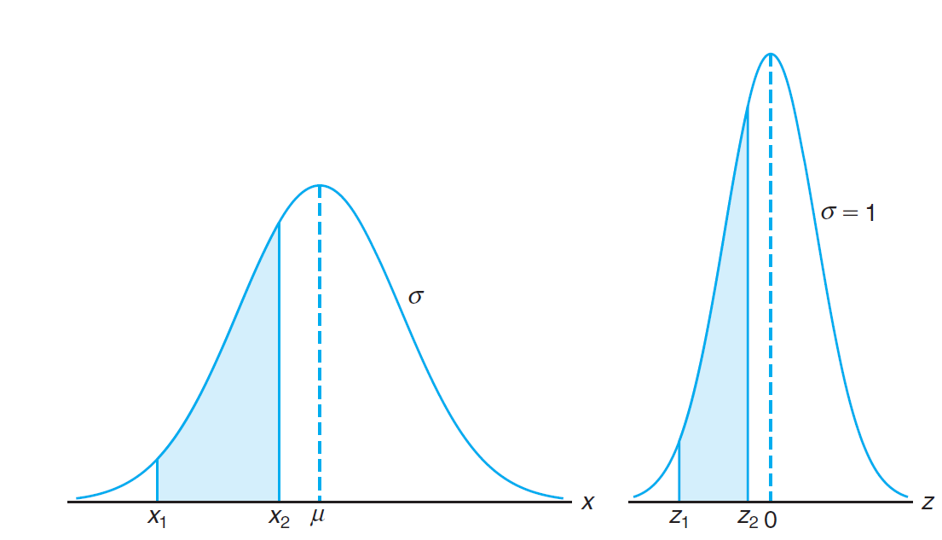

Slide 22
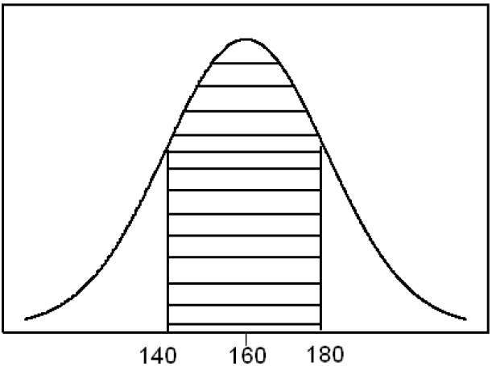
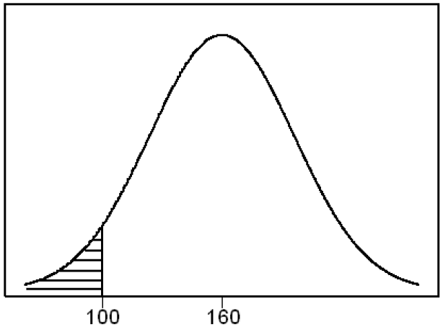
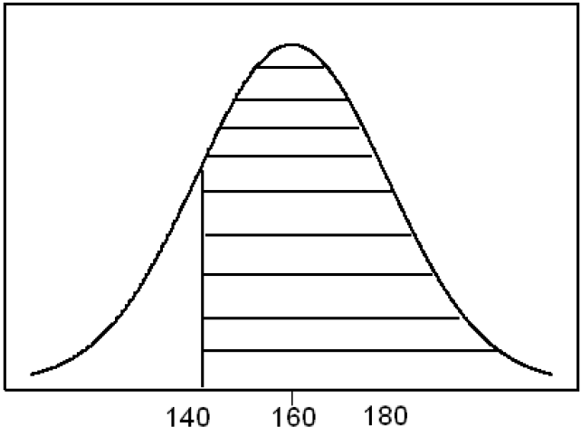
(ii) Probability of an interval event is given by the area under the curve of $f(x)$ and above that interval.

Slide 23
Note: Probabilities of Z~N(0,1):
If X is continuous random variable then:

Slide 24
Finding $P(Z≤z)$ from the table
consider that the value of $z$ is rounded to 2 decimal places as $z=a.bc$
$$z$$ | 0.00 | 0.01 | $$z$$ | ........ | $$0.0c$$ | ........ | 0.09
-3.4
-3.3
......
$$a.b$$
......
3.4
$$P(Z≤a.bc)$$

Slide 25
Example(1): $Z \sim N(0,1)$
$$1) P(Z≤1.50)$$
$$z$$ | 0.00 | 0.01 | 0.02 | ........ | 0.09
-3.4
-3.3
......
$$1.5$$ | 0.9332
......
3.4
0.9332
1.50

Slide 26
Example(2): $Z \sim N(0,1)$
$$2) P\left(Z≥0.98\right)=1−P\left(Z≤0.98\right)=1−0.8365=0.1635$$
$$z$$ | 0.00 | 0.01 | ........ | 0.08 | 0.09
-3.4
-3.3
......
$$0.9$$ |  |  |  | 0.8365
......
3.4
0.1635
0.98

Slide 27
Example (3): $Z \sim N(0,1)$
$$3) P\left(−1.33≤Z≤2.42\right)=P\left(Z≤2.42\right)−P\left(Z≤−1.33\right)$$
$$=0.9922−0.0918=0.9004$$
$$z$$ | 0.00 | 0.01 | 0.02 | 0.03 | .....
.....
-1.3 |  |  |  | 0.0918
......
2.4 |  |  | 0.9922
…..
0.9004
-1.33
2.42

Slide 28
Example(4): $Z \sim N(0,1)$
$$4) P\left(Z≥0\right)=P\left(Z≤0\right)=0.5$$
0.5
0.5
0

Slide 29
Notation
$$P\left(Z≤Z_{A}\right)=A$$
$$A$$
$$1−A$$
$$Z_{A}$$

Slide 30
Example: Z ~ N(0,1)

Slide 31
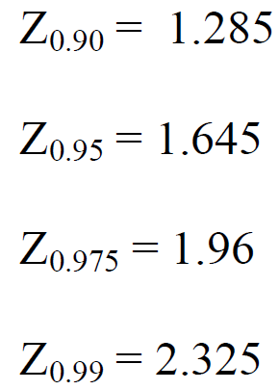
Example: $Z \sim N(0,1)$

Slide 32
Calculating Probabilities of Normal $(μ,σ^{2})$

Slide 33
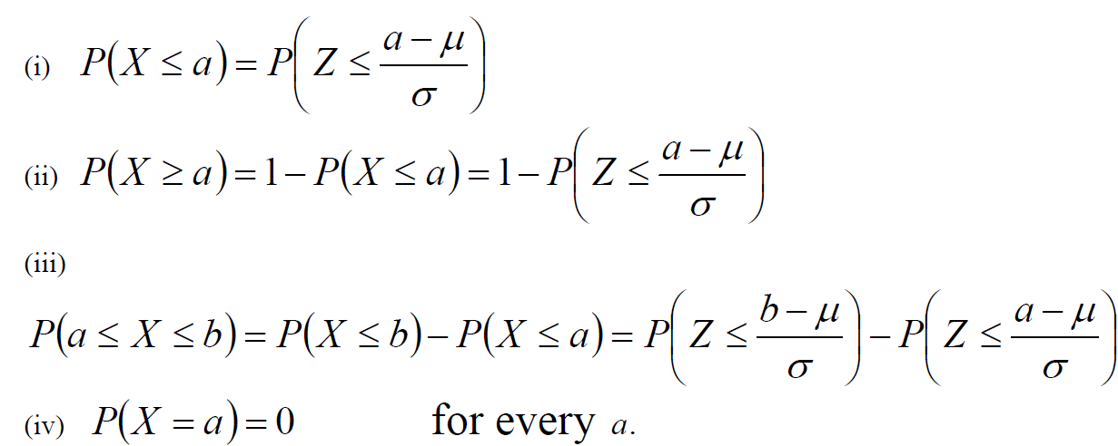
$$(V) P(X≤μ) = P(X≥μ)=0.5$$

Slide 34
Example:
Suppose that the hemoglobin level for healthy adults males has a normal distribution with mean μ=16 and variance σ²=0.81 (standard deviation σ=0.9).
(a) Find the probability that a randomly chosen healthy adult male has hemoglobin level less than 14.
(b) What is the percentage of healthy adult males who have hemoglobin level less than 14?

Slide 35
Solution:
(a) $P\left(X≤14\right)=P\left(Z≤\frac{14−μ}{σ}\right)$
$=P\left(Z≤\frac{14−16}{0.9}\right)=P\left(Z≤−2.22\right)=0.0132$
(b) The percentage of healthy adult males who have hemoglobin level less than 14 is
P(X ≤14) × 100% = 0.01320× 100% =1.32%
1.32% of healthy adult males have hemoglobin level less than 14.

Slide 36
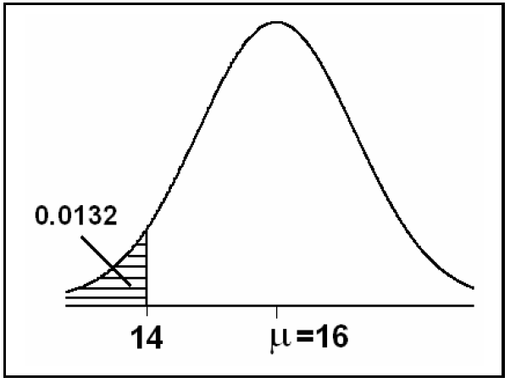

Slide 37
Example:
Suppose that the birth weight of Saudi babies has a normal distribution with mean μ=3.4 and standard deviation σ=0.35.
(a) Find the probability that a randomly chosen Saudi baby has a birth weight between 3.0 and 4.0 kg.
(b) What is the percentage of Saudi babies who have a birth weight between 3.0 and 4.0 kg?

Slide 38
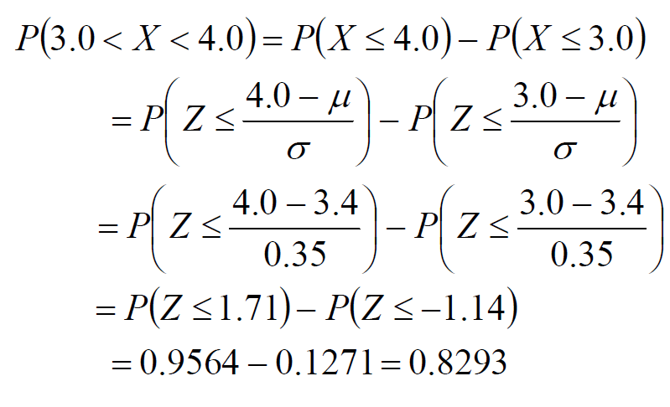
Solution:
(a)
(b) 82.93% of Saudi babies have birth weight between 3.0 and 4.0 kg.

Slide 39
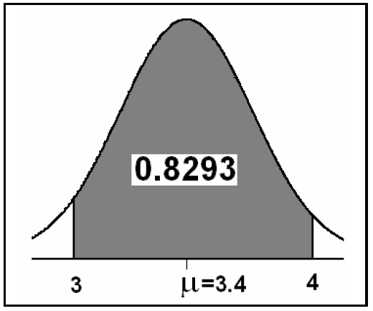

Slide 40
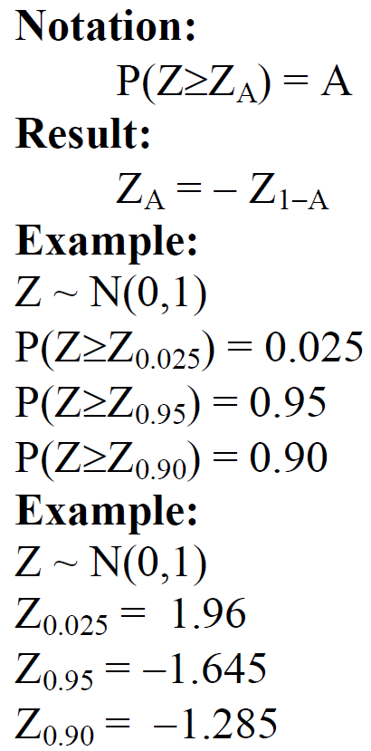
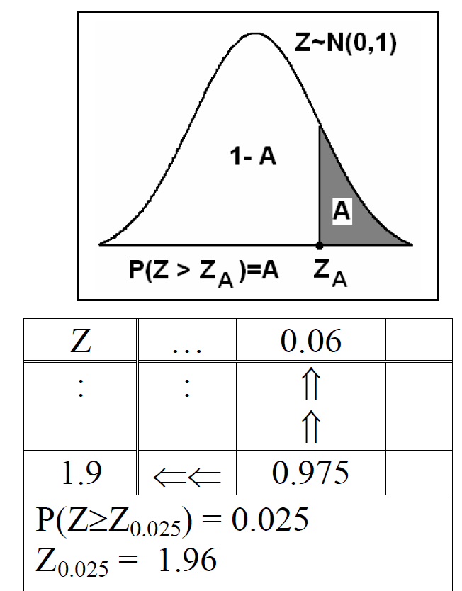

Slide 41
More examples see
Ex: 6.2, 6.3, 6.4 and 6.5 on page 178

Slide 42
Applications of the Normal Distribution

Slide 43
Example:
A certain type of storage battery lasts, on average, 3.0 years with a standard deviation of 0.5 year. Assuming that battery life is normally distributed, find the probability that a given battery will last less than 2.3 years.

Slide 44
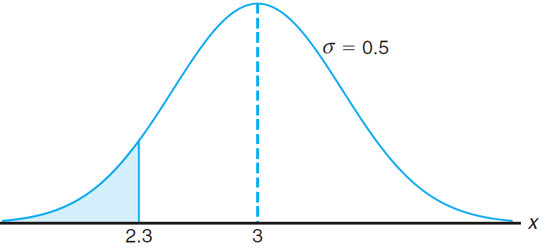
Solution:

Slide 45
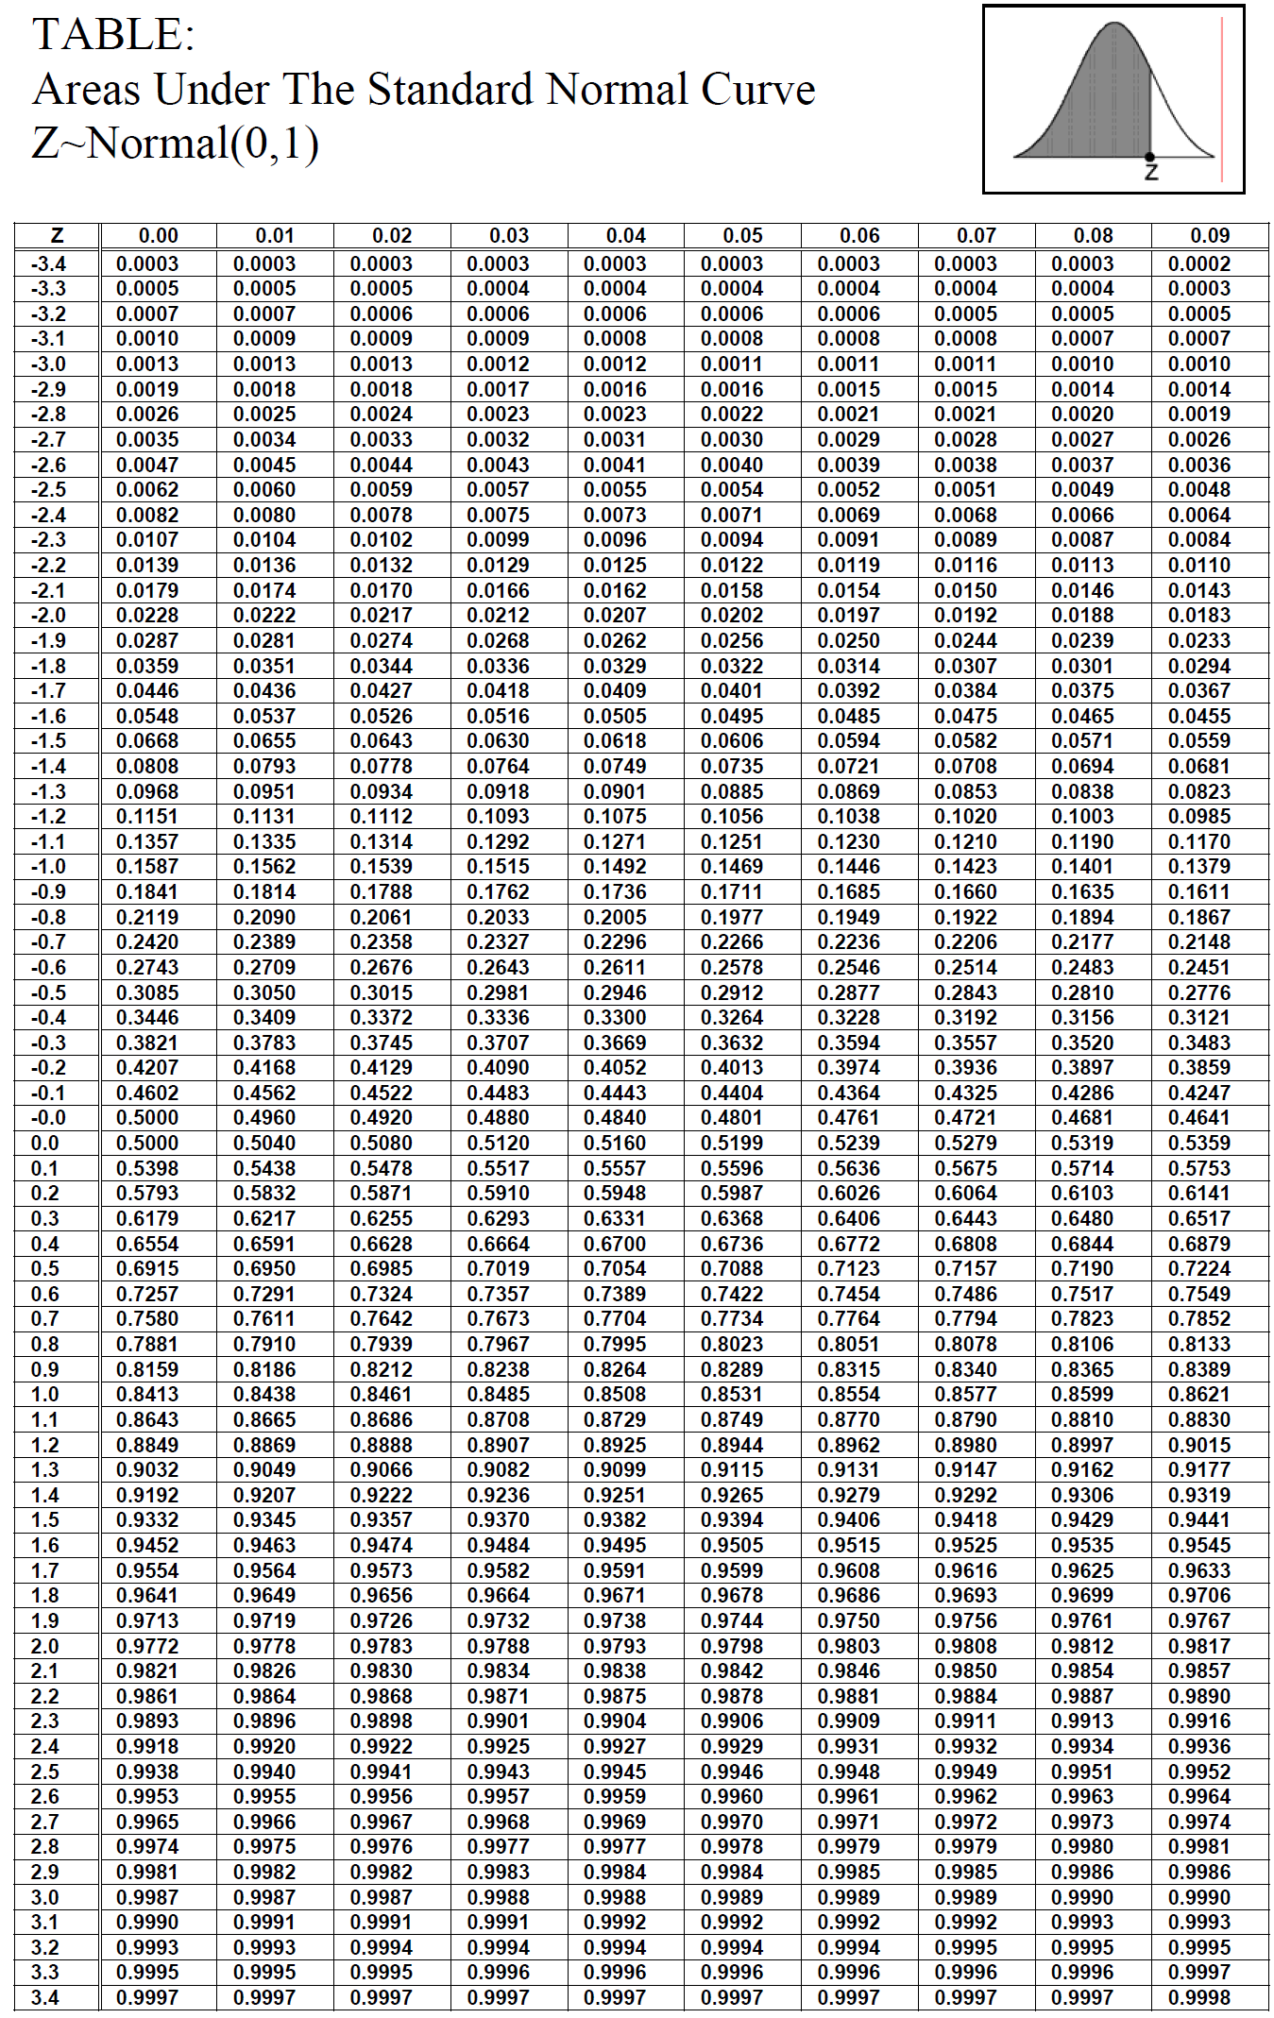

Slide 46
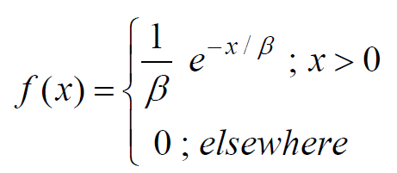
Exponential Distribution
Definition:
The continuous random variable X has an exponential distribution with parameter $β$, if its probability density function is given by:
and we write $X\sim Exp(β)$

Slide 47
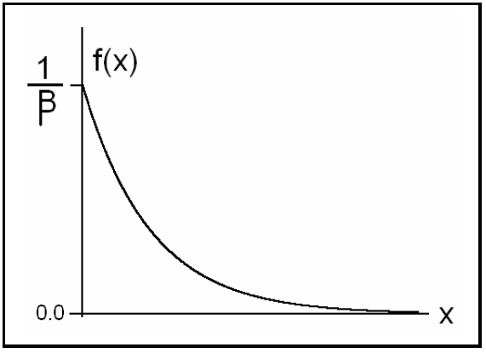

Slide 48
Theorem:
If the random variable X has an exponential distribution with parameter $β$, i.e., $X\sim Exp(β)$, then the mean and the variance of X are:
$$E(X)= μ = β$$
$$Var(X) = σ2 = β2$$

Slide 49
Example
Suppose that a system contains a certain type of component whose time in years to failure is given by T. The random variable T is modeled nicely by the exponential distribution with mean time to failure β=5. If 5 of these components are installed in different systems, what is the probability that at least 2 are still functioning at the end of 8 years?

Slide 50
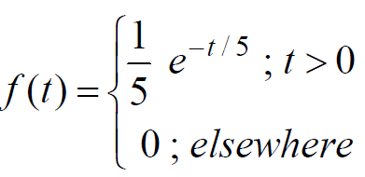
Solution:
$$β=5, T\sim Exp(5)$$
The pdf of T is:
The probability that a given component is still functioning after 8 years is given by:

Slide 51
The probability that at least 2 are still functioning at the end of 8 years is:

