Slide 1
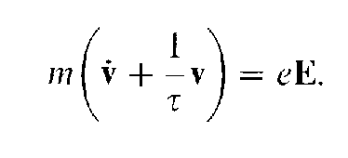
The London-London equation
The London (F. London and H. London 1935) equations are useful in describing many of the magnetic properties of superconductors.
London starts with the Drude-Lorentz equation of motion for electrons in a metal, which is Newton's law for the velocity, v, of an electron with mass, m. and charge, e, in an electric field, E, with a phenomenological viscous drag proportional to

Slide 2
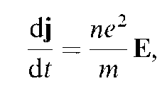
The London-London equation
For a perfect conductor τ→∝. Introducing the current density j = nev, where n is the conduction electron density,, Drude Eq. can be written as
which is referred to as the first London equation.
The time derivative of Maxwell's fourth equation

Slide 3
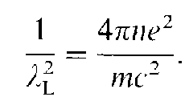
The London-London equation
Taking the curl,
And using we have,
(1)
Where we introduced the London depth λ_{L} defined by

Slide 4
The London-London equation
Eq. (1) has been obtained for a perfect conductor model.
In order to conform with the experimentally observed Meissner effect, we must exclude time-independent field solutions arising from integrating (1) once with respect to time and we therefore write,
(2)
this is referred to as the second London equation.

Slide 5
The London-London equation
As a simple application of London equation we now discuss the behavior of a superconductor in a magnetic field near a plane boundary.
Consider first the case of a field perpendicular to a superconductor surface lying in the x-y plane with no current flowing in the z direction.
From the second Maxwell equation,
we obtain, or H= const .
From the fourth Maxwell equation,
Hence the first term in the 2nd London equation vanishes and hence H=0 is the only solution.
Thus a superconductor exhibiting the Meissner effect cannot have a field component perpendicular to its surface.

Slide 6
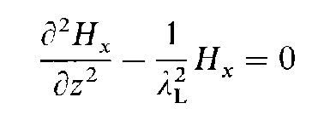
The London-London equation
London equation becomes

Slide 8
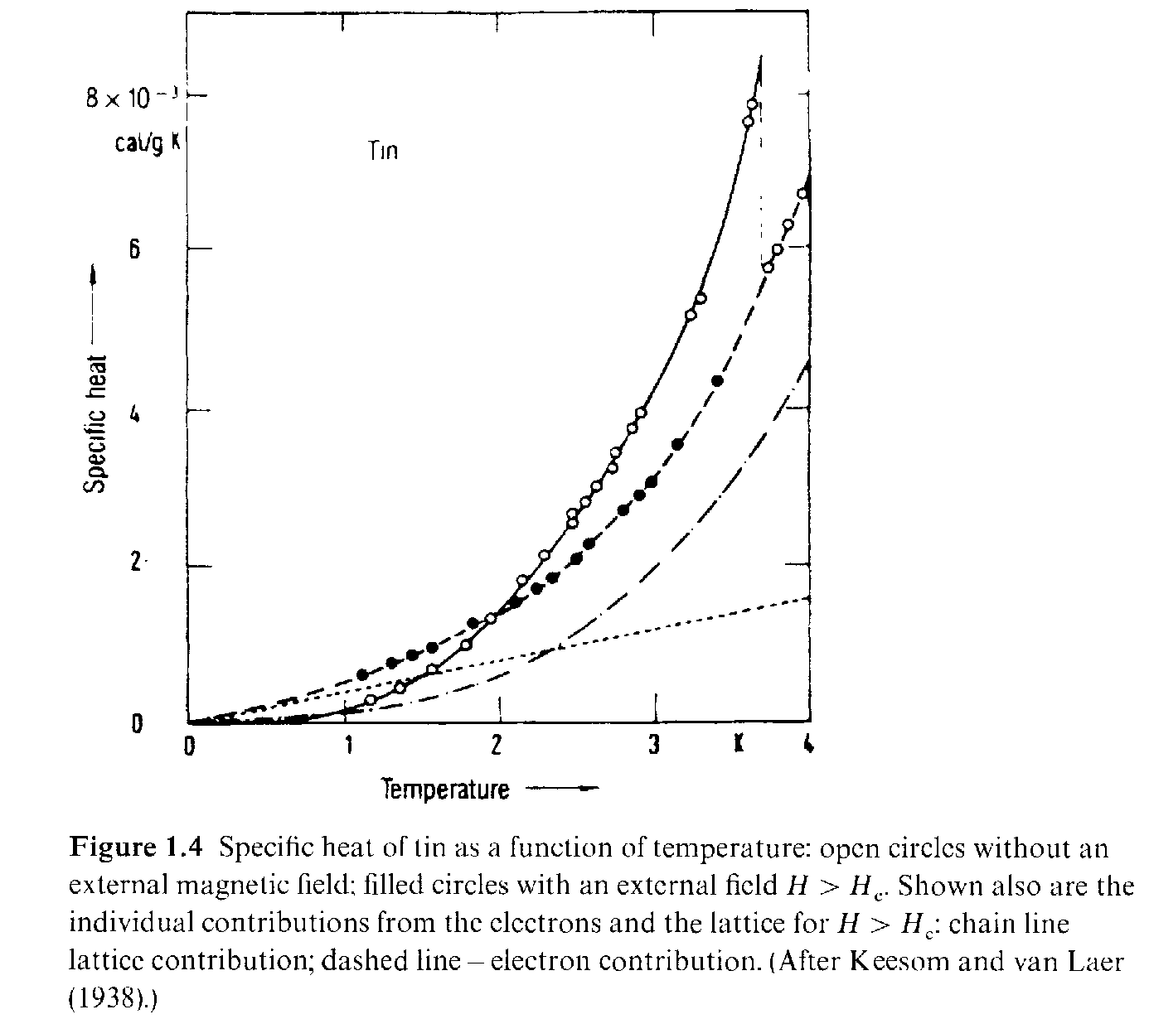
The Pippard’s equation
At temperatures well below the superconducting transition temperature the heat capacity of a superconductor displays an exponential behavior (see Fig.).

Slide 9
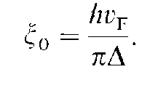
The Pippard’s equation
This suggests that the conduction electron spectrum develops an energy gap, (not to be confused with the gap in a semiconductor):
Electrons in normal metals have a continuous (gapless) distribution of energy levels near the Fermi energy,
One dimensional grounds one can construct a quantity having the units of length from and the Fermi velocity, v_{F}; we define the so-called coherence length by

Slide 10
The Pippard’s equation
This length bears no resemblance to the London depth, λ_{L}, and hence represents a different length scale affecting the behavior of a superconductor.
It can be interpreted as a characteristic length which measures the spatial response of the superconductor to some perturbation (e.g. the distance over which the superconducting state develops at a normal metal superconductor boundary).
Length scales of this kind were introduced independently by Ginzburg and Landau (1950) and by Pippard (1953).
These length scales are not identical, however: the Pippard length is temperature-independent while the Ginzburg Landau length depends on temperature. The Pippard coherence length is related to the BCS coherence length.

Slide 11
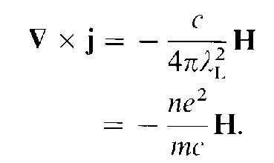
The Pippard’s equation
We first discuss Pippard's phenomenological theory (which semi quantitatively captures the main features of the microscopic theory (BCS).
We begin by writing London's equation in an alternative form. Substituting the fourth Maxwell equation
in the London equation yields

Slide 12
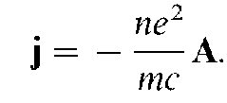
The Pippard’s equation
We next write where A is the magnetic vector potential, and restrict the gauge to satisfy .
and the boundary condition, A_{n} = 0
where A_{n} is the component of A perpendicular to the superconductor surface. London's equation may then be written
(1)

Slide 13
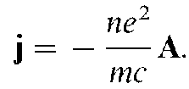
The Pippard’s equation
The boundary condition that the normal component of A_{n} =0, is reasonable.
Because the normal component of the super-current, j_{n}, vanishes at a boundary (this is a good boundary condition at a superconductor-insulator boundary but will require modification for metal superconductor or superconductor-superconductor boundaries).
To generalize Pippard reasoned that the relation between j and A should be nonlocal, meaning that the current j(r) at a point r involves contributions from A(r') at neighboring points r‘ located in a volume with a radius of order go surrounding r.
The mathematical form he selected was guided by the nonlocal relation between the electric field. E(r'). and the current, j(r), which had been developed earlier by Chambers (1952). The expression employed by Pippard was

Slide 14
The Pippard’s equation
The expression employed by Pippard was
(2)
where R = r - r'. The constant C is fixed by requiring (2) reduce to (1) in the quasi-uniform limit where we may take A from under the integral sign; we then have

Slide 15
The Pippard’s equation
(3)
Since Eq. (3) involves two functions, A(r) and j(r), a complete description requires a second
equation which is obtained by substituting
in the fourth Maxwell equation to obtain

Slide 16
The Pippard’s equation
Eq. (3) applies only to a bulk superconductor. An important question we would like to examine is the behavior of a magnetic field near a surface, which will require a modification (or reinterpretation) of (3).
To model the effect of the surface the integration over points r' is restricted to the interior of the superconductor.
If the surface is highly contorted (twisted/bended,), then it can happen that two points near the surface and separated by about a coherence length cannot be connected by a straight electron trajectory without passing through the vacuum; one then has to account for this shadowing effect. We restrict ourselves here to plane boundaries which we take to be normal to the z direction.

Slide 17
The Pippard’s equation
In the limit Eq. (3) reduces to the London equation, as discussed above.
By expanding A(r') in a power series in R, we may obtain corrections to the London equation due to non-locality.
In the opposite limit, , A(r') varies rapidly. Let us assume that A(r) falls off over a characteristic distance λ ; (which we will determine shortly through a self-consistency argument). When , the value of the integral (3) will be reduced roughly by a factor ;
i.e., (4)

Slide 18
The Pippard’s equation
(4)
We may also write (4) in the London-like' form
This equation has solutions which decay in a characteristic length
To achieve self-consistency we set this length equal to λ:

Slide 19
The Pippard’s equation
A more rigorous derivation from the microscopic theory carried out yields,
We conclude that in the Pippard limit the effective penetration depth λ is larger than the London depth, λ_{L}: . At the same time λ remains smaller than the coherence length:

Slide 20
The Pippard’s equation
If our metal has impurities, it is natural to assume the relation between the current and vector potential will be altered. To account for the effects of electron scattering,
Pippard modified the coherence length factor in the exponent of(3) as
Where is the electron mean free path; the coefficient in front of the integral was not altered. Eq. (3) then becomes

Slide 21
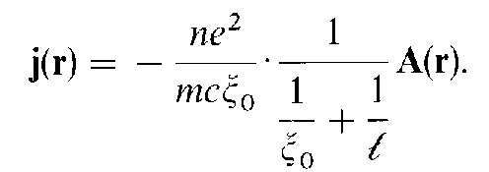
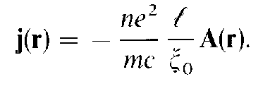
The Pippard’s equation

Slide 22
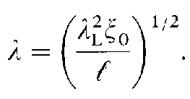
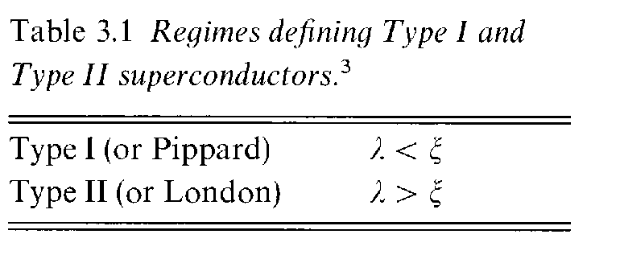
The Pippard’s equation

Slide 23
The Pippard’s equation
END.

