Slide 1
Lipids-I
BCH 302 [practical]

Slide 2
-Lipids are esters of long chain fatty acids and alcohols.
-Fatty acids are lipids’ building blocks
-It can be defined as nonpolar organic compound insoluble in polar solvent , but soluble in organic solvents such as benzene ,ether, chloroform and boiling alcohol.
Biological role of lipids:
Lipids are found naturally in all living organisms.
1)It represents in cell structure and has a structural function in the cell : it presents in cell membranes.
2) An essential source of energy in the body. It give more energy than carbohydrate and proteins.

Slide 4
Fats can be divided according to their chemical composition to:
1) Simple lipids:
-These compounds are: esters of fatty acids with glycerol.
-The triacylglycerol (TAG) is the simplest and most common fat. It is the form in which lipids are stored in the cell.

Slide 5
2) Compound (conjugated) lipids.
Lipids are linking with other compounds:
a)Phospholipids:
Most phospholipids contain diglyceride, and phosphate group.
b)Glycolipids:
lipids with a carbohydrate attached.
c)Proteolipids :
any of a group of proteins to which a lipid molecule is attached.
3) Derived lipids.
They are substances that are soluble in lipid or derived from the above groups of lipids by hydrolysis; for examples, cholesterol and fat soluble vitamins.

Slide 6
1-Solubility test:
Objective: to test the solubility of oils in different solvent.
Principle:
Fats are not dissolved in water due to their nature, which is non-polar (hydrophobic), but it is soluble in organic solvents such as chloroform, benzene, and boiling alcohol.
Note: Different lipids have ability to dissolve in different organic solvent. This property enable us to separate a mixture of fat from each other.

Slide 7
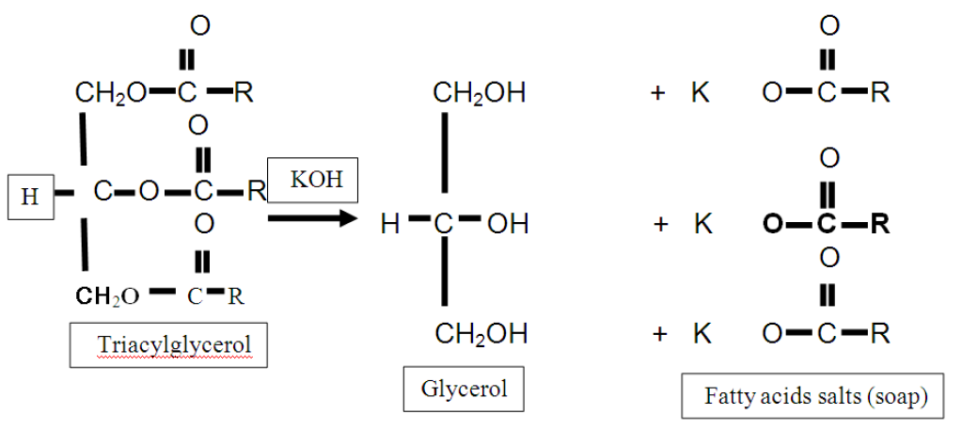
2-Saponification test:
Objective: to form the soap.
TAG can be hydrolyzed into its component fatty acids and alcohol. This reaction can also be carried out in the laboratory by a process called saponification where the hydrolysis is carried out in the presence of a strong base (such as NaOH or KOH)

Slide 8
Principle:
Saponification is a process of hydrolysis of oils or fat with alkaline and result in glycerol and salts of fatty acids (soap) . The process can be used of saponification in the separation of saponifiable materials from unsaponified (which are soluble in lipid).
Note: soap is salt of fatty acid.

Slide 9
3- Testing the separation of soap from the solution by salting out :
Objective: to investigate the effect of NaCl on soap solubility.
Principle:
To get the soap out of solution by salting out, when added solid sodium chloride to the solution until saturation; separated soap in the form of insoluble and floats above the surface.
The NaCl solution provides Na⁺ and Cl⁻ ions that bind to the polar water molecules, and help separate the water from the soap. This process is called salting out the soap.

Slide 10
4-Test formation insoluble fatty acids salt (insoluble soaps):
Objective: to investigate the effect of different cations on soap solubility.
Principle:
-Working calcium, magnesium, lead or iron ions to the deposition of soap and make it insoluble in water, where solve these ions replace the sodium or potassium ions are present in soap.
-Due to the hard water to contain significant quantities of Ca2+ , Mg2+ and some Fe3+ that react with the charged ends of the soaps to form insoluble salts of fatty acid. The insoluble salts of fatty acid that Ca²⁺ and Mg²⁺ form with soap anions cause white precipitate to from.

Slide 11
K⁺ soap + Ca⁺²sulfate=> Ca⁺² soap + K⁺ sulfate.
Potassium soap + calcium sulfate=.> calcium soap + potassium sulfate.
(a white precipitate from calcium stearte or oleate is formed).
Note: hard water, which contains salts of magnesium and calcium

