Slide 1
Lymph
It is fluid derived from tissue fluid that flows through lymphatic vessels, returning to the venous bloodstream.
- It is clear, colourless fluid
- Lymphatic vessels absorb excess interstitial fluid and transport the fluid (lymph) to ducts that drain into veins.
- The lymphatic system returns protein and excess interstitial fluid to the circulation. .

Slide 2
Function of lymphatic system:
1) Brings materials back to the blood system.
- carries fluid from tissue spaces back to the blood.
2) Immunity:
Its cells – called lymphocytes – help to provide immunological defense against disease

Slide 3
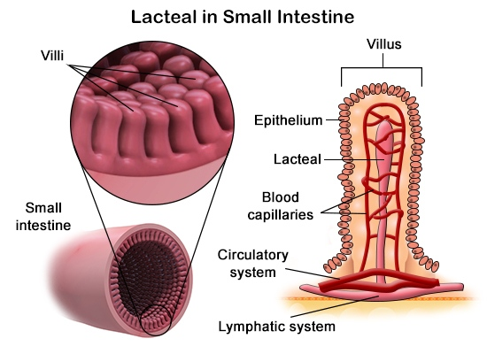
3) Lipid absorption:
Lacteals found in the small intestine absorb dietary lipids that can not be absorbed by the blood capillaries.

Slide 4
4) To maintain the pressure and volume of the extracellular fluid by returning excess water and dissolved substances from the interstitial fluid to the circulation.

Slide 5
- As blood moves through the circulatory system, fluids and small molecules pass from plasma into the surrounding tissues.
- Fluids and some blood proteins that leak from the capillaries into the interstitial fluids are returned to the blood via the lymphatic system.

Slide 6
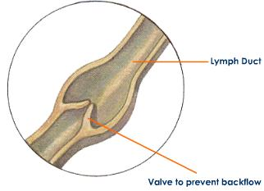
Fluids enter this system by diffusing into tiny lymph capillaries.
Once inside the lymphatic system, the
fluid is called lymph,
Lymph vessels have valves that prevent the
backflow of fluid toward the capillaries.

Slide 7
Lymph filtered through lymph node.
Inside the lymph node connective tissue
filled with white blood cells specialized for defense
-Clusters of lymph nodes are found scattered around the body especially in the armpits, neck, chest, and abdomen.
-When the body is fighting an infection, these cells multiply, and the lymph nodes become swollen.

Slide 8
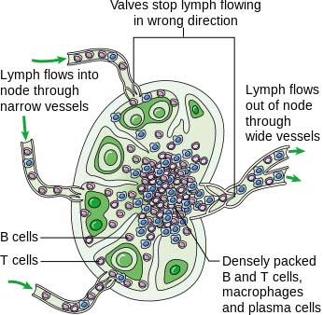

Slide 9
What causes swollen lymph nodes?
Lymph nodes often swell in one location when a problem such as an injury, infection, or tumour develops in or near the lymph node. Which lymph nodes are swollen can help identify the problem.
For example; the glands on either side of the neck, under the jaw, or behind the ears commonly swell when you have a cold or sore throat.

Slide 10
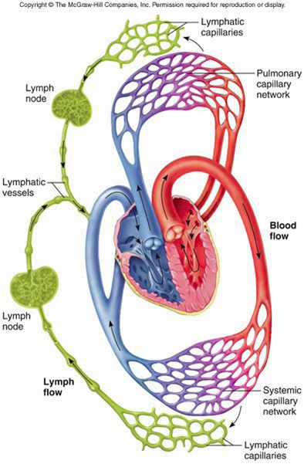

Slide 11
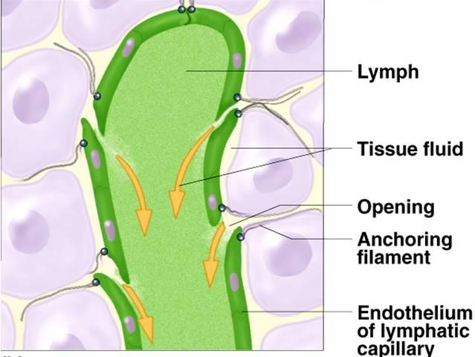

Slide 12
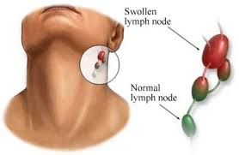
https://www.youtube.com/watch?v=Kh-XdNnTZUo

Slide 13
