Slide 1
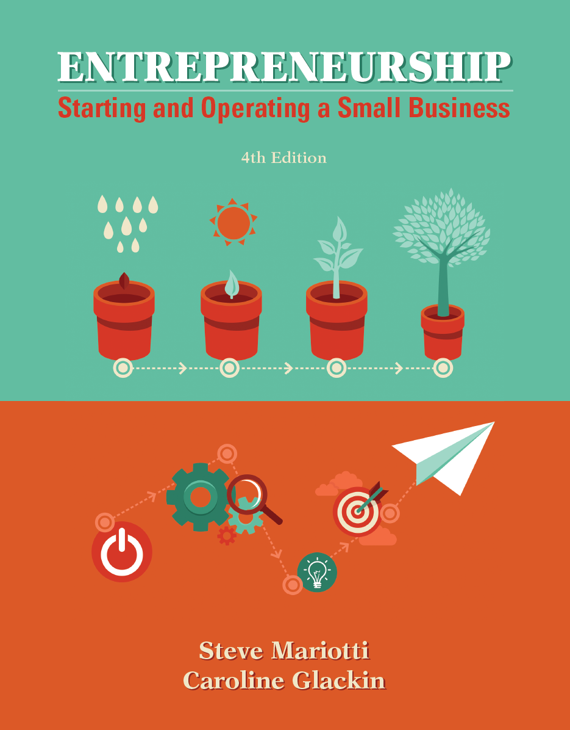
Chapter 3 Creating Business from Opportunity

Slide 2
Chapter Learning Objectives
1. Define your business.
2. Articulate your core beliefs, mission, and vision.
3. Analyze your competitive advantage.
4. Prepare viability tests using “the economics of one unit.”
5. Calculate the value of a business.

Slide 3
Apple and the Personal Computer
In 1943, IBM’s founder Thomas Watson commented, “I think there is a world market for about five computers.”
When Watson made his statement, computers were forbiddingly large and expensive machines that only the government, universities, and a few giant corporations could afford.
market - a group of people or organizations that may be interested in buying a given product or service, has the resources to purchase it, and is permitted by law and regulation to do so.

Slide 4
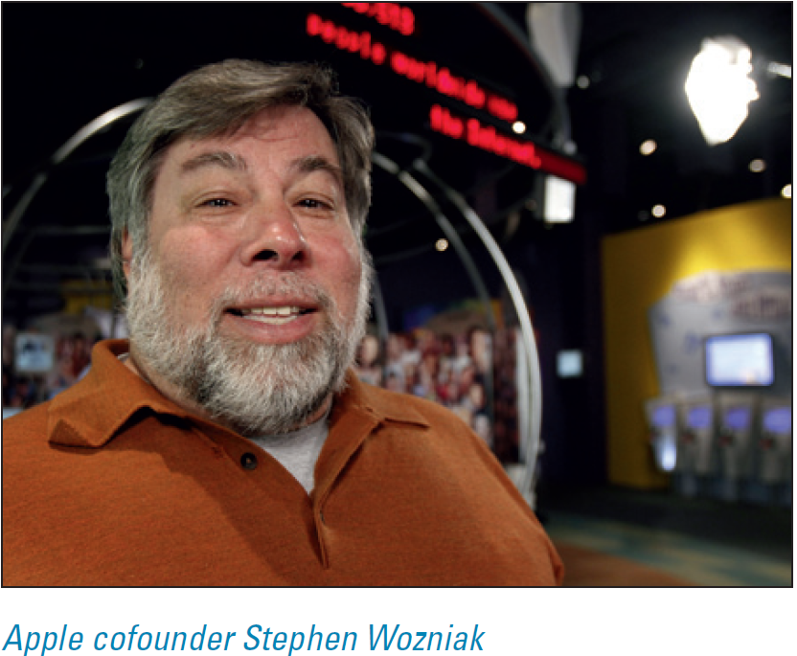
Apple and the Personal Computer
By the 1970s, however, a few people were talking about creating “personal” computers.
One such visionary was Steve Wozniak, who had landed his first job at Hewlett-Packard, then as now a major company.

Slide 5
Apple and the Personal Computer
Wozniak’s friend Steve Jobs also was interested in the technology and set out to sell some hobbyist computers.
Wozniak worked on his design concepts until he created the Apple II, which could display pictures and text.
It is now considered one of the great achievements in computer history.
Jobs, meanwhile, searched for an investor.

Slide 6
Apple and the Personal Computer
By 1984, Apple had sales of $1.5 billion, and sales topped $170 billion in fiscal year 2013.
Wozniak and Jobs recognized an opportunity that led to a product that satisfied the needs of an enormous market the giants of the industry did not recognize.
Notes:
This is a classic demonstration of entrepreneurs recognizing opportunities others do not see.

Slide 7
Business Definition
This business definition includes the offer, target market, and product and delivery capability—answering the questions of who, what, and how.
A solid business definition has three elements:

Slide 8
Business Definition
The offer. What will you sell to your customers? That is called your offer and includes the complete bundle of products and services you will be bringing to the marketplace.
2. Target market. Which segment of the market are you aiming to serve?
.

Slide 9
Business Definition
3. Production and delivery capability. How will you provide your offer to your targeted customers?
This part of the business definition includes the primary activities of:
• buying, developing, or manufacturing the product;
• identifying its potential qualified customers and selling the product to them;
• producing and delivering the product or service; and
• receiving payment.

Slide 10
What Sort of Organization Do You Want?
Each organization has the opportunity to create a unique mission, vision, and culture that will be supported by its core values.
The organization’s culture can be shaped according to the business environment and by the way employees, customers, and other stakeholders are treated—an example that is set by the founding entrepreneur (owner).

Slide 11
Your Company’s Core Values
core values - the fundamental, ethical, and moral philosophy and beliefs that form the foundation of the organization and provide broad guidance for all decision making.
Examples of the core values of a business might be:
“At Superior Printing, we engage in business practices that affect the environment as little as possible.”
“At Sheila’s Restaurant, we believe in supporting local organic farmers.”

Slide 12
Your Company’s Core Values
Exhibit 3-1 Core Values
Zappos.com
Deliver WOW through service
Embrace and drive change
Create fun and a little weirdness
4. Be adventurous, creative, and open-minded
5. Pursue growth and learning
6. Build open and honest relationships with communications
7. Build a positive team and family spirit
8. Do more with less
9. Be passionate and determined
10. Be humble
Notes:
Your core beliefs will affect everything, from the cost of materials to the prices you charge and how you treat customers.

Slide 13
Your Company’s Core Values
Exhibit 3-1 Core Values
Dow AgroSciences
To ensure the prosperity and well-being of Dow AgroSciences employees, customers, and shareholders, cumulative long-term profit growth is essential.
Employees are the source of Dow AgroSciences success. We communicate openly, treat each other with respect, promote teamwork, and encourage personal initiative and growth.
Excellence in performance is rewarded.
Customers receive our strongest commitment to meet their needs with high quality products and superior service.
Notes:
How we achieve this objective is as important as the objective itself. Fundamental to our success are the core values we believe in and practice.

Slide 14
Your Company’s Core Values
Exhibit 3-1 Core Values
Dow AgroSciences
Products are based on innovative technology, continuous improvement, and added value for our customers and end users.
Our conduct demonstrates a deep concern for human safety and environmental stewardship, while embracing the highest standards of ethics and citizenship.
DuPont Company
Safety, concern, and care for people, protection of the environment, and personal and corporate integrity, are this company’s highest values, and we will not compromise them.

Slide 15
Your Company’s Mission Is to Satisfy Customers
The mission of your business, expressed in a mission statement, is a concise communication of your purpose, business definition, and values.
The function of a mission statement is to clarify what the business is trying to do in the present, but it can provide direction and motivation for future action through a clear and compelling message.
A mission statement should be limited to 21 to 40 words to induce clarity in concept and expression.
Notes:
The mission statement should capture your passion for the business and your commitment to satisfying your customers.

Slide 16
Your Company’s Mission Is to Satisfy Customers
Exhibit 3-2 Mission Statements
The Dow Chemical Company—To constantly improve what is essential to human progress by mastering sciences and technology.
Google—To organize the world’s information and make it universally accessible and useful.
The Hershey Company—Undisputed Market Leadership.
Krispy Kreme Doughnuts—To touch and enhance lives through the joy that is Krispy Kreme.
Nike—To bring inspiration and innovation to every athlete in the world.
Teach for America—is growing the movement of leaders who work to ensure that kids growing up in poverty get an excellent education.
Walt Disney Company—To be one of the world’s leading producers and providers of entertainment and information, using its portfolio of brands to differentiate its content, services and consumer products.
Wounded Warrior Project—To honor and empower wounded warriors.

Slide 17
Your Company’s Vision Is the Broader Perspective
The vision for your business is broader and more comprehensive than its mission, painting a picture of the overall view of what you want your organization to become in the future, not what it is at the moment.
It is built on the core values of the organization.
It should energize your people, and they should embrace it with enthusiasm and passion.
This means the vision has to be compelling across the organization.

Slide 18
Your Company’s Culture Defines the Work Environment
The culture of an organization is largely shaped by its leadership. Culture is composed of the core values in action.
Leaders of a company build a particular culture by making the beliefs, values, and behavioral norms explicit and intentional.
Culture includes factors such as risk tolerance and innovation; orientation with respect to people, teams, and outcomes; attention to detail; and communications norms.

Slide 19
Your Company’s Culture Defines the Work Environment
Exhibit 3-3 Vision Statements
Amazon—Our vision is to be earth’s most customer centric company; to build a place where people can come to find and discover anything they might want to buy online.
Bimbo Bakeries USA—We strive to be a highly productive and deeply humane company.
DuPont Company—Our vision is to be the world’s most dynamic science company, creating sustainable solutions essential to a better, safer, healthier life for people everywhere.
General Motors—To design, build and sell the world’s best vehicles.
Kiva—We envision a world where all people – even in the most remote areas of the globe – hold the power to create opportunities for themselves and others.
Krispy Kreme Doughnuts—To be the worldwide leader in sharing delicious taste and creating joyful memories.

Slide 20
The Decision Process
Translating opportunity into success can and has happened in literally millions of different ways.
There are three primary routes in the deliberate-search process to identify opportunities:
The entrepreneur looks for business opportunities through a process of identification and selection, beginning with self-developed (or group-developed) ideas.
The entrepreneur uses essentially the same process but starts with research on hot businesses, trends, or growth areas.
The entrepreneur has an idea for a product or service and searches for a market.
Notes:
Each business has a different story regarding how they received their opportunity for success.

Slide 21
Your Competitive Advantage
For your business to be successful and to fulfill your mission and vision, you will need a strategy for beating the competition.
This will be your competitive advantage, or core competency.
The competitive advantage must be sustainable in order to create long-term viability.
Your competition is defined by your target market and can be direct (selling the same or similar products to the same market) or indirect (selling different products that compete for the same share of customer spending).

Slide 22
Your Competitive Advantage
Your competitive advantage is whatever meaningful benefit you can provide that puts you ahead of the competition.
Can you attract more customers than your competitors by offering better quality or some special service?
Can you supply your product at a lower price than other businesses serving your market?

Slide 23
Find Your Competitive Advantage by Determining What Consumers Need and Want
Bill Gates did not invent computer software, but he did recognize that people were frustrated and intimidated by it.
From there, he supplied operating systems that he purchased from another software company to IBM.
He created a user-friendly software applications that consumers wanted, and packaged them attractively with easy-to-read manuals.
That was his competitive advantage over other software companies.
Notes:
When you know your customers’ wants and needs and your competitors’ capabilities, you should be able to find a competitive advantage.

Slide 24
You Have Unique Knowledge of Your Market
You may be wondering: “How do I figure what customers need? I don’t know anything about them.”
Actually, you do. Your market may well be composed of your friends, neighbors, classmates, relatives, and colleagues.
However, be careful to make the distinction between what you are assuming and what is true, so that you will make good decisions.

Slide 25
You Have Unique Knowledge of Your Market
Sir Richard Branson, the CEO of Virgin Corporation, chose “Virgin” because it reflected his total inexperience in business.
His empire, which includes Virgin Megastores, Virgin Atlantic Airways, and Virgin Mobile, began as a tiny discount mail-order record company, which he started at age 19 after he had dropped out of high school.
Branson knew his market—other young people who were into music—very well.
Then, he learned about the other markets before he entered them.

Slide 26
The Six Factors of Competitive Advantage

Slide 27
The Six Factors of Competitive Advantage
Competitive advantage comes from one (or a combination) of six factors:
Quality. Can you provide higher quality than competing businesses?
2. Price. Can you offer a lower price on a sustained basis than your competition, or does your higher price reflect quality and/or uniqueness?
3. Location. Can you find a more convenient location for customers?

Slide 28
The Six Factors of Competitive Advantage
4. Selection. Can you provide a wider range of choices than your competitors can?
5. Service. Can you provide better, more personalized customer service?
6. Speed/turnaround. Can you deliver your product/service more quickly than the competition?

Slide 29
Is Your Competitive Advantage Strong Enough?
According to Jeffry Timmons’s New Venture Creation, a successful company needs to do one of the following:
• Sell to a market that is large and growing.
• Sell to a market where the competition is able to make a profit.
• Sell to a market where the competition is succeeding but is not so powerful as to make it impossible for a new entrepreneur to enter.
barriers to entry - the factors that contribute to the ease or difficulty of a new competitor joining an established market.

Slide 30
Is Your Competitive Advantage Strong Enough?
According to Jeffry Timmons’s New Venture Creation, a successful company needs to do one of the following:
Sell a product or service that solves problems consumers may have with the competition.
Sell a product or service at a competitive price that will attract customers.

Slide 31
Is Your Competitive Advantage Strong Enough?
According to Jeffry Timmons’s New Venture Creation, a successful company needs to do one of the following:
In addition to the above, it is also necessary to
understand the needs of your customers;
have a sustainable competitive advantage or multiple, evolving advantages; and
deliver a product or service that meets your customers’ needs at the right price.

Slide 32
Checking Out the Competition
To determine whether you have a competitive advantage that will enable you to outperform your closest and strongest competitors, ask these questions:

Slide 33
The Most Chocolate Cake Company
There are a number of ways to highlight your competitive advantage and to identify opportunities.
Amy’s target market was the segment of the public in Springfield that loved chocolate cakes but did not have the time or interest in baking them.

Slide 34
The Most Chocolate Cake Company
Because cakes are usually purchased for special occasions, Amy believed she could charge a premium price, at least as much as a bakery store cake.
She decided she would make the cakes special by
using the finest ingredients and a secret recipe (quality);
personalizing each cake through expert custom-decorating (selection); and
baking the cakes to order, so they would be fresh for the event (quality).

Slide 35
Competitive Analysis

Slide 36
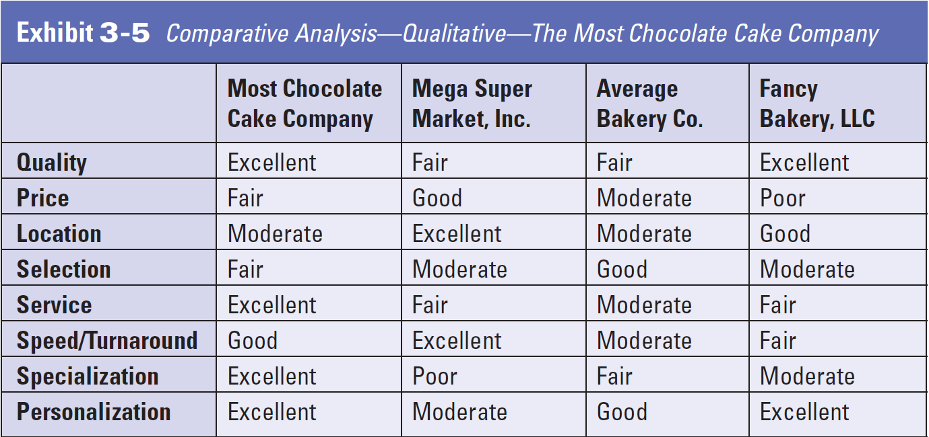
Competitive Analysis

Slide 37
Competitive Strategy: Business Definition and Competitive Advantage
competitive strategy - the combination of the business definition with its competitive advantage.
Your business will only succeed if you can offer the customers in your market something more, better, and/or different from what the competition is doing.
Your competitive advantage (core competency) is essential, and once you establish it, your business decisions will start to fall into place.

Slide 38
Strategy versus Tactics
strategy - a plan for how an organization or individual intends to outdo competitors.
tactics - the specific ways in which a business carries out its strategy.
If you plan to open a bookstore, how will you compete with the chain outlet in the neighborhood?
Perhaps you could make your bookstore a kind of community center, so people will want to gather there.

Slide 39
Strategy versus Tactics
What tactics could you use to carry out this strategy?
Hold poetry readings and one-performer concerts to promote local poets and musicians.
Create special-interest book-discussion groups.
Offer free tea and coffee.
Provide comfortable seating areas for conversation and reading, to encourage customers to spend time in your store.
Set up a binder of personal ads as a dating service.

Slide 40
Feasibility Revisited: The Economics of One Unit as a Litmus Test
Once you have chosen a business idea and determined your competitive advantage, you should make a preliminary analysis to determine whether the idea would be financially viable.
gross profit - total sales revenue minus total cost of goods sold.
economics of one unit of sale (EOU) - the amount of gross profit that is earned on each unit of the product or service a business sells.

Slide 41
Defining the Unit of Sale
unit of sale - the basic unit of the product or service sold by the business.

Slide 42
Cost of Goods Sold and Gross Profit
cost of goods sold (COGS) - the cost of selling one additional unit of a tangible item.
These are:
the cost of materials used to make the product (or deliver the service) and
the cost of labor directly used to make the product (or deliver the service).
cost of services sold (COSS) - the cost of selling one additional unit of a service.

Slide 43
Cost of Goods Sold and Gross Profit

Slide 44
Cost of Goods Sold and Gross Profit

Slide 45
Your Business and the Economics of One Unit
The economics of one unit of sale is a method for seeing whether your business idea could be profitable.
direct labor - employees that actively produce or deliver a product or service.
Total Revenue − Total Cost of Goods Sold = Total Gross Profit

Slide 46
The Cost of Direct Labor in the EOU—An Example
Janet has a business designing handmade bookmarkers. Her unit of sale is one bookmarker:
She sells 40 bookmarkers per week to a bookstore in her neighborhood.
Her selling price is $4.50 each, including an envelope.
Her costs are 80¢ per card for materials (construction paper, glue, and paint) and 20¢ each for the envelopes, for a total of $1.00 each.
On average, it takes her one hour to make six bookmarkers.
Janet pays herself $9 an hour.
The direct labor for each bookmarker is $1.50 ($9/6). Janet wisely realizes that she must include the cost of her labor in the EOU.

Slide 47
Hiring Others to Make the Unit of Sale

Slide 48
Going for Volume
Janet meets a bookstore-supply wholesaler. He offers to buy 2,000 bookmarkers if Janet can deliver them in one month and sell them for $3.50 each, $1 less than she had been getting.
Three questions immediately came to her mind:
Can I produce the 2,000-unit order in the required time frame?
If I lower the price to $3.50 for each bookmarker (instead of $4.50), will I still make an acceptable gross profit per unit?
How much in total gross profit will I make from the order?

Slide 49
Going for Volume
Five breakthrough steps entrepreneurs can take to understand preliminary feasibility are:
calculating the unit of sale,
2. determining the economics of one unit of sale,
3. substituting someone else’s labor,
4. selling in volume, and
5. creating jobs and operating at a profit.

Slide 50
Going for Volume
At first, an entrepreneur can be part of his own economics of one unit.
currency - a term for money when it is exchanged internationally.
foreign exchange (FX) rate - the relative value of one currency to another.

Slide 51
Determining the Value of a Business
The valuation of a business is a combination of art and science, and ultimately a matter of arriving at a price and set of terms that both the buyer and seller find acceptable.
For a public company, valuation is the worth of the stockholders’ equity.
For a going concern with audited financials, the determination can be based on projected earnings and cash flows.
The primary methods of valuation are asset valuation, earnings valuation, and cash flow valuation.
Notes:
Valuing a business for other going concerns, the process is more complex because the quality and reliability of the financial information is less certain.

Slide 52
Asset Valuation Method
asset valuation - a method that analyzes the underlying value of a business’s assets as a basis for negotiating a price.
The four most common standards are:

Slide 53
Earnings Valuation Method
earnings valuation - a method that assesses the value of a business based on a stream of earning that is multiplied either by an agreed-upon factor (the capitalization factor) or by the price/earnings ratio (for a publicly traded company).
Three ways of looking at earnings are:

Slide 54
Cash Flow Valuation Method
cash flow valuation - a method of calculating the worth of a business by using projected future cash flows and the time value of money.
Whatever value is calculated through the quantitative methods above, the final price should also reflect nonfinancial variables.
The value of customer goodwill must also be factored into the price, and the competitive and legal environments also have a role in the pricing.
The offer price and the maximum amount you are willing to pay should encompass all of the factors you have identified.

