Slide 1
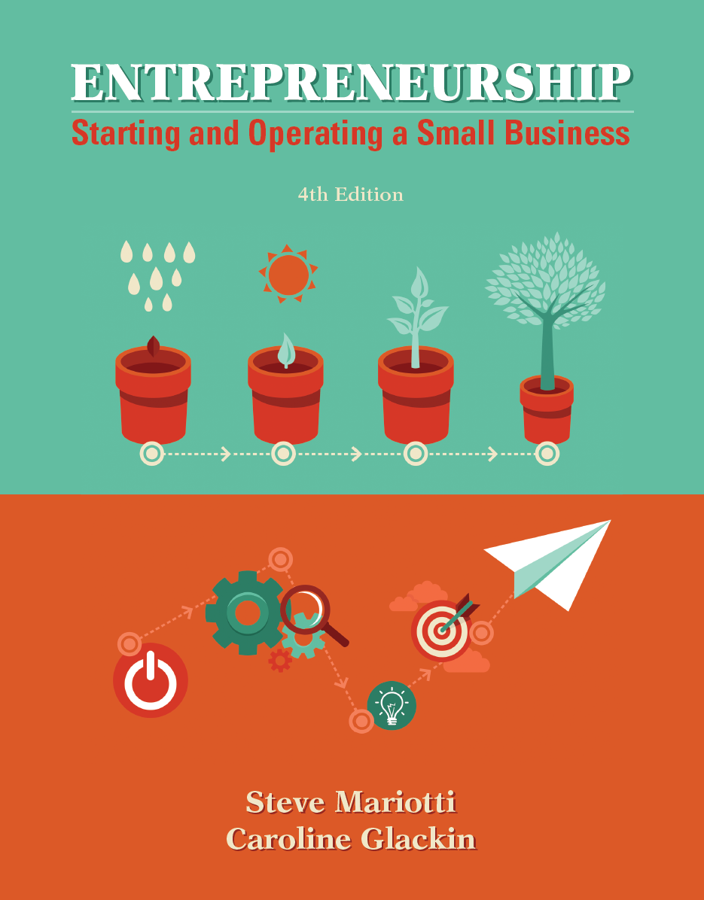
Chapter 4 Exploring Your Market

Slide 2
Chapter Learning Objectives
1. Discriminate between marketing and selling.
2. Summarize how market research prepares you for success.
3. Choose your market segment and research it.
4. Position your product or service within your market.

Slide 3
Markets and Marketing Defined
A market is a group of people or organizations that may be interested in buying a given product or service, can afford it, and can do so legally.
marketing - the development and use of strategies for getting a product or service to customers and generating interest in it.
brand - identifies distinctively the goods or services of one organization from others through a design, symbol, name, term, or other distinguishing features.

Slide 4
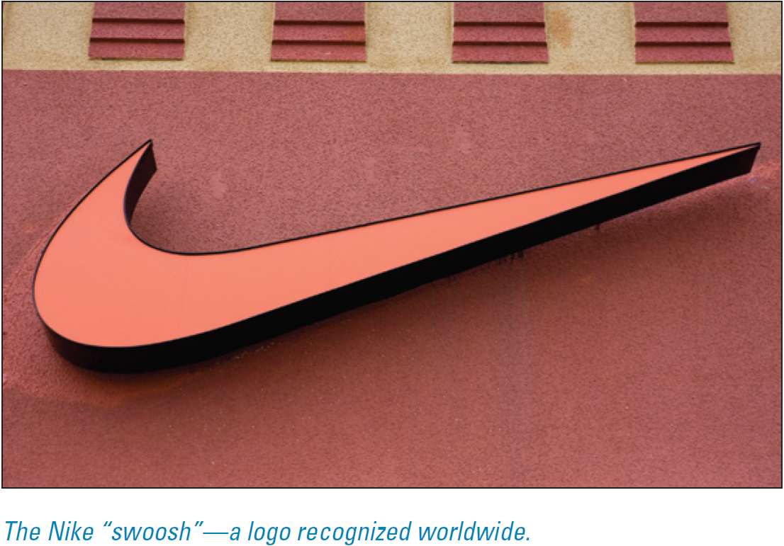
Markets and Marketing Defined
Nike creates advertisements and promotions designed to convince customers that Nike shoes will inspire them to Just Do It.
You can choose athletic shoes from many companies, but Nike hopes you will feel inspired by its marketing to seek out and buy its brand.
Notes:
Nike sells athletic shoes. It puts them in stores where consumers can buy them. But Nike also markets athletic shoes.

Slide 5
A Business That Markets versus a Market-Driven Business
Do not make the mistake of treating marketing as an isolated business function rather than the engine that drives all business decisions.
Most experts agree that, to be successful, a business must develop its marketing vision first, with a consistent customer focus, and then use it as the basis for all subsequent judgments.

Slide 6
Research Prepares You for Success
Whether you have a product or service you want to market, or are searching for a market opportunity with the aim of creating a product or service to fill that need, research can help you succeed.
Your research can be conducted at the level of the industry, the market segment, or the individual consumer.
Whereas the questions you ask will be different at each level, the methods of conducting the research are similar.

Slide 7
Research Your Market Before You Open Your Business
Large corporations spend a great deal of money on marketing and marketing research before they introduce a product or service.
Take a lesson from the big companies: research your market.
Introduce your product to potential customers.
Be open to honest criticism.

Slide 8
Types and Methods of Research
How you conduct your research will help determine whether it is reliable and valid:
primary research - conducted directly on a subject or subjects.
secondary research - carried out indirectly through existing resources.
For example, if you conducted 100 interviews with students on a campus, it would be considered primary research.
If you examined a study on those students conducted by someone else, it would be secondary.

Slide 9
Getting Information Directly from the Source: Primary Research

Slide 10
Getting Information Directly from the Source: Primary Research
Primary research methods include:
Personal interviews. Interview individuals face to face, using either flexible question guides or structured, step-by-step surveys.
Telephone surveys. These are personal interviews conducted via telephone.
Written surveys. These can be administered through the postal service or by e-mail or on special Web sites.

Slide 11
Getting Information Directly from the Source: Primary Research
Primary research methods include:
Focus groups. If you want to get information that is generated through guided group discussion, you can use focus groups.
Observation. By watching, you can observe patterns of interaction, traffic patterns, and volume of purchases that will help you understand your prospective customers and your competition.
Tracking. It can be useful to track advertisements, prices, and other information through the media.

Slide 12
Getting Information Indirectly: Secondary Research

Slide 13
Getting Information Indirectly: Secondary Research
Some Secondary Research methods are:
Online searches. By using search engines—such as Google, Bing, Yahoo!, Dogpile, Ask.com, info.com, and Excite—you can find stories, historical records, biographical information, and statistics.
Database searches. Public databases such as the U.S. Census (http://www.census.gov) are available via the Internet.
Industry associations, chambers of commerce, and public agencies. These types of organizations frequently collect demographic and statistical data on and for their members.

Slide 14
Getting Information Indirectly: Secondary Research
Some Secondary Research methods are:
Review of books and records. Although you may not get access to other companies’ records or those of a company you are thinking of buying, if you can examine records (or even journals or research notes) that are pertinent to your business, you may gain valuable insights.
Competitor Web sites. Look for annual reports for public companies, which are required by the Securities and Exchange Commission (SEC) to be available and which reveal marketing and other information about a company.

Slide 15
Research Helps You Know Your Customer
market research - the collection and analysis of data regarding target markets, industries, and competitors.
Market research is the process of finding out:
who your potential customers are,
where you can reach them,
what they want and need,
how they behave, and
what the size of your potential market is.

Slide 16
Research Helps You Know Your Customer
Whether your customers are individual consumers or other businesses, you will want to get into their minds and find out what they really think about such subjects as:
your product or service,
the name of your business,
your location,
your logo and branding materials,
your proposed prices, and
your promotional efforts

Slide 17
Research Helps You Know Your Customer
Marketing research helps you get a fix on who your customers are by answering these kinds of questions:
How old are they?
What kind of income do they earn?
What are their hobbies and interests?
What is their family structure?
What is their occupation?
What is the benefit your product or service offers that would best attract them?
What problem are you solving with it?

Slide 18
Customer Research
You will want to find out everything you can about your ideal customers:
What do those individuals eat, drink, listen to, and watch on TV?
How much do they sleep?
Where do they shop?
What movies do they like?
How much do they earn?
How much do they spend?

Slide 19
Customer Research
Surveys. Well-designed marketing surveys ask people directly, in interviews or through questionnaires, what they would think about a product or service if it were available.

Slide 20
Customer Research
Your marketing survey should ask about:
product or service use and frequency of purchase;
places where the product is purchased (the competition!) and why consumers like to purchase from these businesses; and
business names, logos, letterheads—everything that will represent your business in a customer’s or potential customer’s mind.

Slide 21
Customer Research
Make sure your marketing surveys also gather specific information about customers that will help you understand them better. They should include:
interests and hobbies,
reading, television-watching, Internet, and social-media habits,
educational background,
age,
occupation,
annual household income,
gender, and
family size and structure.

Slide 22
Customer Research
Focus groups is another way to survey people about a product or service in development is to hold focus-group discussions.
A focus group is typically composed of 10 to 12 people who meet screening criteria, such as being users or prospective users of a particular product.
The group is led by a facilitator who is trained in market research to ask questions about the product or service.
The resulting discussion is usually videotaped or audio taped for later analysis.

Slide 23
Customer Research
Research reports. Marketing research firms are paid by other companies to gather information. Researchers study consumers and their purchasing and consumption patterns.
demographics - population statistics. These sources can provide statistics on the following:
age, annual income, ethnic or religious background;
gender, marital status, geographic location (zip code, census tract, electoral district);
interests, occupation;
type of dwelling—single-family home, condominium, townhouse, or apartment (rental or owned); and
spending and savings patterns.

Slide 24
Industry Research: The 50,000-Foot Perspective
Industry research focuses on a segment of business as a whole rather than on individual consumers. Some places to look include:
The Standard and Poor’s Industry Surveys,
The U.S. Census Web site,
Wetfeet.com, and BizMiner.
A local college or university may subscribe to services such as IBISWorld or
Dun and Bradstreet, which offer an abundance of information.

Slide 25
Industry Research: The 50,000-Foot Perspective
In many cases, industry reports are available on the Census site. There are numerous other sources as well. Once you identify them, you can answer such questions as:
What is the scale (size) of the industry, in units and dollars?
What is the scope (geographic range) of the industry?
Is it local (city or neighborhood only), regional (covering a metropolitan area or state), national, international (present in two or more countries), or global (everywhere)?
Is it a niche industry or does it reach a mass market?
What does industry and individual company profitability look like?

Slide 26
Industry Research: The 50,000-Foot Perspective
Other industry research questions includes:
What trends are occurring in the industry? Is it growing? Declining? Stagnating?
What is the structure of the industry? Is it highly concentrated, with a few companies in control? Is it highly fragmented, with a lot of competition?
What competition is in the market space, and what are they doing?
Perform an industry SWOT analysis to visualize this.

Slide 27
Make Research an Integral Part of Your Business
Research is not something you only do once.
Make it an ongoing part of your operations.
Just as your tastes and desires change as you learn about new ideas and products, so do those of your customers.
By carefully reviewing your customer purchasing and contact history, you can target your surveys for maximum effectiveness.
Keeping up with trade journals and business news is also critical.

Slide 28
How Customers Decide to Buy
It is critical to understand not only which customers are in your target market, but how they will purchase your product (or service).
Step 1. If you have developed a product or service, ask yourself what consumer need it will serve.
Step 2. Think about who might actually buy your product.
Step 3. Analyze the buying process that will lead customers to your product.

Slide 29
How Customers Decide to Buy
Some ways to analyze the buying process that will lead customers to your product:

Slide 30
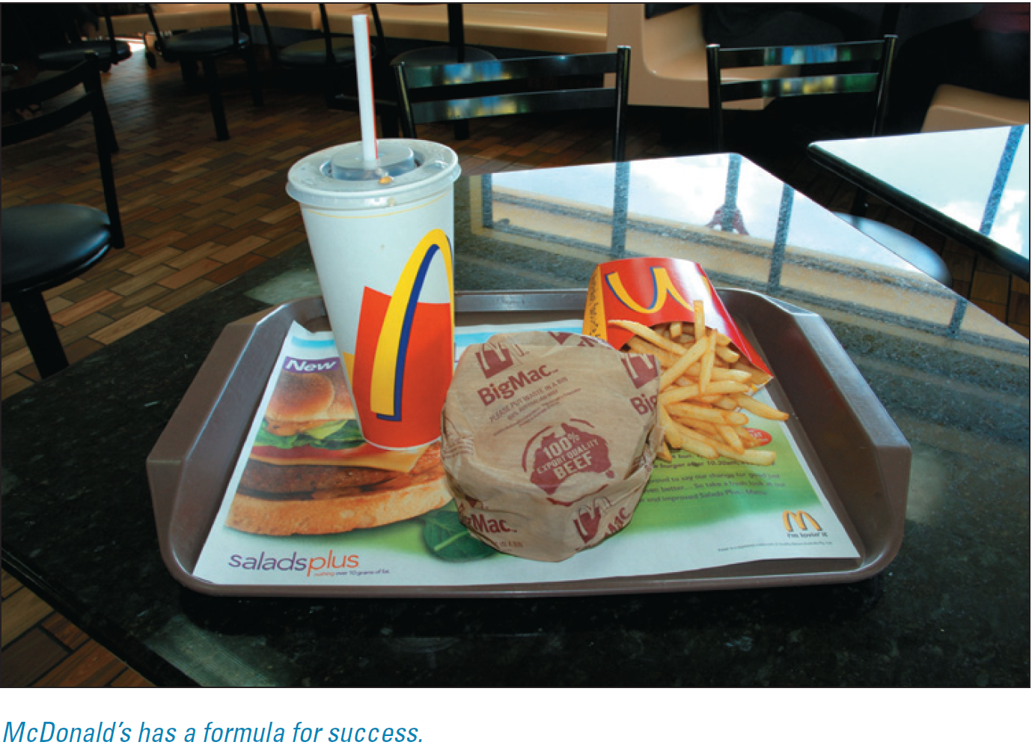
Owning a Perception in the Customer’s Mind
More valuable to McDonald’s than all the Big Macs it sells every year is the perception it owns in the minds of its customers.
That every time they patronize a McDonald’s, they will eat food that tastes exactly the same as at every other McDonald’s.
That the prices will be reasonable, and that the service will be friendly and fast.

Slide 31
Owning a Perception in the Customer’s Mind
For Burger King to compete with McDonald’s, it had to fight for a mind share of the fast-food customer:
Burger King opened its attack with “Have It Your Way,” which targeted McDonald’s mass-manufacturing approach to making hamburgers.
It is almost impossible to topple an established leading brand in a market. Burger King’s executives wisely decided that their goal was to be a strong number two.
Avis lost money for 15 years while trying to overtake Hertz.
You do not have to be number one to be successful.
Discover a competitive advantage and attack the market by creating a new category in the customer’s mind.

Slide 32
Features Create Benefits
There is a subtle, but important, difference between the benefits and the features of a product.
The features are facts.
The features of a drill might include its hardness and sharpness, but the benefit is that it makes a hole.
The feature of a Teflon coating on a pan creates the benefit of easy cleaning.
Smart marketers always emphasize benefits, not features, because consumers will buy what solves their problems or makes their lives more pleasant.
Notes:
The essence of selling is showing how and why the outstanding features of a product or service will benefit customers.

Slide 33
Home Depot: Teaching Customers So They Will Return
Home Depot’s marketing vision is not just to sell tools and materials but to teach people how to use them to improve their homes and lives.
The company’s marketing vision focuses on what its customers need Home Depot products to do.
Successful companies are not built on one-time sales but on repeat business.
The most successful companies pay close attention to consumer demands.

Slide 34
Which Segment of the Market Will You Target?
market segment - a group of consumers or businesses that have a similar response to a particular type of product or service.
Marketing strategies are focused on the customer, and a business has to choose which customers to target.
Home Depot’s competitive advantage would not be strong in the market segment composed of professionals, in which the distribution channels are strong and well established.
It is difficult to target very different segments of a market simultaneously.

Slide 35
Successful Segmenting: The Body Shop
The Body Shop is a good example of the success that can result from choosing the right market segment.
Founder Anita Roddick disliked paying for expensive packaging and perfuming when she bought cosmetics.
She was also annoyed by the extravagant claims made by many cosmetics companies and by the high prices of their perfumes and lotions.
Roddick saw an opportunity to create a different line of cosmetics.
She would use natural products that would be packaged inexpensively and marketed without extravagant claims.

Slide 36
Applying Market Segmentation Methods
Marketers have developed four basic ways to segment:

Slide 37
Applying Market Segmentation Methods
Marketers have developed four basic ways to segment:
• Geographic. Dividing a population by location.
• Demographic. Dividing a population based on a variable
such as age, gender, income, or education.
• Psychographic. Dividing a population by psychological differences, such as values (conservative, liberal, open- minded, traditional), lifestyle (sedentary, active), personality traits (worrier, Type A, shy, extroverted), and social group (white collar, blue collar).
• Behavioral. Dividing the market by purchase behaviors that have been observed, such as brand loyalty or responsiveness to price.

Slide 38
Applying Market Segmentation Methods

Slide 39
Applying Market Segmentation Methods
Here are a few questions you can adapt to your own product or service:
1. Do you currently use this type of product?
2. What brand of this product do you currently use?
3. Where do you buy it? Please be specific about the source, such as the name and location of the store, the direct-marketing representative, or Web site.
4. How much do you pay for it? (Probe for size and price, if appropriate.)
5. How often do you buy it?
6. Would you buy our product/service?
7. How much would you be willing to pay for it?
8. Where would you shop for it?
9. How would you improve it?
10. Now that you have seen/tasted/felt/smelled this product, what do you consider to be its closest competitor?
11. Is our product/service worse or better than those of our competitors?

Slide 40
The Product Life Cycle
product life cycle (PLC) - the four stages that a product or service goes through as it matures in the market—introduction, growth, maturity, and decline.

Slide 41
The Product Life Cycle

Slide 42
Is Your Market Saturated?
Figuring out where your product is in the PLC will tell you whether your market is close to saturation.
In other words, have all 3 million people in your market already bought a competitor’s product?
Nokia, for example, had a 39 percent share of the global market of $1.1 billion in mobile phones.
But that market was nowhere near saturation.

Slide 43
Market Positioning: Drive Home Your Competitive Advantage
positioning - distinguishing a product or service from similar products or services being offered to the same market.
After deciding which market segments to target, an entrepreneur will need to figure out what position the company should try to occupy in those segments.
Use the following format to develop a positioning statement for your business:
1. Your business name/brand
2. Competitive industry/category
3. Provides these benefits, or points of difference
4. Audience/target market
Notes:
The position of a product is its relative place in the customer’s mind compared with its competitors.

Slide 44
Developing a Marketing Plan
After you understand how customer-focused marketing should permeate your business, you will be ready to develop a plan for introducing your product to your market.
The marketing plan can serve as a stand-alone document or be part of an overall business plan.
Before you can develop a marketing vision, you will need to know who your customers are and what they want.
Your marketing plan must include an understanding of prospective customers and their wants, needs, and demands.

