Slide 1
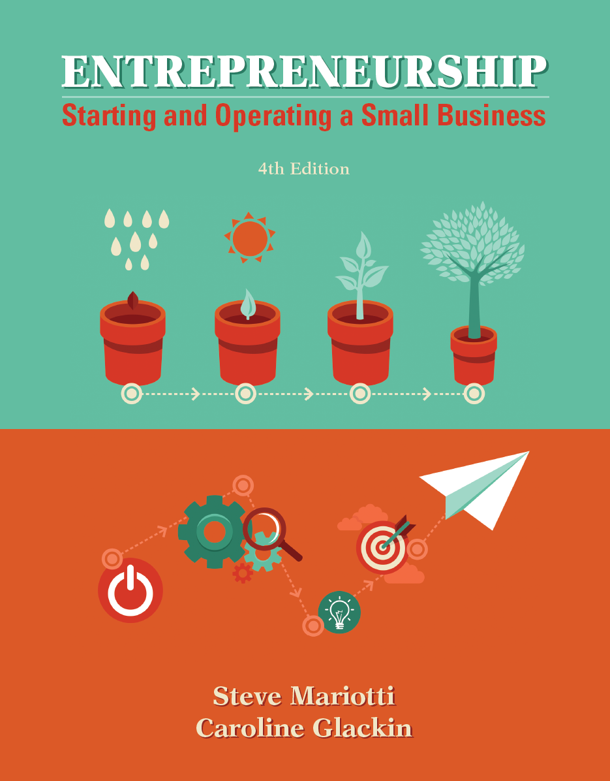
Chapter 12 Operating for Success

Slide 2
Chapter Learning Objectives
1. Examine the significance of operations in a business.
2. Develop a production distribution chain for your business.
3. Manage suppliers and inventory.
4. Recognize the key factors to consider in the location
decision.
5. Explore the design of facilities and their layouts.
6. Evaluate product quality methodologies.
7. Implement technology to benefit your business.

Slide 3
Operations Permit Businesses to Deliver on Their Promises
operations - a set of actions that produce goods and services.
In order for a company to be successful, it must follow up on promises to customers.
What constitutes operations, and the precise steps involved in carrying them out, will depend on the nature of your industry and the specific conditions of your business.
A manufacturing company is one that makes a tangible product and generally does not sell goods directly to consumers.

Slide 4
The Production-Distribution Chain
When a customer buys a pair of athletic shoes in a sporting goods store, for example, the chain would entail four links:
The manufacturer produces a great quantity of a style of athletic shoe.
2. The wholesaler buys a large number of these shoes from the manufacturer.
3. The retailer buys a much smaller number of these shoes to stock a store.
4. The consumer walks into the retailer’s store and buys one pair of shoes.

Slide 5
The Production-Distribution Chain

Slide 6
The Production-Distribution Chain

Slide 7
Supply Chain Management
supply chain management (SCM) - the management of sourcing, procuring, production, and logistics to go from raw materials to end customers across multiple intermediate steps.
In order to create and maintain efficient material (supply) flows between supply points, SCM addresses methods and relations.
Various partners must work together to use tools and techniques for increased efficiency and to apply their knowledge in making decisions.

Slide 8
Finding Suppliers
The world is your market for suppliers. Raw materials, component parts, subassemblies, and completed products may be available to you from anywhere.
You may be growing and packaging your own fruits and vegetables and have seed, fertilizer, packaging, and machinery and equipment suppliers.
Your suppliers will become “partners” in your business. Your success will depend on their capacity to deliver what you need, when you need it, and at a price you are willing to pay.
Notes:
Regardless of the complexity of your supply partners, you will have to find them and work with them.

Slide 9
Finding Suppliers
Some places to look for supplier partners include:
trade shows or conferences,
trade catalogs or journals,
the Yellow Pages,
Internet search engines,
wholesale supply houses and brokers,
newspapers and magazines,
competitors,
firms like yours that are outside of your trading area,
sales representatives, and
customers.

Slide 10
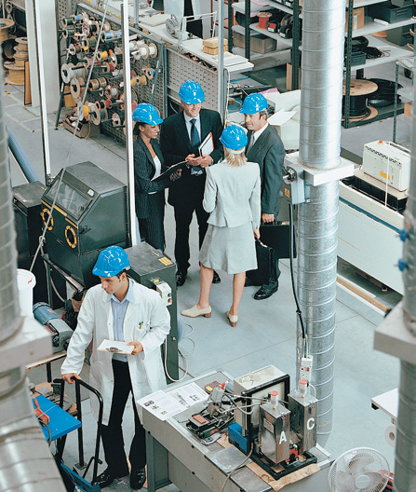
Managing Inventory
Managing inventory is vital to marketing success and to cash flow and there will be an ongoing tension between them.
If inventory is kept at a maximum, customer satisfaction may be high, but costs can become prohibitive.
If inventory is maintained at very low levels, customers may become dissatisfied (even leaving entirely), but cash tied up in inventory is minimized.

Slide 11
Managing Inventory
To balance service and cost management, factors such as demand, cost, sales price, carrying costs, order and setup costs, and lead times must be known.
In reality, demand projections, lead times, and other variables are often estimated—with varying degrees of accuracy.
Business owners can use the best available information and established techniques and tools to make inventory-management decisions.

Slide 12
Visual Control
visual control - inventory management method in which an individual assesses the stock level on hand by visual inspection and reorders when the supply appears low.
This unscientific method of choosing when to order depends on your knowledge of the product-selling rate and delivery times.
It is most effective when you sell relatively few items and are actively involved in the business.

Slide 13
Safety Stock and Reorder Points
safety stock - the amount of inventory or raw materials or work-in-progress that is kept to guarantee service levels.
reorder point (ROP) - the level at which materials need to be ordered again.
A challenge for any business is to find the optimal safety stock levels and reorder points for all inventory items.
If too much inventory is on hand, the costs of storage and tying up money may be great.

Slide 14
Safety Stock and Reorder Points
There are a variety of methods for calculating safety stock and reorder points.
The calculation of the ROP requires a knowledge or projection of
demand, lead time, and safety stock level, and is calculated as:
ROP = (Average Demand per Unit of Lead Time × Lead Time) + Safety Stock

Slide 15
Economic Order Quantity
economic order quantity (EOQ) the amount of inventory to order that will equal the minimum total ordering and holding costs.
If the company manufactured products and wanted to calculate the most economical size for a production run, it would use the same calculation methodology, but O = setup costs rather than order costs.
EOQ = √
2DQ
C

Slide 16
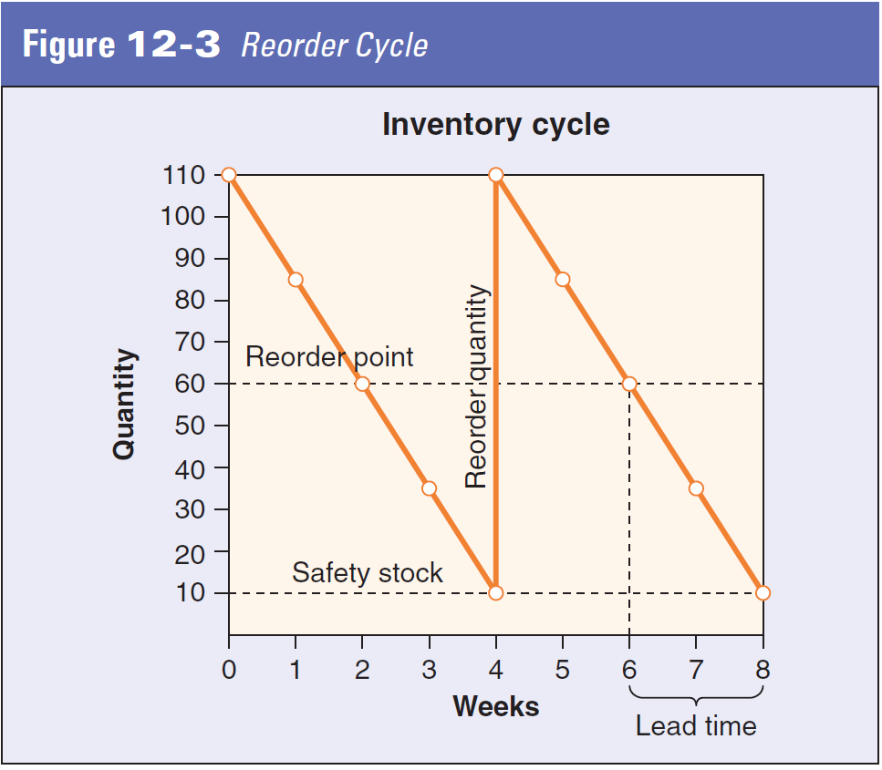
Economic Order Quantity

Slide 17
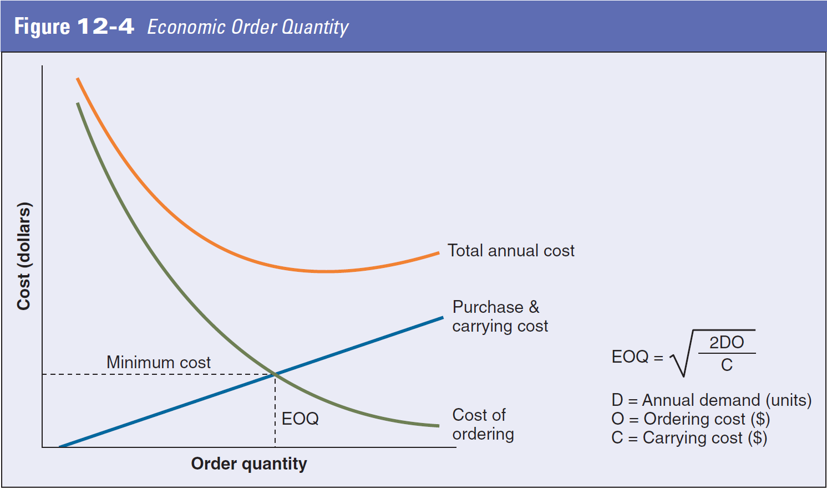
Economic Order Quantity

Slide 18
Facilities, Location and Design
The choice of location for your business can make the difference between success and failure.
The oft-quoted business mantra, “location, location, location,” is broadly accepted as a crucial factor for retail stores.
The location decision may be a one-time scenario, or it may arise multiple times during the life of a business.
For businesses with high transportation costs, a poor location choice can translate into prohibitive expenses.

Slide 19
Key Factors in Deciding on a Location
Common considerations include:

Slide 20
Key Factors in Deciding on a Location
Other common considerations include:

Slide 21
Key Factors in Deciding on a Location
factor-rating method - location-decision criteria that are prioritized and weighted to eliminate subjective considerations.
New business owners commonly opt for the simplest method of site selection: Go with the one you know.
For a lifestyle business, one that draws from a limited local area or one where physical location is less critical, such an approach may produce solid results.

Slide 22
Key Factors in Deciding on a Location
The factor-rating method includes six key steps:
1. Develop a list of critical success factors.
2. Determine the weight of each factor according to its relative importance.
3. Create a measurement scale for the factors.
4. Score each proposed location for each factor (best if done by a team) according to the scale.
5. Multiply the factor weight by the factor score for each factor in each location.
6. Use the sum of these weighted factors for the locations, to compare them and make a location recommendation/decision.

Slide 23
Key Factors in Deciding on a Location
clustering - the strategy of similar businesses locating near each other.
One tool that is available to entrepreneurs at all stages is geographic information systems (GIS).
These include demographic data; extensive maps and topographic information; and major transportation routes, health care facilities, and the like.
After you have identified the factors that are important to your business, you can use a GIS system to discover potential profit-maximizing locations.

Slide 24
Facilities Design and Layout
leasehold improvements - changes made to adapt a rented property for a particular business.
The geographic location and suitability of business facilities matter greatly.
You may have seen signs from real estate companies stating, “Will build to suit.”
This means that they will put up a structure for your particular business.
A purpose-built edifice is necessary for certain businesses, such as restaurants or hotels.

Slide 25
Facilities Design and Layout
For manufacturing, warehousing, and distribution firms, key considerations include:
capacity for efficient movement of materials, equipment, and people (floor space and ceiling height will matter);
flexibility to adapt to changing business requirements;
loading docks and vehicle access for deliveries and outbound shipments;
an environment conducive to work requirements (natural light, appearance, and the like);

Slide 26
Facilities Design and Layout
Other manufacturing, warehousing, and distribution firms, key considerations include:
the ability to include requisite controls, such as regulation of temperature and humidity and cleaning rooms;
parking for commercial and employee vehicles, as well as spaces for visitors (including those with special accessibility needs);
adequate utility services to the building (including power, water, and telecommunications); and security and safety.

Slide 27
Facilities Design and Layout
Retail facilities must meet such business requirements as:
appropriate selling area and configuration of that space;
permission to complete necessary leasehold improvements or improvements to be made by landlord;
space for offices, storage, restrooms, deliveries, and other special needs;
signage for rules/regulations;
parking that is adequate for the anticipated customer volume; and
lighting and security.

Slide 28
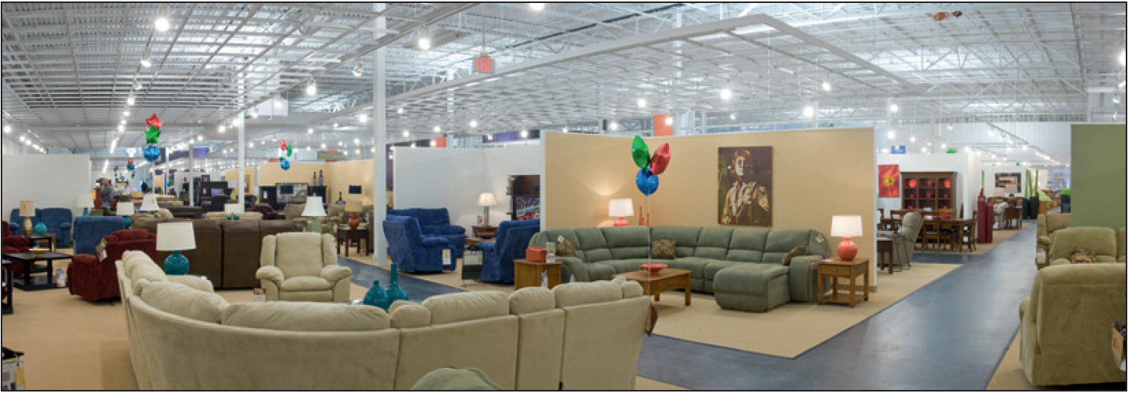
Facilities Design and Layout
Store layout is a particularly important part of a retail business’s marketing and revenue-generation operations.
In-store layout should be designed to entice customers to make purchases, preferably spending more than they had initially planned.
Notes:
Retail stores often place new items or signature products at the front, with sale goods toward the rear or against the walls, thereby compelling customers to pass by a variety of potentially enticing items.

Slide 29
Special Considerations for Home-Based Businesses
Entrepreneurs starting home-based businesses face numerous exceptional conditions, ranging from allocating work and family time to unique business space and zoning.
Starting a venture at home reduces the overhead associated with leasing or purchasing a separate site.
With technological advances in communications and computing, many businesses can now be home-based.
Also, you will need to thoroughly investigate zoning ordinances, deed restrictions, and civic association rules.

Slide 30
Special Considerations for Home-Based Businesses
Often, you can operate a home-based business without a problem as long as your neighbors are not disturbed and have no reason to report you.
However, it is far better to be fully cognizant of zoning requirements before writing your business plan and investing funds.
Another issue to consider is the allocation of space within your home.
A best practice is to clearly delineate your work area from the family living area.

Slide 31
Special Considerations for Web-Based Businesses
Web-based businesses face many of the same location, facilities, and layout decisions as other types of enterprises, but encounter unique opportunities and challenges as well.
Because they conduct business on the Internet, such companies can be located anyplace in the world, with staff that may work remotely from anywhere.
The physical space needed could be a one-room office if (1) orders are taken only online and merchandise is drop-shipped directly from suppliers, (2) delivery of goods or services is provided online, or (3) offered services are to be performed in the client’s home or office.
Notes:
Location, facility, and layout decisions for Web-based businesses should aim to minimize distribution costs.

Slide 32
Defining Quality: It Is a Matter of Market Positioning
quality - degrees of excellence; conformance to specifications or standards.
As a business owner, quality products or services will be largely defined by your market-positioning strategy.
For example, a meal at a five-star restaurant will be vastly different from one at a local diner.
However you position your organization, your quality and the viability of the business will depend on the match between the expectations you create through market positioning and the experience of your customers.

Slide 33
Profits Follow Quality
For many years, American companies had focused less on quality than on short-term profits.
In the early 1950s, however, American economist W. Edwards Deming argued that business should focus on making quality products instead of on maximizing profits and that profit would follow from that focus.
His revolutionary concept was ignored by American corporations, so he went to Japan, which was rebuilding its economy after the devastation of World War II.

Slide 34
Profits Follow Quality
In those days, Japan was notorious for the poor quality of its manufactured goods.
The phrase “Made in Japan” was jokingly used to refer to anything poorly fabricated.
Deming gave a series of lectures in Japan, though, that the Japanese took to heart.
American entrepreneurs and corporate executives traveled to Japan to study why the Japanese had become so successful.
They brought Deming’s ideas back home, where they finally began to be adopted.
Notes:
As you develop your business, it will be the consistent quality of your product or service that will lead to profits.

Slide 35
Organization-Wide Quality Initiatives
Quality management and quality assurance is not solely the job of the production team.
As organizations have evolved in our rapidly changing technology- and service-driven environment, quality has come to require the active involvement of the entire company.
A number of initiatives and methods have been formed to help businesses ensure quality.
Among these are lean manufacturing, benchmarking, ISO 9000, Six Sigma, Total Quality Management, and The Malcolm Baldrige Award.

Slide 36
Benchmarking
benchmarking - the comparison of a company’s performance against that of companies in the same industry, or against best practices, standards, or certification criteria.
Benchmarking is what you are doing when you create a competitive comparison for marketing purposes or when you compare your projected or actual financial ratios to industry levels.
A simple method of benchmarking is to create a list of measures that are important to your customers (using primary market research) or to customers in your industry (using secondary research, such as trade journal reports) and then to compare outcomes.

Slide 37
ISO 9000
process management - the measurement, monitoring, and optimization of tasks.
The family of standards for quality management systems established by the International Organization for Standardization (ISO) is ISO 9000.
These standards are certified by independent companies to document that consistent business procedures are being used and that the organization has been independently audited for compliance.
Initially, ISO standards were applied solely to manufacturing.

Slide 38
ISO 9000
There are eight quality-management principles for organizational improvement:
1. customer focus
2. leadership
3. involvement of people
4. process approach
5. system approach to management
6. continual improvement
7. factual approach to decision making
8. mutually beneficial supplier relationships

Slide 39
Six Sigma
Six Sigma is a measurement of quality that was originated in the 1980s by Motorola engineers.
It is the use of statistical methods to eliminate defects to a failure rate of 3.4 defects per 1 million opportunities, or a 99.9997-percent success rate.
This is a rigorous process-improvement program that aims to achieve near-perfection.

Slide 40
Six Sigma
The two sub-methodologies employed are DMAIC and DMADV.
The DMAIC (define, measure, analyze, improve, and control) system is intended to enhance existing production.
DMADV (define, measure, analyze, design, and verify) process is meant to support new procedures and products.
For most enterprises, this is an intense program, maybe more so than is practical in the early stages of a business.

Slide 41
Total Quality Management
total quality management (TQM) - the quality-assurance methodology of striving for strategic advantage through quality.
continuous improvement - always identifying and implementing changes throughout an organization to focus on the requirements of internal and external customers.
TQM’s success depends on the commitment of all employees to treat one another as customers and to work together to ensure that standards are met at all stages.

Slide 42
Malcolm Baldrige Award
Whereas the previous concepts have focused on quality-management methodologies, the Malcolm Baldrige Award is a competitive process established by the United States Congress in 1987 to recognize quality management.
The Baldrige Award is given to businesses and educational and nonprofit organizations by the president of the United States and is administered by the National Institute of Standards and Technology (NIST).
Thousands of organizations use the Baldrige criteria for self-assessment, training, and the creation of business processes.

Slide 43
Malcolm Baldrige Award
Organizations apply for the award and are judged in the areas of:

Slide 44
Using Technology to Your Advantage
hyperlink - word(s) that, when clicked on, transfer the computer user to another Web page.
uniform resource locator (URL) - a Web-page address.
hypertext - Web-based documents that combine text and graphics.
Regardless of the size or nature of your business, technology can work to your advantage.
Even if your business is not technological, you can apply technology to make your operations more efficient and effective.

Slide 45
Computer Access Is Essential
Every entrepreneur should have access to a computer.
Every business should have a Web site and electronic mail access.
Every business should hire employees who are conversant and comfortable with technology.
Every entrepreneur should be aware of the specialized computer software and equipment that is designed for his or her industry

Slide 46
Computer Access Is Essential
Even the most basic model can be used to:
access the Internet;
create stationery and business cards (although professional designs are preferable);
produce professional letters and check spelling, grammar, and syntax;
keep financial records; and
maintain an updated mailing list of customers and printed mailing labels.

Slide 47
Capture the Potential of the Telephone
Do not forget, however, that technology does not have to be new to be useful.
The telephone is still one of the businessperson’s most important technological tools.
You can turn your phone into an answering service for your business by using a voice-mail system, or you can hire an answering service to provide a more personal touch.
A separate telephone line for your business will provide a number of advantages.

Slide 48
Identify Market-Specific Software and Technology
To increase efficiency and effectiveness in operations, businesses use software and technology designed for their industry or type of business.
For example, retail stores often use point-of-sales (POS) systems that are tailored to their products, and restaurants use ordering systems customized to their menus.
Not-for-profits have specialized fund-raising and accounting software.
Sports stadiums, concert venues, and movie theaters have ticketing systems. Manufacturing plants have materials-planning and inventory systems.

Slide 49
Electronic Storefront (Web Site)
electronic storefront - an online site that customers can visit to view a company’s catalog, price lists, and documentation.
No matter what type of business you have, opening an electronic storefront will make it more accessible to local customers and can introduce it to potential customers all over the world.
An online service would typically build your storefront for you and include promotion and advertisements as part of the deal to help make its subscribers aware of your store.

