Slide 1
MATH 2140 Numerical Methods
Faculty of Engineering
Mechanical Engineering Department
Instructor:
Dr. Mohamed El-Shazly
Associate Prof. of Mechanical Design and Tribology
melshazly@ksu.edu.sa
Office: F072

Slide 2
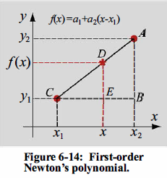
Newton's Interpolating Polynomials
First-order Newton's polynomial

Slide 3
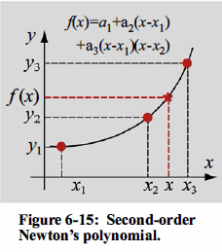
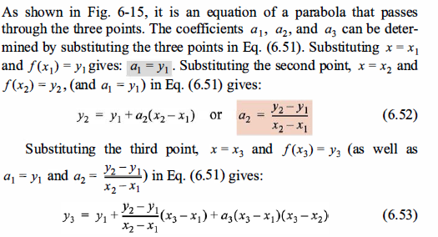
Second-order Newton's polynomial

Slide 4
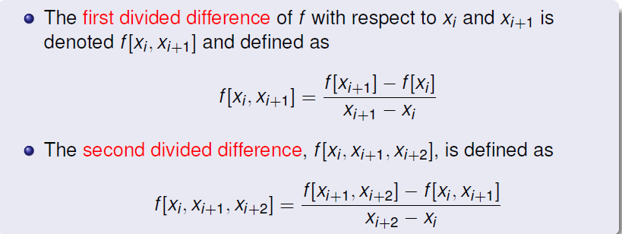

Slide 5
Third-order Newton's polynomial

Slide 6
A general form of Newton's polynomial and its coefficients
For two points, (x₁, y₁), and (x₂, Y₂) , the first divided difference, written as f [x₂, x₁], is defined as the slope of the line connecting the two points:

Slide 8
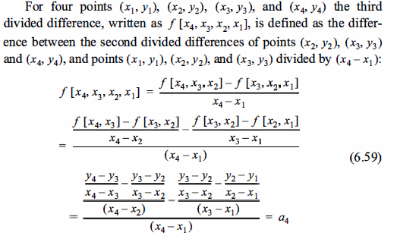

Slide 9
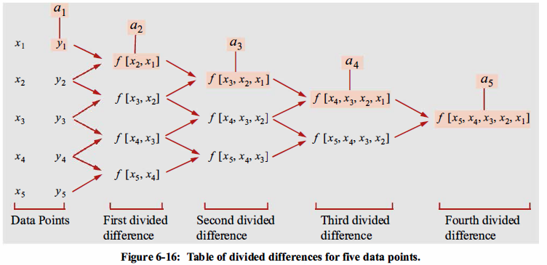

Slide 10
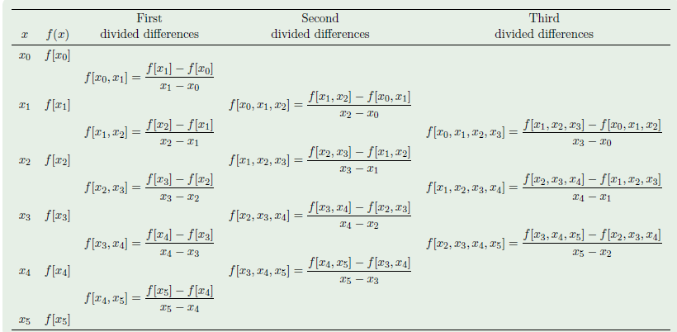

Slide 11
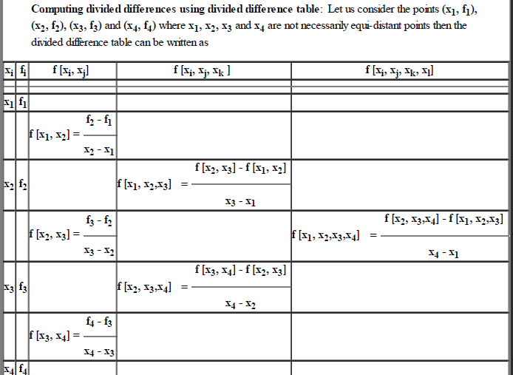

Slide 15
EXAMPLE 2
The power generated by a windmill varies with the wind speed. In an experiment, the following five measurements were obtained in table below. Determine the fourth-order Newton’s interpolating polynomial that passes through the data points. Use the polynomial to calculate the power at a wind speed of 26 mph.

Slide 16
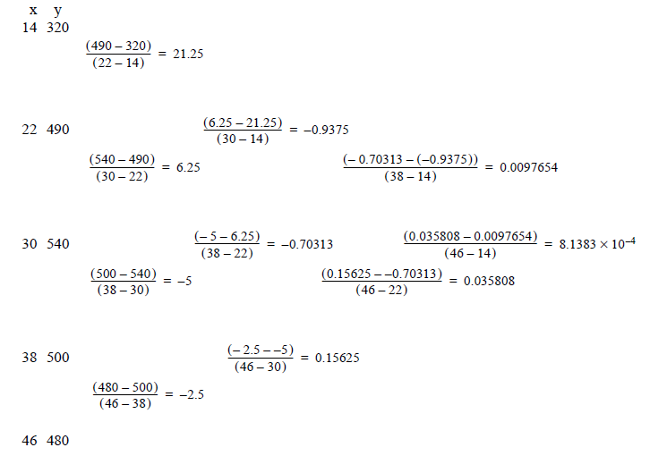
Solution 2

