Slide 1
MATH 2140 Numerical Methods
Faculty of Engineering
Mechanical Engineering Department
Instructor:
Dr. Mohamed El-Shazly
Associate Prof. of Mechanical Design and Tribology
melshazly@ksu.edu.sa
Office: F072

Slide 2
Numerical Differentiation

Slide 3
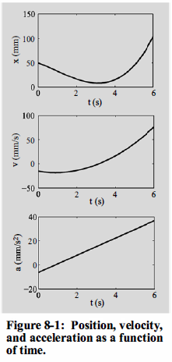
1. BACKGROUND
Differentiation gives a measure of the rate at which a quantity changes.
Rates of change of quantities appear in many disciplines, especially science and engineering.
One of the more fundamental of these rates is the relationship between position, velocity, and acceleration.
If the position, x of an object that is moving along a straight line is known as a function of time, t, (the top curve in Fig. 8-1):

Slide 4
The need for numerical differentiation
The function to be differentiated can be given as an analytical expression or as a set of discrete points (tabulated data).
When the function is given as a simple mathematical expression, the derivative can be determined analytically.
When analytical differentiation of the expression is difficult or not possible, numerical differentiation has to be used.
When the function is specified as a set of discrete points, differentiation is done by using a numerical method.
Numerical differentiation also plays an important role in some of the numerical methods used for solving differential equations, as shown

Slide 5
Approaches to numerical differentiation
Numerical differentiation is carried out on data that are specified as a set of discrete points
If there is a need to calculate the numerical derivative of a function that is given in an analytical form, then the differentiation is done by using discrete points of the function. This means that in all cases numerical integration is done by using the values of points.

Slide 6
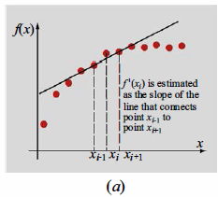
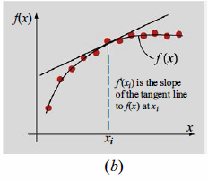
For a given set of points, two approaches can be used to calculate a
numerical approximation of the derivative at one of the points. One approach is to use a finite difference approximation for the derivative
The second approach is to approximate the points with an analytical expression that can be easily differentiated, and then to calculate the derivative by differentiating the analytical expression. The approximate analytical expression can be derived by using curve fitting.

Slide 7
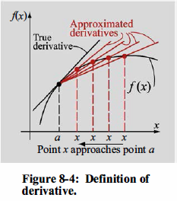
2- FINITE DIFFERENCE APPROXIMATION OF THE DERIVATIVE

Slide 8
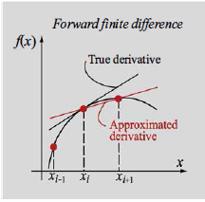
Forward, backward, and central difference formulas for the first derivative

Slide 9
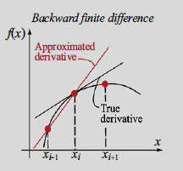

Slide 10
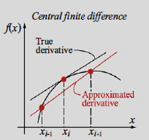

Slide 12
