Slide 1
MATH 2140 Numerical Methods
Faculty of Engineering
Mechanical Engineering Department
Instructor:
Dr. Mohamed El-Shazly
Associate Prof. of Mechanical Design and Tribology
melshazly@ksu.edu.sa
Office: F072

Slide 2
Numerical Integration SIMPSON'S METHODS

Slide 3
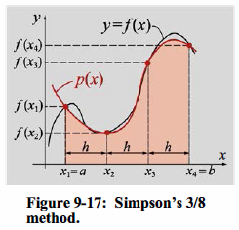
Simpson's 3/8 Method
In this method a cubic (third-order) polynomial is used to approximate the integrand (Fig. 9-17).
A third-order polynomial can be determined
from four points. For an integral over the domain [a, b], the four points used are the two endpoints x1 =a and x4 = b, and two points x2 and x3 that divide the interval into three equal sections.
The polynomial can be
written in the form:

Slide 4
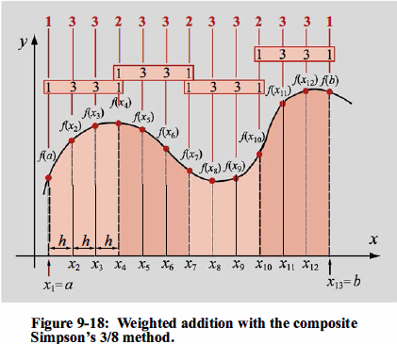
Composite Simpson's 3/8 Method

Slide 5
EXAMPLE 1

Slide 6
SOLUTION:

Slide 7
EXAMPLE: 2

Slide 8
SOLUTION:2

