Slide 1
MATH 2140 Numerical Methods
Faculty of Engineering
Mechanical Engineering Department
Instructor:
Dr. Mohamed El-Shazly
Associate Prof. of Mechanical Design and Tribology
melshazly@ksu.edu.sa
Office: F072

Slide 2
INTERPOLATION USING A SINGLE POLYNOMIAL

Slide 3
INTERPOLATION USING A SINGLE POLYNOMIAL
Interpolation is a procedure in which a mathematical formula is used to represent a given set of data points, such that the formula gives the exact value at all the data points and an estimated value between the points. This section shows how this is done by using a single polynomial, regardless of the number of points.
As was mentioned in the previous section, for any number of points n there is a polynomial of order n - 1 that passes through all of the points.
For two points the polynomial is of first order (a straight line connecting the points).
For three points the polynomial is of second order (a parabola that connects the points), and so on.
This is illustrated in Fig. 6-11 which shows how first, second, third, and fourth-order polynomials connect two, three, four, and five points, respectively.

Slide 4
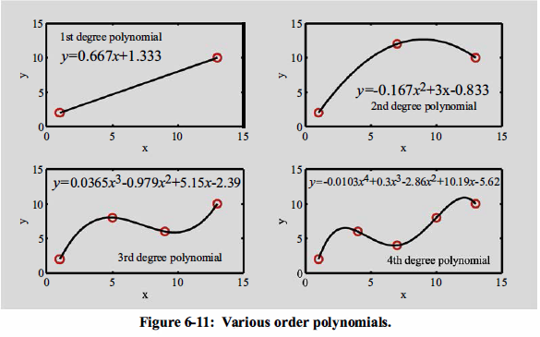

Slide 5
Interpolation
Given a sequence of n unique points, (x_{i}, y_{i})
Want to construct a function f(x) that passes through all the given points
so that …
We can use f(x) to estimate the value of y for any x inside the range of the known base points

Slide 6
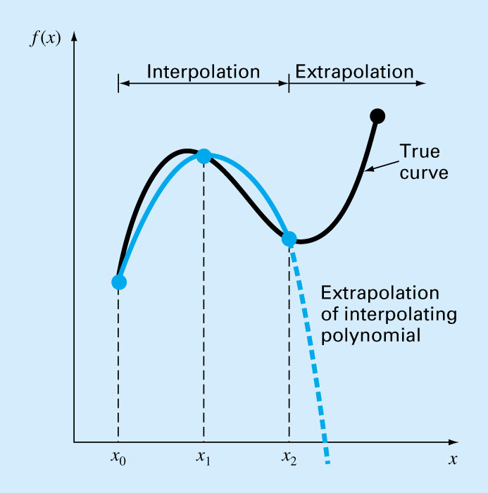
Extrapolation
Extrapolation is the process of estimating a value of f(x) that lies outside the range of the known base points.
Extreme care should be exercised where one must extrapolate.

Slide 7
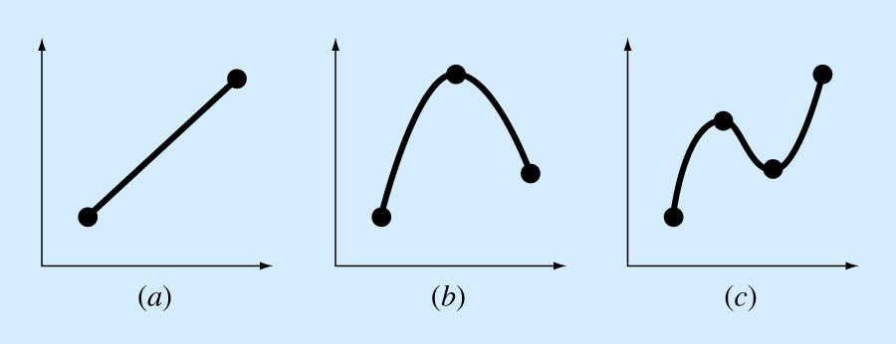
Polynomial Interpolation
Objective:
Given n+1 points, we want to find the polynomial of order n
that passes through all the points.

Slide 8
Polynomial Interpolation
The n^{th}-order polynomial that passes through n+1 points is unique, but it can be written in different mathematical formats:
The conventional form
The Newton Form
The Lagrange Form
Useful characteristics of polynomials
Infinitely differentiable
Can be easily integrated
Easy to evaluate

Slide 9
Lagrange Interpolating Polynomials
Lagrange interpolating polynomials are a particular form of polynomials that can be written to fit a given set of data points by using the values at the points.
The polynomials can be written right away and do not require any preliminary calculations for determining coefficients.

Slide 10
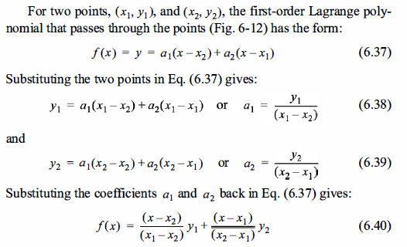
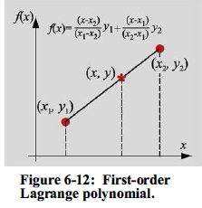

Slide 12
Equation (6.40)
is a linear function of x (an equation of a straight line that connects the two points). It is easy to see that if x = x₁ is substituted in Eq. (6.40), the value of the polynomial is y₁, and if x = x₂ is substituted, the value of the polynomial is Y_{i}· Substituting a value of x between the points gives an interpolated value of y.
Equation (6.40) can also be rewritten in the standard form f(x ) = a₁x + a₀:

Slide 13
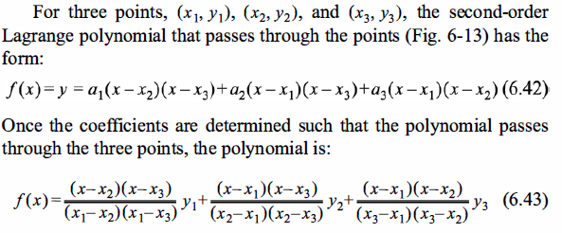
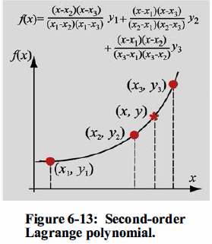

Slide 18
Example
Construct a 4th order polynomial in Lagrange form that passes through the following points:
i | 0 | 1 | 2 | 3 | 4
x_{i} | 0 | 1 | -1 | 2 | -2
f(x_{i}) | -5 | -3 | -15 | 39 | -9
We can construct the polynomial as
where L_{i}(x) can be constructed separately as …
(see next page)

Slide 19
Example
i | 0 | 1 | 2 | 3 | 4
x_{i} | 0 | 1 | -1 | 2 | -2
f(x_{i}) | -5 | -3 | -15 | 39 | -9

