Slide 1
Chapter 1
Sequences, Series and the test of their convergence
Lecture 7: The Ratio and Root Tests
Use the Ratio Test to determine whether a series converges or diverges.
Use the Root Test to determine whether a series converges or diverges.
Review the tests for convergence and divergence of an infinite series.

Slide 2
The ratio test
Example 1

Slide 3
The root test

Slide 4
Strategies for Testing Series
You have now studied 10 tests for determining the convergence or divergence of an infinite series. Skill in choosing and applying the various tests will come only with practice.
Guidelines for Testing a Series for Convergence or Divergence
1. Does the term approach 0? If not, the series diverges.
2. Is the series one of the special types: geometric, p-series, telescoping, or alternating?
3. Can the Integral Test, the Root Test, or the Ratio Test be applied ?
4. Can the series be compared favorably to one of the special types ?

Slide 5
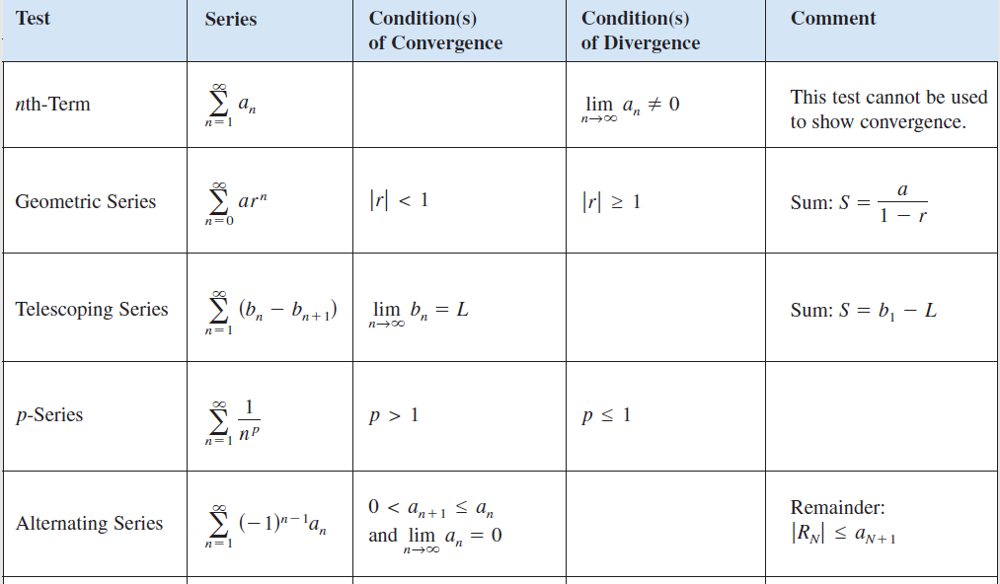

Slide 6
