Slide 1
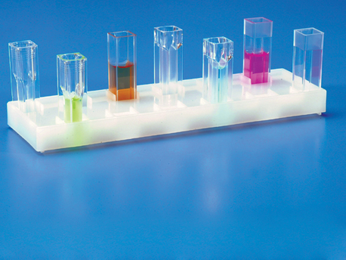
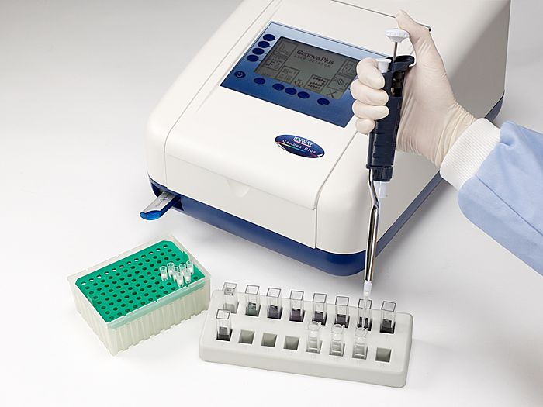
Methods of Enzyme Assay

Slide 2
Introduction:
All enzyme assays measure either the consumption of substrate or production of product over time.
Different enzymes require different estimation methods dependingon the type of reation catalysed, the nature of S and P or coenzyme.
Methods of quantitatively following enzyme reaction:
1-Spectrophotometric methods.
2-Fluorescence methods: using a fluorometer . E.g. NAD+ and NADP+ do not fluoresencein their oxidized forms, but the reduced form have a blue fluorescence reduction reaction.
3- Sampling methods : by withdrawing samples at intervals and estimating the substrate or product by chemical methods. It is for inorganic phosphate. It can be used for phosphatase, phosphorylase, nucleotides and all enzymes involving ATP or ADP including some kinaseand synthetase.

Slide 3
4- Manometric methods: Use manometer ,suitable and accurate methods for following reactions in which one of the component is a gas. e.g. Oxidases(O2uptake), Decarboxylase(CO2output)
5- Eletrode Methods: reactions which involve the production of acids. In this method pH meter is used to measure change in H+ conc. During enzyme reactions. (i.e. measure change in pH as the reaction proceeds).
6- Polarimetric Method: use polarimeter. For isomerases that convert one isomer to another.
D-glucose L-glucose

Slide 4
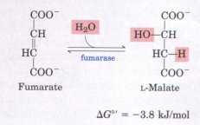
When the Spectrophotometric methods can be used?
1) Cases in which product absorbs
but not the substrate.
e.g. Fumarate hydratase.(catalyze the addition of groups to double bonds)
Fumarate Malate
2) The Co-enzyme NAD/ NADP have an absorption band at 340 nm in the reduced state
NAD (nicotainamide adenine dinuclotide ) NADH
NADP (nicotainamide adenine dinuclotide- p ) NADPH
Oxidized form Reduced form

Slide 5
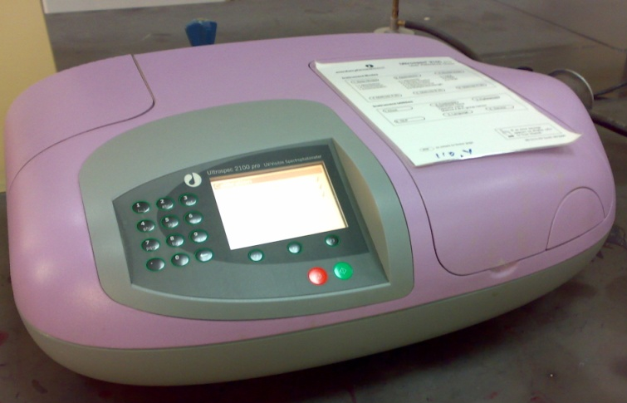
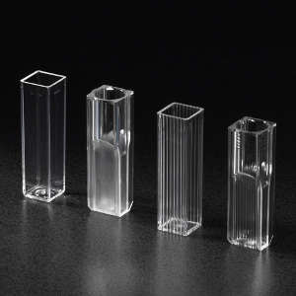
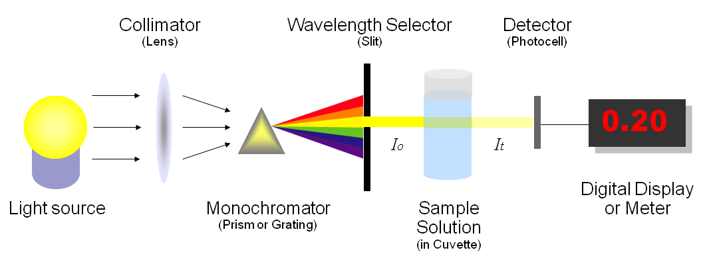

Slide 6
Enzyme assays can be:
- Continuous assay , where the assay gives a
continuous reading of activity.
- Discontinuous assay, where the samples are taken, the reaction stopped then the concentration of
substrates/products determined.

Slide 7
Alanine transaminase
An enzyme that catalyzes a type of reaction between an amino acid and α-keto acid.
Specifically, this reaction (transamination) involves removing the amino group from the amino acid, leaving behind an α-keto acid, and transferring it to the reactant α-keto acid and converting it into an amino acid.

Slide 8
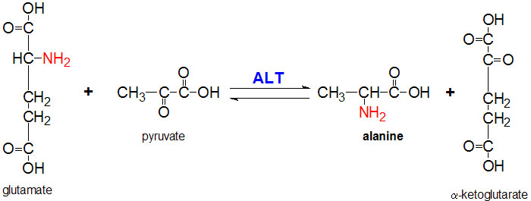

Slide 9
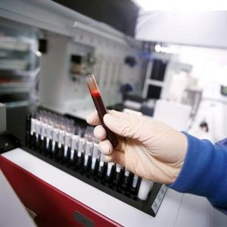
The enzymes are important in the production of various amino acids, and measuring the concentration of various transaminases in the blood is important in the diagnosing and tracking many diseases.
Alanine transaminase or ALT is a transaminase enzyme. It is also called: Serum glutamic pyruvic transaminase (SGPT) or Alanine aminotransferase (ALAT). ALT is found in serum (at low level) but is most commonly associated with the liver.

Slide 10
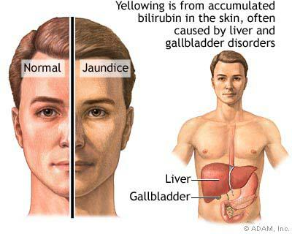
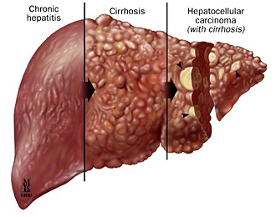
ALT found mainly in liver cells: thus , an elevated level ALT is a sensitive index of acute hepatocellular injury. Elevated serum ALT(SGPT) level are found in hepatitis, cirrhosis , and obstructive jaundice. Levels of ALT (SGPT) are only slightly elevated in patient following a myocardial infraction.

Slide 11
Objectives:
Study the Continuous Assay method by determining the enzymes activity for :
1. Alanine transaminase
2. Lactate dehydrogenase

Slide 12
1-Alanine Transaminase Assay
Principle:
It catalyzes the transfer of an amino group from alanine to α-ketoglutarate, to form pyruvate and glutamate under controlled condition (37°C) and pH 7.4 ± 0.05
Alanine + α- ketoglutarate → Pyruvate + glutamate
The pyruvate formed in the reaction is reduced to L-Lactate by Lactate dehydrogenase (LDH) with the Oxidation NADH. Measure the absorbance of NADH/NAD+ at 340nm
Pyruvate + NADH+H+ → L-Lactate+ NAD+ +H2O

Slide 13
Material
A- Chemicals
ALT (SGPT) reagent:
100 mmol/L Tris ( PH =7.5 , ̠̟0.05)
350 mmol/L L-alnine
15 mmol/L 2-Oxoglutarate with preservative
0.25mmol/L NADH
≥5000 U/L LDH with filler and stabilizer
Serum Sample
B- Instruments:
Quartz cuvette( invisible region)
Spectrophotometer (340nm)
Stop watch

Slide 14
1-Alanine Transaminase Assay
Method:
1- Alanine + 2-Oxoglutarate → Pyruvate + L- glutamate
2-Pyruvate + NADH+H+ → L-Lactate+ NAD+ +H2O
ALT
LDH
T1
Pipette 3ml of the ALT reagent
Pre-warm the tubes at 37 for 3 min
Pipette 0.2ml /200µl of serum sample
Mix , and allow 60 seconds for temperature equilibration
Read the absorbance at 340nm every minute for 3 minute /use(H2O) as blank

Slide 15
Results:
ΔA/min | Absorbance at 340nm |  | Test Tube
((A1-A2)+(A2-A3))/3 |  | A1 | T1
 |  | A2
 |  | A3
ALT Activity ( U/L) = ΔA/min x 1768
ALT Activity (U/L) = U/L
NORMAL RANG OF ALT: up to 32 U/L female
Unit definition
: ΔA/min = measured the rate of change in absorbance per min
(U/L) = the amount of enzyme that will reduce one micromole of NADH per min per liter of sample at specific temperature.

Slide 16
2-Lactate Dehydrogenase Assay
Use the co-enzyme in measure the activity of Lactate dehydrogenase:
An enzyme that catalyzes the conversion of lactate to pyruvate. (LDH)
This is an important step in energy production in cells.
Many different types of cells in the body contain this enzyme. Some of the organs relatively rich in LDH are the heart, kidney, liver, and muscle. It is responsible for converting muscle lactic acid into pyruvic acid, an essential step in producing cellular energy.

Slide 17
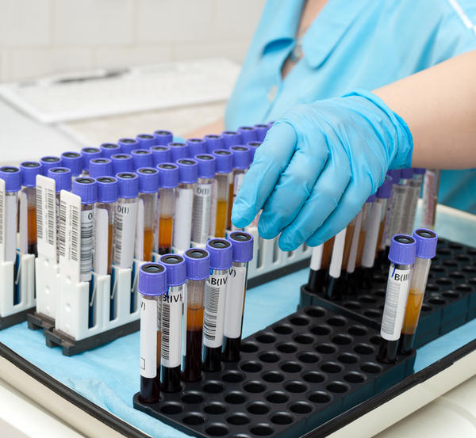
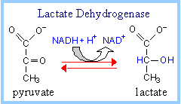
Lactic acid dehydrogenase (LDH) is present in almost all of the tissues in the body and becomes elevated in response to cell damage. LDH levels are measured from a sample of blood taken from a vein. Generally, the upper limit of normal for adults is in the range of 200 units/liter. Elevated level of LDH in serum are found in myocardial infraction, liver diseases, renal diseases, certain forms of anemia, malignant diseases and progressive muscle dystrophy.

Slide 18
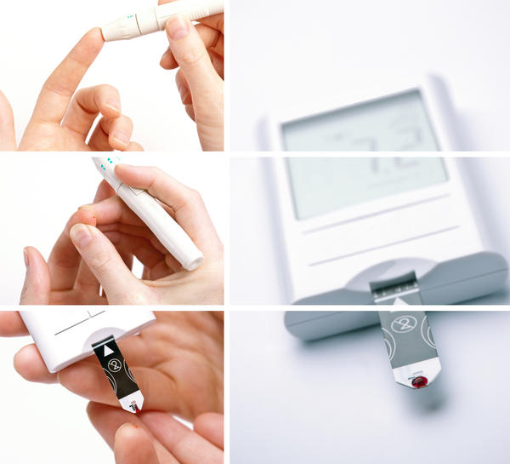
Low LDH can be seen in malnutrition, hypoglycemia, adrenal exhaustion, or low tissue or organ activity.

Slide 19
2-Lactate Dehydrogenase Assay
Principle:
LDH catalysis the following reaction:
L-Lactate + NAD+ Pyruvate +NADH + H+
The rate of NADH formation is indicated by increase the absorbance at 340nm and it is directly proportional to serum LDH activity.
If:
NADH is product : increase the absorbance /min
NADH is reactant: decrease the absorbance /min
LDH

Slide 20
Material:
A- Chemicals
LDH reagent:
80 mmol /L Buffer ( PH =8.6 , ̠̟0.05)
70 mmol /L Lithium L-Lactate
5.5 mM NAD+
Non reactive stabilizer with preservative.
Serum Sample.
B- Instruments:
Quartz cuvette ( invisible region)
Spectrophotometer (340nm)
Stop watch

Slide 21
2-Lactate Dehydrogenase Assay
Method:
L-Lactate+ NAD+ → Pyruvate + NADH+H+
LDH
T1
Pipette 3ml of the LDH reagent
Pre-warm the tubes at 37 for 3 min
Pipette 0.4 ml/400µl of serum sample
Mix , and allow 60 seconds for temperature equilibration
Read the absorbance at 340nm every minute for 3 minute /use(H2O) as blank

Slide 22
Results:
ΔA/min | Absorbance |  | Test Tube
((A3-A2)+(A2-A1))/3 |  | A1 | T1
 |  | A2
 |  | A3
LDH Activity ( U/L) = ΔA/min x 4984
LDH Activity (U/L) = U/L
NORMAL RANG OF LDH ( 103- 277) U/L

Slide 23
Thank You
☺

