Slide 1
Microsoft Excel – Part II
MIS 201 Management Information Systems
Lab Session 2

Slide 2
Outline
Part I (Basics)
Sum (Total)
Average
Count Numbers
Maximum and Minimum Value
Simple IF function
IF Function (multiple tests)
Part II (Financial formulas)
PV
FV
NPV and IRR

Slide 3
PV Function
Summary
The Excel PV function is a financial function that returns the present value of an investment. You can use the PV function to get the value in today's dollars of a series of future payments, assuming periodic, constant payments and a constant interest rate.
Purpose
Get the present value of an investment
Return value
present value
Syntax
=PV (rate, nper, pmt, [fv], [type])
Arguments
rate - The interest rate per period.
nper - The total number of payment periods.
pmt - The payment made each period.
type - [optional] When payments are due. 0 = end of period, 1 = beginning of period. Default is 0.
https://exceljet.net/excel-functions/excel-pv-function

Slide 4
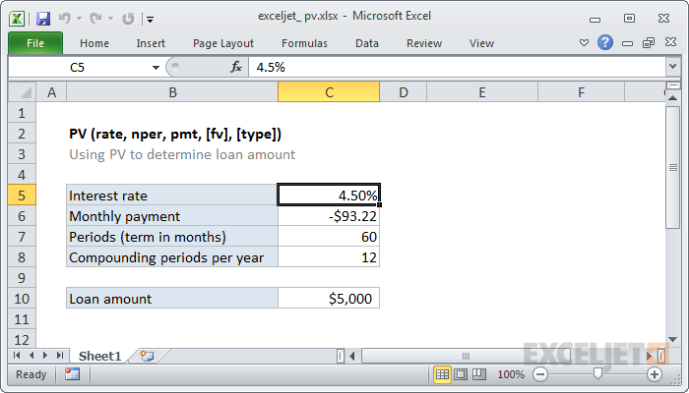
PV Function
Ex: Calculate the original amount of a loan (PV) with a 4.50 % interest rate per years, and a payment of $93.22 per month for a period of 60 months?
=PV(C5/12,C7,C6)
https://exceljet.net/excel-functions/excel-pv-function

Slide 5
FV Function
Summary
The Excel FV function is a financial function that returns the future value of an investment. You can use the FV function to get the future value of an investment assuming periodic, constant payments with a constant interest rate.
Purpose
Get the future value of an investment
Return value
future value
Syntax
=FV (rate, nper, pmt, [pv], [type])
Arguments
rate - The interest rate per period.
nper - The total number of payment periods.
pmt - The payment made each period. Must be entered as a negative number
type - [optional] When payments are due. 0 = end of period, 1 = beginning of period. Default is 0.
https://exceljet.net/excel-functions/excel-fv-function

Slide 6
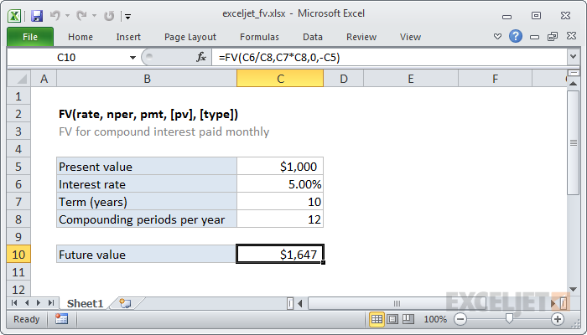
FV Function
Ex: This example assumes that $1000 is invested for 10 years at an annual interest rate of 5%, compounded monthly.
https://exceljet.net/excel-functions/excel-fv-function

Slide 7
NPV Function
Summary
The Excel NPV function is a financial function that calculates the net present value (NPV) of an investment using a discount rate and a series of future cash flows.
Purpose
Calculate net present value
Return value
Net present value
Syntax
=NPV (rate, value1, [value2], ...)
Arguments
rate - Discount rate over one period.
value1 - First value(s) representing cash flows.
value2 - [optional] Second value(s) representing cash flows.
https://exceljet.net/excel-functions/excel-npv-function

Slide 8
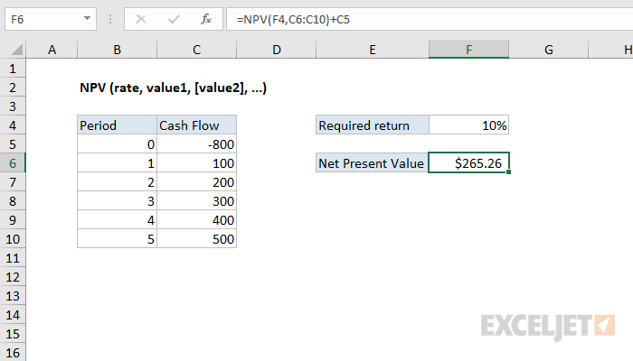
NPV Function
Ex: the assumption is that an investment will return $100 per year over a period of 5 years, and discount rate required is 10%.
https://exceljet.net/excel-functions/excel-npv-function

Slide 9
IRR Function
Summary
The Excel IRR function is a financial function that returns the internal rate of return (IRR) for a series of cash flows that occur at regular intervals.
Purpose
Calculate internal rate of return
Return value
Calculated return as percentage
Syntax
=IRR (values, [guess])
Arguments
values - Array or reference to cells that contain values.
guess - [optional] An estimate for expected IRR. Default is .1 (10%).
https://exceljet.net/excel-functions/excel-irr-function

Slide 10
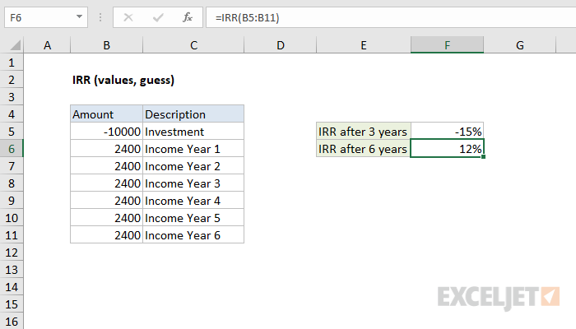
IRR Function
Ex: A company is deciding whether to purchase new equipment that costs $10.000 Management estimates the life of the new asset to be 6 years and expects it to generate an additional $2400 of annual profits. calculate IRR after 3 years and after 6 years?
https://exceljet.net/excel-functions/excel-irr-function

Slide 11
End of Part II

