Slide 1
King Saud University College of Business Administration Management Information Systems
MS ACCESS

Slide 2
Overview
What is MS Access?
Access Terminology
Access Window
Database Window
Create New Database
Setting Field Properties
Create New Query in Database
Relational Database Management System
Creating Forms in Database
Creating Reports in Database

Slide 3
What is a MS Access?
MS Access is an application software that facilitates us to create Database Management Systems (DBMS).
(DataBase Management System) Software that controls the organization, storage, retrieval, security and integrity of data in a database. It accepts requests from the application and instructs the operating system to transfer the appropriate data.

Slide 4
Access Terminology
Field – A single characteristic or attribute of a person, place, object, event, or idea. A field is also called as a Key.
Record – A set of related field values.
Table – A collection of records that identify a category of data, such as Customers, Orders, or Inventory.
Query – A tool (object) that extracts records from other tables / queries under some criteria.
Form – A tool (object) that makes easy operations on database like Insertion, deletion, saving, searching etc.
Report – A tool (object) through which we can take output (Hardcopy or softcopy) from the database.

Slide 5
Access Terminology (cont)
Illustration of fields, records, and a table
fields
Student Table
StudentId
StudentLastName
StudentFirstName
StudentRank
700100109
Wilkinson
June
Senior
700987131
Hughes
Brian
Junior
700617912
Abair
Mindy
Freshman
700941142
Carlton
Larry
Junior
700464654
Williams
Pamela
Sophomore
700654778
Dulfer
Candy
Freshman
records
2/18/2009
Microsoft Access
4

Slide 6
The Access Window
When a database is opened, the Access window and the Database window will be displayed.
The Access window contains a menu bar, toolbars, a task pane, and a status bar.
In the Access window, use the task pane to create a new database or to open an existing database.
To create a new database, make a selection from the New section of the task pane.
To open an existing database, select from the list of Recently opened databases or from the More files option.

Slide 7
The Database Window
The Database window is the main control center for working with an Access database.
The Database window contains a menu bar, one or more toolbars, an objects bar, and a groups bar.
The Objects bar lists all the objects available in the database.
The list of objects consists of tables, queries, forms, reports, pages, macros, and modules.
You can click on any of the objects in the Objects bar to obtain a list of objects of that type.

Slide 8
To Create New Database
To create The Database,
Click on File Menu > New
Click on Blank Database
Type database filename and click on button. The database is created. You can see database name in the title bar of the database window.

Slide 9
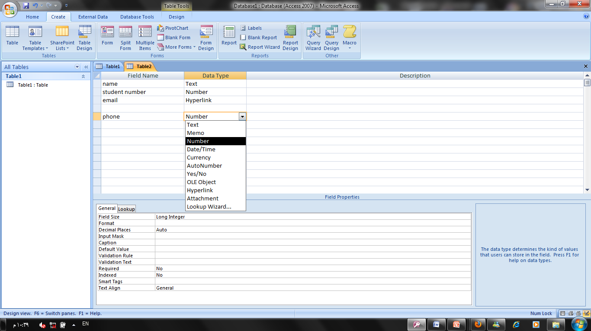
To Create New Table in Database
To create new table, follow the following steps:
Click on Create on the menu bar.
Click on ‘Table Design’
When completed, then click on Save. Type Table name and click on OK.
Type fieldnames and select data type in front of each fieldname (as shown in the following figure).

Slide 10
Setting Field Properties
Field properties include their data type, field sizes, and an optional description of the field.
When selecting a field size, make sure the size is big enough to hold the largest piece of data that will be stored there.
Make sure the data type you select for a field is appropriate for the kind of data to be stored in that field.

Slide 11
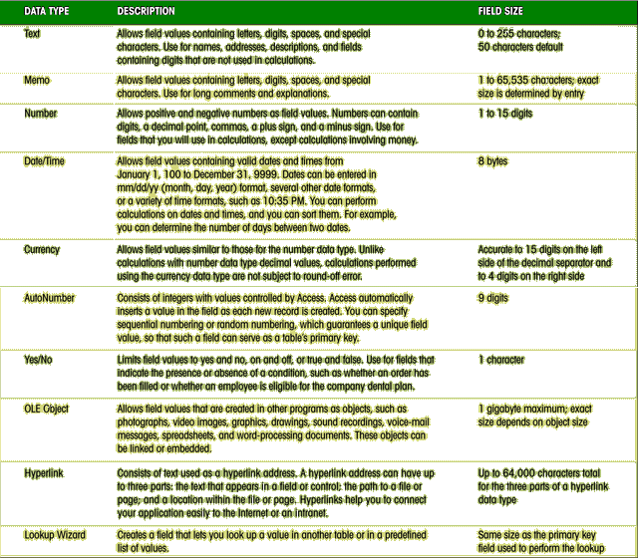
Field Properties

Slide 12
Open an Access Database Table
To open a table, you must first open a database:
In the list of tables, select the table you want to open and click on the Open button.
When a table is opened, it is in Datasheet view, which shows the table's data as a collection of rows and columns.
Each row in the Datasheet view represents a record in the table.

Slide 13
Data Sheet View of Table
Fieldnames
Current record
13

Slide 14
To Create New Query in Database
To create new Query, follow the following steps:
Click on Create in menu bar.
Click on ‘Query Wizard’
You will see the following dialogue box.

Slide 16
Fields Selection in Query
In the Simple Query Wizard dialog box, select which fields you want included in the query.
Move all the fields into the Selected Fields box.
Move the fields one at a time.
Remove fields out of the Selected Fields box by pressing one of the remove buttons.
If you wanted to select all the fields except one, you can move them all to the selected fields list and then remove the one field you don't want.
Once you have made your selections, press Next to move to the next dialog box in the Wizard.

Slide 17
Data Sheet View of Query

Slide 18
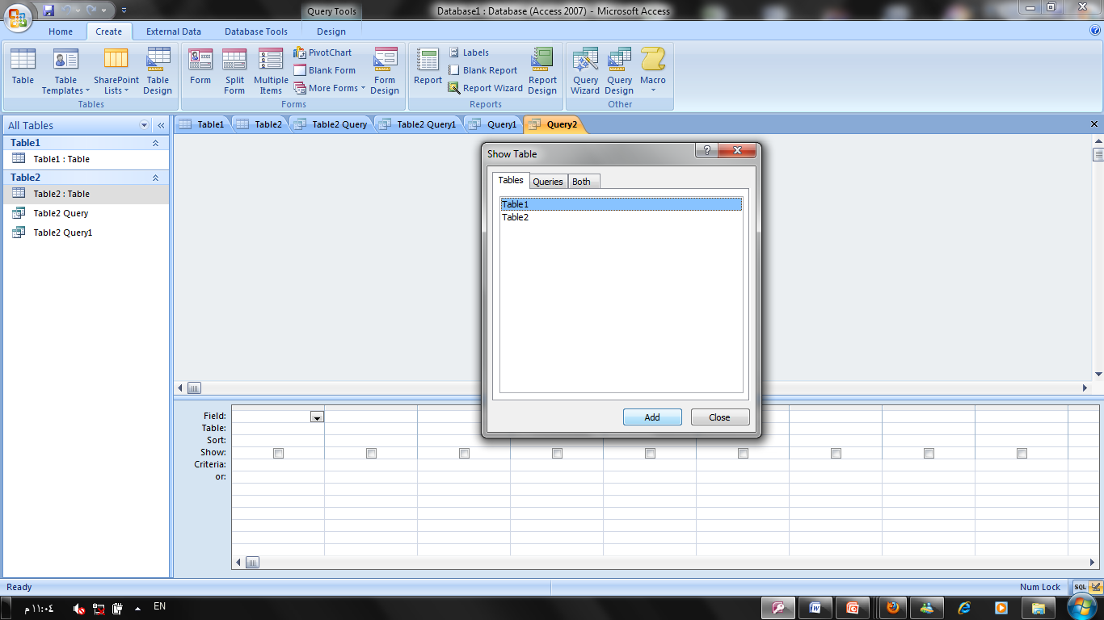
Create Query Design
To create new Query, follow the following steps:
Click on Create in menu bar.
Click on ‘Query design’
You will see the following dialogue box .

Slide 19
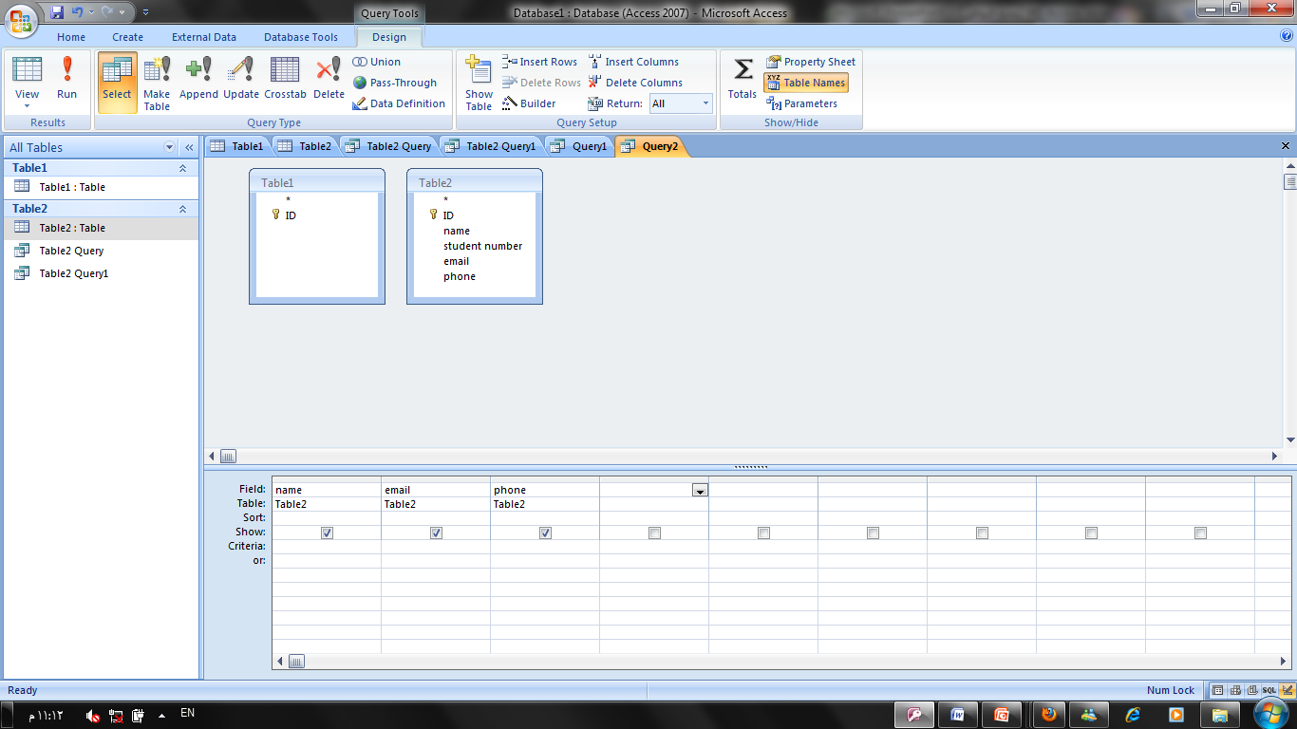

Slide 20
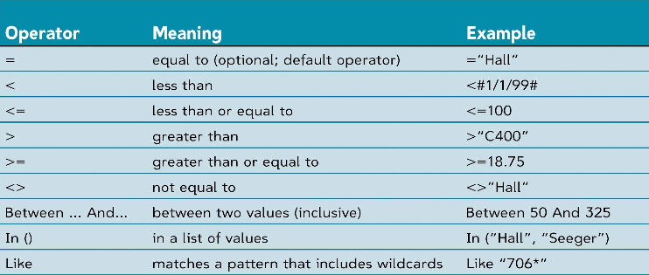
Criteria in Query
Criteria in the query means the condition which is fulfilled for extraction of records from table like Basic Salary<=3000.
Access contains the following comparison operators. These operators are used in criteria as per requirements:

Slide 21
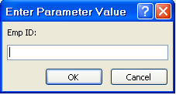
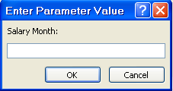
Parameter Query
The parameter query will prompt the user to enter the value they want to use to select records. Once the user has supplied this information, those records that match the value will be displayed in the query datasheet.
To create parameter query, enter the fields (for which the query will ask the user for values) in the Criteria under that fieldname as [fieldname:]. In the following example, there are two parameters for which the user is asked when the query is run Emp ID and Salary Month.
Parameter Fieldname
Parameter Fieldname

Slide 22
Relational Database Management System
Primary Key - The key that uniquely identifies record in the table is called Primary Key.
Foreign Key - A foreign key (sometimes called a referencing key) is a key used to link two tables together. Typically you take the primary key field from one table and insert it into the other table where it becomes a foreign key (it remains a primary key in the original table).
Relational Database - In Relational Database, data is held in tables (also called relations) and the tables are linked by means of common fields. Relational databases support a number of different types of relationships between tables, all designed to enforce the concept of referential integrity. Access supports three different types of relationships between tables.

Slide 23
One-to-one relationships - occur when there is exactly one record in Table-A that corresponds to exactly one record in Table-B.
One-to-many relationships - occur when each record in Table-A may have many linked records in Table-B but each record in Table-B may have only one corresponding record in Table-A.
Many-to-many relationships - occur when each record in Table-A may have many linked records in Table-B and vice-versa.

Slide 24
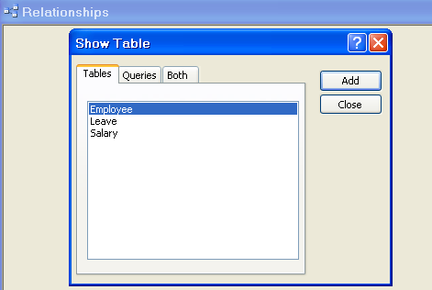
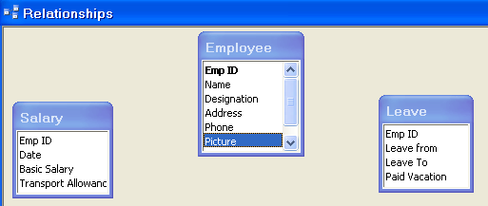
Creating Relationships Between Tables
Close any open table so that only the database window is visible.
Click on Tools (menu) > Relationships, or Click on the Relationships icon in the standard toolbar. The Relationships window appears:
Now right click an empty part of the relationship window and select Show Tables option.
Add tables or queries you want to relate
Relate the tables as explained in the next slide.
Selected Tables
List of Tables/Queries
Select Table / Query from List and click on Add

Slide 25
Selected Tables
List of Tables/Queries
Select Table / Query from List and click on Add

Slide 26
Relating Two Tables
Move the mouse pointer to the primary key field in the primary table. That key is boldfaced.
Drag that fieldname to the corresponding field in the related table (Child table) i.e. drag it to the appropriate foreign key.
Release the mouse button to display a dialogue box.
Select (Check) the to enforce referential integrity between the two tables.
Click the button to finish the job.

Slide 27
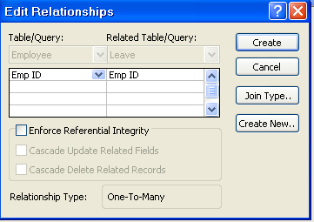
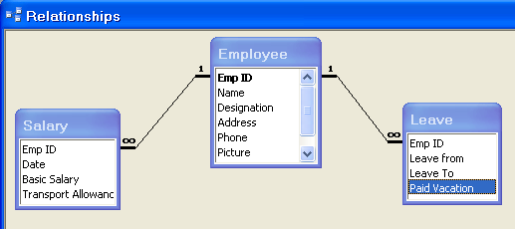
One to Many Relationship
One to Many Relationship
Primary Key
Foreign Key

Slide 28
Creating Forms in Database
Form – A tool (object) that makes it easy to operate on database like Insertion, deletion, saving, searching records etc.
To create new Form, follow the following steps:
Click on Create in menu bar then more form then form wizard.
There are two methods to create new form: Design View and Form Wizard’
Design View: Select the Design View option to create the form yourself by adding controls in Design View.
Form Wizard: Select the Form Wizard option to have Access create the form for you according to your specifications. The form wizard option lets you choose the specific fields to include which might belong to one or more tables or queries.

Slide 29
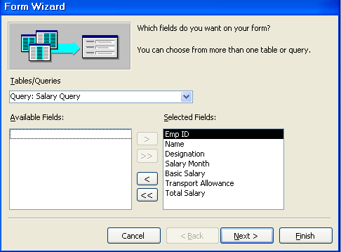
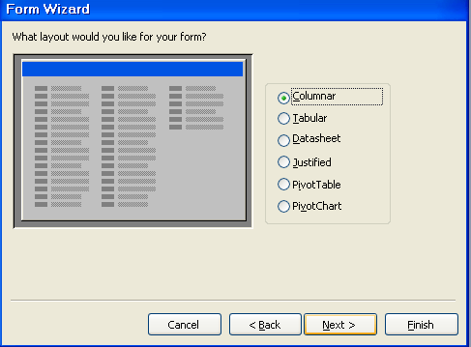
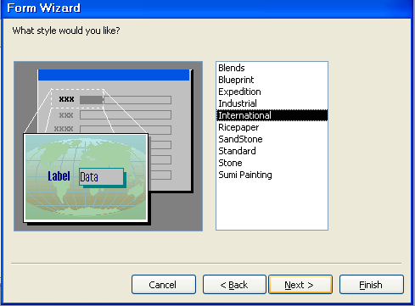
Form Wizard
click on Create Form by using Wizard, you will see the following dialogue box.
Select Table/Query, select fields and click on OK.
Select Layout of Form i.e. Columnar, Tabular……
Select Style of Form like Blends, Blueprint, ……..
Then save form with any title.
1
2
3

Slide 30
Creating Form (Cont)
You can add controls to the form this toolbox.
View of the Form During Design.

Slide 31
Creating Reports in Database
Report is a tool (object) through which you get output (hardcopy or softcopy) from the database.
To create new Report, follow the following steps:
Click on CREATE in menu bar then report wizard.
There are two methods to create new form: Design View and Report Wizard’
Design View: Select the Design View option to create the Report yourself by adding controls in Design View.
Report Wizard: Select the Report Wizard option to have Access create the Report for you according to your specifications. The Report wizard option lets you choose the specific fields to include which might belong to one or more tables or queries.

Slide 32
Create a Report Using the Report Wizard
You can easily create a formatted printout of data in table(s) in a database by using the Report Wizard.
The Report Wizard will ask you a series of questions to help you format the report.
Once the report has been created, either with the Report Wizard or your own design, you can change the design later.
You will find that the choices you make in the Report Wizard are similar to the choices in the Form Wizard.
Choices include grouping and sorting options, as well as report layout options. You can preview the report to view how it will look when printed.

Slide 33
Steps in Creating a Report
Create a new report with Report Wizard.
Select primary table (or query) – In this example, select Employee table.
Move the following fields from the Available Fields list box to the Selected fields list box:
Emp ID
Name
Designation
Select related table (or query) – In this example, select Salary table.
Move the following fields from the Available Fields list box to the Selected fields list box:
Date
Basic Salary
Transport Allowance
Click Next to get further dialogue box for grouping level.

Slide 34
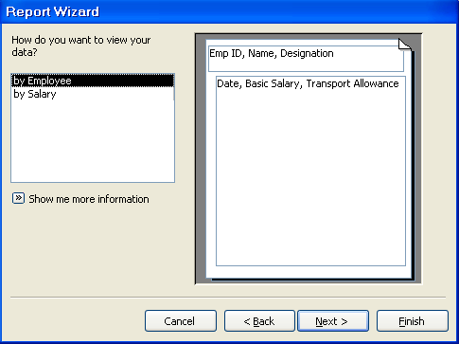
Grouping Report Data
You should decide how you want the report to be grouped. This figure shows a sample report (in the Report Wizard) that is grouped by the Employee table.
The secondary table is the Salary table. This will develop a report where each employer's Salary is grouped under that employer.
Data Grouped by Table

Slide 35
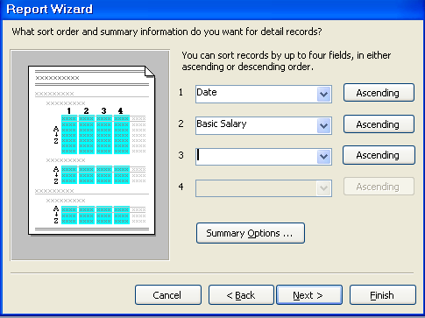
Sorting Report Data
You can sort the data on a particular field or on several fields.
If you choose to sort on two or more fields, the grouping is in order as selected on the Sort Order portion of the Report Wizard.
If you choose to sort on Date and then on Basic Salary, the report would be sorted on Date and then within each Date group, the data would be sorted on Basic Salary.

Slide 36
Choose a Report Layout
The Layout dialogue box asks you to select the layout and orientation.
Then click next.

Slide 37
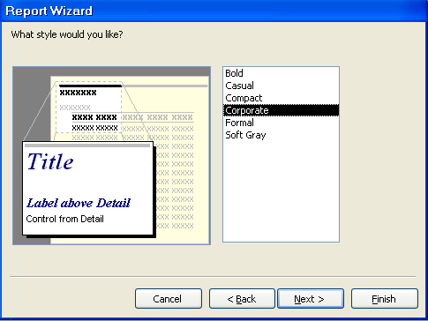
Choose a Report Style
The next dialogue box asks you to select the Style of the report.
Select the desired style and click Next.
Save your Report with a Report name. Now the report is ready. You can make changes in it by opening it into design view.
Then click next.
Select one style and then click Next

Slide 38
Preview and Print a Report
Before printing the report, you can view it in Print Preview by pressing the Print Preview button.
If the preview looks OK, you can print the report. To print the report:
Click the File menu, and then click Print.

Slide 39
The End………

