Slide 1
preparation of the squamous epithelium cells from the human mucosa mouth
By : T. Moudy bin Saleh

Slide 2
Introduction
Squamous cells are the thin, flat cells that make up the epidermis, or the outermost layer of the skin.
It protects many of the passages of the digestive and respiratory tracts in the body.
Large numbers of mucous cells occur in the mouth, where mucus is used both to moisten food and to keep the oral membranes moist while they are in direct contact with the air.

Slide 3
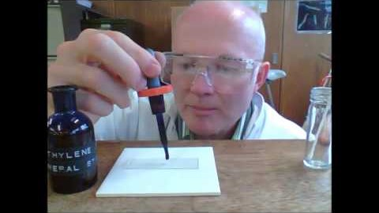
How to make a slide of squamous cell ?

Slide 4
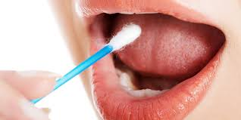
Materials
Glass microscope slides
Plastic cover slips
Paper towels or tissue
Methylene Blue dye
cotton swabs

Slide 5
Metods :
Take a clean cotton swab and gently scrape the inside of your mouth.
Smear the cotton swab on the center of the microscope slide for 2 to 3 seconds.
Add a drop of methylene blue solution and place a coverslip on top.
Remove any excess solution by allowing a paper towel to touch one side of the coverslip.
Place the slide on the microscope, with 4 x or 10 x objective in position and find a cell. Then view at higher magnification.

Slide 6
Concentrated methylene blue is toxic if ingested. Wear gloves and glases .
This dye is toxic when ingested and it causes irritation when in contact with the skin and eyes.

Slide 7
Lets work together

