Slide 1
Note 9 The Product Life Cycle

Slide 2
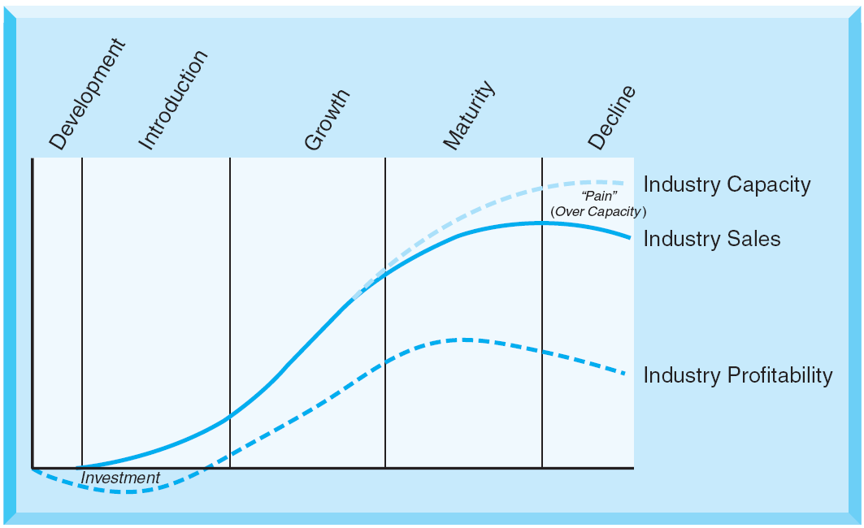
Figure Note 9-1 - The Product Life Cycle
Notes:
Every product moves through an introduction phase, a growth phase, a maturity phase, and ends with a decline phase.
Each of these phases is characterized by changes in demand, competition, marketing tasks, and decisions.
These changes during the “product life cycle” can be generalized across markets.
Understanding and anticipating those changes is important for planning and for effectively adapting marketing strategies.
In order to understand the product life cycle for any market, it is essential to first define the market or the product under consideration.
There are life-cycle effects underlying the evolution of an industry, a specific market, a product form, and individual products.
Not all products and industries, enter a “decline” stage in the life cycle.
Some products have a very specific life cycles - “fad” life cycles, that grow, mature, and decline toward obsolete quickly.

Slide 3
Changes in Markets Across the Product Life Cycle
The single phases of a product life cycle differ in a number of important characteristics
Competition and product assortment
Customer behavior and segment configuration
Distribution

Slide 4
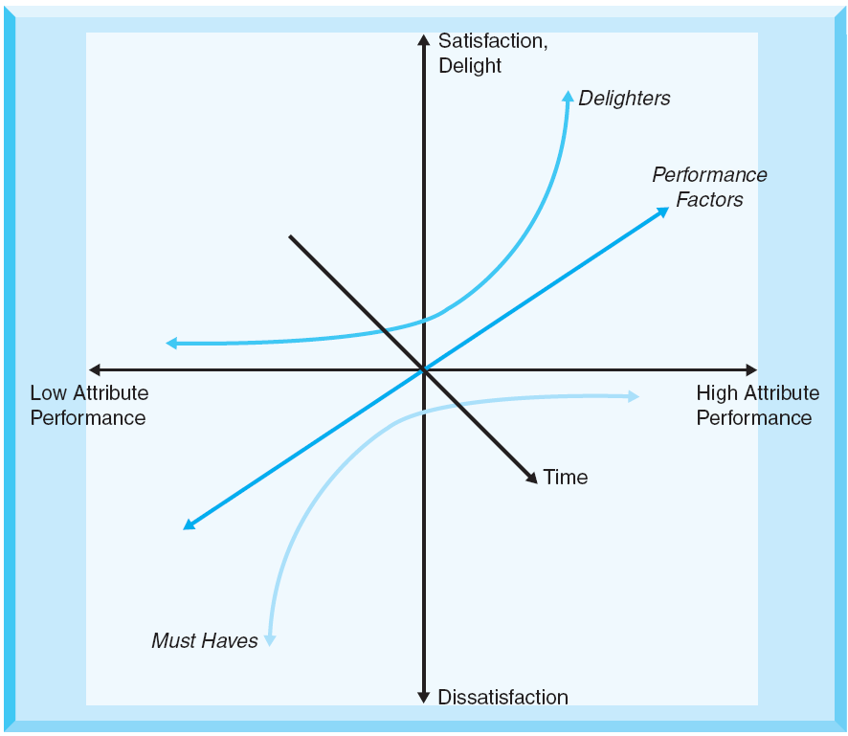
Figure Note 9-2 - Kano’s Model of Customer Satisfaction
Notes:
Kano’s model of customer satisfaction - A useful model to distinguish between different types of product attributes.
It describes three different types of product characteristics:
Delighters - Cause satisfaction or even excitement if delivered, but that do not necessarily lead to dissatisfaction if not delivered. They are not explicitly expected and articulated.
Must haves - Minimum requirements that a product must fulfill. They do not lead to satisfaction if fulfilled, but lead to dissatisfaction if not present.
Performance factors - Lead both to dissatisfaction or satisfaction depending on how well they perform.
This model is dynamic - The three types of attributes change over time.

Slide 5
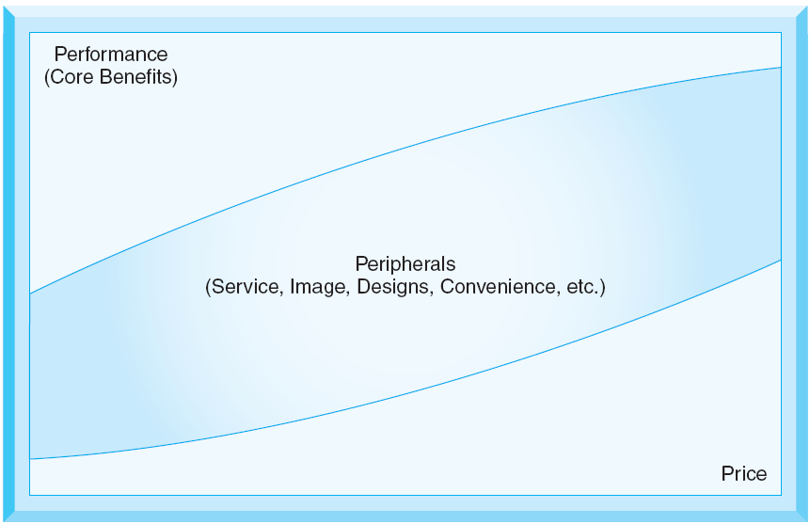
Figure Note 9-3 - Criterion in Consumer Preferences and Choice
Notes:
As product life cycles evolve, so do the drivers of consumer preferences and choice.
Early in the life cycle consumers focus on product performance and core benefits.
During growth and product maturity, greater consideration is given to “peripheral” product attributes.
Price emerges as a very important decision criterion as the product life cycle moves forward and becomes the dominant decision driver for many consumers in the later stages of the product life cycle.
The process of commoditization denotes a competitive environment where:
Product differentiation becomes very difficult.
Customer loyalty and brand preferences erode.
Competition is based primarily on price.
Competitive advantages come from cost leadership.
As products move into the maturity phase of the life cycle, commoditization becomes a likely threat.
Ways to delay the forces of commoditization:
Innovate
Bundle
Segment

Slide 6
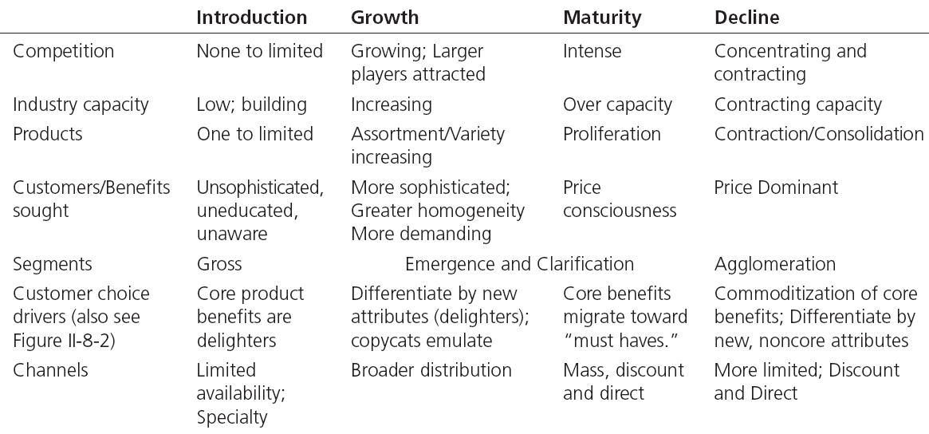
Table Note 9-1 - Market Characteristics Across the Product Life Cycle

Slide 7
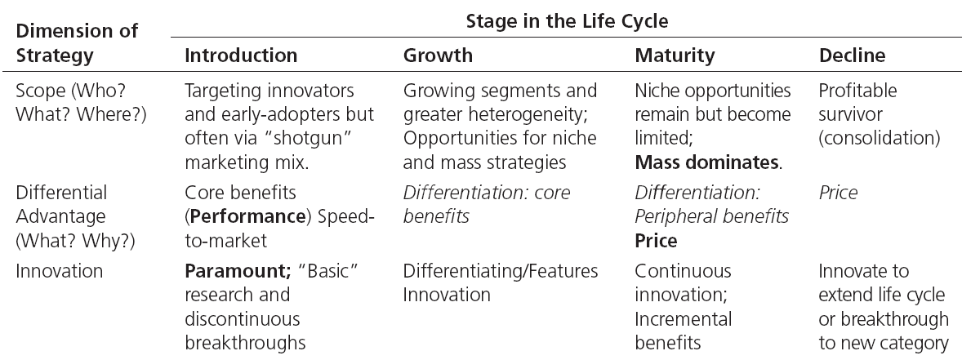
Table Note 9-2 - Marketing Strategies Across the Product Life Cycle

Slide 8
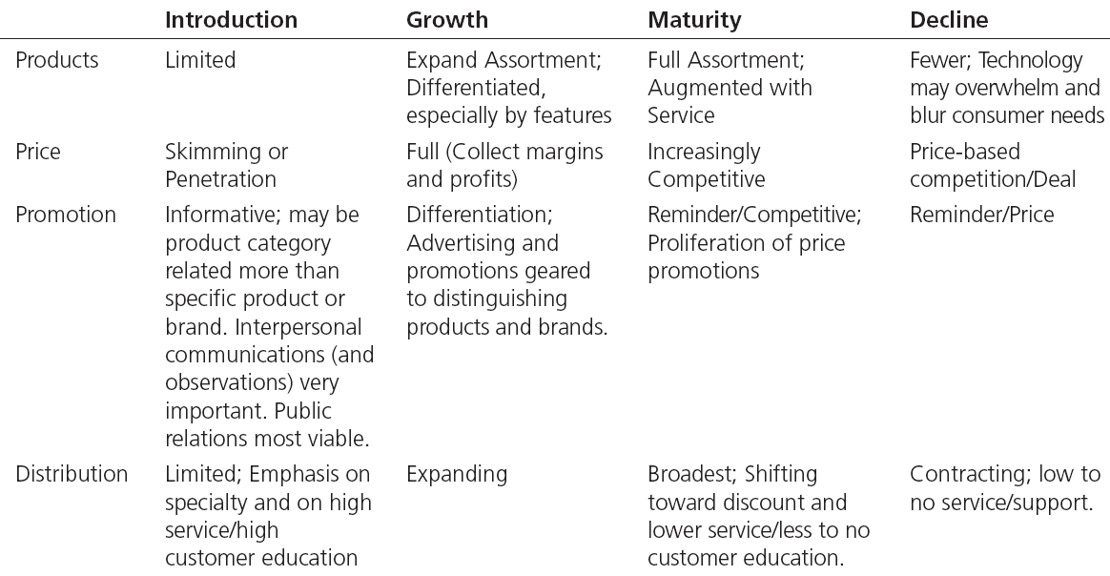
Table Note 9-3 - Marketing Tactics Across the Product Life Cycle

Slide 9
Products—Innovations
In marketing strategy, innovations refer to discontinuous innovations—products that are truly “new to the world” and that change the way a customer need is met

Slide 10
Customer Value and Product Innovation
Value is defined as what the customers get adjusted for what the customers give
Relative performance adjusted for relative price

Slide 11
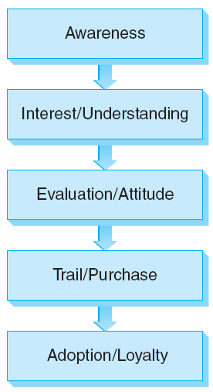
Figure Note 31-3 - The Adoption Process
Notes:
The adoption process of an innovation includes stages that a consumer moves through on their way from unaware of a new product to eventual adoption and loyalty.

Slide 12
Attributes of the Product/Innovation
Relative advantage
Trialability
Complexity/Ease of use
Observability
Compatibility
Risk
Network effects

