Slide 1
Note 13 Market-Share Effects

Slide 2
Introduction
Most organizations hold high market share as their primary objective
As marketers strive to improve sales, they are also working to improve market share
The processes of increasing sales and increasing market share are inextricable, in low- or no-growth markets

Slide 3
Market Share as a Strategic Objective
Empirical studies have demonstrated that market share is related to cost advantages and profitability
Market-share effects are incorporated into strategic considerations

Slide 4
Market Share and Cost Advantages
Market share shows a firm’s success relative to the competition
An increase in the market share should lead to certain competitive advantages
The firm with higher market share has greater scale, and scale leads to advantages in learning and unit costs
Scale effects connect the number of units produced to lower per-unit costs - offers a significant competitive advantage

Slide 5
Market Share and Cost Advantages
The experience curve posits that the more often a task or operation is repeated, the lower will be the cost of completing it
Economies of scale arise when unit costs decrease as output increases

Slide 6
Market Share and Profits
Firms with lower costs can:
Charge a lower price for its product.
Take higher margins at the market price.
Experience curve effects offer the benefits of higher reliability and quality
As a firm makes more units, its number of defects decreases and its “conformance” or uniformity across units increases

Slide 7
Market Share and Profits
Increased market share seems to be a desirable outcome that is associated with specific competitive advantages
For this reason market-share targets are included in company objectives and strategic planning
Extensive research has shown that market share and profitability correlate
The relationship between share and profits is complex
It is not clear whether market share actually causes higher profitability

Slide 8
Market Share and Profits
The reverse relationship also can be true
Profitability may lead to higher market share, and other factors may lead to the differences in both profits and share

Slide 9
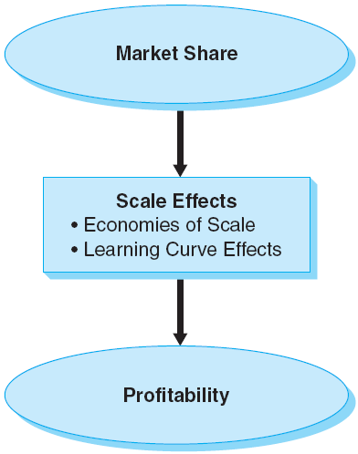
Figure Note 13-1 - Market Share and Profitability
Notes:
In this figure the basic share-profitability connections are illustrated.

Slide 10
Empirical Findings: The Profit Impact of Marketing Strategy (PIMS) Data
The PIMS data have led to several observations
Market attractiveness and competitive position are strongly correlated with profitability and returns

Slide 11
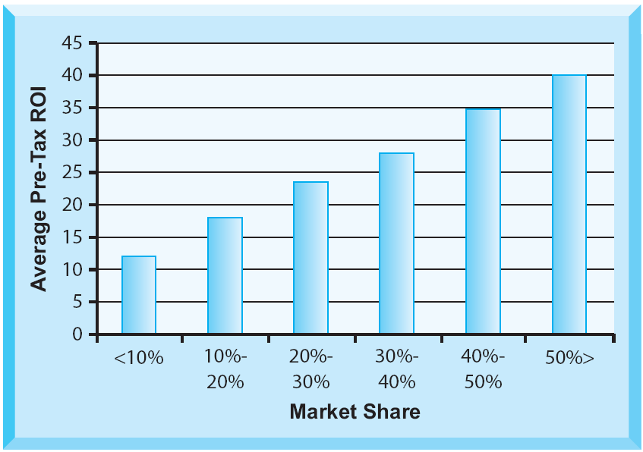
Figure Note 13-2 - Market Share and ROI
Notes:
An increase of three percentage points in market share is related to a one-percentage-point increase in profitability.

Slide 12
Strategic Implications of Market Share
Defining the market that is shared
Causation and covariates
Competitor-oriented objectives

Slide 13
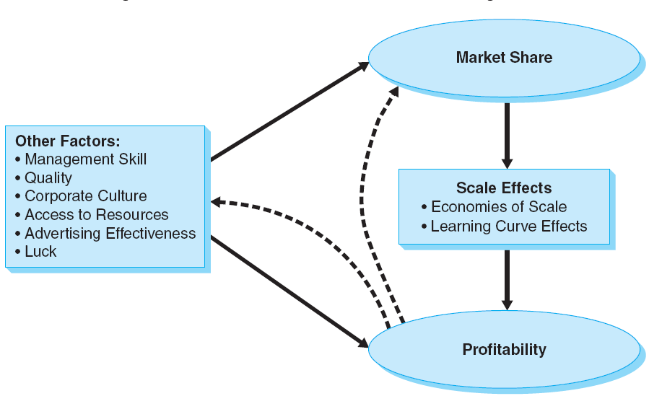
Figure Note 13-3 - Possible Market Share—Profitability Relationships

Slide 14
Market Share and Strategy
Issues to consider when integrating market-share considerations into a strategy
Scale effects
Dissuasion of competitors
Standardization
Ancillary sales
Customer “stickiness”

Slide 15
All rights reserved. No part of this publication may be reproduced, stored in a retrieval system, or transmitted, in any form or by any means, electronic, mechanical, photocopying, recording, or otherwise, without the prior written permission of the publisher. Printed in the United States of America.
Copyright © 2012 Pearson Education, Inc.
Publishing as Prentice Hall

Slide 16
Introduction
Marketing concept - firms will be most successful at achieving goals when they orient around the consumers’ needs and align the entire organization around satisfying those needs
Market orientation - a firm wide customer and competitor focus and coordination of activities
Notes:
Market orientation has been shown to lead to superior firm-level performance, including profitability, ROI, and stock returns.

Slide 17
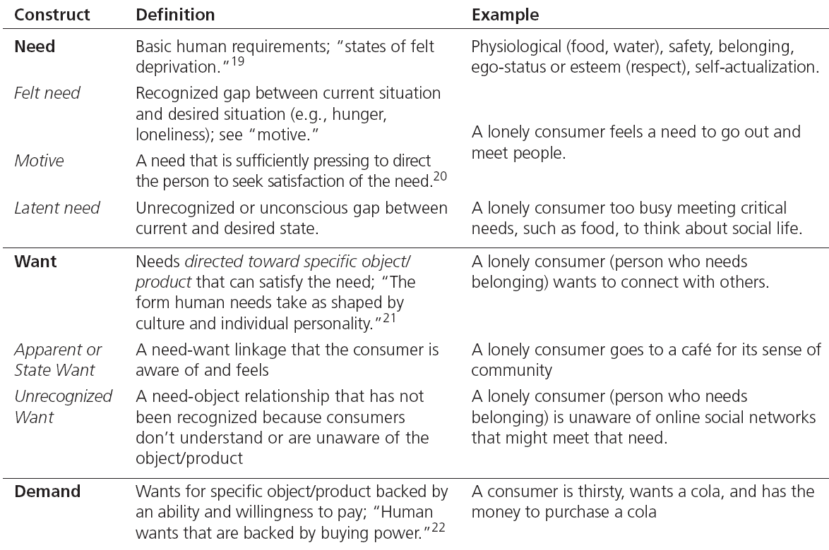
Table Note 15-1 - Needs, Motives, Wants, and Demand

