Slide 1
Note 16 What is a Marketing Strategy?

Slide 2
Introduction
Strategy is the coordinated means by which an organization pursues its goals and objectives
It encompasses an integrated set of choices and decisions intended to support and advance the company’s vision and objectives
It describes how to compete in a particular market or market segment

Slide 3
Introduction
Strategic marketing decisions address following range of issues and critical tasks:
The long-term direction of a company
The scope of the company
The identification and/or creation of competitive advantages
The maintenance and protection of those competitive advantages

Slide 4
Introduction
The identification and prioritization of opportunities and threats in the external environment
The identification and prioritization of customer needs as well as expectations and the needs and interests of other stakeholders

Slide 5
Introduction
Marketing strategy should fulfill three basic requirements:
Comprehensive
Integrative
Consistent

Slide 6
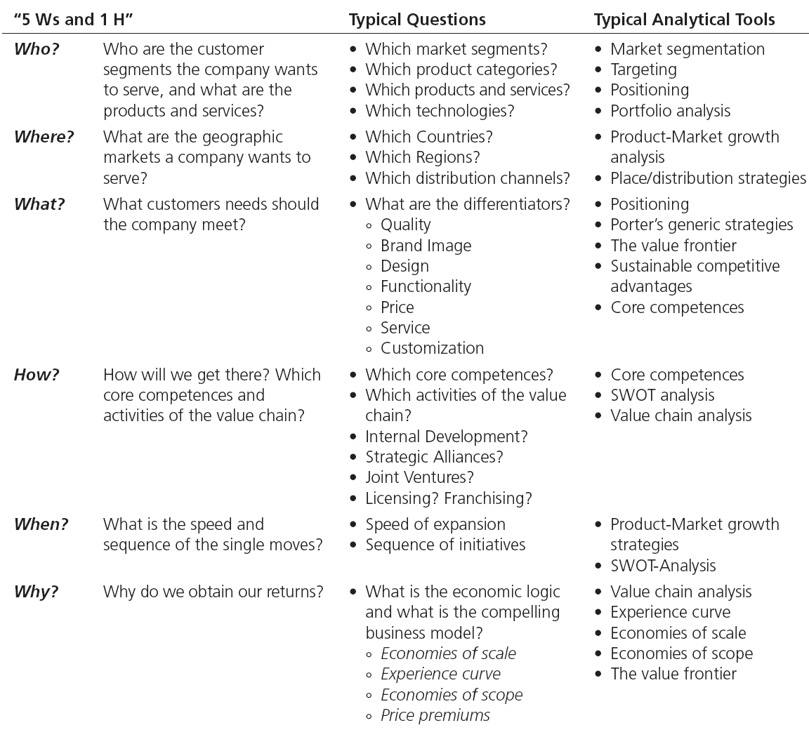
Table Note 16-1 - The 5 Ws and 1 H of the Marketing Strategy
Notes:
Target segments and competitive advantages are the key factors in the six essential elements of a comprehensive marketing strategy.

Slide 7
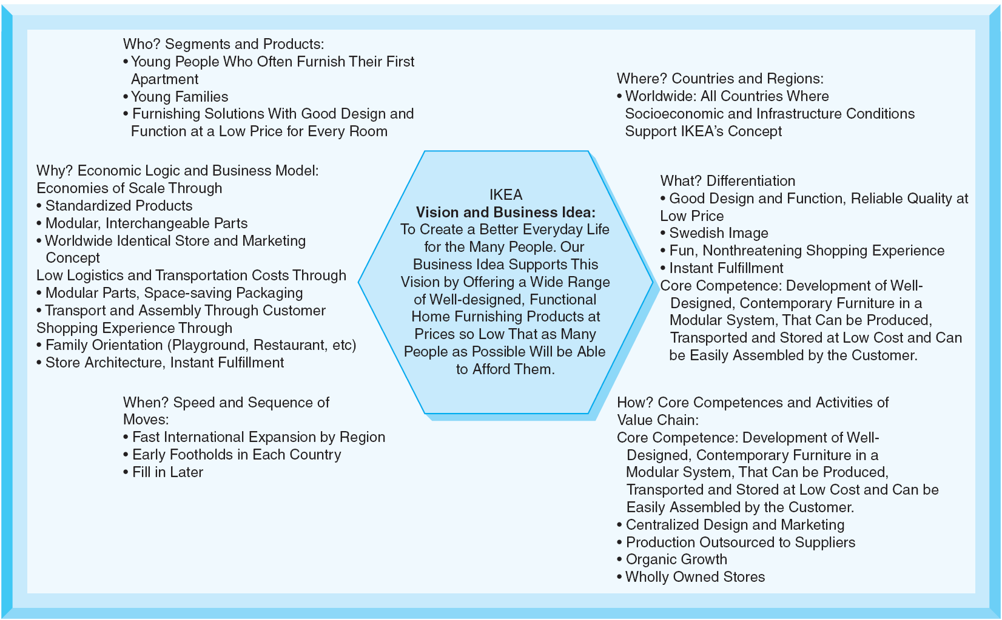
Figure Note 16-1 - The “Hexagon” of Strategy (IKEA)
Notes:
A good example of a comprehensive strategy is that of IKEA.
The Swedish furniture retailer has a clear and compelling strategy that has been consistent and enduring.

Slide 8
All rights reserved. No part of this publication may be reproduced, stored in a retrieval system, or transmitted, in any form or by any means, electronic, mechanical, photocopying, recording, or otherwise, without the prior written permission of the publisher. Printed in the United States of America.
Copyright © 2012 Pearson Education, Inc.
Publishing as Prentice Hall

