Slide 1
Note 17 Generic Strategies— Advantage and Scope

Slide 2
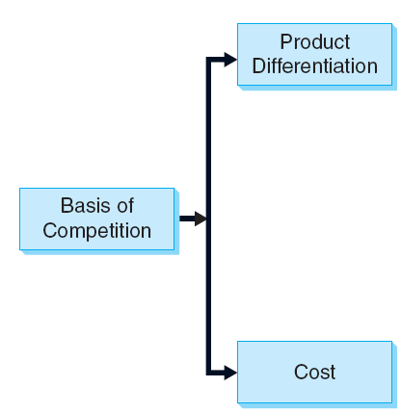
Figure Note 17-1 - Basis of Competition: Cost Leadership and Differentiation
Notes:
Companies are successful when they are able to create a sustainable difference.
Creating a difference:
Bringing an identical or similar product or service to market more cost effectively than the competitors.
Bundling unique benefits in an offering for which customers are willing to pay a price premium.

Slide 3
Cost Leadership
A cost leader typically offers a standardized, no-frills product
The strategic objective of the cost leader:
To deliver the products at lowest costs
To sell those products at the lowest price
To communicate that proposition to price-sensitive markets

Slide 4
Cost Leadership
Cost leaders’ products are:
Highly standardized, with no-frills
Produced for mass markets
Cost leader must excel in:
Operational efficiency
Process improvement
The dominant values are
Cost-consciousness
Efficiency
Risk aversion
Notes:
Cost leaders adopt a top–down approach and are authoritative to enforce smooth flowing, standardized processes, and consistency.

Slide 5
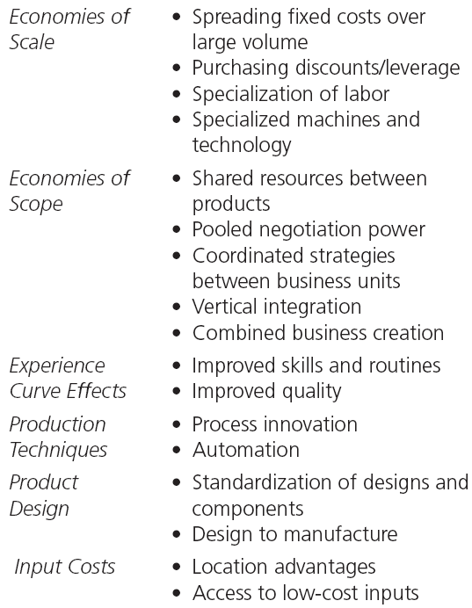
Table Note 17-1 - Sources of Cost Advantages
Notes:
Potential sources of cost advantages are summarized in the table above.
If there is more than one cost leader per industry, then a price war may be a possibility.
Market share becomes crucial to becoming and staying the cost leader.

Slide 6
Differentiation
An advantage can be created when a company is able to deliver a superior product or service to the customer, for which the customer is willing to pay a premium because it better fulfills his needs
Superior value can stem from:
Higher quality
Better service
More features and more convenience
Better brand image
Other distinctive qualities

Slide 7
Differentiation
A differentiation strategy requires almost the opposite skills and organizational characteristics than a cost-leadership strategy
Differentiation requires:
Continuous innovation
Exceptional brand management
A differentiated offering is highly sophisticated
Offers exceptional quality and/or a unique brand image

Slide 8
Differentiation
A differentiator must:
Be customer oriented
Be innovative
Have special skills in brand management
Companies with differentiation strategy
Have very flexible and organic organizational structures
Work with cross-functional teams

Slide 9
Differentiation
Leaders of differentiated organizations are visionaries who:
Involve employees in decision making
Encourage employees to innovate and generate creative ideas

Slide 10
Table Note 17-2 - Common Bases of Differentiation
Notes:
The table above summarizes selected sources of differentiation.
The assortment of potential points of differentiation emphasizes the range of ways that an offering can deliver superior satisfaction and greater value to customers.

Slide 11
Table Note 17-3 - Comparing Cost Leadership and Differentiation

Slide 12
Table Note 17-4 - Generic Strategies and Their Requirements

Slide 13
Hybrid Strategies
Companies can pursue a hybrid strategy that simultaneously seeks to achieve differentiation and lower prices
Hybrid strategies are more the exception than the rule and that they are difficult to execute
One exception to the rule of choosing one or the other
An offering that is distinct for its low cost and differentiated by its high reliability and/or conformity

Slide 14
Competitive Scope
It is the size and breadth of the market(s) the strategy means to serve or target(s)
It may vary in terms of:
The number of customers the firm targets
The number of segments the firm targets
The heterogeneity of different customers and segments
The variety of needs that the firm endeavors to serve
Notes:
The dimensions and decisions that structure competitive scope are the same as those that define market segmentation.

Slide 15
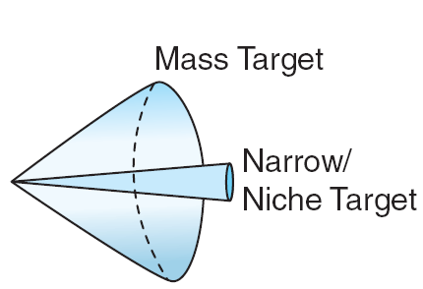
Figure Note 17-2 - Scope of Competition
Notes:
Competitive scope can be thought of as a continuum covering a range of viable alternatives.
Some firms serve mass markets with standardized offerings.
Some firms even target the whole world as a single market - global strategies.
Some firms serve very small markets or “niches” with highly customized, value-added offerings.
Some firms carve out any number of intermediate competitive scopes.

Slide 16
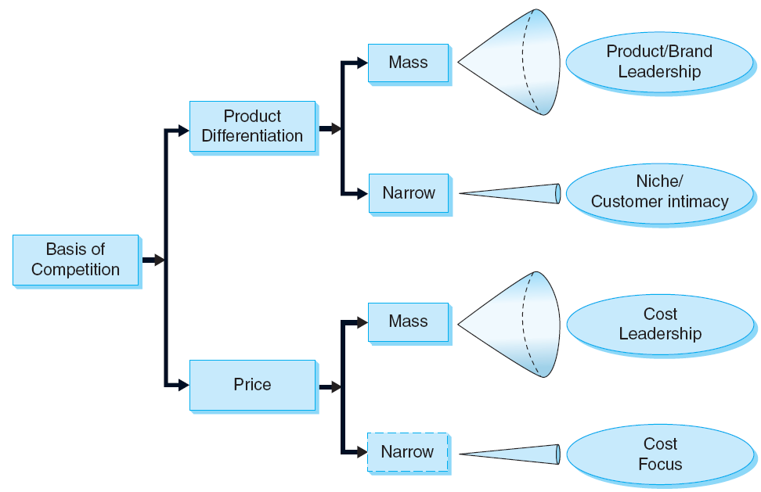
Figure Note 17-3 - Generic Strategies

Slide 17
Application of Customer Value Analysis
A customer value analysis serves two purposes:
It can be useful in the formulation of market databased strategies, which are preferable to vague definitions or blurry descriptions of strategies
This type of analysis helps identify clear measures to implement strategies

Slide 18
Application of Customer Value Analysis
In order for an analysis to be successful, the marketer must have clear answers to the following questions, ideally based on market research data:
What is our target market?
Who are our competitors in the target market?
What are the customers’ buying criteria?
How important is each of these criteria?

Slide 19
Application of Customer Value Analysis
How do customers evaluate our product and the competitors’ products on the basis of these buying criteria?
What are our prices and those of the competitors?
What is the customers’ price sensitivity?

Slide 20
Application of Customer Value Analysis
Steps of analysis
Step 1: Definition of the target market
Step 2: Identification of competitors
Step 3: Identification of customers’ buying criteria and their relative importance
Step 4: Assessment of product performance and price
Step 5: Calculation of relative quality and relative price

Slide 21
Application of Customer Value Analysis
Step 6: Estimation of customers’ price sensitivity
Step 7: Creation of the customer value map and formulation of strategies
Step 8: Definition of an action plan using importance- performance analysis

