Slide 1
Note 20 Specific Marketing Strategies

Slide 2
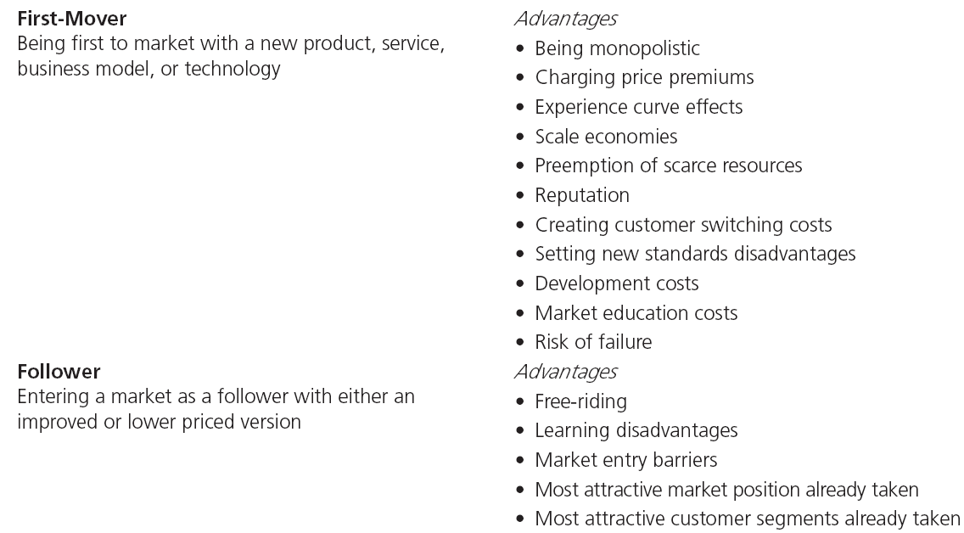
Table Note 20-1 - First-Mover versus Follower Strategy
Notes:
A company can be either:
The first to market, capturing the first-mover advantage.
The follower, trying to learn from the first entrant and to imitate or even improve.

Slide 3
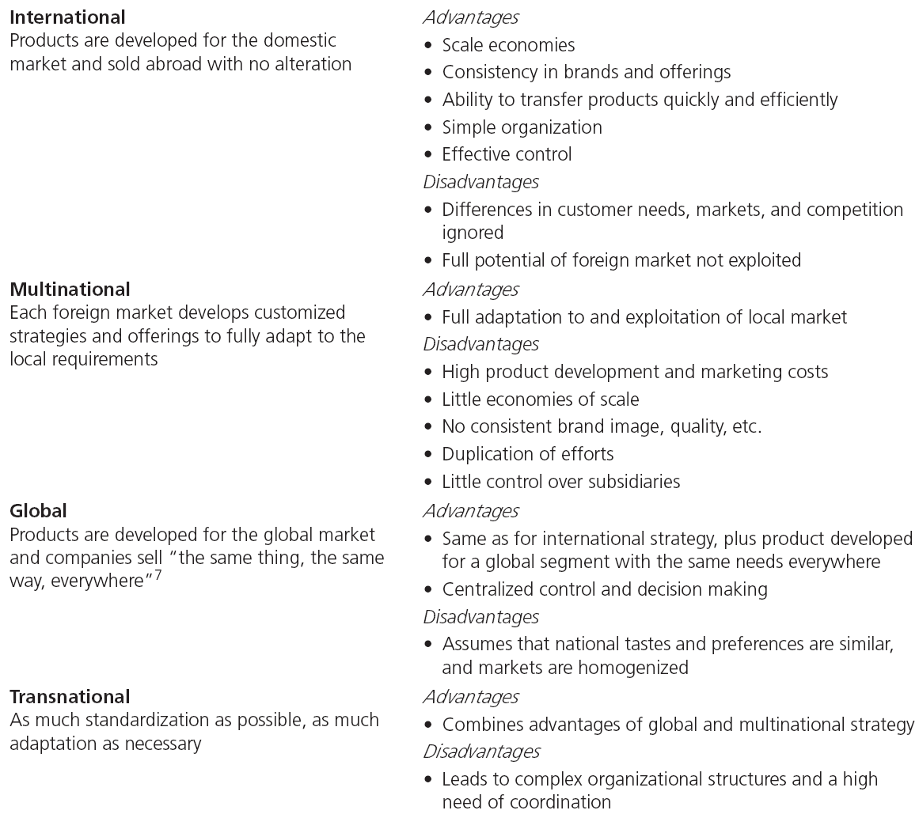
Table Note 20-2 - Approaches to Internationalization
Notes:
When a company internationalizes, it has four options:
Build an international strategy
Build a multinational strategy
Build a global strategy
Build a combination of the above or a transnational strategy

Slide 4
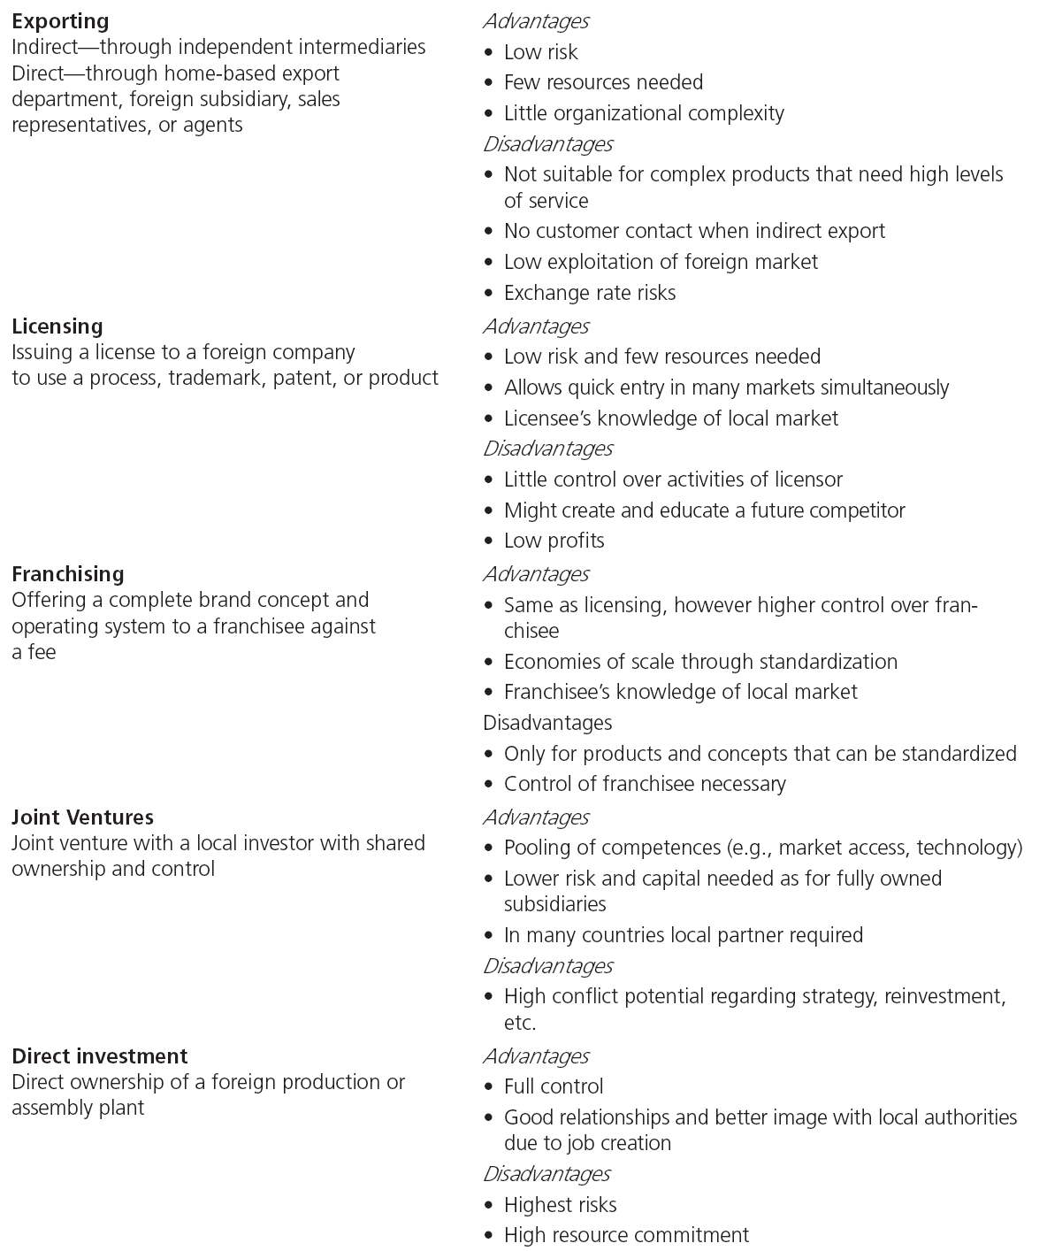
Table Note 20-3 - Market Entry Strategies
Notes:
To enter international markets, five entry modes with specific advantages and disadvantages exist:
Exporting
Licensing
Franchising
Joint ventures
Direct investment

Slide 5
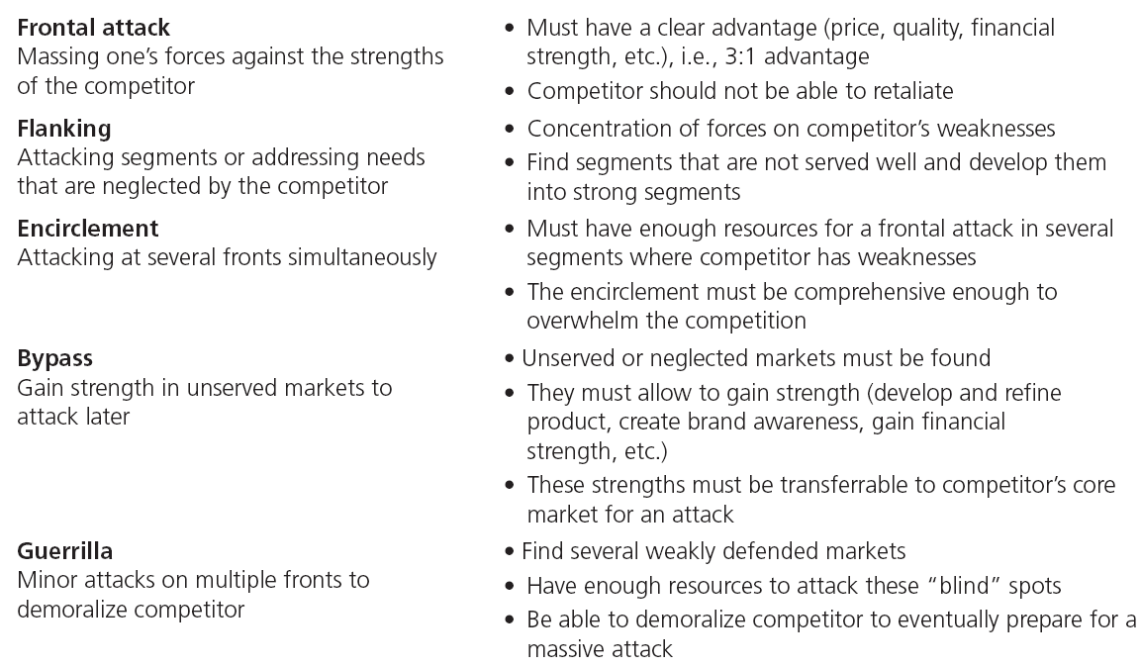
Table Note 20-4 - Offensive Strategies
Notes:
Business strategists and marketers have developed some strategies that describe how companies can attack their competitors.
The table describes the characteristics for these strategies.

Slide 6
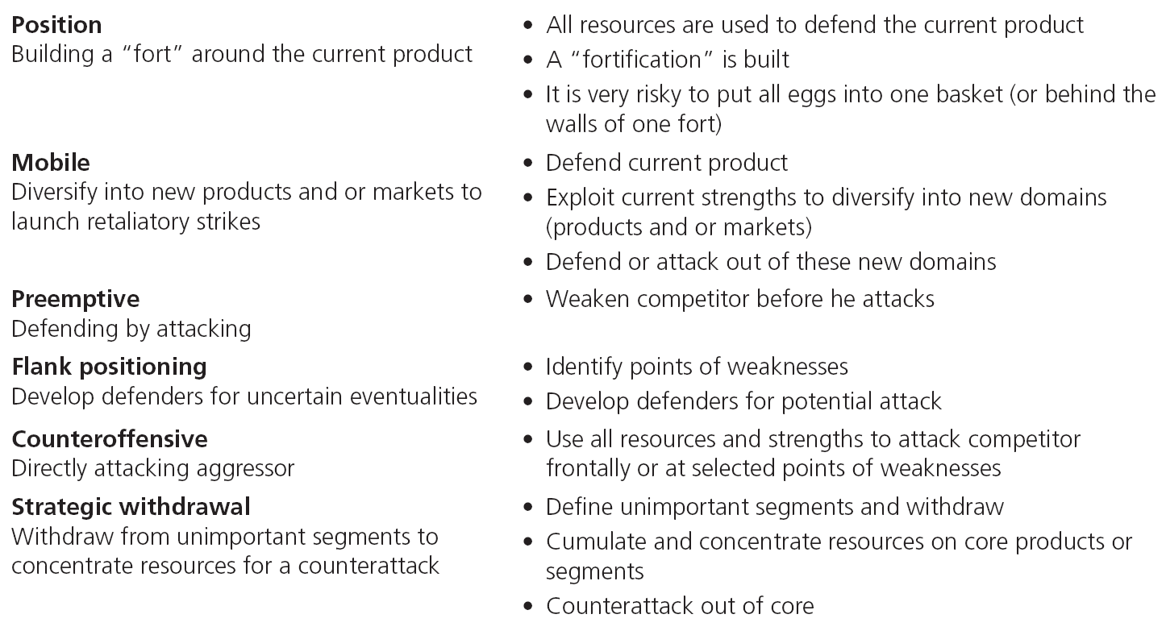
Table Note 20-5 - Defensive Strategies
Notes:
Business strategists and marketers have developed some strategies that describe how they can defend themselves against the aggressor.
The table lists the characteristics of these strategies.

Slide 7
All rights reserved. No part of this publication may be reproduced, stored in a retrieval system, or transmitted, in any form or by any means, electronic, mechanical, photocopying, recording, or otherwise, without the prior written permission of the publisher. Printed in the United States of America.
Copyright © 2012 Pearson Education, Inc.
Publishing as Prentice Hall

