Slide 1
Note 24 Competitive Advantages

Slide 2
Introduction
In the strategic management literature there are two broad schools of thought
The marketbased view (MBV)
The resource-based view (RBV)

Slide 3
The Market-Based View (MBV)
According to MBV, the firm’s success depends on:
Its abilities to position itself in an attractive industry
To adapt to industry structures
To develop strategies accordingly

Slide 4
The Market-Based View (MBV)
Strategy development should progress through four steps:
The company’s environment should be analyzed
The company should select attractive industries that promise above-average returns
Strategies that are aligned with the industry structure should be developed
The company should develop or acquire the necessary resources and capabilities to implement those strategies

Slide 5
The Resource-Based View (RBV)
It argues that each company is a collection of unique resources and capabilities, and that those strategic resources of the company are the sources of above-average returns
A company has a “sustainable competitive advantage” (SCA) if it has resources or capabilities that are:
Valuable in the market
Rare
Not imitable or substitutable
Transferable to other markets or products

Slide 6
The Resource-Based View (RBV)
Strategy development
Strengths and weaknesses of the company are analyzed
Based on strengths and weaknesses, competitive advantages are identified
Industries, markets, and, especially, market segments are targeted in which these competitive advantages can be exploited
Strategies for these industries and markets are developed and implemented based on the competitive advantages

Slide 7
Identifying Competitive Advantages
Step 1
What do we do better than the competition?
What are our competitive advantages?
Step 2
Which resources or capabilities are the sources of these advantages?
Step 3
Which of these resources or capabilities are valuable, unique, and not imitable or transferable to other industries or markets?

Slide 8
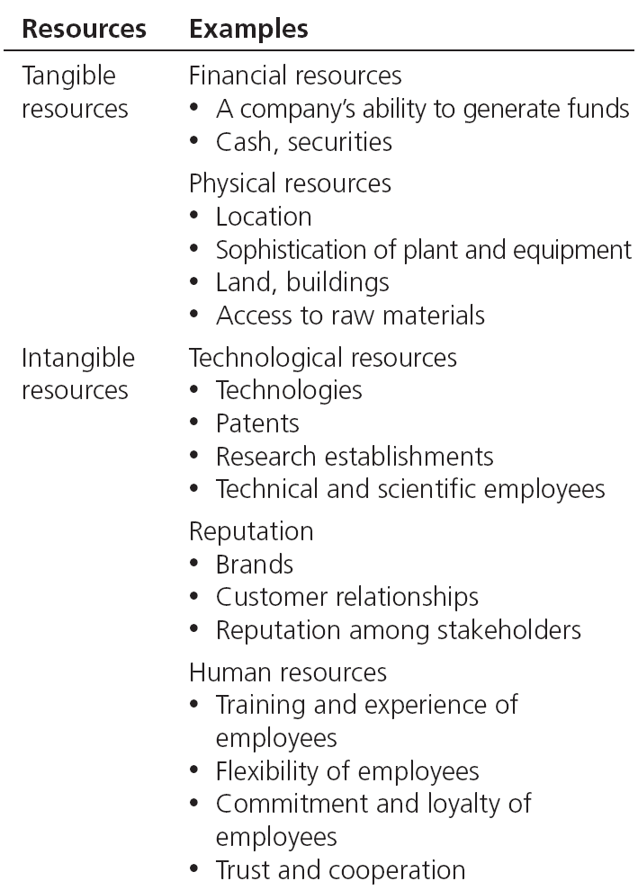
Table Note 24-1 - Examples of Resources

Slide 9
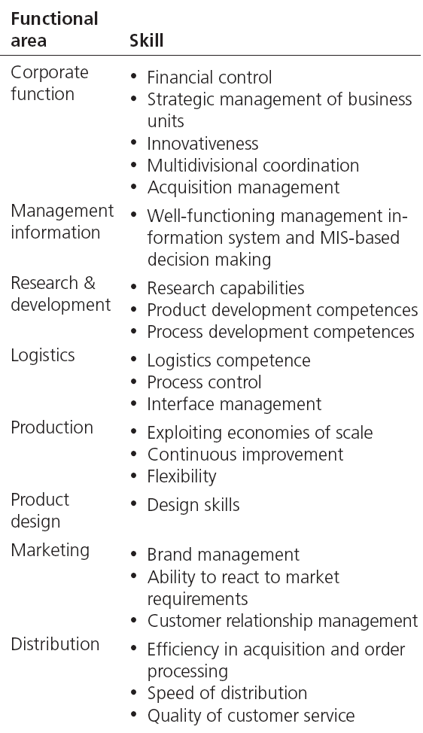
Table Note 24-2 - Examples of Capabilities

Slide 10
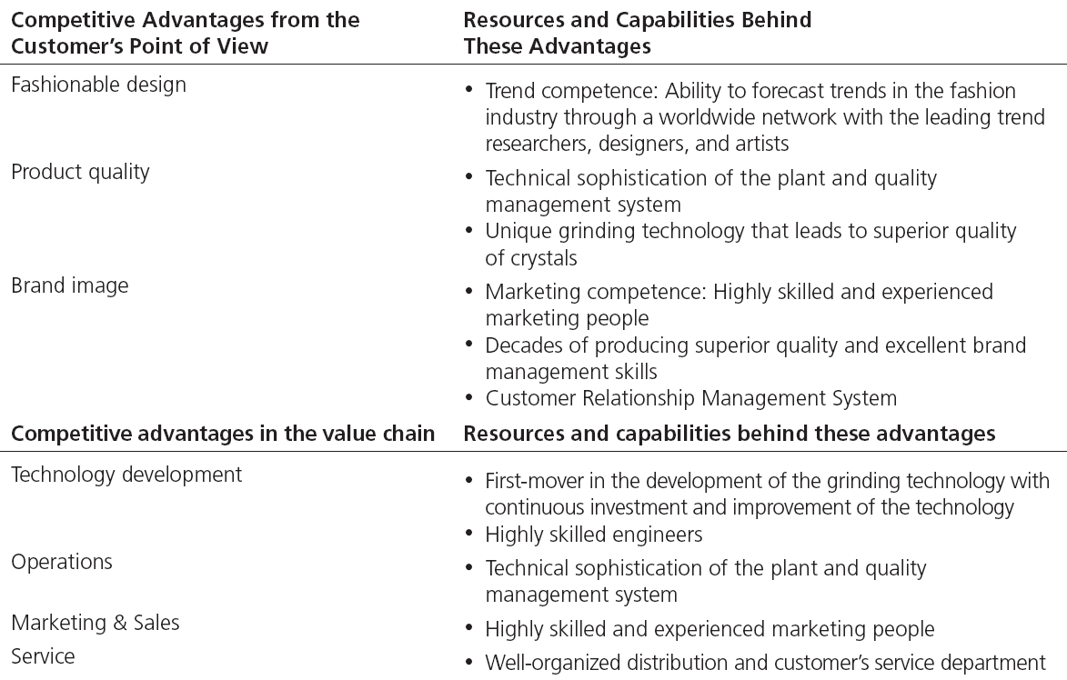
Table Note 24-3 - Competitive Advantages and Underlying Resources

Slide 11
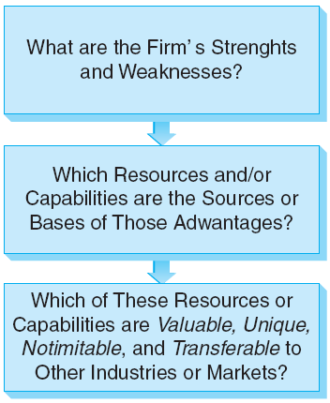
Figure Note 24-5 - Identifying Sustainable Competitive Advantages

Slide 12
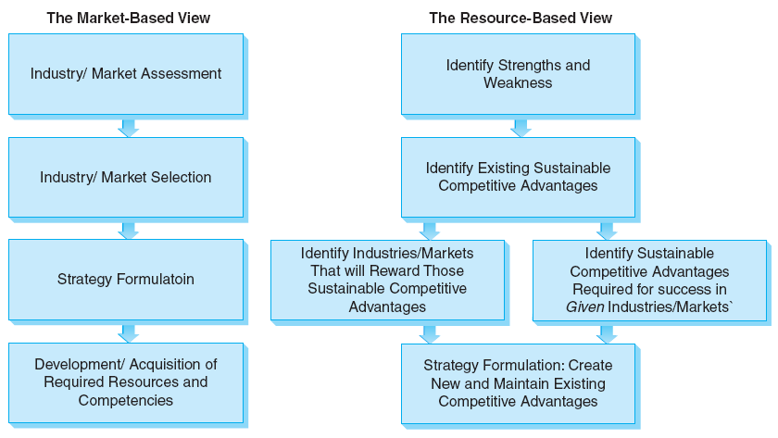
Figure Note 24-6 - Distinct Strategy-Formation Processes Underlying the Market-Based and Resource-Based Views

Slide 13
All rights reserved. No part of this publication may be reproduced, stored in a retrieval system, or transmitted, in any form or by any means, electronic, mechanical, photocopying, recording, or otherwise, without the prior written permission of the publisher. Printed in the United States of America.
Copyright © 2012 Pearson Education, Inc.
Publishing as Prentice Hall

