Slide 1
Note 29 Brands and Branding

Slide 2
Introduction
Brand - a name, term, design, symbol, or any other feature that identifies one seller’s good or service as distinct from those of other sellers
The legal term for brand is trademark
As concepts in customers’ minds and hearts, brands have rich symbolism and meanings that go beyond their identifying function

Slide 3
Introduction
Strategic roles of a brand
To identify the product and its producer to consumers
To differentiate the offering in a valued way
To command margin

Slide 4
Brand Marks and the Functions of Brands
A brand’s identifying characteristics include:
The brand name (or “trade name”)
Logos and marks (“trademarks”)
Distinguishing features such as packaging, colors, and sounds

Slide 5
Table Note 29-1 - The Benefits of Brands

Slide 6
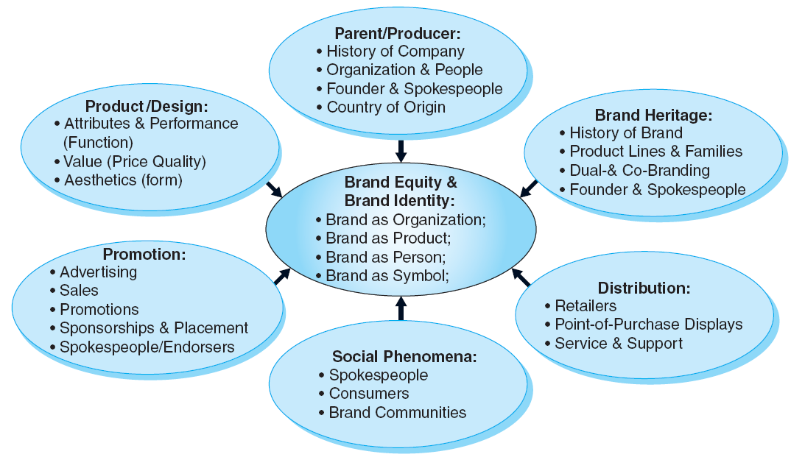
Figure Note 29-2 - Building Brand Identity and Brand Equity
Notes:
The figure organizes the many controllable factors that can influence brand identity/ meaning, brand equity, and brand strength.

Slide 7
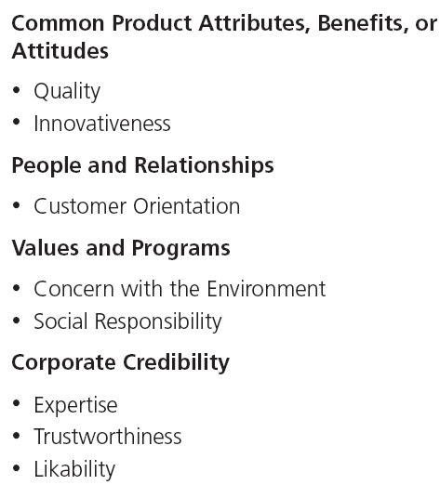
Table Note 29-2 - Dimensions of Corporate Image
Notes:
The table presents various aspects of corporate image that can influence product brand images.

Slide 8
Measuring Brands
Measuring brands can be approached in at least two basic ways:
Consumer-level brand meaning, brand equity, and brand strength
Firm- or brand-level value

Slide 9
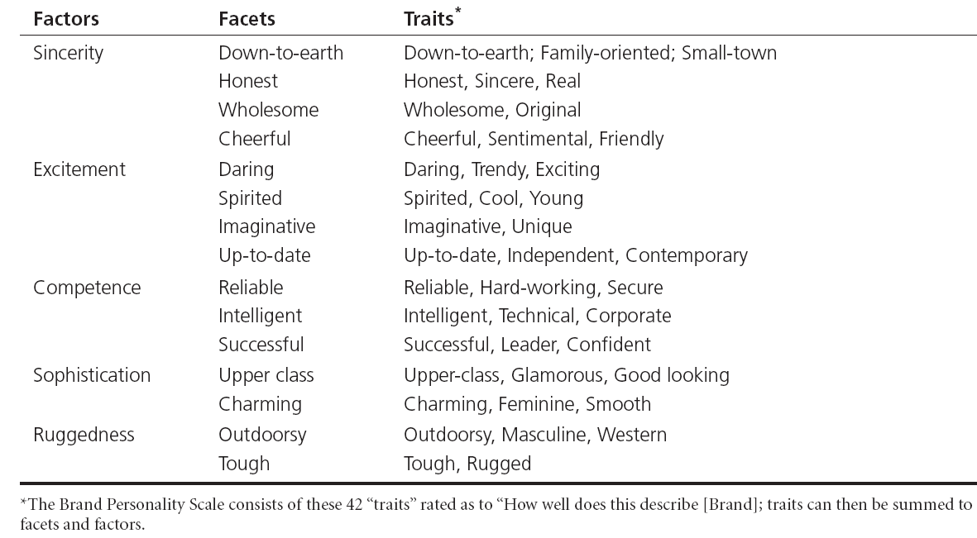
Table Note 29-3 - Brand Personality

Slide 10
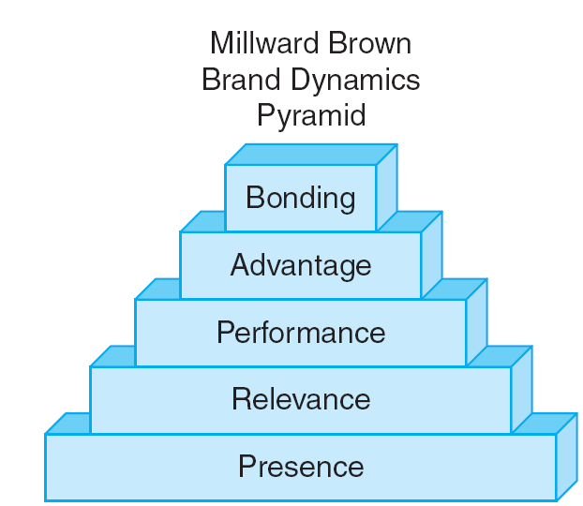
Figure Note 29-3 - Millward Brown’s BrandDynamics® Model

Slide 11
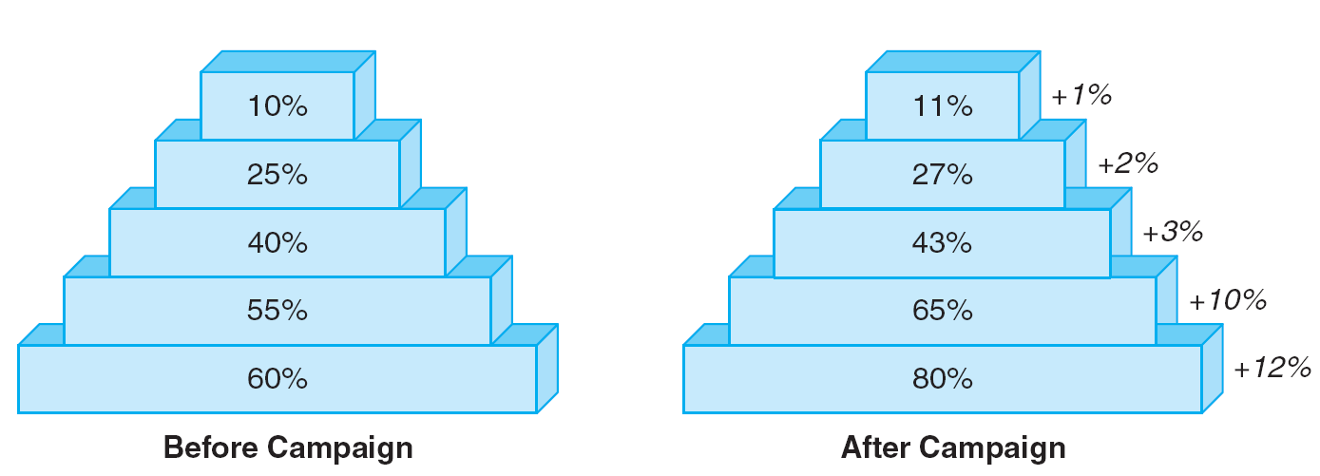
Figure Note 29-4 - Hypothetical Effect of a Communications Investment on Brand Dynamics

Slide 12
Brand Valuation
It is a brands:
Worth taken as a whole
Contribution to the firm’s financial value
The brand is valuable to the firm because:
It can be expected to generate sales and command margin in the future
Sales and margins are the product of cumulative individual-level feelings about the brand

Slide 13
All rights reserved. No part of this publication may be reproduced, stored in a retrieval system, or transmitted, in any form or by any means, electronic, mechanical, photocopying, recording, or otherwise, without the prior written permission of the publisher. Printed in the United States of America.
Copyright © 2012 Pearson Education, Inc.
Publishing as Prentice Hall

