Slide 1
Unit 2:
Protein Synthesis

Slide 2
Protein synthesis
is simply the "making of proteins."
In order to make even one protein
  the body must seek the aid of messenger RNA, transfer RNA, DNA, amino acids, ribosomes, and multiple enzymes.

Slide 3
What is a Protein?
A protein is simply a long chain of amino acids linked together by bonds.
The backbone of amino acids form strong covalent bonds and the actual amino acids form temporary weak bonds.
These weak bonds allow the amino acids
  to change shape,
  remain mobile, and
  attain flexibility.
The most important quality to understand about proteins is that the position of their amino acids determine their function.

Slide 4
Three BASIC steps of protein synthesis
Transcription
Transferal
Translation

Slide 5
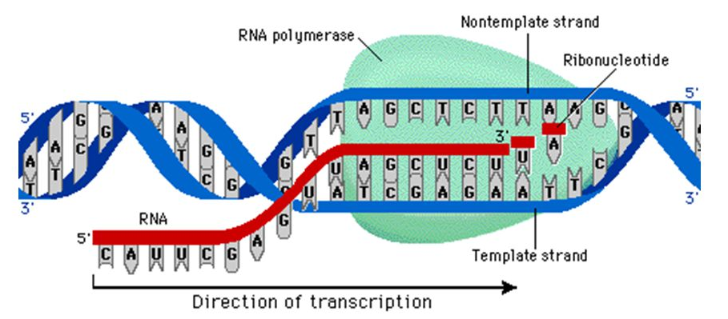
Transcription
In the nucleus, enzymes make a RNA copy using a portion of DNA.
The RNA is then transformed into a messenger RNA (mRNA).
The mRNA leaves the nucleus through the pores and gets into the cytoplasm. Here, the mRNA mixes with the ribosome, which begins the process of protein synthesis.
So basically in this stage, RNA is created, so it can go and make instruct the making of protein.

Slide 6
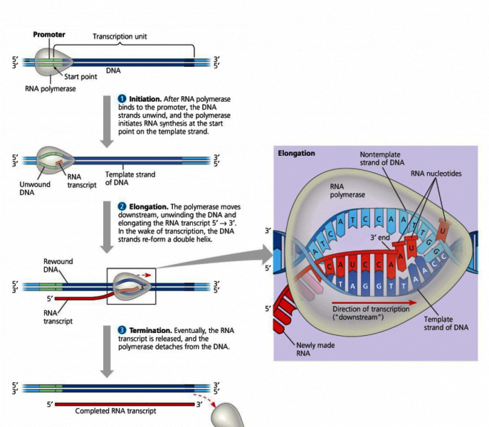
3 Stages in Transcription

Slide 7
Synopsis
Initiation Elongation Termination
During the initiation phase, a ribosome attaches to the mRNA and reads the codon (AUG)
During the elongation phase, tRNA bring the corresponding amino acids to each codon, as the ribosome moves down the mRNA strand.
During the last phase, termination, the molecule is read, and the synthesis ends and releases the protein.

Slide 8
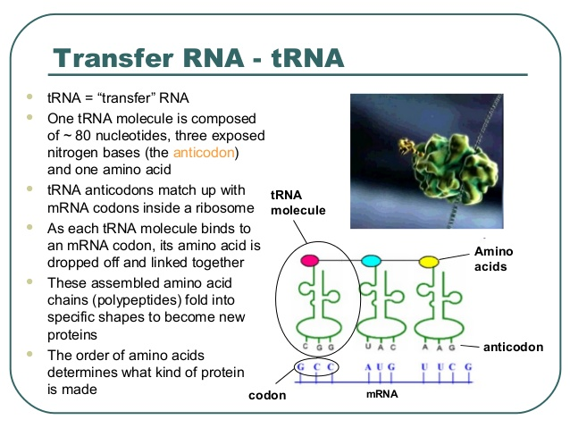
Transferal
In this stage, an amino acid activating enzyme attaches an amino acid to one end of transfer RNA (tRNA), also called an adaptor molecule.
On the other end of the adaptor is a codon (a specific three-nucleotide code) which will be used when the adaptor reaches the mRNA.
Once the codon is retrieved, the mRNA continues to the ribosome.
So basically, in this stage, an adaptor is connected to an amino acid so it can be energized and have enough strength to continue its journey.

Slide 9
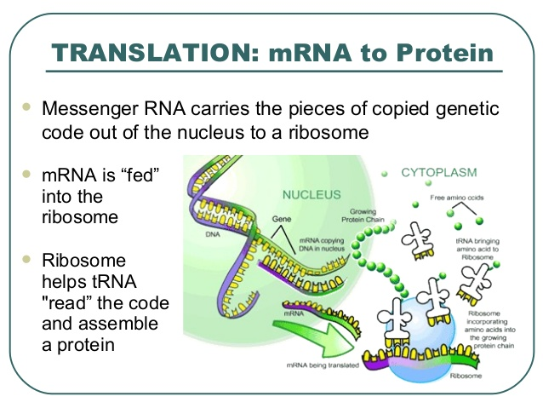
Translation:
mRNA to Protein
At this point, one amino acid is attached to an adaptor.
Messenger RNA carries the pieces of copied genetic code out of the nucleus to a ribosome.
mRNA is “fed” into the ribosome
Ribosome helps tRNA “read” the code and assemble a protein.

Slide 10
What happens during the process of translation?
Messenger RNA is made from DNA.
The cell uses information from messenger RNA to produce proteins.
Transfer RNA is made from messenger RNA
Copies of DNA molecules are made.

Slide 11
The role of Cell Organelles in Protein Synthesis

Slide 12
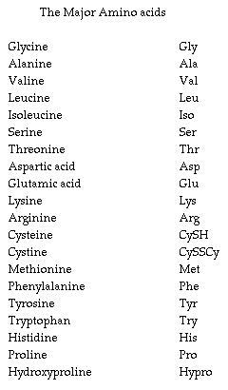
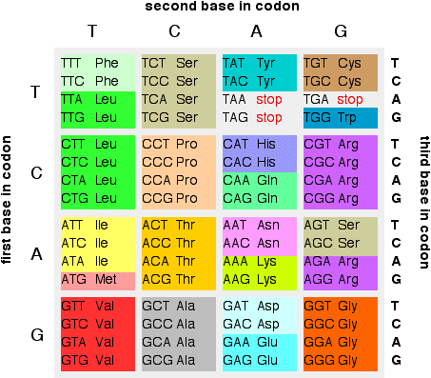
Genetic Code

Slide 13
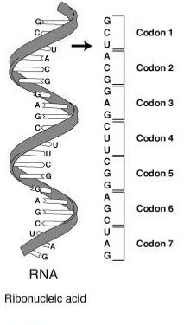
Genetic code
(the language of mRNA)
is the set of rules by which information encoded in genetic material is translated into proteins by living cells.
the information in DNA is in the form of triplet codons.
it is first transcribed into RNA and then into proteins.
Every triplet codon in the DNA specifies one amino acid in the protein.

Slide 14
End!

