Slide 1
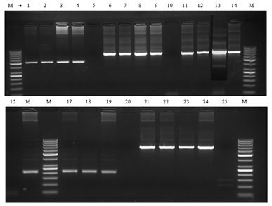
PCR troubleshooting

Slide 2
Aim
To do PCR troubleshooting

Slide 3
PCR steps
Identify the location of your target
Primer Design using website
PCR optimization
Start your reaction!
Analyze the results using agarose gel electrophoresis.
PCR troubleshooting
Send the sequence to a company to synthesize it

Slide 4
PCR troubleshooting
Even with the simplest PCR reaction things can go wrong, so you need to have a good checklist of ideas for PCR troubleshooting and rectifying the problem.
PCR troubleshooting is a collection of techniques that alter PCR reactions in order to achieve optimum PCR results.

Slide 5
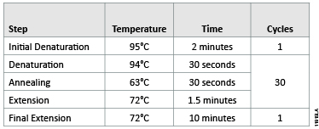
PCR Cycles
Range

Slide 6
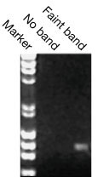
No Band or Faint Band
Too few number of cycles were used
Denaturation temperature was too low
Primers concentration was too low
Denaturation temperature was too low
Not enough template was in the reaction
Primers were designed or synthesized incorrectly
Not enough Mg2+

Slide 7
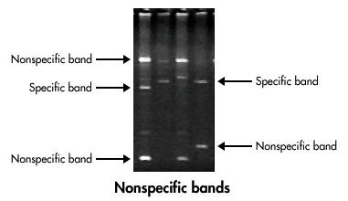
Nonspecific Bands or Primer-Dimers
Too many cycles were used
Calculated primer T_{m}was inaccurate
Too much primer was added
Impure water was used
Impure water was used
Annealing temperature was too low
Primers were designed or synthesized incorrectly by user or manufacturer
To identify Primer dimers, it always has a very low molecular wheght (less than 100 bp usually)
Non specific amplification:
To have the correct target is amplified, in addition to other target (in the same well)
Primer dimer:
primer molecules that have attached (hybridized) to each other because of strings of complementary bases in the primers.

Slide 8
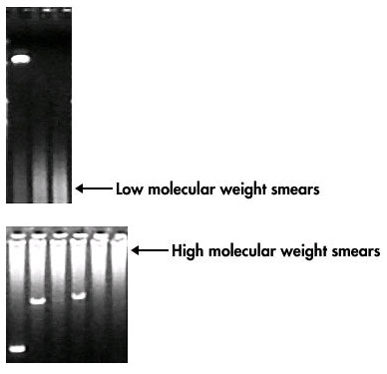
Smeared Bands
Too much template was added
Water was impure
Too much primer was added
Impure water was used

Slide 9
INCORRECT PRODUCT SIZE
To have a single band, however it is not the same size of your target.
Mispriming
Improper Mg⁺⁺concentration
Incorrect annealing temperature
Impure water was used
Primers were designed or synthesized incorrectly by user or manufacturer

Slide 10
What you should do today?
Today you will analyze the annealing temperature that you did in the last lab.
1
You should choose the best one.
2
Answer the question that will be given to you
3

Slide 11
Homework

