Slide 1
pedigree

Slide 2
overview
What is a pedigree?
Definition
Uses
Constructing a pedigree
Symbols
Connecting the symbols
Interpreting a pedigree

Slide 3
What is a pedigree?
A pedigree is a chart of the genetic history of family over several generations
Genetic counselor would find out about your family history and make this chart to analyze.

Slide 4
Constructing a pedigree
Female
Male

Slide 5
Connecting pedigree symbols
Examples of connected symbols
Fraternal Twins
Identical Twins

Slide 6
Connecting pedigree symbols
Examples of connected symbols
Married Couple
Siblings

Slide 7
What does a pedigree chart look like?
A B

Slide 8
Pedigree Symbols
Marriage / Partnership
(horizontal line)
Male
Female
/
Partnership that has ended
Person whose sex is unknown
P
Offspring (vertical line)
Pregnancy
Miscarriage
X weeks
Affected Male & Female
Parents and Siblings
Carrier Male & Female
© 2012 NHS National Genetics Education and Development Centre
Genetics and genomics for healthcare
www.geneticseducation.nhs.uk
Notes:
When drawing the family tree we use these universal symbols and relationship lines

Slide 9
Interpreting a pedigree chart
Determine if the pedigree chart shows an autosomal or X-linked disease.
If most of the males in the pedigree are affected the disorder is X-linked
If it is a 50/50 ratio between men and women the disorder is autosomal

Slide 10
Example of pedigree charts
Is it autosomal or X-linked

Slide 11
answer
Autosomal

Slide 12
Interpreting a pedigree chart
2. Determine whether the disorder is dominant or recessive.
If the disorder is dominant, one of the parents must have the disorder.
If the disorder is recessive, neither parent has to have the disorder because they can be heterozygous.

Slide 13
Example of pedigree chart
Dominant or Recessive?

Slide 14
answer
Dominant

Slide 15
Example of pedigree
Is it dominant or recessive?

Slide 16
Answer
Recessive

Slide 17
summary
Pedigrees are family trees that explain your genetic history
Pedigree are used to find out the probability of a child having disorder in a particular family
To begin to interpret a pedigree, determine if the disease or condition is autosomal or X-linked and dominant or recessive.

Slide 18
activity
Trace the pedigree of each family and determine what type of inheritance.
Family A: the father has heart disease while the mother has no illness problem at all.
Family B: both father and mother is a carrier of genetic disease.

Slide 19
Collecting family history information
This presentation can be used as part of Lesson Plan 3 Taking and Drawing a Family History. It can also be used with the Family History booklet available on the website. If individual slides are taken for use in other presentations please ensure appropriate copyright is taken into account
© 2012 NHS National Genetics Education and Development Centre
Genetics and genomics for healthcare
www.geneticseducation.nhs.uk

Slide 20
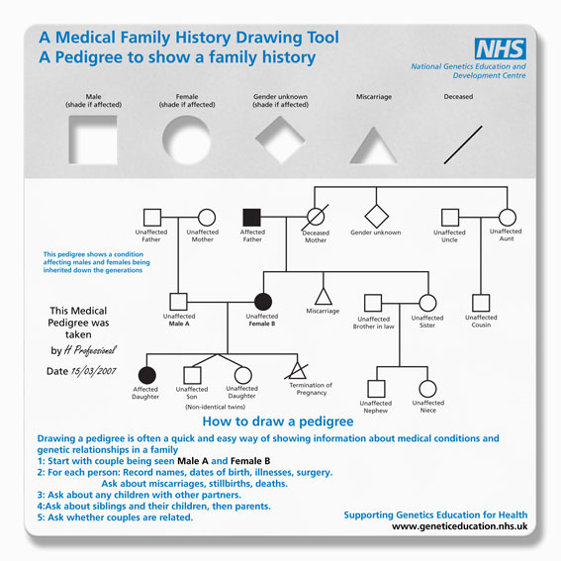
© 2012 NHS National Genetics Education and Development Centre
Genetics and genomics for healthcare
www.geneticseducation.nhs.uk
Notes:
These are the resources you can download or we can send the plastic template for your teaching if you contact us: enquiries@geneticseducation.nhs.uk

Slide 21
Why collect family history information?
Patient concern
Clinical feature
Routine assessment
Result of screening test
Opportunistic
© 2012 NHS National Genetics Education and Development Centre
Genetics and genomics for healthcare
www.geneticseducation.nhs.uk
Notes:
It is important to understand why we are taking the family history and what we are looking for as we ask the appropriate questions.
The patient could have raised the concern themselves. It might be that a paediatrician or a clinical specialist has noticed some physical or laboratory features which raise concerns. Or it could be part of an assessment or screening gives cause for concern. Sometimes it is just an opportunistic conversation that makes the professional feel that asking the medical family history could be relevant

Slide 22
What information should you collect?
Information depends on the context and reason for collecting it:
Establish biological relationships
Clarify the medical conditions that people have
3 generations
For each person:
Full name
Date of birth (or age)
Date of death (or age died)
Medical information (age at diagnosis)
© 2012 NHS National Genetics Education and Development Centre
Genetics and genomics for healthcare
www.geneticseducation.nhs.uk
Notes:
The information needed will be based on the reasons why you are collecting the history.
It is important to clarify biological relationships, often families have a range of relationship, with parents re-marrying and step siblings. Also sometimes people will call others Uncle or Aunt when that is not a true blood relationship.
It is also important to have full information about the medical condition, it may be possible to follow this up at a later date with patient notes, but try to avoid general terms such as gynaecological cancer, or cancer of the gut.
Usually we take a 3 generational family history but this may need to be expanded if appropriate. This is often determined by the relevant information the individual has about their family or if the health professional can see a pattern forming that would benefit from further information
It is important to document in as much detail as possible these four bits of information

Slide 23
How should the information be recorded?
Longhand notes
Family history form
Family tree
© 2012 NHS National Genetics Education and Development Centre
Genetics and genomics for healthcare
www.geneticseducation.nhs.uk
Notes:
Family history information can be document in any of these three ways, the use of a pedigree gives an easy pictorial view of any patterns developing

Slide 24
Drawing a family tree
Marriage / Partnership
(horizontal line)
Male
Female
/
Partnership that has ended
Person whose sex is unknown
P
Offspring (vertical line)
Pregnancy
Miscarriage
X weeks
Affected Male & Female
Parents and Siblings
Carrier Male & Female
© 2012 NHS National Genetics Education and Development Centre
Genetics and genomics for healthcare
www.geneticseducation.nhs.uk
Notes:
When drawing the family tree we use these universal symbols and relationship lines

Slide 25
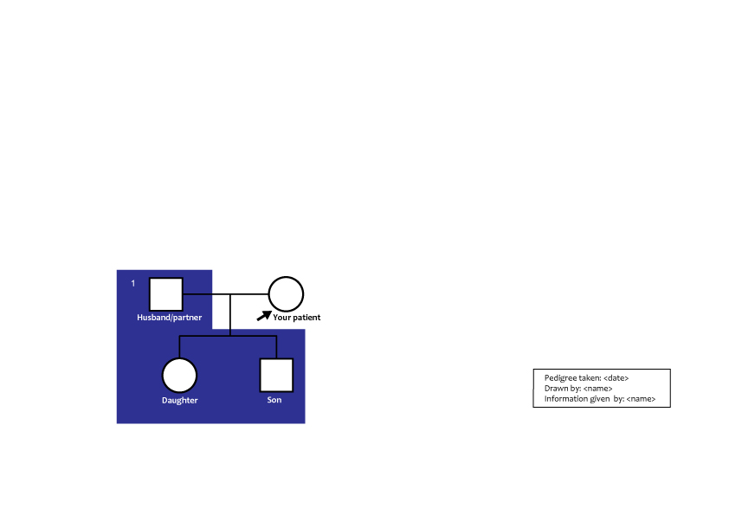
Steps in taking and recording a genetic family tree
Notes:
Ask about your informant and his or her partner(s) and their children (Branch 1):
“How many children have you had? Have you lost any children?”
“Are all your children with the same partner or were any with previous partners?”
Be sensitive when trying to determine if partners are related by blood (a consanguineous relationship). Questions may include:
“Are you and your partner related (except by marriage)?”
“Are there any surnames or maiden names in common in the family?”
“Did any couples have the same surname before they were married to each other?”

Slide 26
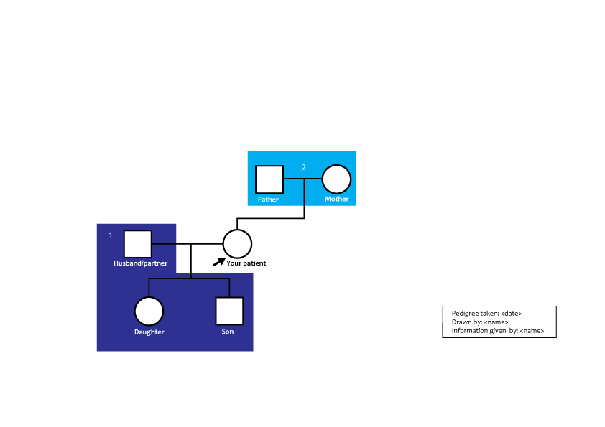
Notes:
Record details about the parents of your informant (Branch 2).

Slide 27
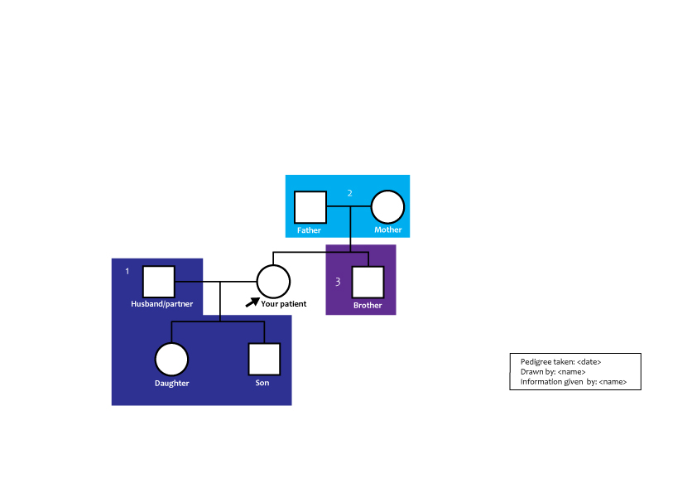
Notes:
Next ask about each full brother and sister of the informant (Branch 3), his or her spouse(s) and their children (Branch 4). Remember to ask if any have died, or were lost during pregnancy.

Slide 28
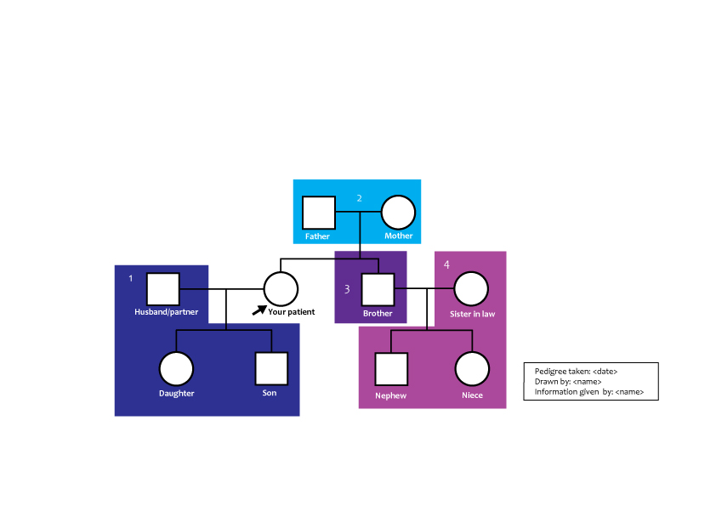
Notes:
and their children (Branch 4). Remember to ask if any have died, or were lost during pregnancy.
Ask whether either parent of your patient had children with other partners (the half-brothers and sisters of your patient), and draw in these relationships.

Slide 29
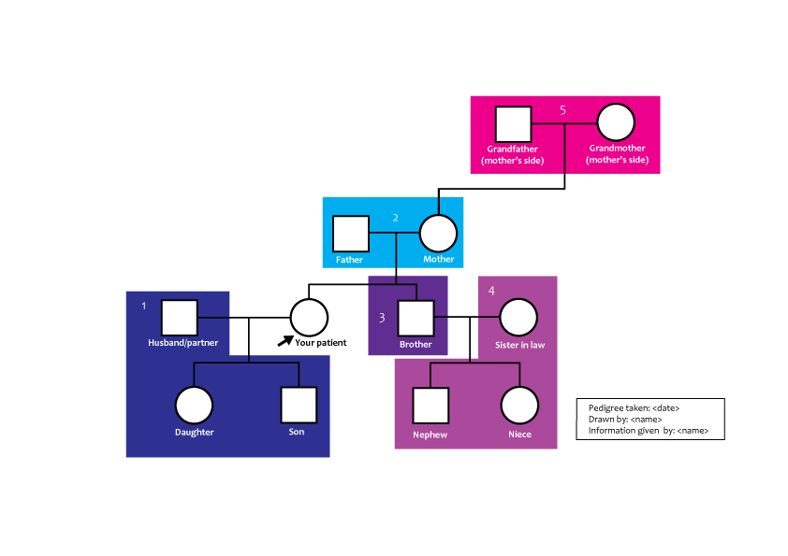
Notes:
Choose one of the parents (usually the mother) and record information on your patient’s maternal grandparents (Branch 5) …..

Slide 30
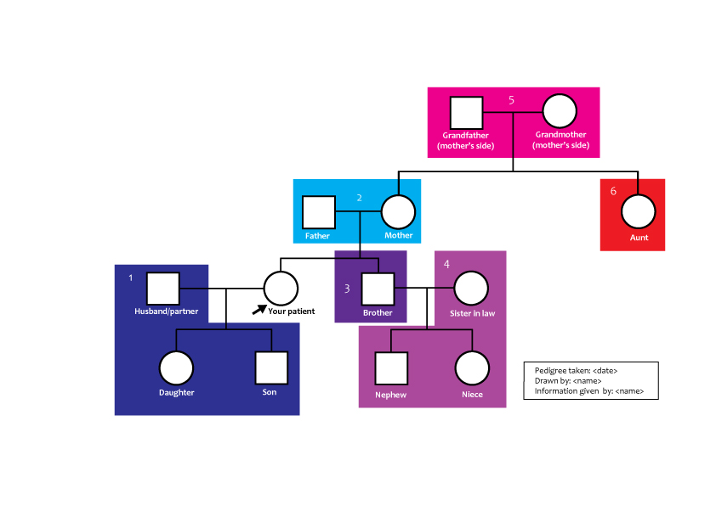
Notes:
and your parent’s full brother and sisters (Branch 6) …..

Slide 31
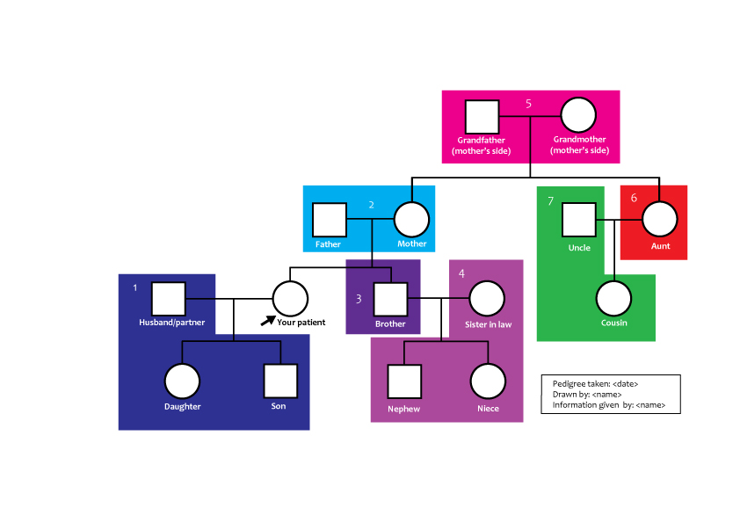
Notes:
and their spouses and children (Branch 7).

Slide 32
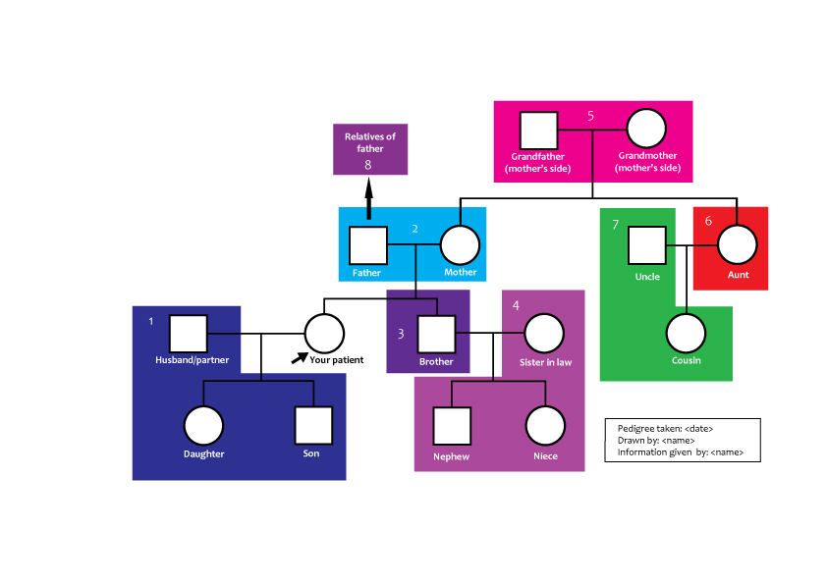
Notes:
Then ask the same questions about relatives of the other parent, usually the father (Branch 8).

Slide 33
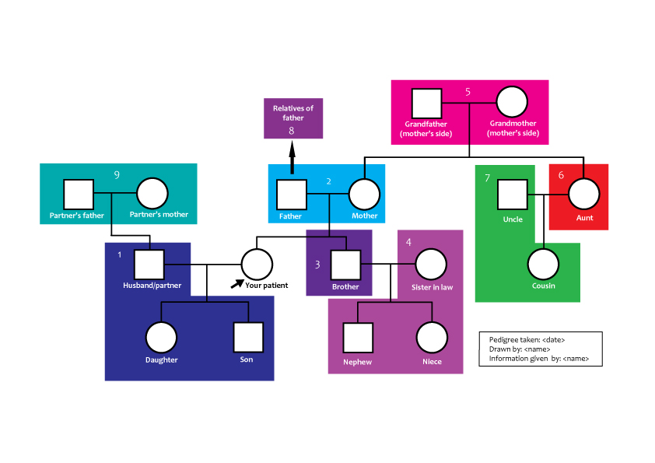
Notes:
Now return to your informant’s partner and collect information about his/her relatives - parents first (Branch 9)…….

Slide 34
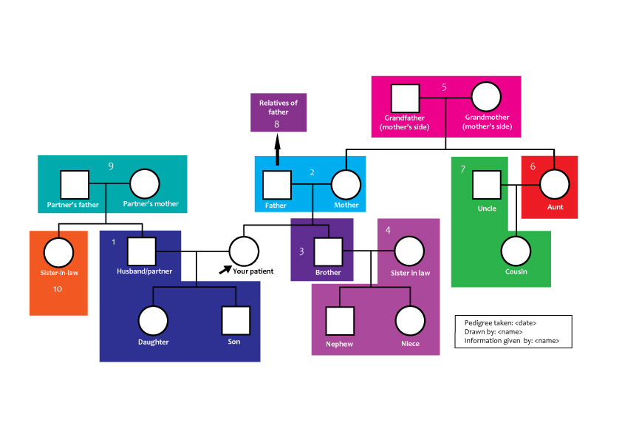
Notes:
and then full brothers and sisters (Branch 10)

Slide 35
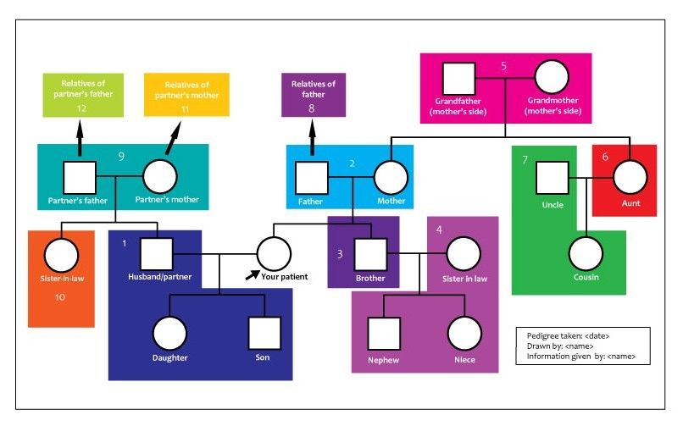
© 2012 NHS National Genetics Education and Development Centre
Genetics and genomics for healthcare
www.geneticseducation.nhs.uk
Notes:
If you need information about the relatives of parents of the partner, choose one - usually the mother first (Branch 11) and ask about her parents and her brothers and sisters.
Finally, ask about the relatives of the father of the partner (Branch 12).
At the end;
Thank the informant, and ask “Is there anything else you think I should know that I haven’t asked about?”
Date and write your name legibly on the pedigree. Add an explanation of any abbreviations.
Ask for consent to share family history information with colleagues and/or other family members and note this.

Slide 36
Acting on the information collected
Reassure
Knowledge of the condition
Local/national referral guidelines
Refer
To the GP or clinical genetics service
Seek further advice
Trusted sources of information
Clinical Genetics Department On-Call Service
© 2012 NHS National Genetics Education and Development Centre
Genetics and genomics for healthcare
www.geneticseducation.nhs.uk
Notes:
Ensure that you act on the information either within your sphere of expertise accessing appropriate trusted resources, or contact you regional genetics services for guidelines or advice.

Slide 37
Multiple closely related people with the same condition
Disorders which occur at a younger age than usual (e.g. colon cancer, breast cancer, dementia)
Sudden cardiac deaths in people who seemed healthy
Three or more pregnancy losses
Medical problems in children of parents related by blood
Congenital anomalies, dysmorphic features and developmental delay
Clues specific to the condition of concern
© 2012 NHS National Genetics Education and Development Centre
Genetics and genomics for healthcare
www.geneticseducation.nhs.uk
Notes:
These are some of the red flags that would alert you to consider a condition might have an inherited basis but you may want to look for further information….

Slide 38
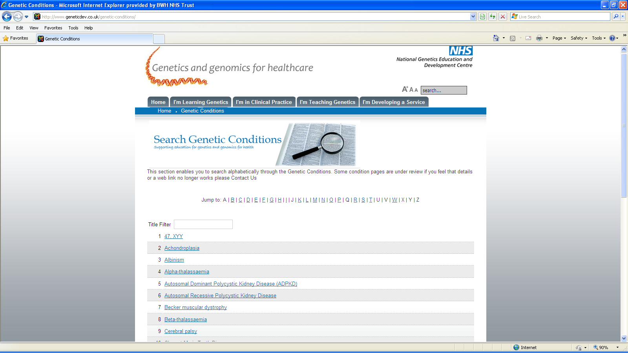
www.geneticseducation.nhs.uk
© 2012 NHS National Genetics Education and Development Centre
Genetics and genomics for healthcare
www.geneticseducation.nhs.uk
Notes:
The NHS National Genetics Education website has a section to enable the searching for conditions also ……next slide

Slide 39
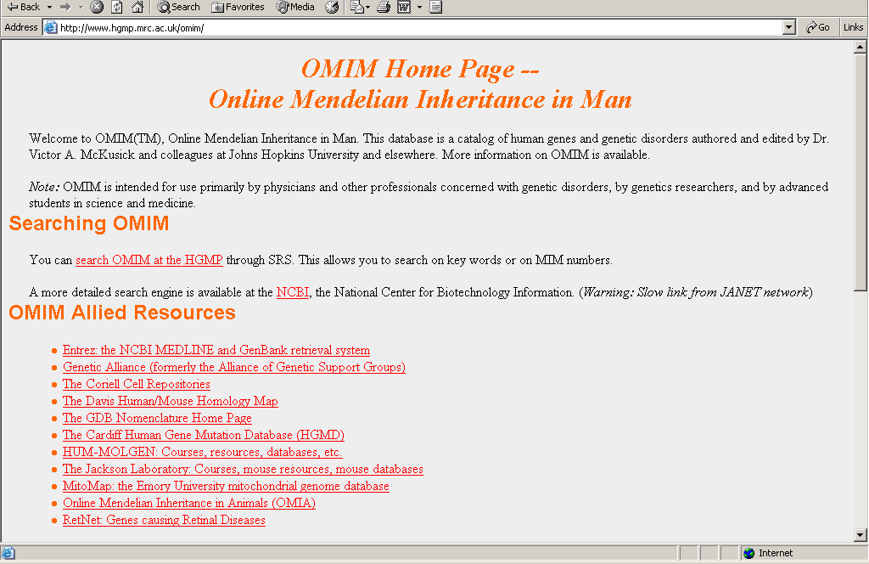
Notes:
From the last slide ….. the OMIM website

Slide 40
Clinical Genetics Services
© 2012 NHS National Genetics Education and Development Centre
Genetics and genomics for healthcare
www.geneticseducation.nhs.uk
Notes:
These postcards are available from the website with the contact details of all the Regional Genetics Centres

Slide 41
www.geneticseducation.nhs.uk
© 2012 NHS National Genetics Education and Development Centre
Genetics and genomics for healthcare
www.geneticseducation.nhs.uk

Slide 42
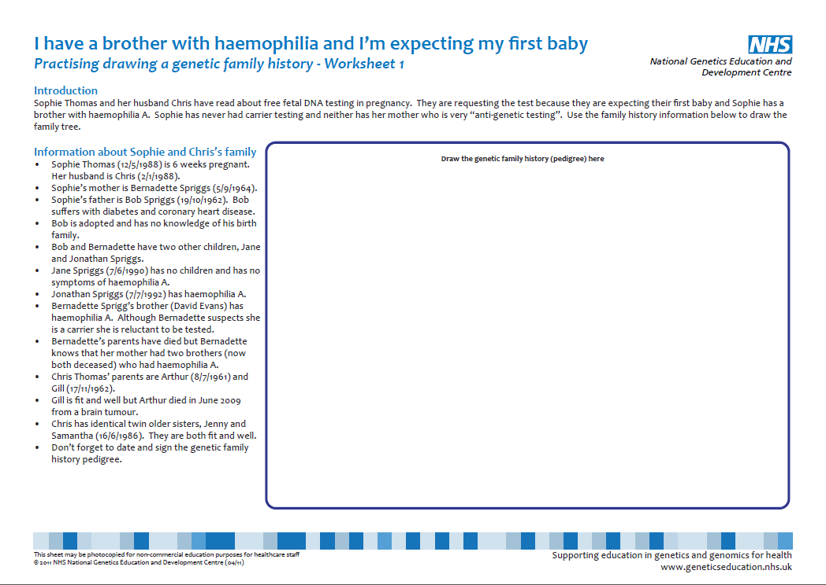
Practising sheets and videos
Notes:
TEACHING Notes: These videos and worksheets are available from the website for students to observe or practice how to take a Family History

