Slide 1
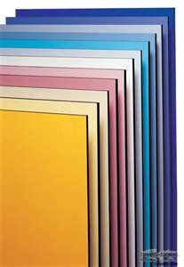
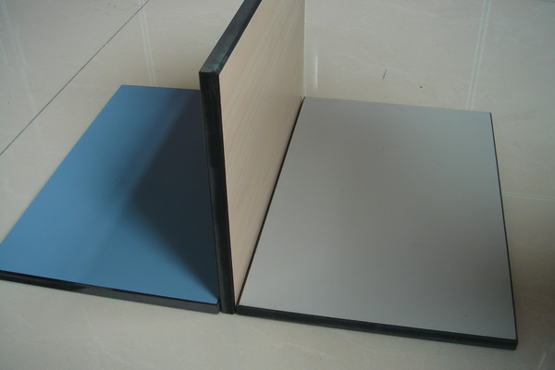
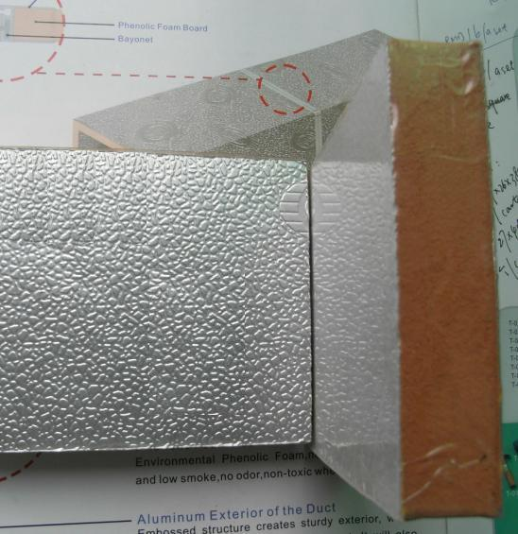
phenolic board manufacturers
refrigerating and air-conditioning industries

Slide 2
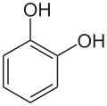
phenols
phenol
catechol
resorcinol
aromatic

Slide 3
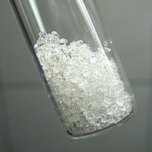
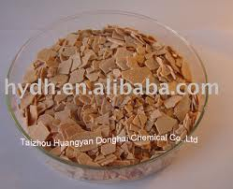
Physical state
catechol | resorcinol | phenol
Solid |  |  | state
Gray fine powder | Puffy flaky | White crystal | color
Phenolic odor |  |  | odor

Slide 4
Ignition test
catechol | resorcinol | phenol
√ | √ | √ | inflammability
√ | √ | √ | luminous
√ | √ | √ | smoky
melting |  |  | Apperance change
No change |  |  | Color change
No change |  |  | Odor change
No residue |  |  | residue

Slide 5
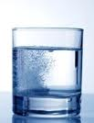
solubility
All soluble in water and they can convert the blue litmus paper to red that means All acids→ acidic by Na2CO3
* all neutral

Slide 6
Preliminary test
catechol | resorcinol |  | phenol
No reaction |  |  | Phenolic odor | On cold | Soda lime
Phenolic odor |  |  | Not done | On hot
No rection |  |  |  | On cold | 30%NaOH
 |  |  |  | On hot
Green color and rapidly dark |  | Blue or violet color |  | On cold | Fecl3
Not done |  |  |  | On hot
No recion |  |  |  | On cold | Conc. H2so4
 |  |  |  | On hot

Slide 7
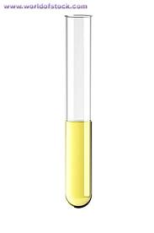
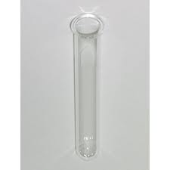
General test
Azo dye formation test:
1 drop aniline +dil Hcl +NaNO2 →Pale yellow color( unstable diazonum salt* )
PHENOLS +10% NaOH
Add 2 on 1 gradually phenol and resorcinol will give red orang dye but catechol give dark purple color
Notes:
Put the test tube 1 on cold or iced water

Slide 8
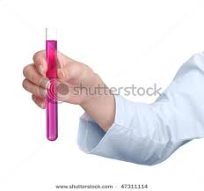
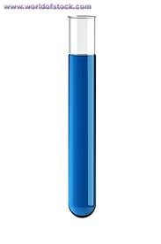
Specific test
Phenols + phthaline anhydride + Conc. H2SO4 heat until fussion then pour to beaker containning 10%NaOH to give
-pink coclr with phenol due to phenol phthaline indicator.
-green fluorescence with resorcinol.*
-blue color with catechol due to alizarin indicator formation
Notes:
Dilute with water to see fluorescence

