Slide 1
Php&SQL evaluation

Slide 2
Evaluation 1

Slide 3
Database
1. create tables of below database with the relation
Database Name: Restaurants
Restaurant (ID, name, license , owner)
Branch (ID, name, location, manager, phoneNo, restaurantID)
2. insert values
3. select all branches of “pizza hut”
4. delete “domino’s” restaurant
ID | name | license | owner
1 | domino’s | 12-435 | James Monaghan
2 | pizza hut | 326-556 | Dan Carney
ID | name | location | manager | phoneNo | restaurantID
1 | King Fahad Rd | Al Murabba | Omar | 9200 00910 | 2
2 | Al Imam Ash Shafii | Al Manar | Ahmed | 9200 00910 | 2
3 | Umar Ibn Abdul Aziz | Ar Rabwah | Adam | 9200 12345 | 1

Slide 4
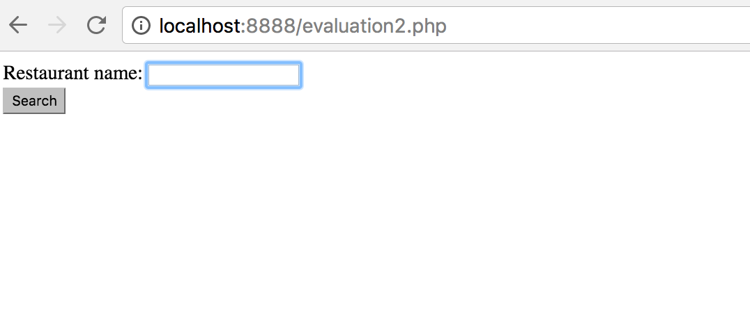
PHP

Slide 5
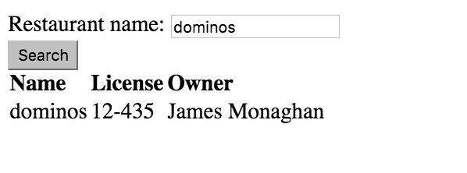
Result

Slide 6
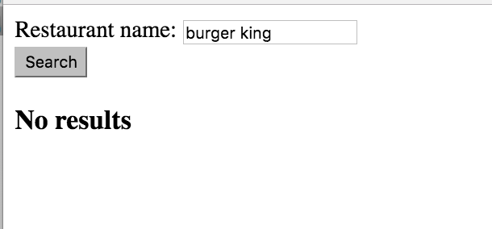
Result

Slide 7
HW 3

Slide 8
Database
1. create tables of below database with the relation
Database Name: Company
Branch (ID, name, work_hours, phone)
Employee (ID, name, sex, salary, BranchID)
2. insert values
3. select all employees of “Second branch”
4. Add 500 to Asma’s salary
ID | name | sex | salary | BranchID
1 | Ahmed | Male | 1200 | 2
2 | Asma | Female | 3000 | 2
3 | Ali | Male | 2300 | 1
ID | name | Work_hours | phone
1 | First branch | 8am-8pm | (123) 444-5544
2 | Second branch | 6am-6pm | (567) 888-9870

Slide 9
PHP
Write a PHP script that displays all branches in your DB as hyperlinks. Once a user clicks on a branch, all its details (including employees who work in the selected branch) should be displayed in another web page.

Slide 10
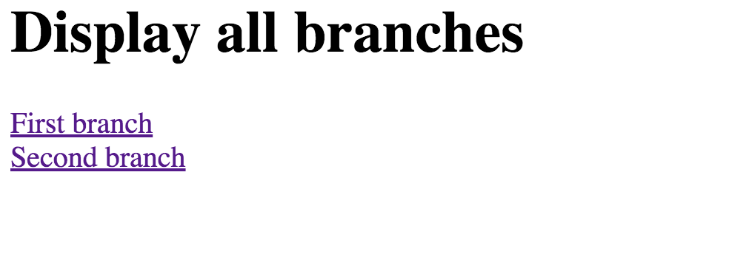
Display all branches page

Slide 11
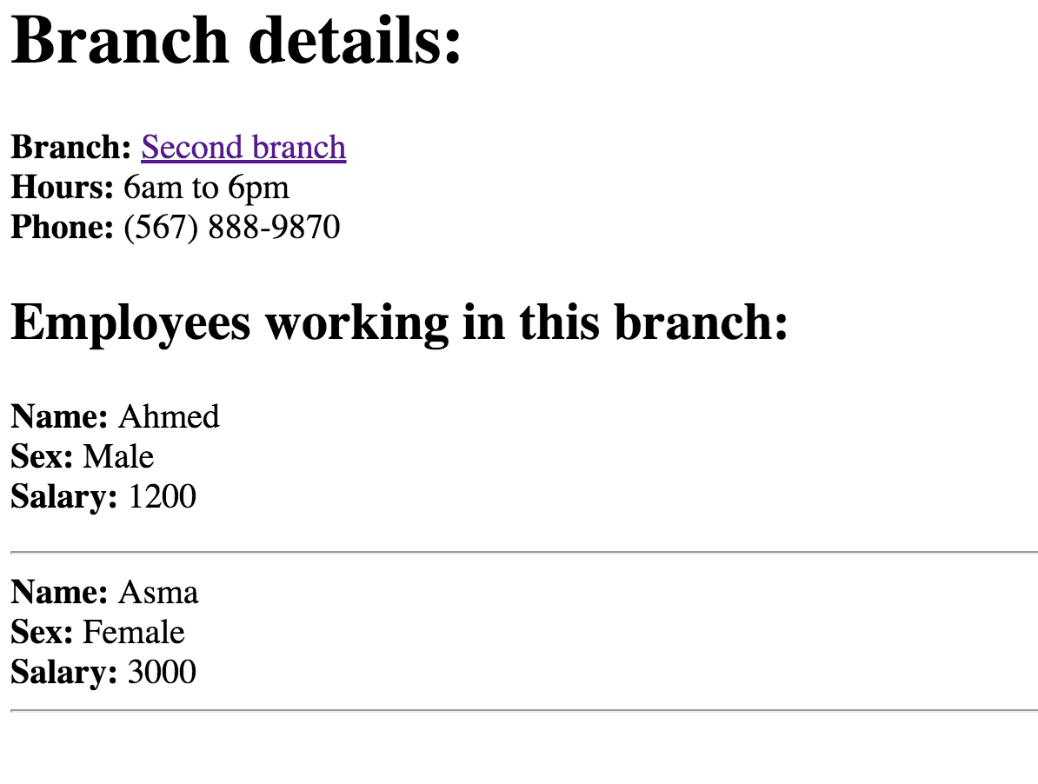
View branch details page

