Slide 1
Pharmaceutical Quality Control & current Good Manufacturing Practice
PHT 436
Lecture 12

Slide 2
Drug Stability and Expiry date

Slide 3
Drug stability
Stability is officially defined as the time lapse during which the drug product retains the same properties and characteristics that it possessed at the time of manufacture.
The stability of a product is expressed as the expiry period or technically as shelf-life.

Slide 4
Expiration date
The date placed on the container label of a drug product designating the time prior to which a batch of the product is expected to remain within the approved shelf life specification if stored under defined conditions, and after which it must not be used.
Shelf life (expiration dating period)
The time period during which a drug product is expected to remain within the approved shelf-life specification, provided that it is stored under the conditions defined on the container label.

Slide 5
Objectives of Stability Study
To provide an evidence on how the quality of a drug substance or drug product varies with time under the influence of a variety of environmental factors such as temperature, humidity, and light.
To establish a:
  re-test period for the drug substance,
  or a shelf life for the drug product,
  and recommended storage conditions

Slide 6
Factors affecting drug stability
Storage time.
Storage conditions.
Type of dosage form.
Container and closure system.

Slide 7
Chemical stability implies:
The lack of any decomposition in the chemical moiety that is incorporated in the formulation as the drug, preservatives or any other excipients.
Microbiological stability implies that:
The formulation has not suffered from any microbiological attack and is meeting the standards with respect to lack of contamination/sterility.

Slide 8
Physical changes
• Appearance.
• Melting point.
• Clarity and color of solution.
• Crystal modification (Polymorphism).
• Particle size.
Chemical changes
• Increase in degradation products.
• Decrease of assay.
Microbial changes
• Growth of microorganism.

Slide 9
Packaging And Stability :
The immediate container and closure are particularly important in affecting product stability. They play an important role in the product shelf-life.
They may:
  accelerate degradation reactions,
  be an additive to or an absorbent of the drug substance,
  or be ineffective in protecting the contents from environmental conditions.

Slide 10
Glass
- Glass is resistant to chemical and physical change and is the most commonly used materials
Limitations | overcomes
1. Its alkaline surface may raise the pH of the product and induce chemical reaction. 2- Ionic radicals in the drug may precipitate insoluble crystals from the glass such as barium sulfate. 3- Permits the transmission of light which may accelerate physical and chemical reactions in the drug. | use of Borosilicate glass which contains fewer reactive alkali ions than the other 3 types of USP-recognized glass Treatment the glass with heat as well as the use of buffers. Amber colored glass reducing light-induced reactions.

Slide 11
Metals
Various alloys and aluminum tubes may be utilized as containers for emulsions, ointments, creams and pastes.
Limitation: They may cause corrosion and precipitation in the drug product especially with products at extreme pH values or those containing metallic ions.
Overcome: Coating the tubes with polymers may reduce these tendencies.

Slide 12
Rubber
Limitation: Rubber also has the problems of extraction of drug ingredients and leaching of container ingredients.
Overcome:
  The use of neoprene, butyl or natural rubber, in combination with certain epoxy, Teflon, or vanish coating, substantially reduces drug-container interaction.
  The pretreatment of rubber vial stoppers and closures with water and steam removes surface blooms and also reduces potential leaching that might affect chemical analysis, toxicity, or pyrogenicity of the drug formulation.

Slide 13
Stability studies at different stages
1. Stress- and accelerated Testing with drug substances.
2. Stability on pre-formulation batches.
3. Stress testing on scale-up Batches.
4. Accelerated and long term testing for registration.
5. On-going Stability testing.
6. Follow-up Stabilities.

Slide 14
Before commencement of a stability evaluation the stability protocol should be written and approved—usually by technical services and QA.
The key elements of a stability protocol include
  Product name and packaging details. The information should be sufficiently detailed to clearly identify the specific formulation(s) to be evaluated, the specific container/closure types (and sources), the batch size(s).
  The storage condition.
  Number of batches to be evaluated. Normally a minimum of three batches is required to provide a sufficient basis for shelf-life prediction.
    Development and stability batches may be used provided they are of the same formulations as the commercial product and they were processed in an equivalent manner.

Slide 15
4) Test methodology.
The stability testing monograph need not include all of the criteria defined in the product release monograph. Only those parameters that are potentially susceptible to change during storage and that may impact on quality, safety, or efficacy need to be evaluated.
5) Test frequency should be adequate to demonstrate any degradation and to provide enough data points for statistical evaluation.
For the scale-up batches and the first three commercial batches testing is expected initially, at 3-month intervals during the first year, 6-monthly in the second year, and yearly thereafter.
6) Name and/or titles of those responsible for assessing the data.
7) Where possible, and appropriate, the data should be evaluated statistically to obtain the shelf-life.

Slide 16
In general, “significant change” for a drug product is defined as:
A 5% change in assay from its initial value; or failure to meet the acceptance criteria for potency when using biological or immunological procedures;
Any degradation product’s exceeding its acceptance criterion;
Failure to meet the acceptance criteria for appearance, physical attributes, and functionality test (e.g., color, phase separation, resuspendibility, caking, hardness, dose delivery per actuation); however, some changes in physical attributes (e.g., softening of suppositories, melting of creams) may be expected under accelerated conditions; and, as appropriate for the dosage form.
Failure to meet the acceptance criterion for pH; or
Failure to meet the acceptance criteria for dissolution for 12 dosage units.

Slide 17
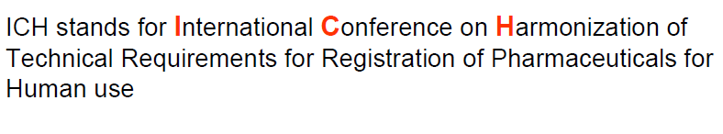

Slide 18
Stability storage conditions will normally involve:
  long-term studies at 25° ± 2°C with 60% RH ± 5% with at least 12 months of data before filing;
  accelerated studies at 40° ± 2°C and 75% RH ± 5% with at least 6 months of data.
Where ‘‘significant change’’ occurs during the 40°C accelerated study an additional intermediate station should be used, such as 30° ± 2°C/ 60% RH ± 5%.
‘‘Significant change’’ was defined as mentioned before in slide 16.

Slide 19
For less stable products the storage (and labeling) conditions may be reduced but the accelerated conditions should still be at least 15°C above those used for long-term evaluation.
• For products where water loss may be important, such as liquids or semisolids in plastic containers, it may be more appropriate to replace the high-RH conditions by lower RH such as 10–20%.

Slide 20
Storage Conditions

Slide 21
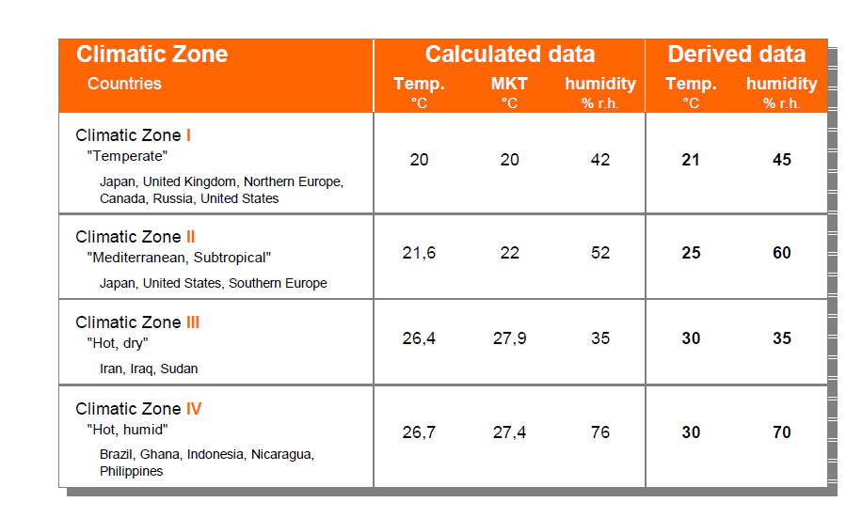
ICH used the climatic zone concept
The four zones in the world that are distinguished by their characteristic prevalent annual climatic conditions.

Slide 22
Stability studies can be classified into three types:
Accelerated conditions
to predict a tentative shelf-life for a new or modified product or process.
For a new drug substance these studies usually commence with a preformulation evaluation.
The effect of stress conditions such as temperature, humidity, light, acidity, and oxygen, can provide much useful information to the formulator.
The potential interactive effects of the bulk drug and the anticipated dosage form excipients may also be evaluated.
The accelerated studies at elevated temperature on the dosage form should allow some extrapolation to provide a tentative shelf-life.
The ICH guidelines allow extrapolation of 6 months data under accelerated conditions with 12 months data at 25°C/60% RH to predict a shelf-life of up to 24 months. Shelf-life in excess of 24 months should rarely be extrapolated from accelerated data.
At the accelerated storage condition, a minimum of three time points, including the initial and final time points (e.g., 0, 3, and 6 months, from a 6-month study is recommended).

Slide 23
2)Studies under conditions appropriate to the market
Studies defined in the product labeling which used to provide real-time data for confirmation of the predicted tentative shelf-life.
These studies are usually performed using controlled environmental cabinets.
A typical warehouse may be an acceptable alternative provided temperature and humidity are recorded.
For certain physical parameters such as dissolution, tablet fragility, and parenteral sterility, accelerated conditions may not provide useful data for extrapolation.
Real-time studies are also used to extend the defined shelf-life where the predicted value is found to be too pessimistic (bad).

Slide 24
3) Stability studies on current production.
Once the shelf-life is established it is necessary to evaluate some ongoing batches to confirm that current production is behaving in a similar manner.
This is to detect the possible impact of any subtle or unknown changes to the components or process.
In the event that a change is observed, it will be necessary to perform a root cause analysis.
At this stage there should be a considerable amount of available stability data that identify the shelf-life limiting factors.

Slide 25
Final Exam
All lectures included.
Marks: 20/20

Slide 26
Thank you
Wish you a bright future

