Slide 1
Pharmaceutical Quality Control & current Good Manufacturing Practice
PHT 436
Lecture 8

Slide 2
Current Good Manufacturing Practices Regulations
Subpart E. Control of components and drug product containers and closures

Slide 3
Sec. 211.80 General requirements
There shall be written procedures describing in sufficient detail the receipt, identification, storage, handling, sampling, testing and approval or rejection of components and drug product containers and closures; such written procedures shall be followed.
Components and drug product containers and closures shall at all times be handled and stored in a manner to prevent contamination.
Bagged or boxed components of drug product containers , or closures shall be stored off the floor and suitably spaced to permit cleaning and inspection.
Each container or grouping of containers for components or drug product containers, or closures shall be identified with a distinctive code for each lot in each shipment received. This code shall be used in recording the disposition of each lot. Each lot shall be appropriately identified as to its status (i.e., quarantined, approved or rejected).

Slide 4
Sec. 211.82 Receipt and storage of untested components, drug product containers, and closures.
Upon receipt and before acceptance, each container or grouping of containers of components, drug product containers, and closures shall be examined visually for appropriate labeling as to contents, container damage or broken seals and contamination.
Components, drug product containers and closures shall be stored under quarantine until they have been tested or examined, as appropriate, and released.

Slide 5
Visual examination of materials on receipt is an important quality step:
This should confirm that the correct material has been delivered,
and if any physical damage has occurred.

Slide 6
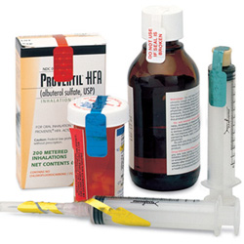
Broken seals on containers
may indicate that the container has been opened or lost inadvertently somewhere during transit.
and the material may have been exposed to unacceptable environmental conditions.
examination of any inner seals may be required before a final decision can be made.
The possibility of deliberate sabotage is very real as well,
suppliers should encouraged to
use seals with unique designs or
logos to minimize this potential
of deliberate tampering.

Slide 7
Containers should also be examined for physical deformation and for visible signs of spillage from other materials as well as for potential rodent attack. These situation will require additional evaluation and could result in rejections.
Users of components during the production process should also be required to conduct visual inspection prior to use.

Slide 8
In fact, low frequency defects in packaging components are more often detected during the filling/packaging process than by sampling on receipt.
It is essential to confirm the name of suppliers, when materials are purchased through agents, these should be requested to identify the actual producer,
otherwise the agent may interchange producers according to availability and price and without notification.
Any change in supplier may have an impact on product quality. To eliminate any potential impact it may be necessary to perform additional testing other than that included in the specification.

Slide 9
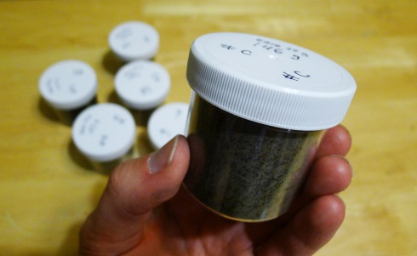
Sec. 211.84 Testing and approval or rejection of components, drug product containers, and closures
Each lot of components, drug product containers and closures shall be withheld from use until the lot has been sampled, tested or examined, as appropriate, and released for use by the quality control unit.
Representative samples of each shipment of each lot shall be collected for testing or examination.
The number of containers to be sampled, and the amount of material to be taken from each container shall be based upon appropriate criteria such as a statistical criteria for component variability, confidence levels and degree of precision desired, the past quality history of the suppliers and the quantity needed for analysis.

Slide 10
There are occasions when a variety of reasons materials arrive at a plant site and are required for immediate use.
The reason for this could include that:
delivery,
rejection of the scheduled delivery,
unexpected increase in sales,
or rejection of the scheduled batch of drug product.

Slide 11
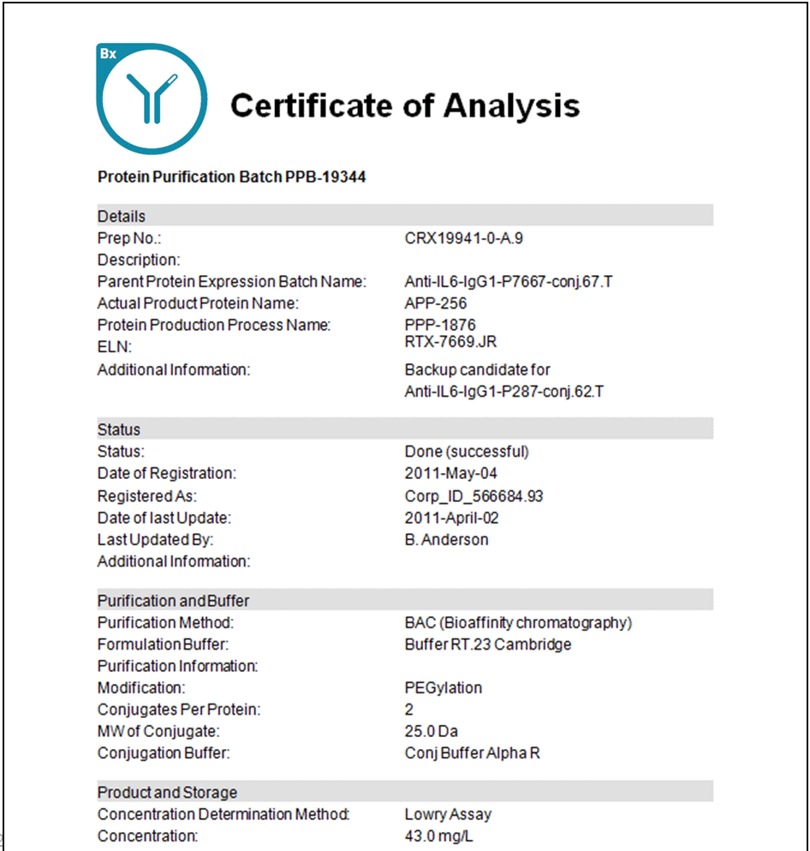
Deliveries of material to bulk storage requires special mention. It is usually impractical to hold a delivery vehicle until material can be fully evaluated.
In such cases it is usual to ensure that the certificate of analysis accompanies the delivery and that the more sensitive tests are performed before the material is discharged into the bulk storage system.
In the event that the full analysis identifies a problem it may be necessary to quarantine the contents of the storage tank until a comprehensive evaluation has been performed.
Any parameter that might be affected by shipping and storage conditions should be examined.
Quality variability would rarely be a reason for increasing sample size.

Slide 12
Sampling should be collected in accordance to the following procedures:
The containers of components selected shall be cleaned where necessary, by appropriate means.
The containers should be opened, sampled, and released in a manner designed to prevent contamination of their contents and contamination of other components, drug product containers and closures.
Sterile equipment and aseptic sampling techniques shall be used when necessary.
If it is necessary to sample a component from the top, middle and bottom of its container, such sample subdivision shall not be composited for testing.

Slide 13
Sample containers shall be identified so that the following information can be determined:
name of the material sampled,
the lot number,
the container from which the sample was taken,
the date on which the sample was taken
and the name of the person who collected the sample.
6) Containers from which samples have been taken shall be marked to show that samples have been removed from them.

Slide 14
The process of sampling can itself pose risks of contamination.
For this reason containers may need to be cleaned, a vacuum system is effective.
Containers should be opened for sampling in an acceptable environment that will not expose the material for further risks.
For drug substances and excipients it is preferable to provide a sampling area with environmental conditions similar to that the manufacturing area.

Slide 15
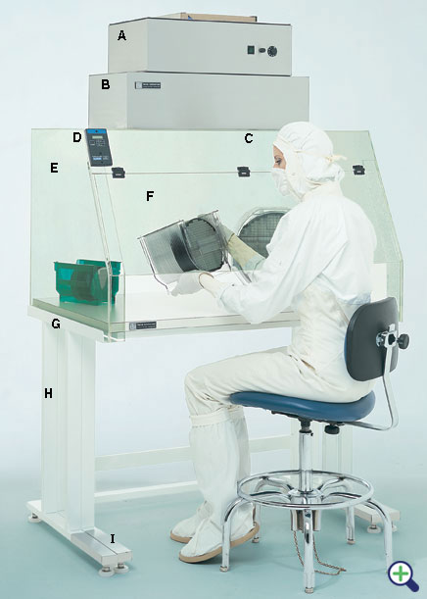
An alternative is useful a portable laminar flow hood with dust extraction capability that can be placed over the materials to be sampled.
This negates the need to move materials from quarantine to another area for sampling and then returning to quarantine afterword.
Materials requiring microbiological evaluation need to be sampled under more rigorous conditions involving the use of sterile equipment.

Slide 16
Samples shall be examined and tested as follows:
At least one test shall be conducted to verify the identity of each component of a drug product. Specific identity tests, if they exist, shall be used.
Each component shall be tested for conformity with all appropriate written specifications for purity, strength, and quality.
In lieu of such testing by the manufacturer, a report of analysis may be accepted from the supplier of a component, provided that at least one specific identity test is conducted on such component by the manufacturer, and provided that the manufacturer establishes the reliability of the supplier's analyses through appropriate validation of the supplier's test results at appropriate intervals.

Slide 17
3) Containers and closures shall be tested for conformance with all appropriate written procedures.
In lieu of such testing by the manufacturer, a certificate of testing may be accepted from the supplier,
provided that at least a visual identification is conducted on such containers/closures by the manufacturer
and provided that the manufacturer establishes the reliability of the supplier’s test results through appropriate validation of the supplier’s test results at appropriate intervals.

Slide 18
When appropriate, components shall be microscopically examined.
Each lot of a component, drug product container, or closure that is liable to contamination with filth insect infestation, or other extraneous adulterant shall be examined against established specifications for such contamination.
Each lot of a component, drug product container or closure that is liable to microbiological contamination that is objectionable in view of its intended use shall be subjected to microbiological tests before use.

Slide 19
Components, containers and closures used for production of pharmaceuticals must obviously comply with their quality specifications.
As suppliers introduce effective procedures and embrace the principles of vendor certification, the need for customer testing is reduced.
For new supplier it will usually be necessary for the customer to perform full testing.
This could be the case of new dosage form which although validated using a minimum of three batches could still undergo process improvement/optimization.

Slide 20
Vendor Certification
It is a system that assure that a supplier’s product is produced under controlled conditions, resulting in consistent quality conformance.
Being based on the principle of defect, prevention, rather than defect detection and inspection, it significantly reduces the need for customer inspection.
Vendor certificate is a supplier-customer partnership and can only be successful with the full involvement and agreement of both partners.

Slide 21
Customer Teams
The team will include representatives from manufacturing, packaging engineering, purchasing and quality assurance with support, as appropriate, from other disciplines such as finance and research and development.
The initial task of the team will be to define the objectives and potential benefits and to write a process that can be used as a basis for discussion with suppliers.

Slide 22
Customer Inspection
After it has been confirmed that a supplier has a controlled process, there usually will be a period when both parties evaluate material quality and compare data.
This provides the needed assurance that supplier and customer have of comparable evaluation ability and minimize future potential for disagreements that are due to tests results rather than atypical product.
The customer may also wish to revert to comprehensive evaluation at intervals as an additional assurance.

Slide 23
Decertification
Certification results in a high level of reliance on the supplier: reduced incoming inspection, reduced inventories, higher output.
Any failure by the supplier can therefore have serious consequences and may require decertification of that supplier for that material.

Slide 24
Any lot of components, drug product containers and closures that meets the appropriate written specifications of identity, strength, quality and purity and related tests under paragraph (d) may be approved and released for use. Any lot of such material that does not meet such specifications shall be rejected.

Slide 25
Any lot of components, drug product containers and closures that not meeting the specification is to be rejected.
This does not preclude recovery by an appropriate rework or inspection procedure provided the material after this rework meets the specification.
However, this could become a problem if specifications are set without full regard to their impact on product quality.

Slide 26
For example, if color standards for cartons are set as specifications, this could prevent the use of slightly atypical material in an urgent situation- even though the quality impact may be negligible.
In such instances it may be advisable to include certain noncritical parameters as action levels, provided the procedures clearly define who makes the decision.
There is an obvious need for supplier and customer to agree on specifications; without such an agreement, there could be some pressure to use atypical components simply to avoid financial loss.

