Slide 1
Current Good Manufacturing Practice & Pharmaceutical Quality Control
PHT 436
Lecture 3

Slide 2
Current Good Manufacturing Practice regulations
Subpart B: Organization and personal

Slide 3
Part 211: Current GMP for finished pharmaceuticals Subpart B: Organization and personal
Sec. 211.25 Personnel qualifications.
Sec. 211.28 Personnel responsibilities.
Sec. 211.34 Consultants.

Slide 4
Sec. 211.25 Personnel qualifications.
Each person engaged in the manufacture, processing, packing, or holding of a drug product shall have education, training, and experience, or any combination thereof, to enable that person to perform the assigned functions.
Training shall be in the particular operations that the employee performs and in CGMP (including the CGMP regulations in this chapter and written procedures required by these regulations) as they relate to the employee's functions.
Training in CGMP shall be conducted by qualified individuals on a continuing basis and with sufficient frequency to assure that employees remain familiar with CGMP requirements applicable to them.
Each person responsible for supervising the manufacture, processing, packing, or holding of a drug product shall have the education, training, and experience, or any combination thereof, to perform assigned functions in such a manner as to provide assurance that the drug product has the safety, identity, strength, quality, and purity that it purports or is represented to possess.
There shall be an adequate number of qualified personnel to perform and supervise the manufacture, processing, packing, or holding of each drug product.

Slide 5
Discussion
It can be said that people are the most important factor in CGMP compliance. Why?
They write the procedures, handle and test components, container closures, in-process materials, packaging materials, labeling and finished product.
They also manufacture the product and complete the required documentation and records.
The degree of accuracy to which these actions are accomplished is directly related to their knowledge, skill and training.
Well-qualified and trained individuals make few mistakes, and assure a suitable level of compliance with CGMP.

Slide 6
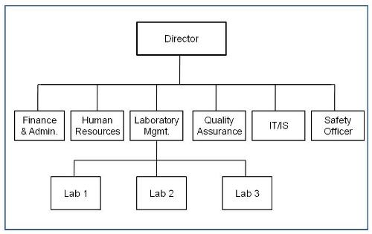
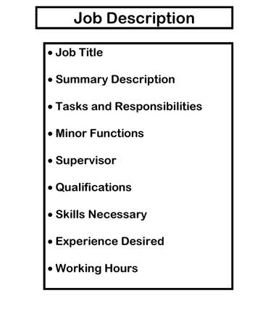
The manufacturer must
have an organization chart.
People in responsible
positions should have specific
duties recorded in written
job descriptions
and adequate authority to
carry out their responsibilities
of CGMP.

Slide 7
Their duties may be delegated to designated deputies of a satisfactory qualification level.
There should be no gaps or unexplained overlaps in the responsibilities of those personnel concerned with the application

Slide 8
Key Personnel includes:
the head of Production,
the head of Quality Control,
if at least one of these persons is not responsible for the release of products the authorized person(s) designated for the purpose: Normally key posts should be occupied by full-time personnel.
The heads of Production and Quality Control must be independent from each other.

Slide 9
Responsibilities of The Head of The Production Department
to ensure that products are produced and stored according to the appropriate documentation in order to obtain the required quality.
to approve the instructions relating to production operations and to ensure their strict implementation.
to ensure that the production records are evaluated and signed by an authorized person before they are sent to the Quality Control Department.

Slide 10
Responsibilities of The Head of The Production Department (cont.)
to check the maintenance of his department, premises and equipment.
to ensure that the appropriate validations are done.
to ensure that the required initial and continuing training of his department personnel is carried out and adapted according to need.

Slide 11
Responsibilities of The head of the Quality Control Department
1. to approve or reject, as he sees fit, starting materials, packaging materials, and intermediate, bulk and finished products.
2. to evaluate batch records.
3. to ensure that all necessary testing is carried out.
4. to approve specifications, sampling instructions, test methods and other Quality Control procedures.
5. to approve and monitor any contract analysts.

Slide 12
Responsibilities of The head of the Quality Control Department (cont.)
6. to check the maintenance of his department, premises and equipment;
7. to ensure that the appropriate validations are done.
8. to ensure that the required initial and continuing training of his department personnel is carried out and adapted according to need.

Slide 13
General CGMP Training
It includes:
a history of CGMP,
its purpose,
importance of CGMP in drug manufacturing,
FDA’s role in enforcing CGMP regulations,
importance of the individual in understanding and complying with these regulations.
It is for:
new employees who are not familiar with CGMP.
all employees periodically as a “refresher “course to keep all employees familiar with basic concepts of CGMP regulations.
It must be conducted by: qualified individuals.

Slide 14
Specific CGMP Training
It is training provided to enable an individual to perform the functions to which they are assigned.
It involves:
having the individual observe the functions being performed,
reading the written procedures related to the functions,
assigning a trainer to explain the functions, how to do them,
and observing and documenting the trainee’s ability to accurately perform them.

Slide 15
For example,
if the function is batch record review,
A trainer would be assigned.
The trainee observe a review being done.
The trainee would be required to read all procedures applicable to batch record review.
The trainee conduct a batch record review under the supervision of the trainer.
When the trainer believes that the trainee is proficient in batch record review, the trainee is “released,” and allowed to conduct batch record reviews under the same supervision as others doing such reviews.

Slide 16
Documentation For Training
There must be accurate records documenting:
The training of each individual for both work-related training and CGMP training.
The facility’s training program .
This would be done by written procedures and policies describing:
How training is conducted and documented.
How the effectiveness of training is evaluated.
e.g. error rates, employee evaluations and trainee input and opinion.

Slide 17
Supervisor Qualifications
A supervisor must be competent
in several related manufacturing functions.
This requires the qualifications of supervisory personnel to be more extensive than non-supervisory personnel, because of the larger variety of functions that are involved.
A supervisor must have the knowledge to know if a function or task is performed improperly.
e.g. a Packaging Department Manager must be knowledgeable in all packaging functions, whereas a filling machine operator is concerned with only the filling operation.

Slide 18
Sec. 211.28 Personnel responsibilities.
Personnel engaged in the manufacture, processing, packing, or holding of a drug product shall wear clean clothing appropriate for the duties they perform. Protective apparel, such as head, face, hand, and arm coverings, shall be worn as necessary to protect drug products from contamination.
Personnel shall practice good sanitation and health habits.
Only personnel authorized by supervisory personnel shall enter those areas of the buildings and facilities designated as limited-access areas.
Any person shown at any time (either by medical examination or supervisory observation) to have an apparent illness or open lesions that may adversely affect the safety or quality of drug products shall be excluded from direct contact with components, drug product containers, closures, in-process materials, and drug products until the condition is corrected or determined by competent medical personnel not to jeopardize the safety or quality of drug products. All personnel shall be instructed to report to supervisory personnel any health conditions that may have an adverse effect on drug products.

Slide 19
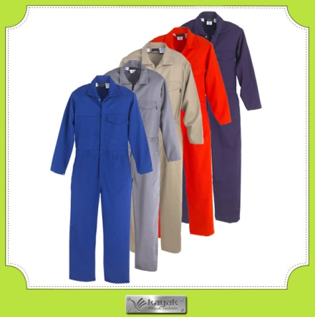
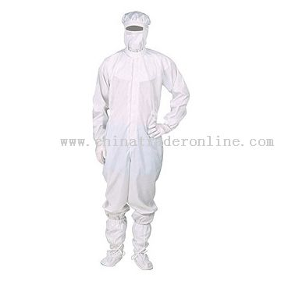
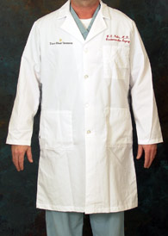
Clothing
There should be written procedures that describe:
the clothing e.g. lab coats, uniforms or coveralls.
frequency of changing or cleaning.
e.g. frequency of changing could include daily, weekly, or some other specified time, need for a clothing change other than time would include; excessive accumulation of dust or dirt, oil or grease, leaving an aseptic processing area and entering a non-sterile area.
actions to be taken if clothing becomes soiled.

Slide 20
Protective Apparel
It is worn in addition to clean clothing. It includes:
head coverings, face coverings, gloves and arm covers when long-sleeve clothing is not worn.
Protective apparel provides protection for the following:
The product from human contamination, such as the head and body hair
The individual from direct contact with active ingredients and in-process materials that can be absorbed through the skin, eyes, mouth or nose and cleaning agents and solvents that may cause burns.
E.g. Hair is a common contaminant, but most hair is not lost from the head of an individual, but from the arms. This is the reason long sleeves or arm coverings are required, as well as head and face coverings.

Slide 21
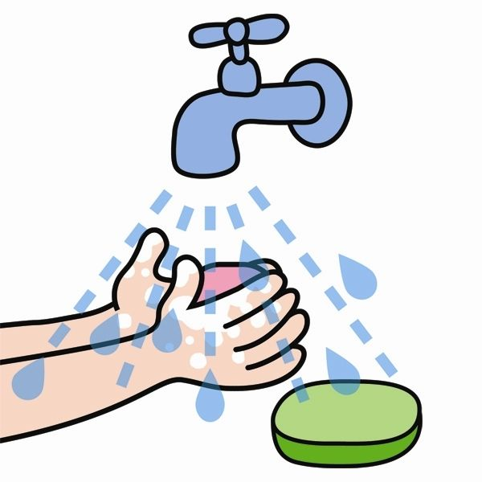
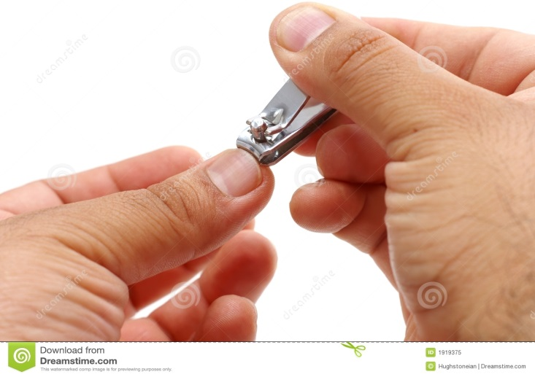
Sanitation and Health Habits
Following Sanitation and Health Habits will minimize contamination through:
washing hands after using washing and toilet facilities, trimming and cleaning fingernails, flushing toilets after use and keeping the use of cosmetics to a minimum.
Removing exposed jewelry is a good practice.

Slide 22
Limited Access Areas
Means only authorized personnel being
present,
This reduces the possibility of cross-contamination with in- process materials from different products, or a mix-up of labeling from different products.
Limited access areas would include:
labeling storage, aseptic processing, and areas where powders tend to be generated, such as blending and milling and areas where controlled substances are manufactured.
E.g. A label room is an example of a limited access area. Access is restricted to supervisors, labeling personnel and Quality. These individuals understand how to control labeling to prevent mix-ups. A tablet machine operator would not.

Slide 23
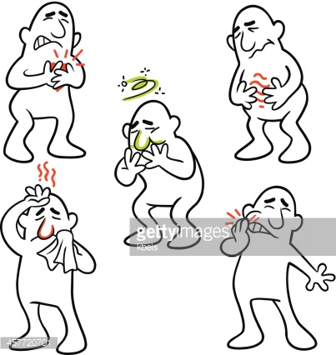
Health Conditions
Detailed hygiene programs
should be established to the
different needs within the factory.
They should include procedures relating to the health, hygiene practices and clothing of personnel.
These procedures should be understood and followed in a very strict way by every person.
Hygiene programs should be promoted by management and widely discussed during training sessions.
All personnel should receive medical examination upon recruitment.

Slide 24
Health Conditions (cont.)
After the first medical examination,
examinations should be carried out when necessary for the work and personal health.
Any health condition that could have an adverse impact be reported to the individual’s supervisor.
The supervisor must decide if the condition is a problem, and if so, assign that individual to reviewing records or other activity not involving the manufacture of the product.
E.g. an individual comes to work with symptoms of the flu (coughing, sneezing, watering eyes). The individual goes to the supervisor and reports not feeling well. The supervisor observes the symptoms and informs the individual to go home (take a sick day), and return when the flu is gone.

Slide 25
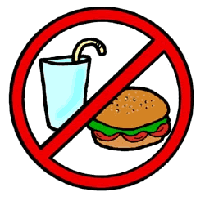
Eating, drinking, chewing or smoking, or the storage of food, drink, smoking materials or personal medication in the production and storage areas should be prohibited.

Slide 26
Sec. 211.34 Consultants.
Consultants advising on the manufacture, processing, packing, or holding of drug products shall have sufficient education, training, and experience, or any combination thereof, to advise on the subject for which they are retained.
Records shall be maintained stating the name, address, and qualifications of any consultants and the type of service they provide.

Slide 27
If a company has used a consultant, then a record of this consultant and services provided must be kept.
The record must contain, at a minimum: the consultant’s name, address, qualifications and type of service provided.
Failure to maintain records of this nature is a violation of CGMP regulations.

