Slide 1
Chpter#5 -part#1 Project Scope and Human Resource Planning
Project Planning.
Project Scope.
Work Breakdown Structure.

Slide 2
Objectives
Acquire a general understanding of the parts of the project management plan
Understand the importance of discovering and documenting stakeholder requirements
Understand how to create a detailed scope statement and work breakdown structure (WBS)
Learn how to match the right person, with the needed skill set, to the appropriate activity

Slide 3
Project Planning. Integration Management KA.
Project planning starts with the project plan development process, which is part of the Integration Management knowledge Area
The single deliverable from this process is the project management plan, which consists of deliverables from each of the other 8 eight knowledge areas.
Project Plan =
Telling the team “WHAT TO DO”

Slide 4
Project Management Plan: Main Components
Scope management plan (Chapter 5)
Work breakdown structure (WBS) (Chapter 5)
Human Resource management plan (Chapter 5)
Time (schedule) management plan (Chapter 6)
Cost management plan (Chapter 6)
Quality management plan (Chapter 7)
Process improvement plan (Chapter 7)
Communication management plan (Chapter 7)
Risk management plan (Chapter 8)
Procurement management plan (Chapter 9)

Slide 5
Build the Project Plan
Many organizations not only have documented business templates for each part of the plan to speed up development of the plan and to maintain consistency across projects but also may have slightly different standard formats, based on different project characteristics, such as size, complexity, length, and risk level.
For example, a small, low-risk project would have a shorter and less formal project planning document than a large, complex project with members of the project team spread out all over the world.

Slide 6
Attributes of Good Project Plans
Plans should be dynamic
Plans should be flexible
Things always happen during the project to change each of these four constraints so plans should be built to accommodate room for issues/problems/delays.
Plans should be updated as changes occur (Integrated Change Control)
Plans should first and foremost guide project execution
Plans should never assume the team will work overtime, at least not at the start
Assuming that the only way to hit the project plan objectives for 1) scope, 2) time, 3) cost, and 4) quality is to schedule over time at the very beginning is a sure recipe for disaster.

Slide 7
What the main reason to create Project Plan? The answer: Project Cost and Project Time
The Cost of Software Change Law is a very well-known law (see on the right).
Errors found “upstream” during the planning phase cost on the order of 200 times less to fix than errors found “downstream” during the building of the product.
Planning “forecasting”, “seeing into the future” is not an easy task
T. Capers Jones (1998) summed it up this way: “The seeds of major software disasters are usually shown in the first three months of commencing the software project. Hasty scheduling, irrational commitments, unprofessional estimating techniques, carelessness of the project management function are the factors that tend to introduce terminal problems.”

Slide 8
Project Plan Creation and Analysis Paralysis
Although planning is crucial, project teams must be careful to avoid over-planning
the planning must be appropriate to the size, complexity, and risk of the project
Project managers must be careful to avoid what many systems analysis text books refer to as “analysis paralysis”—getting stuck in the analysis phase, trying to get everything defined perfectly

Slide 9
From Integration Management KA to Scope Management KA
Scope Management consists
of 3 processes:
1. Collect Requirements
2. Define Scope
3. Crete WBS (Work
Breakdown Structure)

Slide 10
SW Requirements Engineering
A requirement is a singular documented need of what a particular product or service should be or perform. It is a statement that identifies a necessary attribute, capability, function, characteristic, or quality of a system in order for it to have value and utility to a user.
Business requirements describe in business terms WHAT must be delivered or accomplished to provide value.
Product requirements describe properties, functions and attributes of a system or product (which could be one of several ways to accomplish a set business requirements.)
Process requirements describe HOW activities performed by the developing organization (methodologies to be followed, and constraints that the organization must obey.

Slide 11
SW Requirements Engineering (cont.)
The requirements documentation may consist of the following main topics (or, components) *):
Functional and nonfunctional system requirements
Business rules
Impacts on any other systems and/or departments
Support and training requirements
Acceptance criteria for each requirement or set of requirements
Quality requirements

Slide 12
Scope Statement
Scope refers to all (100%) of the work involved in creating the products of the project and the processes used to create them
Scope statement describes the characteristics of the product that the project was created to deliver.

Slide 13
Scope Statement (cont.)
Scope statements may take many forms depending on the type of project being implemented and the nature of the organization. However, a baseline scope statement should contain:
The project name
The project owner, sponsors, and stakeholders
The project charter (roles and responsibilities,
identities of stakeholders, etc.)
The problem statement
The project goals and objectives
The project requirements
The project deliverables
The project non-goals (what is out of scope)
Milestones (timetable, schedule)
Cost estimates

Slide 14
Work Breakdown Structure (WBS)
Work breakdown structure (WBS) is a method used to define group of project's discrete work elements in a way that helps organize and define the total work scope of the project.
WBS element may be a
a task,
a product,
data,
a component,
a service, or
any combination of these elements.
100% rule:
The WBS represents 100 percent of the work required to produce the final products, and, therefore,
All tasks must add up to 100% of the total scope and should not go over 100% (No “I forgot to add …” statements at all after project WBS has been approved)

Slide 16
Building a WBS
Various approaches can be used to build the WBS:
Analogy approach
A WBS is first created by looking for a similar projects done in the past and using its WBS as a starting point. SE
Design Concept: “Do NOT reinvent the wheel” (check web sites of similar projects)
Top-down approach
Start with the largest items of the project and keep breaking them down into smaller and smaller parts
Bottom-up approach
Start with the detailed tasks and roll them up
Thread-based approach
Concentrate on most important items first
Using guidelines:
Some organizations, like the DoD, National Science Foundation (NSF) provide guidelines/requirements for preparing a WBS

Slide 17
Which Approach to Choose? Some recommendations …
In case of the existence of a similar project:
would lead you to the analogy approach which if done correctly is the fastest and most accurate method
In case of an evolutionary type of project:
depends on experience level of the project manager and team:
if little experience, choose the top-down approach;
if many years of experience then choose a bottom-up approach
In case of a revolutionary type of project:
if the product or process is very unique, never anything like it before in this company or by this team then choose the top-down approach

Slide 19
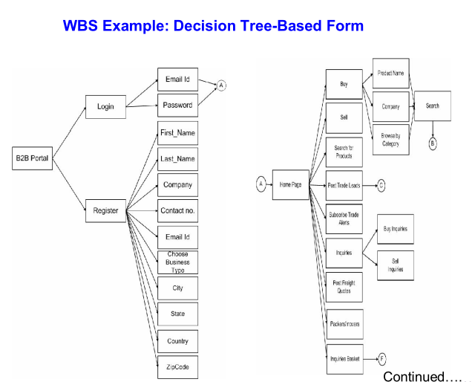

Slide 21
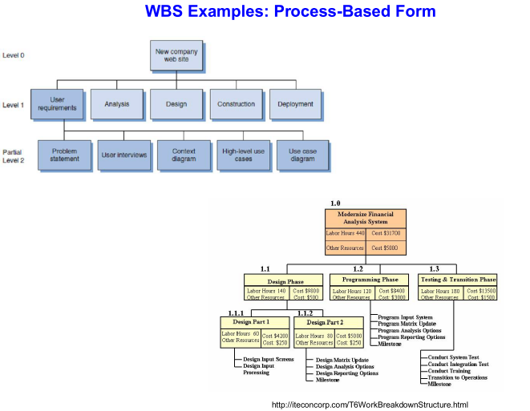

Slide 22
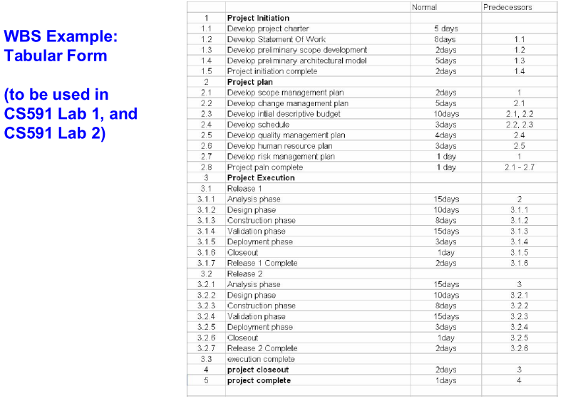

Slide 23
Basic Principles for Creating a WBS
The WBS represents 100% of the work required to produce the product. As soon as you define more than 100% of the scope, you have committed to doing more than you agreed to - scope creep has begun (100% Rule)
Each WBS element represents a single deliverable
Each deliverable is distinct
Accountability for each task can be assigned to one team member
Not all elements of the WBS need to be decomposed to the same depth
Have all reporting and control mechanisms been included
Be prepared for changes
scope creep The unanticipated gradual growth of information systems requirements during the life of a project, causing budget and time overruns.

