Slide 1
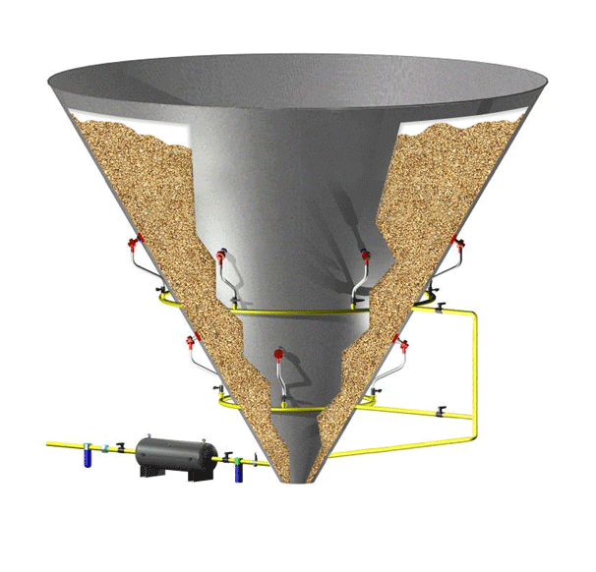
FLOW OF POWDERS

Slide 2
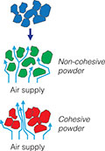
Pharmaceutical powders may be classified as free-flowing or cohesive (non-free flowing)
► Flow properties are significantly affected by changes in particle size, density, shape, electrostatic charge and adsorbed moisture, which may arise from processing or formulation.
► Pre-formulation, powder flow should be determined for the improvement of pharmaceutical formulation and consequences of processing.
► This subject becomes vital for the development of a commercial solid dosage form containing a large percentage of cohesive material.

Slide 3
Factors affecting powder flowability
1- Particle size
▪ Frictional and cohesive forces (resistance to flow) are increased as the particle size is reduced. Very fine particles don't flow as large particles
▪ In general, particles in the size range of 250-2000 micron flow freely if the shape is agreeable.
Particles in the size range of 75-250 micron may flow freely or cause problems, depending on shape and other factors. With particles less than 100 micron in size, flow is a problem.
2- Density and porosity
▪ Particles with density and low porosity tend to posses free flowing properties.

Slide 4
3. Particle shape
Rough irregular particles present more points of contact than smooth spherical Particles thus spherical particles flow better than needles.
4. Particle size distribution
Larger amount of fines can inhibit poor flowing
5. Moisture content
Drying the powders will reduce the cohesiveness

Slide 5
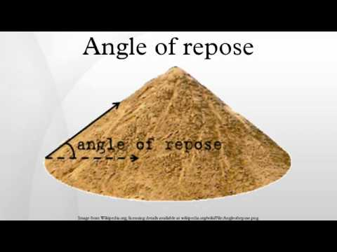
Angles of repose Ф
► The angle of repose is a relatively simple technique for estimating the flowability of a powder.
► Such measurements give at least a qualitative assessment of the internal cohesive and frictional effects under low levels of external loading, as might apply in powder mixing, or in tablet die or capsule shell filling operations.
► The angle of repose can be determined experimentally by allowing a powder to flow through a funnel and fall freely onto a surface.
► The height and diameter of the resulting cone is measured.
It is the maximum angle that can be obtained between the free standing surface of a powder heap and the horizontal plane.

Slide 6
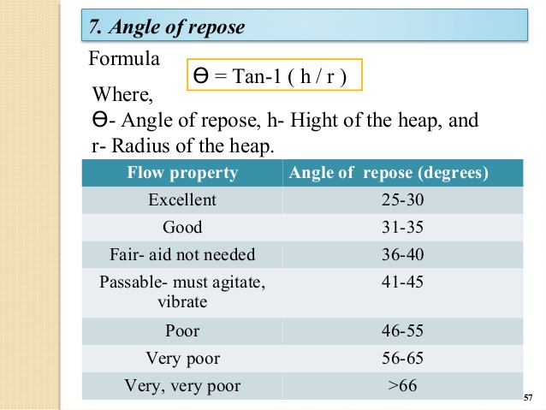
Angle of repose can be defined by the equation

Slide 7
Porosity, void and bulk volume
Packing and flow of powders are important for:
▪ Impacting the size of container required for packaging
▪ The flow of granulations
▪ The efficient of the filling apparatus during tabletting
▪ Encapsulation process.
A number of characteristics can be used to describe powders including:
Porosity, true volume, bulk volume, apparent density, true density and bulkiness
The void is the space between the particles which resulting in a porosity.
If the particles are not uniform, the smaller particles will slip into the void spaces between The larger particles and decrease the void areas.

Slide 8
Apparent density, true density and bulkiness
▪ Bulk density is of great importance for capsule filling, tablet compressibility and for the homogeneity of formulation in which there are large difference in drug and excipient densities.
▪ Apparent bulk density (g/ml) is determined by pouring presieved (40-mesh) bulk drug into a graduated cylinder via a large funnel and measuring the volume and weight .
▪ Powders with low apparent density and large bulk volume are light powders, and those with high apparent density and small bulk volume are heavy powders.

Slide 9
Particle size analysis

Slide 10
Why measuring particle size is important?
The particle size of a drug can affect its physical, chemical, pharmacological properties.
- The particle size of a drug can also affect its release from dosage forms.
- The particle size of a drug can also affect the final formulation of dosage forms such as performance, appearance, stability and “Processability” of powder (API or excipient)

Slide 11
Methods for determining particle size
1. Microscopy
2. Sieving
3. Sedimentation techniques
4. Optical and electrical sensing zone method
5. Laser light scattering techniques
(Surface area measurement techniques)

Slide 12
Choosing a method for particle sizing
Nature of the material to be sized, e.g.
estimated particle size and particle size range
solubility
ease of handling
toxicity
flowability
intended use
Cost
capital
running
Specification requirements
Time restrictions

Slide 13
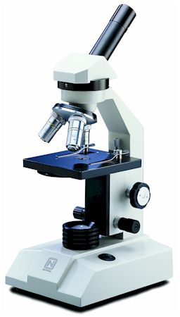
1. Microscopy
- A very powerful technique as it allows direct observation of particles within the approximate size range 1 -150 microns Optical microscopy
- For submicron particles it is necessary to use either
TEM (Transmission Electron Microscopy) or
SEM (Scanning Electron Microscopy).
TEM and SEM (0.001-5µm)
- Produces a number distribution based on measurement of diameters - or more usually projected area diameters

Slide 14
► Microscopy is being able to examine each particle individually has led to microscopy being considered as an absolute measurement of particle size.
► Can distinguish aggregates from single particles
When coupled to image analysis computers each field can be examined, and a distribution obtained.
► Number distribution
► Most severe limitation of optical microscopy is the depth of focus being about 10µm at x100 and only 0.5µm at x1000.
With small particles, diffraction effects increase causing blurring at the edges - determination of particles < 3µm is less and less certain.

Slide 15
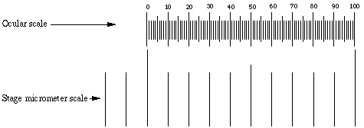
Manual Optical Microscopy
Advantages
● Relatively inexpensive
● Each particle individually examined - detect aggregates, 2D shape, colour, melting point etc.
● Allows direct observation of the particles rather than observing a property dependent on particle size.
● Permanent record - photograph
● Small sample sizes required
●The dispersion of the sample can be assessed
● Initially easy to set up and use. Image Analysis is Quick but software must be good enough to resolve particle boundaries.

Slide 16
Disadvantages
● Time consuming - high operator fatigue - few particles examined
● Very low throughput
● No information on 3D shape
● Certain amount of subjectivity associated with sizing - operator bias
● Sampling of the distribution is poor! It is impossible to measure all the particles present!
● The result is a number distribution not a volume distribution.

Slide 17
Transmission and Scanning Electron Microscopy
Advantages
Particles are individually examined
Visual means to see sub-micron specimens
Particle shape can be measured
Disadvantages
Very expensive
Time consuming sample preparation
Materials such as emulsions difficult/impossible to prepare
Low throughput - Not for routine use

Slide 18
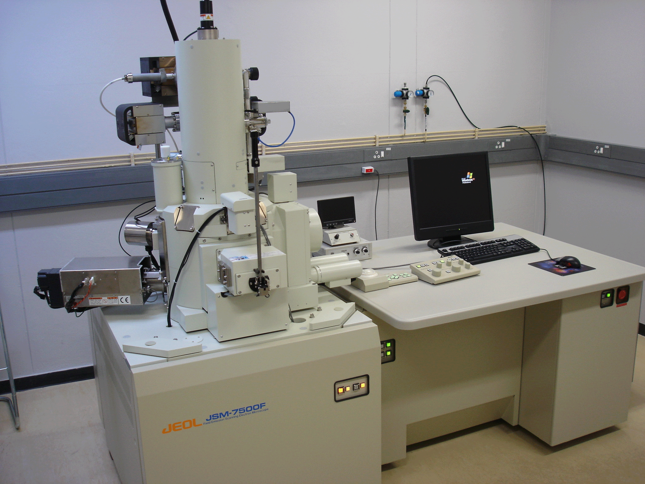
Scanning electron microscope

Slide 19
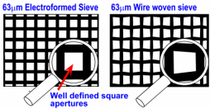
2. Sieving
● Particles are passed through the series of sieve, the proportion of particles
Passing through or being withheld on each sieve is determined in a specified time.
● A widely used method of particle sizing
● Sieve analysis is performed using a nest or stack of sieves where each lower sieve has a smaller aperture size than that of the sieve above it.
● Sieves can be referred to either by their aperture size or by their mesh size (or sieve number).
● The mesh size is the number of wires per linear inch.
Standard woven wire sieves cover size range of 20um to 125mm.
Electroformed micromesh sieves at the lower end or range (< 20µm)
Punch plate sieves at the upper range.
● Punched hole sieves available to cm range
● Micromesh sieves extend the range down to 5um.

Slide 20
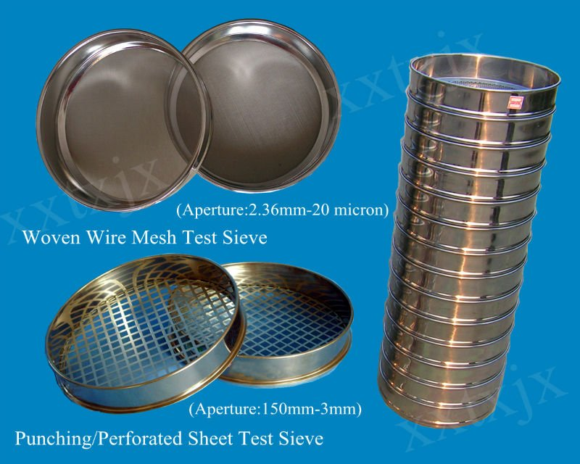

Slide 21
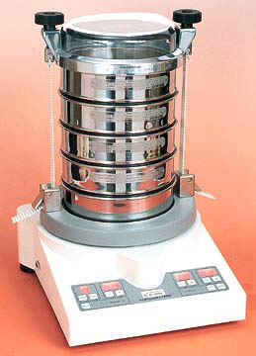
Sieving may be performed wet or dry; by machine or by hand, for a fixed time or until powder passes through the sieve at a constant low rate
Wet sieving
Air-jet sieving
Weight distribution

Slide 22
Advantages
Easy to perform
Wide size range
Inexpensive
Disadvantages
Known problems of reproducibility
Wear/damage in use or cleaning
Irregular/agglomerated particles
Rod-like particles : overestimate of under-size
Labour intensive

Slide 23
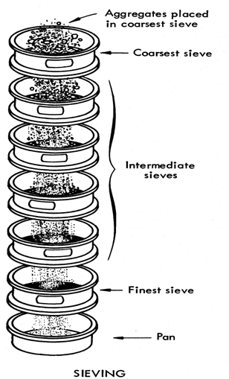

Slide 26
3. Sedimentation
The particle size is determined by measuring the settling velocity of particles through a liquid medium in a gravitational or centrifugal environment.
Sedimentation rate may be calculated from stokes’s law using the Andreasen pipet which is designed where the sample can be removed from the lower portion at selected time intervals.
- The powder is dispersed in a non-solvent and agitated then 20ml samples is removed over a period of time, each sample is dried and weighed.

Slide 27
Advantages
A relatively cheap technique to use if you have the time!
Capable of producing reproducible results if used in the right hands.
Disadvantages
Since Stokes law depends on the viscosity of the fluid, temperature has to be well controlled.
Unable to handle mixtures of different density.
The technique is slow
Tends to underestimate sizes
● Particle re-aggregation during extended measurements.
● Particles have to be completely insoluble in the suspending liquid.

Slide 28
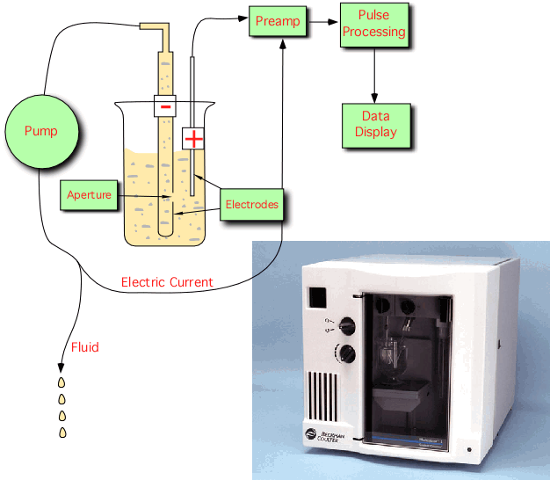
4.Electrical sensing zone method
(Coulter Counter)
▪ Instrument measures particle volume which can be expressed as dv : the diameter of a sphere that has the same volume as the particle.
▪ The number and size of particles suspended in an electrolyte is determined by causing them to pass through an orifice an either side of which is immersed an electrode.
▪ The changes in electric impedance (resistance) as particles pass through the orifice generate voltage pulses whose amplitude are proportional to the volumes of the particles.
▪ Volume distribution

Slide 30
Disadvantages
Difficult to measure emulsions
Must measure in Electrolyte
Requires regular calibration
Very poor dynamic size range
Lowest size set by the orifice selected - around 2 microns.
Porous particles give problems
● Good technique for blood cells but not suitable for most industrial materials
● High resolution for narrow distributions

Slide 31
May be also prepared as divided powders by adding inert diluent
Double-wrapping is desirable for further protection
Extremely hygroscopic compounds cannot prepared as powders

Slide 32
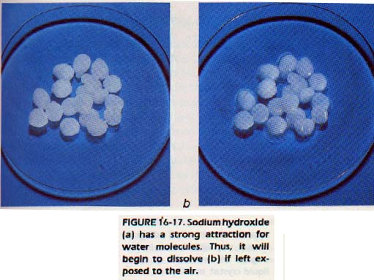

Slide 34
Magnesium carbonate or light oxide are used commonly and effective diluents for this purpose although kaoline, starch, bentonite and other adsorbents have been recommended.

Slide 38
Volatile substance
The loss of camphor, menthol and essential oils by volatilization when incorporated into powders may be prevented or retarded bu the use of heat sealed plastic bags or double wrapping with a waxed or glassine paper inside a bond paper.
Liquids
The liquids may be incorporated into divided powders
Magnesium carbonate, starch or lactose may be added to increase the absorbability of the powders if necessary.
When the liquid is a solvent for a nonvolatile heat stable compound, it may be evaporated gently on a water bath.
Lactose may be added during the evaporation to increase the rate of solvent loss by increase surface area.

