Slide 1


قسم الصيدلانيات
كلية الصيدلة
جامعة الملك سعود
PHT 432)) Industrial Pharmacy
Dr. Fars Alanazi
AA91

Slide 2
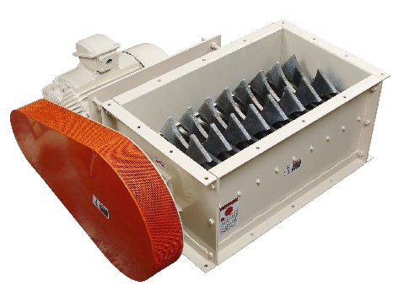
2-3
Lectures
Size Reduction

Slide 3
Outline of the lecture:
Size Reduction
Definition
Theory of size reduction
Mechanism of size reduction
Size reduction equipment
1. Hammer mill, (vertical, horizontal) 2. Cutting mill
3. End and edge runner mill
4. Fluidized energy mill
5. Ball mill and types
6. Oscillating granulator
7. Colloid mill

Slide 4
Definition of size reduction:
It is the process that reduces large solid unit masses to smaller unit masses by mechanical means.

Slide 5
Importance of size Reduction in Pharmacy: (Advantages)
?

Slide 6
Importance of size Reduction in Pharmacy:
Advantages:
Increase surface area which increase the solubility, and dissolution rate of material so enhance its bioavailability.
Improvement of extraction rate.
Improvement and increasing the drying rate.
Improve mixing of materials together so give less problems in uni­formity of weight and contents of tablets.
Improve color and/or active ingredient dispersion in tablet excipient diluents.
Improve flowability of materials in tablet machine.
Control particle size distribution of a dry granulation or dry mix to minimize segregation while handling and tableting .

Slide 7
Disadvantages
?

Slide 8
Disadvantages:
A possible change in polymorphic form of the active ingredient ren­dering it less or totally inactive or unstable.
Possible degradation of the drug as a result of heat build up during milling by oxidation or adsorption of unwanted moisture due to the increased surface area.
A decrease in bulk density may cause problems in the flowability of material.
A decrease in particle size may create static charge problems causing the small drug particles to agglomerate therefore effectively decreasing surface area. This may decrease the dissolution rate.

Slide 9
Size reduction is a rate process that depends on:
The size of the starting material, the feed.
Type of size reduction machine
The orientation of the material in the crushing machine.
The time of milling to which these materials are subjected

Slide 10
The principal means of accomplishing size reduction are:
Communion
Cutting
Shearing
Compression
Impaction
Attrition, Rubbing
Grinding, Trituration
Chappin

Slide 11
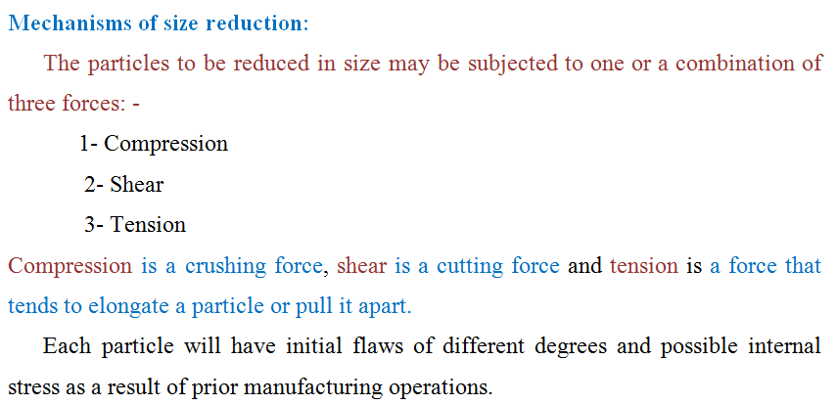

Slide 12
A flaw in a unit particle is a discontinuity or imperfection in the structure.

Slide 13
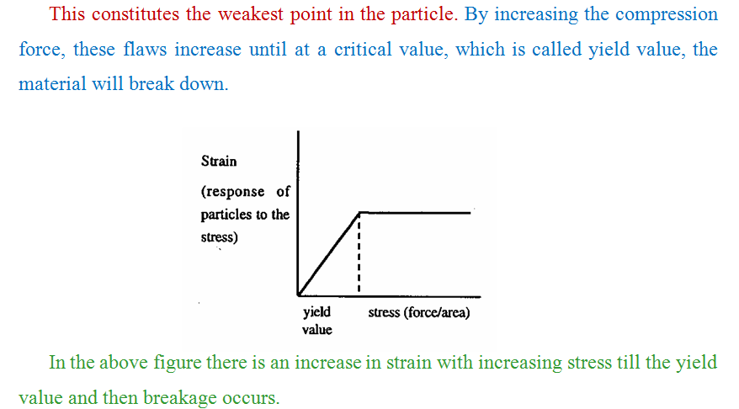

Slide 14
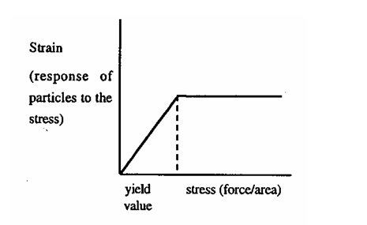
Compression at any point along the line below the yield value, the material will go back and returns to its original shape and this is called elastic deformation.
However compression above the yield value will result in plastic deformation in which the substance break down and not go back to its original shape after removing stress.

Slide 15
Kinds of materials according to the process of size reduction:
1- Brittle
2- Fibrous
3- Hard

Slide 16
General hardness classification of some pharmaceutical materials:
Material | Hardness
Talc | Soft
Chalk | Soft to brittle Soft
Boric acid | Soft but Plastic
Cellulose | Moderately hard to brittle
Aspirin | Moderately hard to brittle
Lactose | Moderately hard to brittle
NH4CI | Moderately hard to brittle
Sucrose | Hard to brittle
Dextrin | Hard
Sorbitol | Hard
Kaolin | Hard
Magnesium oxide | Abrasive Hard
Calactate | Abrasive Very hard
Amobarbital | Abrasive

Slide 17
Mechanical Engineering
Rittinger's law :This law states that the energy required for the crushing process is proportional to the surface sheared, (for fine grinding)
Kick's law:
The law states that energy required for crushing materials is proportional to the log­arithm of the ratio between the initial (r₁) and final diameters (r₂) of the particles .
Log (r₁/r₂)

Slide 18

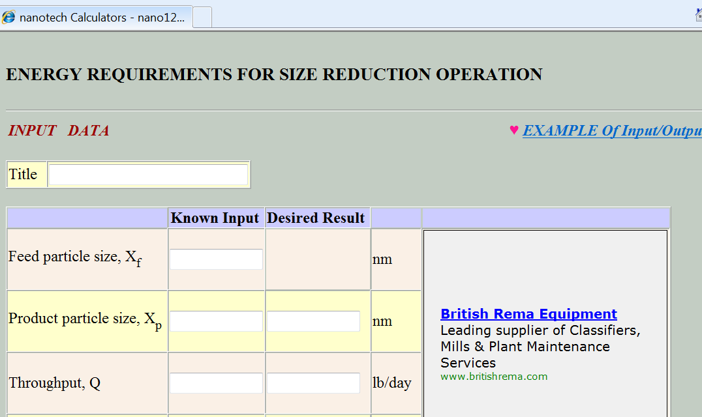

Slide 19
Energy may be consumed in so many aspects in the size reduction process as:
  Producing elastic deformation of particles before the occurrence of fractures, which is a waste energy.
  Producing inelastic deformations which lead to size reduction and this is the wanted energy
  Causing elastic distortion consequently failure of the equipment
  Friction between the particles and the machine
  Noise, heat and vibration in the plant.

Slide 20
There are factors associated with the nature of the material reduction as:
    Friability
    Structure which may be granular, Fibrous
    Hardness
    Stickiness
    Soapiness
    Moisture content

Slide 21
Grinding can be wet or dry when wet low speed mills are used
Advantages of wet grinding
    The power consumption is less by 20 - 30%.
    The capacity of the plant is increased.
    Removal of the product is facilitated and the amount of
    fines is reduced.
    Dust formation is eliminated
    The solids are more easily handled

Slide 22
Selection of size Reduction Equipment depends upon:
Kind of material.
Initial size of material.
Final product particle size whether we need fine or large particles.
Range of abrasion: some materials are abrasive so we use machine hard enough which withstand this abrasion effect.
Hardness of materials are arranged in order of increasing hardness in the
Mohr scale:
1- Talk 4- Fluorspar 7- Quartz
2- Rock salt & gypsum 5- Apotite 8- Topaz
3-Calcite 6- Felspar 10- Diamond 9- Carborundum
E. Moisture content of material whether it is hydrous or anhydrous.
F. Particle size distribution and shape.
G. Structure, strength, friability, stickiness

Slide 23
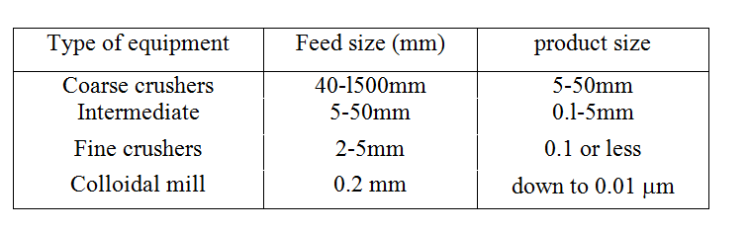
Classification of size Reduction equipment:
The oldest size reduction equipment is Busherstone.
They are classified according to the products they intended to produce as follows:

Slide 24
Classification of size Reduction equipment
Coarse crushers: have no applications in pharmacy as blake jaw crusher, Dodge crusher, Gyratery crusher and Rotary coal breaker
Intermediate crushers :
    Hammer mills
    Cutting mills
    Edge and end runner mills.
Fine crushers:
- Ball mill
- Fluid energy mill.
- Oscillating granulator.
4. Colloidal mills.

Slide 25
Classification of size Reduction equipment
All milling or Comminution equipment Consist of three main or basic parts: -
  Feeding part.
  Milling chamber.
  Receiver.
  Some mills are also fitted with cyclones for classifying the partcles by size.

Slide 26
Outline of the lecture:
Size Reduction
Definition
Theory and mechanisms of size reduction
Mechanism of size reduction
Size reduction equipment
1. Hammer mill, (vertical, horizontal) 2. Cutting mill
3. End and edge runner mill
4. Fluidized energy mill
5. Ball mill and types
6. Oscillating granulator
7. Colloid mill

Slide 27
1. Hammer mill, (vertical, horizontal) 2. Cutting mill
3. End and edge runner mill
4. Fluidized energy mill
5. Ball mill and types
6. Oscillating granulator
7. Colloid mill
Intermediate Crushing
Fine Crushing
For Liquids

Slide 28
Intermediate Crushing
1- Hammer Mill
Hammer Mill: A, rotating disc; B, shaft; c, hammers; D, breaker plates; E, screen

Slide 29
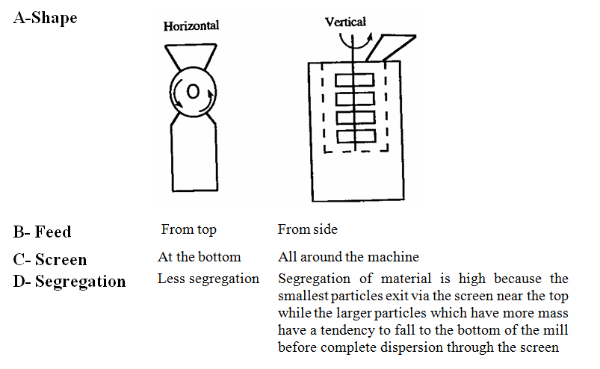
There are 2 types of Hammer mill
Horizontal - shaft type. 2. Vertical - shaft type.

Slide 31
Advantages of Hammer mill:
Easy to set up or build
Easy to clean.
Small space requirement.
It has a wide range of the size of feed start.
Disadvantages:
Possibility of clogging of screen
Heat build up during milling and cause degradation of product so not used for heat labile substances.
Mill and screen wear with abrasive materials

Slide 32
2-Cutting Mill:
It is similar to Hammer mill but here, the hammer like knives or blades
Processes: Cutting and shearing.
It is used for fibrous materials, wet and dry materials and for dispersion of powder. (e.g. liquorices root). It is not used for hard, abrasive materials
3- Edge and End runner mills:
The only advantage is using scraper which can be put on the edge. The feed is from the top or from side.
Processes: shearing and attrition

Slide 33
Fine Crushers
1- Fluid Energy Mill
It is rapid and very efficient method of reducing powders to 30 μm and less with relatively narrow particle size distribution.
Attrition and impaction. | Processes:
A high-velocity air stream introduces the powder to the milling chamber by a venturi tube (a high - velocity air stream passing an opening containing the powder produces a vacuum in the opening and draws the powder into the air stream) | Principle of operation:

Slide 34
Milling takes place immediately because of the high - velocity collisions between particles suspended within the air steam.
Grinding nozzles (usually 2-6 depending on the size of the mill) may be laced tangential or opposed to the initial powder flow path to increase the particle velocity resulting in higher impact energy.
The air from the grinding nozzles transports the powder to a classifier which removes the smaller particles.

Slide 35
Schematic of fluid energy mill and particle collection system

Slide 36
The particle size depends on:
The configuration of the mill
Feed size
Position of the nozzles.
Design of the classifier.
Feed rate.
If the feed rate is high → larger particle size could be obtained If the feed rate is slow → smaller particle size could be obtained

Slide 37
Heat -labile sbubstances can be milled with little danger of thermal degradation. This is because of the cooling effect of the air and rapid heat ex­change between particles and air. It produces very small and uniform distributed particles. Inert gases can be used instead of air to minimize or eliminate the oxidation of susceptible compounds which may occur with compressed air. | Advantages:
Ultra-fine grinding Materials: Moderately hard 20 - 200 mesh gives 30-5 μm or less. Materials not recommended for mill soft, tacky, fibrous | Uses:

Slide 38
Ball Mill Types:
Batch
Continuous
Continuous closed – circuit milling

Slide 39
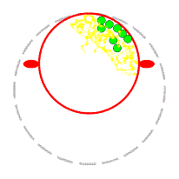

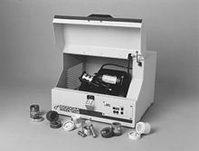

Slide 40
Ball Mill
A. Batch:
It is a cylindrical shell filled to about 1/2 its volume with grinding media with different sizes.
The shell rotates on its central axis by means of motor- driven rol­lers on which it rests.

Slide 41
B- Continuous:
It is a conical shell with grinding media of different sizes.
Feed enters from the hollow end of the mill and milled material exits through a grating or small ports of the opposite end.

Slide 42
Harding Mill

Slide 43
Another classification of ball mills:
1- Simple ball mill 2- Pebble mill 3-Tube mill
4- Compound ball mill 5- Hardinage mill 6- Rod mill
Hardinage mill

Slide 44
C. Continuous closed -circuit milling:
It is arranged using the continuous mill with a gas or liquid classify­ing system.

Slide 45
Air and feed enters through the opening at end of the mill.
The large feedstack drops into the milling zone and the smaller particles become entrained in the air stream flowing through the mill and exiting through the opposite end to a particle classifier.
The classifier removes the smallest particles while the larger particles are recycled to the mill inlet for further size reduction.

Slide 46
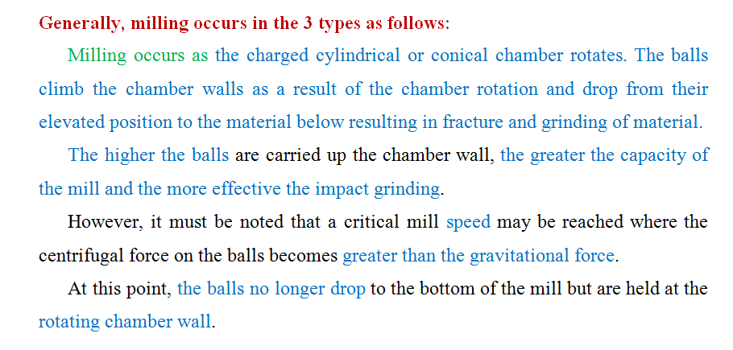

Slide 47
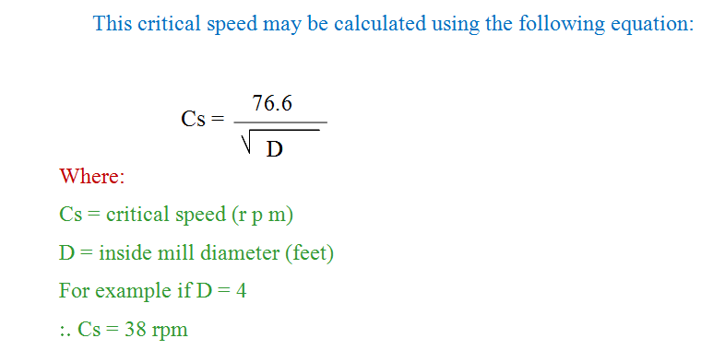
At and above the critical speed, the mill is said to be centrifuging and grinding of material not occur.
Therefore, milling must be carried out below the critical speed of the mill at some optimum speed where the balls are carried to the highest point in the chamber without centrifuging.

Slide 48
This speed is dependent on:
Chamber size
Grinding - media size (i.e. Ball size)
Shape, density and size distribution of material.
Amount of material used in the mill.
Factors influencing the size of the product in the ball mill:
(1) The rate of feed (2) Weight of balls
(3) The diameter of the balls (4) The slope of the mill
(5) Discharge freedom (6) The speed.

Slide 49
Advantage of the ball mill:
It is used for milling highly abrasive materials.
Disadvantages:
Difficult to clean
Long milling time (i.e. time consuming)
High energy requirements and high cost.

Slide 50
1. Hammer mill, (vertical, horizontal) 2. Cutting mill
3. End and edge runner mill
4. Fluidized energy mill
5. Ball mill and types
6. Oscillating granulator
7. Colloid mill
Intermediate Crushing
Fine Crushing
For Liquids

Slide 51
3- Oscillating Granulator
Feed size = 2.0 mm
Product size: 0.3 mm
It is used for: the size reduction of wet and dry granulations.
Processes: Shearing (with some attrition)
Principle of operation:
It consists of an oscillating bar contacting a woven wire screen. Feed enters through a hopper above the oscillator and screen and is forced through the screen by the oscillating motion of the bar.

Slide 52
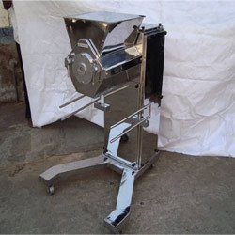

Slide 53
Collection of the product may be directly onto trays in the case of wet granulations or into drums via a sleeve from a specially fitted collec­tor funnel that minimizes dust during the processing of a dry granula­tion to collector (dry) trays (wet).
The oscillator speed is constant while the screens can be interchangea­ble and can produce particle with the desired size

Slide 54
Advantages of the oscillating granulator:
Narrow size range.
Minimum amount of fines obtained during size reduction of a dry granulation.
Very uniform wet granulation size which promotes uniform drying.
Disadvantages:
Low rate of production
Wear on the screens.
The possibility of product contamination by metal particles chipped/ away form the screen by the oscillator.

Slide 55
1. Hammer mill, (vertical, horizontal) 2. Cutting mill
3. End and edge runner mill
4. Fluidized energy mill
5. Ball mill and types
6. Oscillating granulator
7. Colloid mill
Intermediate Crushing
Fine Crushing
For Liquids

Slide 56
Colloid mills

Slide 57
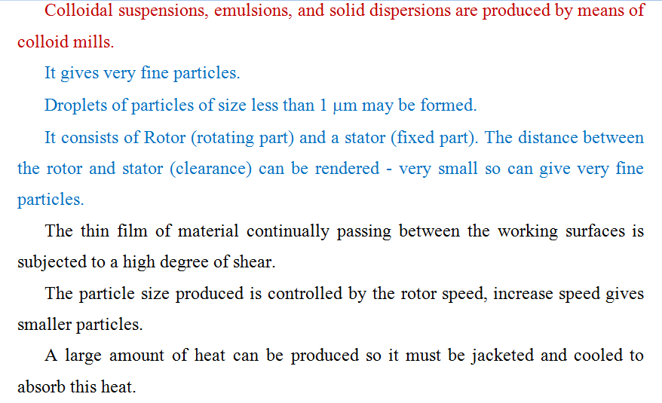

Slide 58
Conclusions:
Size Reduction
Definition
Theory and mechanisms of size reduction
Mechanism of size reduction
Size reduction equipment
Hammer mill, (vertical, horizontal) Cutting mill
End and edge runner mill
Fluidized energy mill
Ball mill and types
Oscillating granulator
Colloid mill

