Slide 1

College of Business Administration
Health Administration Department
HHA-501 Health Administration Course
Dr. Mohammed Aljuaid
Office: S271, second floor, Business Admin. College
Tel:0114674305
maljuaid@ksu.edu.sa

Slide 2
Agenda…
Welcome!
About Me…
Syllabus/Course overview
My Objective/ Role
My Expectations
Need for this Course

Slide 3
Course Outline
Session Topic
Session 1 Introduction to HA
Session 2 Personality and EQ
Session 3 Motivation
Session 4 Team Processes and Creativity
Session 5 Leadership Fundamentals
Session 6 Power and Influence
Session 7 Organizational Culture
Session 8 Organizational Change
Session 9 Selected themes in HRM
Session 10 Syndicate team works/ Exam Review
Individual
Team
Firm

Slide 4
Course Materials
No core text book
Chapters in books
Papers
Reports
All available online or in the library
Reading list and material on the lecturer website
Lecture slides
  On the lecturer website
  Before each lecture

Slide 5

Assessments
Individual
•Final Exam 70%
Participation (Exercises)
•6 Quizzes 20%
•Everest Simulation 10%

Slide 6
My Objective/ Role…
To create ALE and have FUN.
Affirmative
Learning
Environment

Slide 8
My Expectations…
FOUR “P” MODEL
Presence & Punctuality (physically present on time and with your completed readings)
Preparation (Reading articles: have something useful to say)
Participation (active involvement-Class/ Team)
Professionalism (listen to classmates, challenge ideas not people)

Slide 9

Need for this Course…

Slide 10
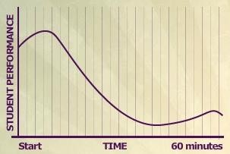
Bligh (1998): attention span in lectures
N= 350
(152 males and 198 females in the treatment group)
100 mins

Slide 11
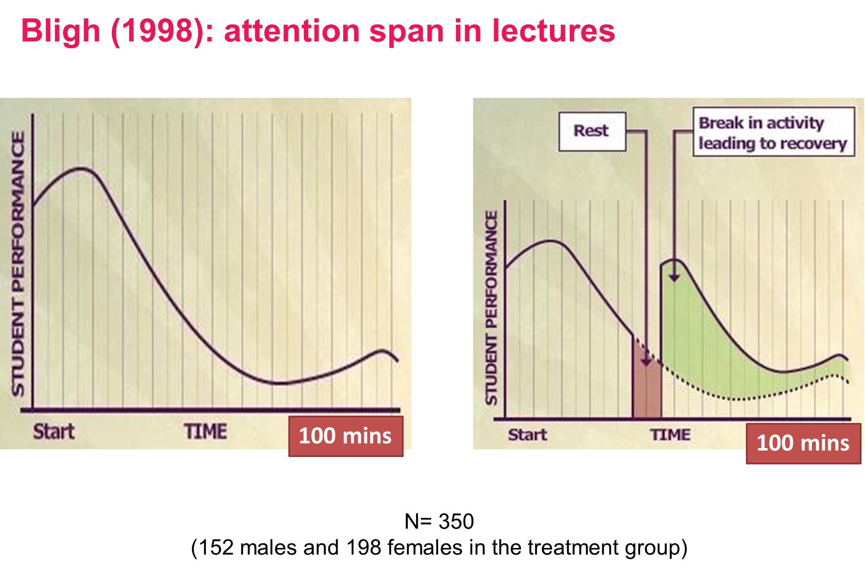

Slide 12
Preparation for the next class…
Read article: “What Makes a leader, HBR”

Slide 13


