Slide 1
Quantitative Proteins Estimation by lowry method

Slide 2
Importance of determining concentration of protein
Quantitative assays Determine the concentration of a substance
Protein assays are one of the most widely used methods in life science research. Estimation of protein concentration is necessary in protein purification, cell biology, molecular biology and other research applications.
Is necessary before processing protein samples for isolation, separation and analysis.

Slide 3
Example
You have different egg samples, and you want to estimate the protein concentration in each, how you will do it?
First, you must know that there are many method for protein determination,

Slide 4
Specificity and Sensitivity of the method
Sensitivity of an assay is a measure of how little of the analyte the method can detect
Specificity of an assay relates to how good the assay is in discriminating between the requested analyte and interfering substances

Slide 5
There are many Spectrophotometric method for determining the protein concentration
Bicinchoninic acid method
lowry
Bradford
Warburg christian
(A280/A260)
biuret
There are a wide variety of protein assays available. but each assay has its own advantages and limitations
The factors that you should consider in choosing a method:
Sensitivity
The presence of interfering substance
Time available of the assay

Slide 6
Method | sensitivity | Time | Reagent
Biuret | Low (1-20 mg) | 20-30 min | Alkaline copper-sulphate | Destructive to protein samples
Lowry | High (-5 µg) | 40-60min | Cu+ Folin-Ciocalteu reagent | Destructive to protein samples
Bradford | High (-1 µg ) | 15min | Coomassie brilliant blue G-250 | Destructive to protein samples
BCA | High(1 µg ) | 60 min | Cu+2, Bicinchoninic acid | Destructive to protein samples
Warburg christian (A280/A260) | Moderate (50-100 µg ) | ----- | No reagent | -----

Slide 7
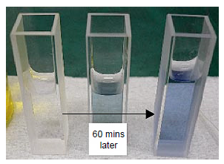
Lowery Method
Is based on two chemical reactions:
The first reaction is the reduction of copper ions under alkaline conditions, which forms a complex with peptide bonds .
The second is the reduction of Folin-Ciocalteu reagent by the copper-peptide bond complex, which subsequently causes a color change of the solution into blue with an absorption in the range of 650 to 750 nm detectable with a spectrophotometer.

Slide 8
Lowery Method
The advantages of this assay are its sensitivity, and most importantly, accuracy
However, it requires more time than other assays

Slide 9
Example
You have different egg samples, and you want to estimate the protein concentration in each, how you will do it?
There is a linear relationship between absorbance and concentration.
First you must have the following,
Your sample
??
Standard solutions
Known concentration
You must measure the absorbance of all the tube, then draw a standard curve

Slide 10
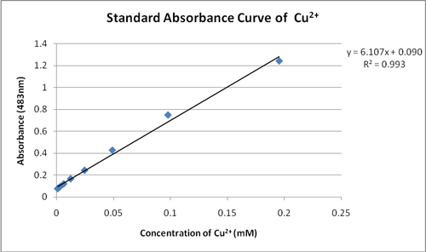
Standard Curve
The amount of protein in the sample can be estimated using a standard curve of a selected standard protein solution such as (Bovine serum Albumin)BSA.
Standard curve are most commonly used to determine
the concentration of a substance, using serial dilution of
solutions of known concentrations(standard solutions)
Concentration of unknown sample

Slide 11
Set up 7 tubes as follows:
Tube | Water | Bovine serum albumin Standard Concentration [100mg/dl] | sample [unknown concentration]
Blank | 1 ml | - | -
A | 0.8 ml | 0.2 ml | -
B | 0.6 ml | 0.4 ml | -
C | 0.4 ml | 0.6 lm | -
D | 0.2 ml | 0.8 ml | -
E | - | 1.0 ml | -
F | - | - | 1.0 ml
Add 3ml reagent C (include copper and alkaline reagent) to all tubes.
Mix and let stand at room temperature for 15 min.
3. Add 0.5 ml of Folin-Ciocalteu reagent. (Add this reagent to one tube at a time and immediately after adding it mix well).
4. Let the tubes stand at room temperature for 45 min. 5. Read absorbance at 720 nm against the blank.

