Slide 1
Software project mgt.
session # 2 – lab manual
Aman quadri
http://faculty.ksu.edu.sa/aquadri

Slide 2
What you’ll do.
Through out the rest of the sessions, you will play the role of the fictitious Project Manager of a defense project, where, you are required to help the MoD to establish a software development center for the ministry of defense, which allows them to develop their own software solutions.

Slide 3
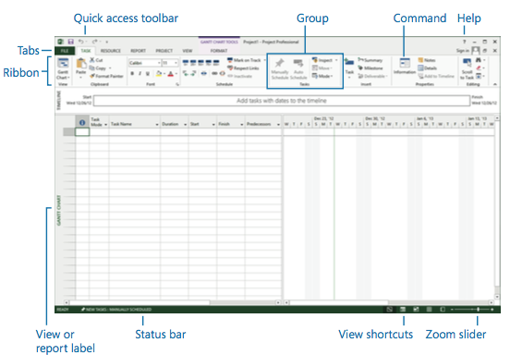
Guided tour

Slide 4
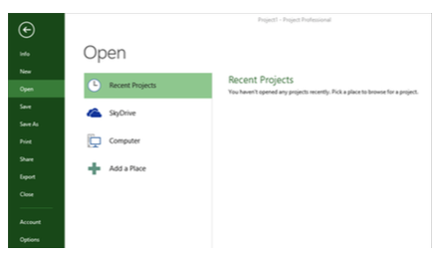
The backstage view

Slide 5
Backstage view..contd
^{Click the File tab .}
Project displays the Backstage view .
If the Open screen is not already visible, on the left side of the Backstage view click the Open tab.

Slide 6
Lets get started! Setup a new plan
Objectives
Start a new plan, set its start date, and save it.
Review the available base calendars, and then create a working-time exception in the project calendar.
Enter some properties about the plan.

Slide 7
steps
In Project, Click on the File tab, and then click New.
For this exercise, you will create a new blank plan.
In the list of available templates, click Blank Project
Notice the “manually scheduled” mode of tasks in the status bar.
On the Project tab, in the Properties group, click Project Information.
Click OK to accept this start date and close the Project Information dialog box.
Observe the change in the time line, when it sets the project start date.
Save the plan:
Click on File – Save As – “Simple plan”

Slide 8
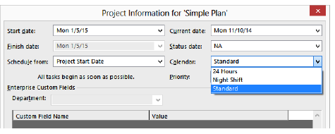
Setting non-working days
The project calendar defines the general working and nonworking days and time for tasks.
Project includes multiple calendars, called base calendars.
Review the existing calendars in the Microsoft Project.
On the Project tab, in the Properties group, click Project Information.
The Project Information dialog box appears.
In the Calendar box, click the down arrow.

Slide 9
Review the different types of calendars
Select the Standard calendar and close the Project Information
Setting a non working day in the calendar.
On the Project tab, in the Properties group, click Change Working Time.
The Change Working Time dialog box appears
In the Name field on the Exceptions tab in the lower portion of the dialog box, type Eid party, and then click in the Start field.
In the Start field, type 1/22/15, and then click the Finish field or press the Right Arrow key
Click OK to close the Change Working Time dialog box.

