Slide 1
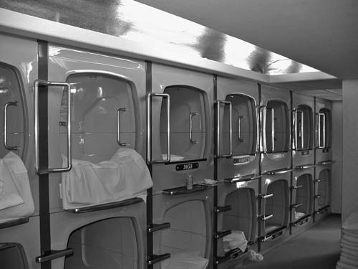
Chapter 3:
Positioning Services
in Competitive Markets

Slide 2
Overview of Chapter 3
Focus Strategies for Services
Market Segmentation
Service Attributes and Levels
Positioning Distinguishes a Brand from its Competitors
Developing an Effective Positioning Strategy
Using Positioning Maps to Analyze Competitive Strategy
Changing Competitive Positioning

Slide 3
Focused Strategies for Services

Slide 4
Standing Apart from the Competition
“A business must set itself apart from its competition. To be successful it must identify and promote itself as the best provider of attributes that are important to target customers.”
George S. Day

Slide 5
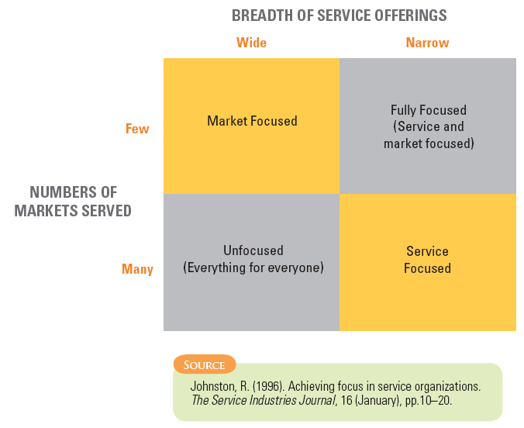
Basic Focus Strategies for Services

Slide 6
Considerations for using Focused Strategies
Fully focused: Limited range of services to narrow and specific market
Opportunities
Developing recognized expertise in a well-defined niche may provide protection against would-be competitors
Allows firms to charge premium prices
Risks
Market is too small to generate needed volume
Demand may be displaced by generic competition from alternative products
Purchasers in chosen segment may be susceptible to economic downturn

Slide 7
Considerations for using Focused Strategies
Market focused
Narrow market segment with wide range of services
Need to make sure firms have operational capability to do and deliver each of the different services selected
Need to understand customer purchasing practices and preferences
Service focused
Narrow range of services to fairly broad market
As new segments are added, firm needs to develop knowledge and skills in serving each segment

Slide 8
Considerations for Using Focus Strategies
Unfocused
Broad markets with wide range of services
Many service providers fall into this category
Danger – becoming a “jack of all trades and master of none”

Slide 9
Market Segmentation

Slide 10
Market Segmentation
Firms vary widely in their abilities to serve different types of customers
A market segment is composed of a group of buyers sharing common characteristics, needs, purchasing behavior, and consumption patterns
Target segments should be selected with reference to
Firm’s ability to match or exceed competing offerings directed at the same segment
Not just profit potential

Slide 11
Service Attributes and Levels

Slide 12
Developing Right Service Concept for a Specific Segment
Use research to identify and prioritize which attributes of a given service are important to specific market segments
Individuals may set different priorities according to:
Purpose of using the service
Who makes decision
Timing of use
Whether service is used alone or with a group
Composition of that group

Slide 13
Important vs. Determinant Attributes
Consumers usually choose between alternative service offerings based on perceived differences between them
Attributes that distinguish competing services from one another are not necessarily the most important ones
Determinant attributes determine buyers’ choices between competing alternatives
service characteristics that are important to purchasers
customers see significant differences between competing alternatives on these attributes

Slide 14
Establishing Service Levels
Make decisions on service levels – level of performance firm plans to offer on each attribute
Easily quantified attributes are easier to understand – e.g., vehicle speed, physical dimensions
Qualitative attributes subject to individual interpretation – e.g., physical comfort, noise levels
Can often segment customers according to willingness to trade off price versus service level:
Price-insensitive customers willing to pay relatively high price for high levels of service
Price-sensitive customers look for inexpensive service with relatively low performance

Slide 15
Positioning Distinguishes a Brand from its Competitors

Slide 16
Four Principles of Positioning Strategy
Must establish position for firm or product in minds of customers
Position should be distinctive, providing one simple, consistent message
Position must set firm/product apart from competitors
A company cannot be all things to all people – must focus its efforts

Slide 17
Principles of Positioning

Slide 18
Developing an Effective Positioning Strategy

Slide 19
Developing an Effective Positioning Strategy
Positioning links market analysis and competitive analysis to internal corporate analysis
Market Analysis
Focus on overall level and trend of demand and geographic locations of demand
Look into size and potential of different market segments
Understand customer needs and preferences and how they perceive the competition

Slide 20
Developing an Effective Positioning Strategy
Internal Corporate Analysis
Identify organization’s resources, limitations, goals, and values
Select limited number of target segments to serve
Competitor Analysis
Understand competitors’ strengths and weaknesses
Anticipate responses to potential positioning strategies

Slide 21
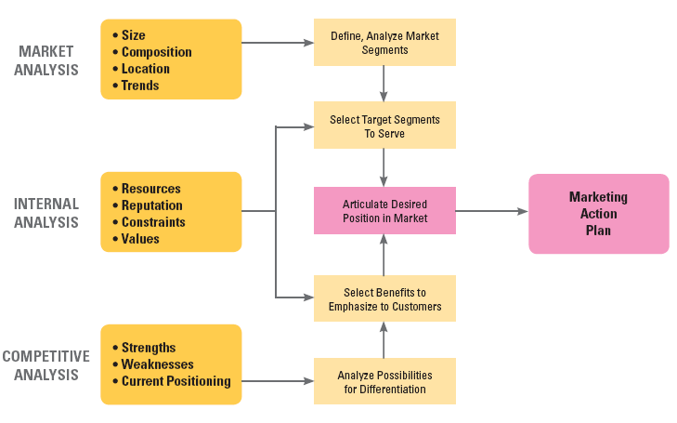
Market, Internal, and Competitive Analyses

Slide 22
Anticipating Competitive Response
Competitors might pursue same market position
Independently do same positioning analysis and arrive at similar conclusions
Threatened by new strategy, take steps to reposition own service
New entrant plays “follow the leader”
Conduct internal corporate analysis for challengers and analyze possible effects of alternative moves
Impact of price cut on demand, market share, and profits
Responses of different segments to changes in service attributes

Slide 23
Using Positioning Maps to Analyze Competitive Strategy

Slide 24
Using Positioning Maps to Plot Competitive Strategy
Great tool to visualize competitive positioning and map developments of time
Useful way to represent consumer perceptions of alternative products graphically
Typically confined to two attributes, but 3-D models can be used to portray positions on three attributes simultaneously
Information about a product can be obtained from market data, derived from ratings by representative consumers, or both

Slide 25
Positioning of Hotels in Belleville: Price vs. Service Level
Expensive
Grand
Regency
PALACE
Shangri-La
High
Moderate
Service
Atlantic
Service
Sheraton
Italia
Castle
Alexander IV
Airport Plaza
Less Expensive

Slide 26
Positioning of Hotels in Belleville: Location vs. Physical Luxury
High Luxury
Grand
Regency
Shangri-La
Sheraton
PALACE
Financial
Shopping District
Inner
District
and Convention Center
Suburbs
Castle
Italia
Alexander IV
Atlantic
Airport Plaza
Moderate Luxury

Slide 27
Positioning After New Construction: Price vs. Service Level
Expensive
Mandarin
New Grand
Heritage
Marriott
Continental
Action?
Regency
PALACE
Shangri-La
High
No action?
Moderate
Service
Service
Atlantic
Sheraton
Italia
Castle
Alexander IV
Less Expensive
Airport Plaza

Slide 28
Positioning After New Construction: Location vs. Physical Luxury
High Luxury
Mandarin
New Grand
Continental
Heritage
Marriott
Regency
Action?
Sheraton
Shangri-La
PALACE
Financial
No action?
Shopping District
Inner
District
and Convention Center
Suburbs
Castle
Italia
Alexander IV
Atlantic
Airport Plaza
Moderate Luxury

Slide 29
Positioning Maps Help Managers to Visualize Strategy
Research provides input to development of positioning maps – challenge is to ensure that
Attributes employed in maps are important to target segments
Performance of individual firms on each attribute accurately reflects perceptions of customers in target segments
Predictions can be made of how positions may change in light of future developments
Charts and maps can facilitate “visual awakening” to threats and opportunities, suggest alternative strategic directions

Slide 30
Changing Competitive Positioning

Slide 31
Repositioning
Firm may have to make significant change in existing position
Revising service characteristics; redefining target market segments; abandoning certain products; withdrawing from certain market segments
Improving negative brand perceptions may require extensive redesign of core product
Repositioning introduces new dimensions into positioning equation that other firms cannot immediately match

Slide 32
Summary
Focus Strategies:
Fully focused
Service focused
Market focused
Unfocused
Market Segmentation – buyers share common characteristics, needs, purchasing behavior & consumption patterns
Service attributes – determinant attributes are often the ones most important to customers

Slide 33
Summary
Positioning links:
Market Analysis
Internal Analysis
Competitive Analysis
Positioning maps are useful for plotting competitive strategy:
Identify potential competitive responses
Help executives to visualize strategy

