Slide 1
Chapter 6:
Setting Prices and
Implementing
Revenue Management

Slide 2
Overview Of Chapter 6
Effective Pricing is Central to Financial Success
Pricing Strategy as Represented by the Pricing Tripod
Revenue Management: What it is and How it Works
Ethical Concerns in Service Pricing
Putting Service Pricing into Practice

Slide 3
Effective Pricing is
Central to Financial Success

Slide 4
What Makes Service Pricing Strategy Different and Difficult?
Harder to calculate financial costs of creating a service process or performance than a manufactured good
Variability of inputs and outputs:
How can firms define a “unit of service” and establish basis for pricing?
Importance of time factor – same service may have more value to customers when delivered faster
Customers find service pricing difficult to understand, risky, and sometimes even unethical

Slide 5
Objectives for Pricing of Services
Revenue and Profit Objectives
Seek profit
Cover costs
Patronage and User-Based Objectives
Build demand
Demand maximization
Full capacity utilization
Build a user base
Stimulate trial and adoption of new service
Build market share/large user base

Slide 6
Pricing Strategy
As Represented by the Pricing Tripod

Slide 7
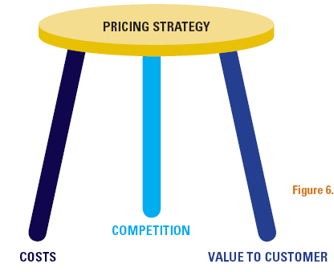
The Pricing Tripod

Slide 8
Floor and Ceiling of Price
Value to customer
Competition
Costs

Slide 9
Three Main Approaches to Pricing

Slide 10
Cost-Based Pricing: Traditional vs. Activity-Based Costing
Traditional costing approach
Emphasizes expense categories (arbitrary overheads allocation)
May result in reducing value generated for customers
ABC management systems
Link resource expenses to variety and complexity of goods/services produced
Yields accurate cost information
BUT, customers care about value to themselves, not what service production costs the firm

Slide 11
Value-Based Pricing: Understanding Net Value
Net Value = Perceived Benefits to Customer (Gross Value) minus All Perceived Outlays (Money, Time, Mental/Physical Effort)
Consumer surplus: difference between price paid and amount customer would have been willing to pay in absence of other options
Competing services are then evaluated via comparison of net value

Slide 12
Value-Based Pricing: Strategies for Enhancing Net Value
Enhance gross value – benefits delivered
Add benefits to core product
Enhance supplementary service
Manage perceptions of benefits delivered
Reduce costs incurred by
Reducing monetary costs of acquisition and usage
Cutting amount of time required to evaluate, buy, use service
Lowering effort associated with purchase and use

Slide 13
Defining Total User Cost
Money
Purchase
Search Costs*
Time
Operating Costs
Physical Effort
Incidental Expenses
Purchase and Service Encounter Costs
Psychological Burdens
Sensory
Burdens
Necessary
Follow-up
Post Purchase Costs*
Problem
Solving
* Includes all five
cost categories

Slide 14
Competition-Based Pricing

Slide 15
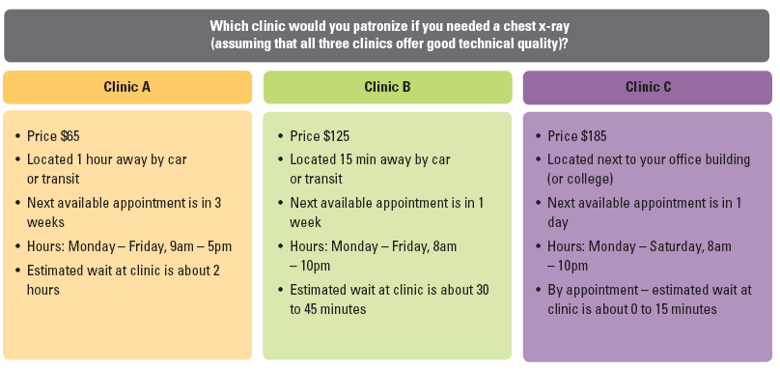
Competitive-Based Pricing

Slide 16
Revenue Management:
What it is and How it works

Slide 17
Maximizing Revenue from Available Capacity at a Given Time
Most effective in the following conditions:
High fixed cost structure
Relatively fixed capacity
Perishable inventory
Variable and uncertain demand
Varying customer price sensitivity
Revenue management (RM) is price customization
Charge different value segments different prices for same product based on price sensitivity

Slide 18
Maximizing Revenue from Available Capacity at a Given Time
RM uses mathematical models to examine historical data and real time information to determine
What prices to charge within each price bucket
How many service units to allocate to each bucket
Rate fences deter customers willing to pay more from trading down to lower prices (minimize consumer surplus)

Slide 19
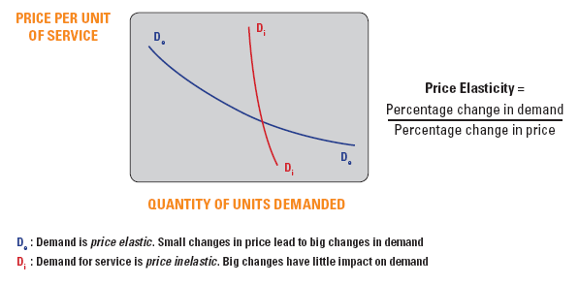
Price Elasticity

Slide 20
Key Categories of Rate Fences: Physical (Product-Related) Fences
Product-Related Fences
Rate Fences | Examples
Basic Product | Class of travel (Business/Economy class) Size and furnishing of a hotel room Seat location in a theater
Amenities | Free breakfast at a hotel, airport pick up, etc. Free golf cart at a golf course
Service Level | Priority wait listing Increase in baggage allowances Dedicated service hotlines Dedicated account management team

Slide 21
Key Categories of Rate Fences: Non Physical Fences
Transaction Characteristics
Rate Fences | Examples
Time of booking or reservation | Requirements for advance purchase Must pay full fare two weeks before departure
Location of booking or reservation | Passengers booking air tickets for an identical route in different countries are charged different prices
Flexibility of ticket usage | Fees/penalties for canceling or changing a reservation (up to loss of entire ticket price) Non-refundable reservation fees

Slide 22
Key Categories of Rate Fences: Non Physical Fences
Consumption Characteristics
Rate Fences | Example
Time or duration of use | Early bird special in restaurant before 6pm Must stay over on Sat for airline, hotel Must stay at least five days
Location of consumption | Price depends on departure location, especially in international travel Prices vary by location (between cities, city centre vs. edges of city)

Slide 23
Key Categories of Rate Fences: Non Physical Fences
Buyer Characteristics
Rate Fences | Examples
Frequency or volume of consumption | Member of certain loyalty tier with the firm get priority pricing, discounts or loyalty benefits
Group membership | Child, student, senior citizen discounts Affiliation with certain groups (e.g., Alumni)
Size of customer group | Group discounts based on size of group

Slide 24
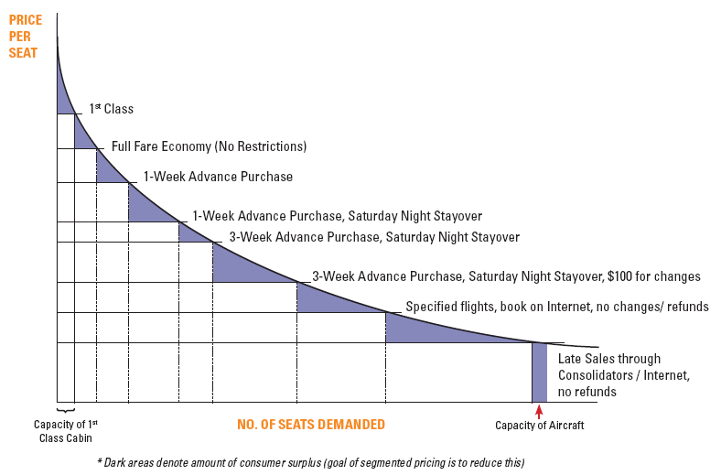
Relating Price Buckets and Fences to Demand Curve

Slide 25
Ethical Concerns in Service Pricing

Slide 26
Ethical Concerns in Pricing
Many services have complex pricing schedules
hard to understand
difficult to calculate full costs in advance of service
Unfairness and misrepresentation in price promotions
misleading advertising
hidden charges
Too many rules and regulations
customers feel constrained, exploited
customers unfairly penalized when plans change

Slide 27
Designing Fairness into Revenue Management
Design clear, logical, and fair price schedules and fences
Use high published prices and present fences as opportunities for discounts
Communicate consumer benefits of revenue management
Use bundling to “hide” discounts
Take care of loyal customers
Use service recovery to compensate for overbooking

Slide 28
Putting Service
Pricing into Practice

Slide 29
Pricing Issues: Putting Strategy into Practice

Slide 30
Putting Service Pricing into Practice
How much to charge?
Pricing tripod provides a useful starting point
A specific figure must be set for the price
Need to consider the pros and cons, and ethical issues
What basis for pricing?
Completing a task
Admission to a service performance
Time based
Monetary value of service delivered (e.g., commission)
Consumption of physical resources (e.g., food and beverages)
1. How much to charge?
2. What basis for pricing?

Slide 31
Putting Service Pricing into Practice
Who should collect payment?
Service provider or specialist intermediaries
Direct or non-direct channels
Where should payment be made?
Conveniently located intermediaries
Mail/bank transfer
When should payment be made?
In advance
Once service delivery has been completed
3. Who should collect payment?
4. Where should payment be made?
5. When should payment be made?

Slide 32
Putting Service Pricing into Practice
How should payment be made?
Cash
Token
Stored value card
Electronic fund transfer
Charge Card (Debit/Credit)
Vouchers
How to communicate prices?
Relate the price to that of competing products
Ensure price is accurate and intelligible
6. How should payment be made?
7. How to communicate prices?

Slide 33
Summary
Pricing objectives can include
Generating revenues and profit, building demand, and developing user base
Three main foundations to pricing a service
Cost-based pricing
Competition-based pricing
Value-based pricing
Firm must be aware of competitive pricing but may be harder to compare for services than for goods

Slide 34
Summary
Revenue management
Maximizes revenue from a given capacity at a point in time
Manage demand and set prices for each segment closer to perceived value
Use of rate fences
Ethical issues in pricing
Complex pricing schedules
Unfairness and misrepresentation in advertising
Hidden charges
Too many rules and regulations

