Slide 1
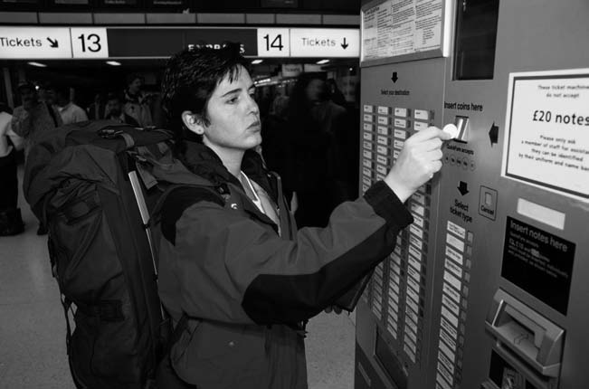
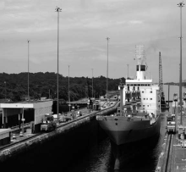
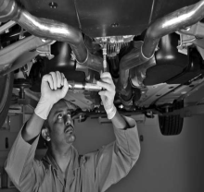
Services Marketing 7e, Global Edition
Chapter 8:
Designing and Managing
Service Processes

Slide 2
Overview of Chapter 8
Flowcharting Customer Service Processes
Blueprinting Services to Create Valued Experiences and Productive Operations
Service Process Redesign
The Customer as Co-Producer
Self-Service Technologies

Slide 3
Flowcharting Customer Service Processes

Slide 4
Flowcharting Service Delivery Helps to Clarify Product Elements
Technique for displaying the nature and sequence of the different steps in delivery service to customers
Offers way to understand total customer service experience
Shows how nature of customer involvement with service organizations varies by type of service:
People processing
Possession processing
MentalStimulusprocessing
Information processing

Slide 5
Flowcharts for People and PossessionProcessing Services

Slide 6
Flowcharts for Mental Stimulus and Information Processing Services

Slide 7
Blueprinting Services to Create Valued Experiences and Productive Operations

Slide 8
Developing a Blueprint (plan or model)
Developing a Blueprint
Identify key activities in creating and delivering service
Define “big picture” before “drilling down” to obtain a higher level of detail
Advantages of Blueprinting
Differentiate between “frontstage” and “backstage”
Clarify interactions and support by backstage activities and systems
Identify potential fail points; take preventive measures
Pinpoint stages where customers commonly have to wait

Slide 9
Blueprinting the Restaurant Experience: A Three-Act Performance
Act 1: Prologue(introduction) and Introductory Scenes
Act 2: Delivery of Core Product
Cocktails, seating, order food and drinks, tea service
Potential fail points: Menu information complete? Menu intelligible? Everything on the menu actually available?
Mistakes in transmitting information a common cause of quality failure
Customers may not only evaluate quality of food and drink, but how promptly it is served or serving staff attitudes
Act 3: The Drama Concludes
Remaining actions should move quickly and smoothly, with no surprises at the end
Customer expectations: accurate, intelligible and prompt bill, payment handled politely, guest are thanked for their patronage(support)

Slide 10
Improving Reliability of Processes Through Fail-Proofing
Identify fail points
Analysis of reasons for failure reveals opportunities for failure-proofing to reduce/eliminate future errors
Need fail-safe methods for both employees and customers

Slide 11
Setting Service Standards and Targets
Service providers set standards for each step sufficiently high to satisfy and even delight customers
Include time limits, script and prescriptions for appropriate style and manner
Must be expressed in ways that permit objective measurement
Performance targets – specific process and team performance targets for which staff are responsible for

Slide 12
Setting Service Standards and Targets
First impression is important
Affects customer’s evaluations of quality during later stages of service delivery as customer perceptions of service experiences tend to be cumulative
For low-contact service, a single failure committed front stage is relatively more serious than in a high-contact service

Slide 13
Setting Standards and Targets for Customer Service Processes
Service Attributes
(qualities)
Service Process Indicators
Service Process Standards
Performance Targets
Responsiveness
Reliability
Competence
Accessibility
Courtesy
Communication
Credibility
Confidentiality
Listening to the customer
Processing time to approve applications
24 hours
80% of all applications in 24 hours
Creates a Base to Measure Customer Satisfaction
Define Service Quality Goals for Staff
Define/Process Departmental Service Goals

Slide 14
Redesigning Service Processes

Slide 15
Why Redesign?
Revitalizes(refreshes) process that has become outdated
Changes in external environment make existing practices outdated and require redesign of fundamental processes
Rusting(expire) occurs internally

Slide 16
Why Redesign?
Redesign aims to achieve these performance measures:
Reduced number of service failures
Enhanced(improved) productivity
Increased customer satisfaction

Slide 17
Process Redesign: Approaches and Potential Benefits
Eliminating non-value-adding steps
Modernize front-end and back-end processes of services
Shifting to self-service
Delivering direct service
Improve productivity and customer satisfaction
Increase in productivity and service quality
Lower costs and perhaps prices
Enhance technology reputation
Distinguishes company
Improve convenience for customers
Productivity can be improved by eliminating expensive retail locations
Increase customer base

Slide 18
Process Redesign: Approaches and Potential Benefits
Bundling
services
Redesigning physical aspects of service process
A better fit to the needs of target segment
Increase productivity with customized service
Increase per capita service use
Involves grouping multiple services into one offer, focusing on a well-defined customer group
Focus on tangible elements of service process (facilities and equipment)
Increase convenience
Enhance satisfaction and productivity of frontline staff
Promote interest in customers

Slide 19
The Customer as Co-Producer

Slide 20
Levels of Customer Participation
High – Customer works actively with provider to co-produce the service
Medium – Customer inputs required to assist provider
Low – Employees and systems do all the work
Service cannot be created without customer’s active participation
Customer can risk quality of service outcome
Provide needed information and instructions
Make some personal effort; share physical possessions
Involves standardized work

Slide 21
Customers as Partial (incomplete) Employees
Customers can influence(effect) productivity and quality of service processes and outputs
Customers not only bring expectations and needs but also need to have relevant service production competencies
For the relationship to last, both parties need to cooperate with each other

Slide 22
Self-Service Technologies

Slide 23
Self-Service Technologies (SSTs)
Definition
Self-Service Technologies (SSTs) are technological interfaces allowing customers to produce services independent of involvement of direct service employee. Self service technologies are replacing many face-to-face service interactions with the intention to make service transactions more accurate, convenient and faster. For example, automatic Teller Machines, Self pumping at gas stations, Self-ticket purchasing on the internet and Self-check-out at hotels etc.
SSTs are the ultimate form of customer involvement where customers undertake specific activities using facilities or systems provided by service supplier
Customer’s time and effort replace those of employees

Slide 24
Self-Service Technologies (SSTs)
Many companies and government organizations seek to divert customers from employee contact to Internet-based self-service
Advantages:
Time and Cost savings
Flexibility
Convenience of location
Greater control over service delivery
High perceived level of customization
Disadvantages:
Anxiety(worry) and stress experienced by customers who are uncomfortable with using them
Some see service encounters as social experiences and prefer to deal with people

Slide 25
What Aspects Of SSTs Please Or Annoy(upset) Customers?
People love SSTs when… | People hate SSTs when…
SST machines are conveniently located and accessible 24/7– often as close as the nearest computer! Obtaining detailed information and completing transactions can be done faster than through face-to-face or telephone contact | SSTs fail – system is down, PIN numbers not accepted, etc. Customers themselves mess up–forgetting passwords; failing to provide information as requested; simply hitting wrong buttons
Key weakness:Few firms incorporate service recovery systems such that customers are still forced to make telephone calls or personal visits

Slide 26
Putting SSTs to Test by Asking a Few Simple Questions
Does the SST work reliably?
Firms must ensure that SSTs are dependable and user-friendly
Is the SST better than interpersonal alternatives?
Customers will stick to conventional methods if SST doesn’t create benefits for them
If it fails, what systems are in place to recover?
Always provide systems, structures, and technologies that will enable prompt service recovery when things fail

Slide 27
Managing Customer’s Reluctance(unwillingness) to Change
Increasing customer’s participation level in a service can be difficult
Marketing communications to be used to:
Prepare customer for change
Explain the rationale(justifications) and benefits
What customers need to do differently in the future

Slide 28
Summary
Service blueprinting can be used to design a service and create a satisfying experience for customers. Key components of the blueprint include:
Blueprinting a restaurant (or other service) can be a three-act performance
Prologue and introductory scenes
Delivery of the core product
Conclusion of the drama

Slide 29
Summary
Service standards and targets are different and can be used to evaluate performance
Service process redesign reducesservice failure and enhancesproductivity
When the customer is a co-producer, issues to consider are
Levels of customer participation
Self-service technologies (SST)
Psychological factors in customer co-production
Aspects of SST that please or annoy customers

