Slide 1
Radiology of small and large intestines
Department of Radiology

Slide 2
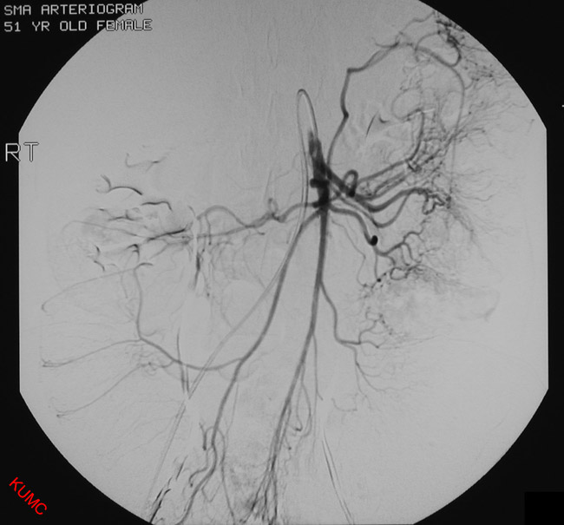

Slide 3
1
4
2
3
5
Middle colic artery.
Jeujenal artery.
Superior mesentric artery.
Right colic artery.
Ileo-colic artery.

Slide 4
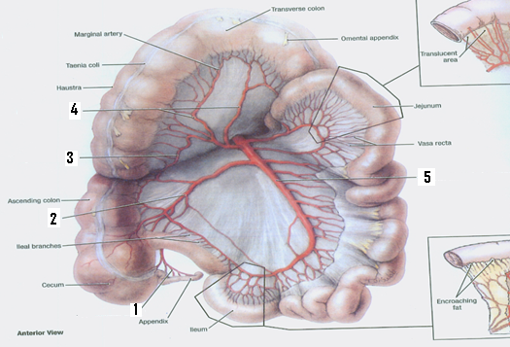
Appendicular artery.
Ileo-colic artery.
Right colic artery.
Middle colic artery.
Superior mesentric artery.

Slide 5
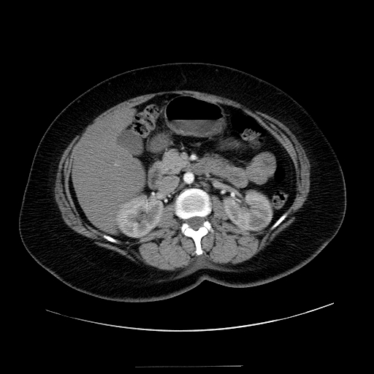
5
1
2
6
3
4
Superior mesentric artery.
Abdominal aorta.
Descending colon.
Left kidney.
Gallbladder.
Inferior vena cava.

Slide 6
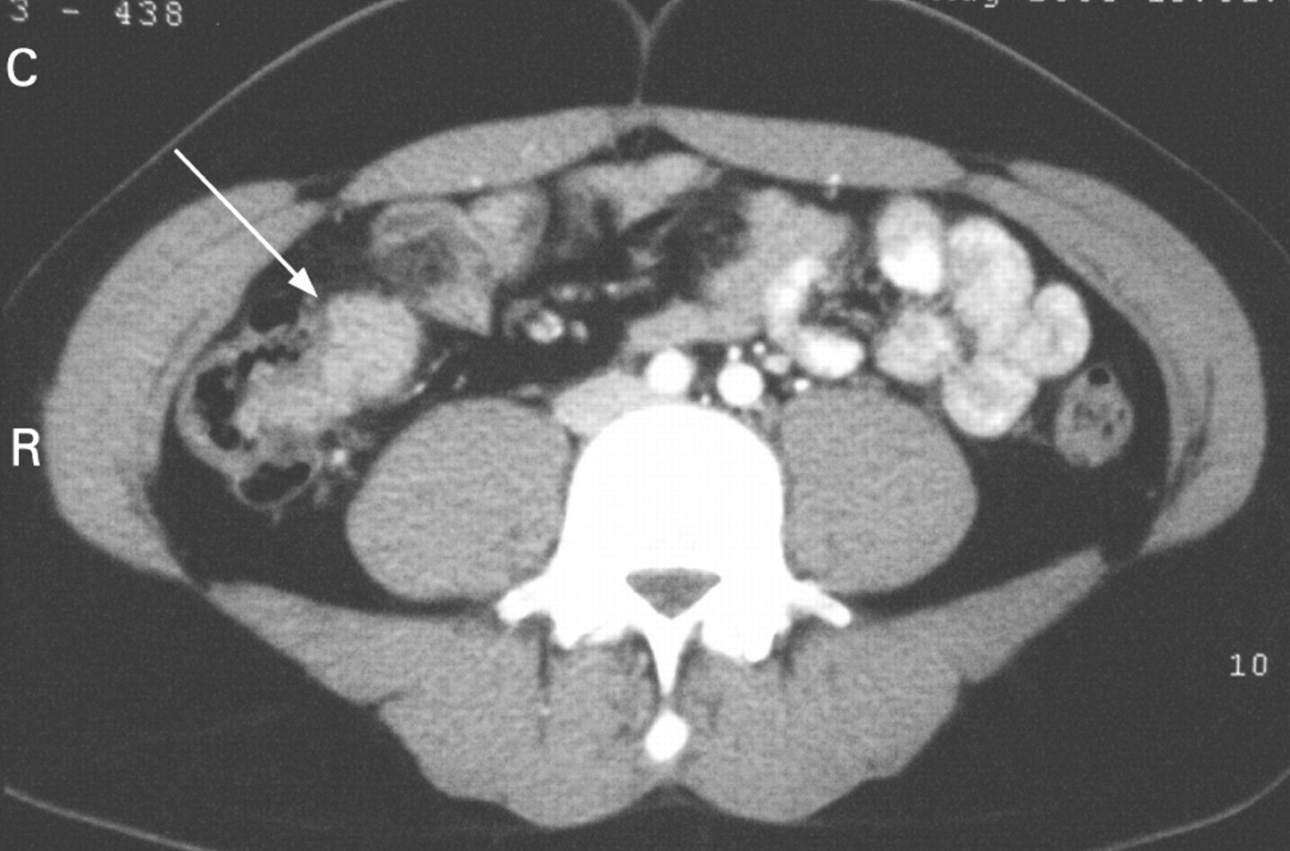
1
3
4
2
5
Left common iliac artery.
Descending colon.
Right common iliac artery.
Ascending colon / caecum.
Right psoas major muscle.

Slide 7
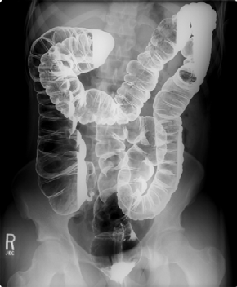
1
2
3
4
5
6
Splenic flexure.
Descending colon.
Sigmoid colon.
Caecum.
Appendix.
rectum

