Slide 1
Soft gelatin capsules

Slide 2
Soft Gelatin Capsules
Definition:
Soft Gelatin Capsules are one-piece forms that encase a predetermined dose of liquid or semi liquid fill.
Filled and hermetically sealed in a single operation

Slide 3
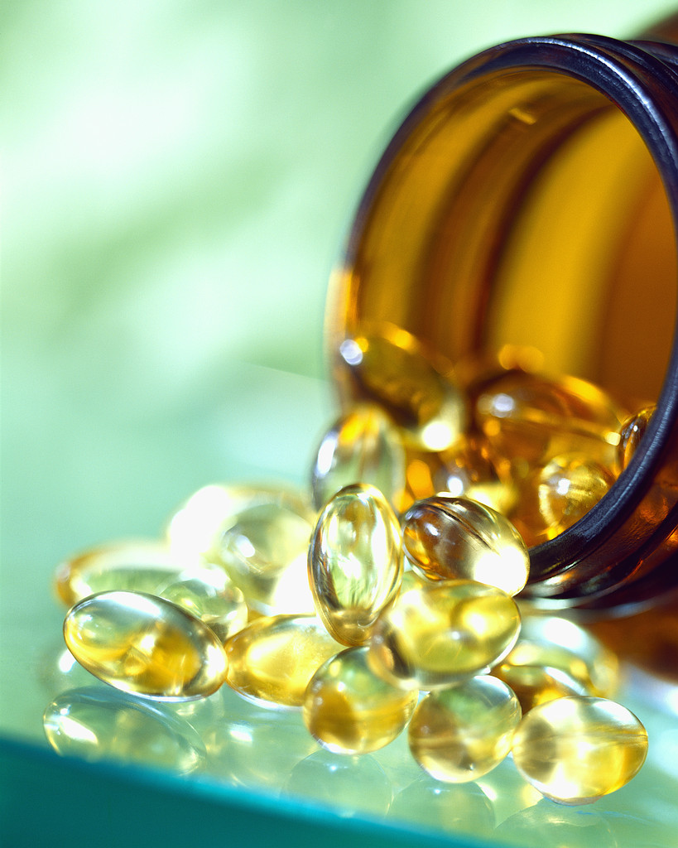
Advantages:
Improved bioavailability
Enhanced drug stability
Superior patient compliance
Product differentiation by colour, size and shape
Portability and easy to swallow
Bad taste masking
Uniformity and precision dosage

Slide 4
Limitations
Equipment
Higher manufacturing cost as compared to tablets

Slide 5
Hard Vs soft gelatin Capsules
Criteria | Hard Gelatin Capsules | Soft Gelatin Capsules
Shell | Less or not plasticized | Plasticized (glycerin, propylene glycol, sorbitol)
Moisture | 12-16% | 6-10%
Sizes and Shapes | Limited Two-piece | One-piece
Content | Usually dry solids | Usually liquids or suspensions (dry solids possible)
Manufacture | Shells made in one operation and filled in a separate process | Formed/filled in one operation
Closure | Traditional friction-fit; mechanical interlock | Hermetically sealed (inherent)

Slide 6
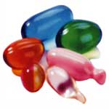
Frequently used capsule sizes
Oblong-20minim
Oval-16minim
Round-9minim
1 Minim = 0.0612 centimeter

Slide 7
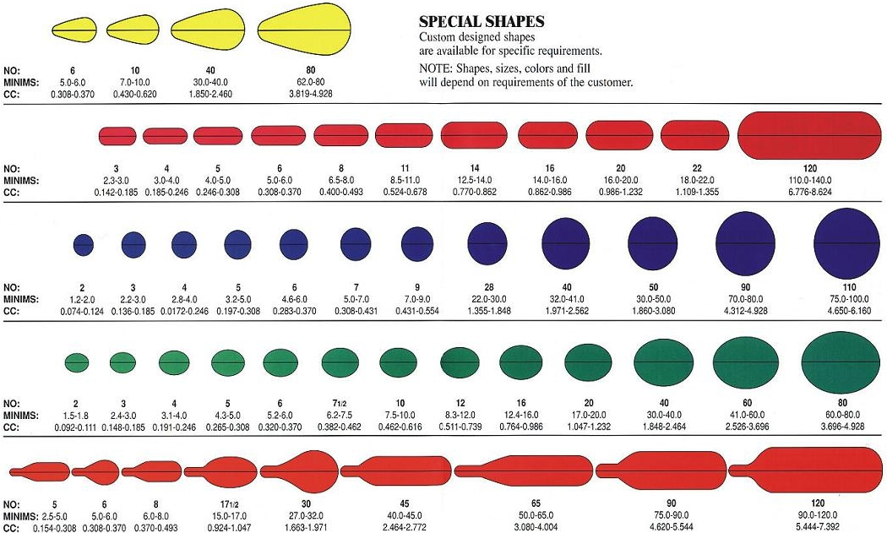

Slide 8
Category I
Additional components of gelatin mass
Ingredient | purpose
glycerin, propylene glycol, sorbitol | Plasticized
Parabens | Preservatives
Water soluble dyes,lakes,vegetable colors | Colorants
Titanium dioxide | Opacifier
Essential oils | Odor & taste
Ethyl vanillin | Odor and taste

Slide 9
Category II
Ingredient | Purpose
Sugar(sucrose) | Chewable shell and taste
Fumaric acid | Aids solubility,reduces adehyde tanning of gelatin

Slide 10
Source and types
Type | Source | Isoelectric pH | Precursor treatment | character
Type-A | Pork skin | 9 | Acidic hydrolysis | Plasticity & clarity
Type-B | Animal bones | 4.7 | alkaline hydrolysis | Tough film
Acid-bone | Bone | 5.5-6.0 | Acid | Intermediate film character.

Slide 11
Importance of plasticizers:
Plasticizer α softness
Determines disintegration and dissolution characters
Must be compatible with fill formulation with minimum migration.

Slide 12
WATER:
To ensure proper processing during gel preparation and soft gel encapsulation.
Excess-capsules become soft and fuse
Insufficient-hard and embrittle
Equilibrium moisture content 6-10%w/w

Slide 13
COLORS:
An important aspect
The color of the capsule shell should never be lighter in hue than capsulated material.
Test for any reaction with the compound
Dark spots with iron compounds
Clear colors –clear type fill
Opaque –suspensions
Titanium dioxide-
As an opaquant and also to protect light sensitive ingredients
In combination with different dyes produces different colors
FD&C,D&C approved colors must be used

Slide 14
PRESERVATIVES
Microbial growth occurs due to presence of moisture.
Examples:
Methyl paraben
Propyl paraben
Humectants-glycerin

Slide 15
FILL FORMULATION:
To dispense active compounds formulated as
Liquids
Semisolids
Suspensions
Micro emulsion preconcentrate(nanoemulsions)
Dry powders
They are formulated such that
Smallest possible capsule consistent with maximum amount of ingredient and it is physically stable.
(ii) Therapeutically effective
(iii)Production efficiency

Slide 16
Liquids:
Determine the solubility of drug in range of pharmaceutically acceptable solvents.
Water-miscible liquids:
PEG-400
Polysorbates(non-ionic surfactants)
5-10% of propylene glycol, ethanol, glycerin
Water-immiscible liquids:
Vegetable oils
Aliphatic & Aromatic chlorinated hydrocarbons
Esters
Ethers

Slide 17
Liquids which can not be incorporated:
Water-in more than 5% of total formulation
Ethyl alcohol
Aldehydes
Liquids with extremes of pH

Slide 18
Methods of manufacture: 1.Plate press method:
Semi-automatic batch process
Gelatin sheets placed on a mold, liquid medication is evenly poured and distributed on it.
A second sheet of gelatin is carefully is placed on the top of the medication.
Apply pressure to the mold to form a fill and sealed capsule simultaneously.

Slide 19
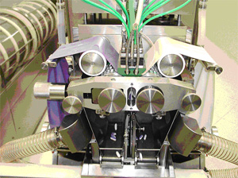
2.Rotary die process
Patented by Robert.P.Scherer in 1933
Principle: Two independent processes take place, often simultaneously,yielding two different materials.Both are united in the encapsulation process that produces wet soft gels.
https://www.youtube.com/watch?v=pu9bvGlCxVc

Slide 20
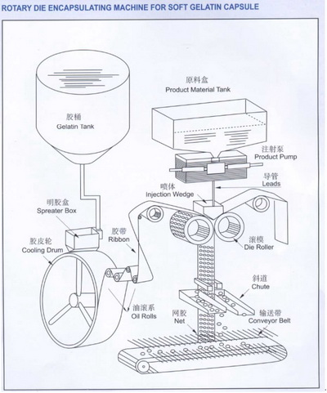

Slide 21
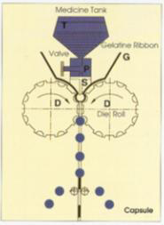
Encapsulation Process
Gelatin ribbons are brought together and the medicine is injected from the segment(S) into the die pocket from the pump(P).
The necessary temperature for sealing is provided by the segment(S) and
pressure provided by the die rolls(D).

Slide 22
Typical parts of the machine:
01. Spreader Box
02. Cooling Drum
03. Oil Lubrication Roller
04. Gelatin Ribbon Guide Roller
05. Die Roll
06. Injection Wedge
07. Capsule Stripper
08. Conveyor
09. Medicine Filling Hopper
10. Medicine Filling Pump

Slide 23
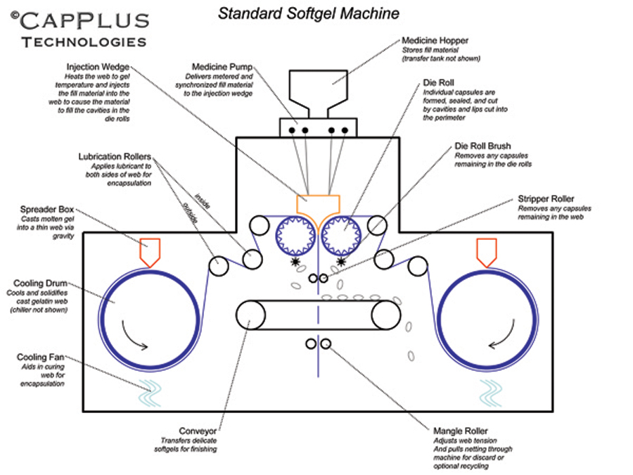

Slide 24
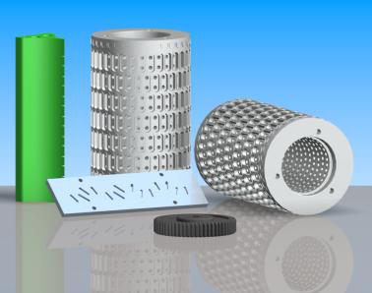
Injection
segment
Die
rolls
Distribution
plate
Change gear

Slide 25
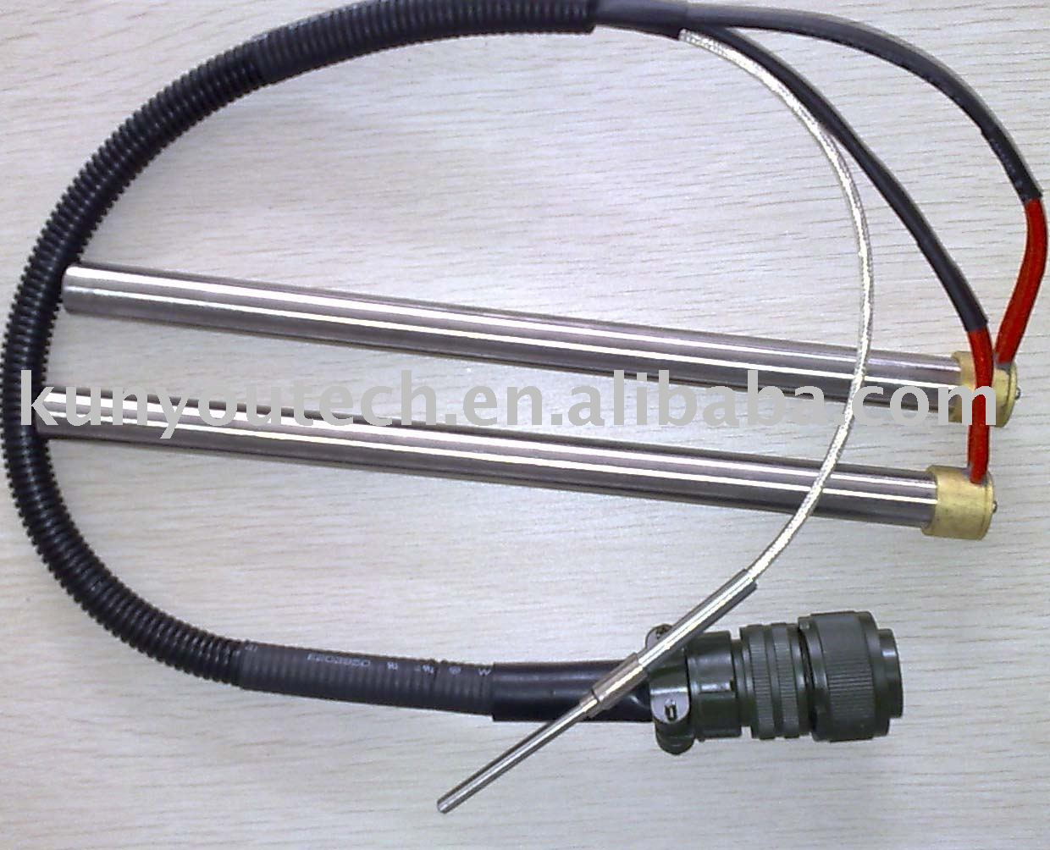
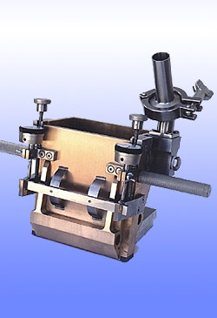
The soft gelatin capsule encapsulation machine wedge heater/ heating element is very important for making good quality softgels
Spreader box

Slide 26
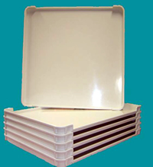
Drying:
Tumble dryer
Tray drying
Moisture content-toluene distillation method
Bulk holding container
Washing
Offline printing
Inspecting
packaging
Tray dryer

Slide 27
Product quality considerations:
Final product testing
Microbiological testing
Assay and identity of activities
Physical appearance
Fill weight
Dissolution & disintegration
Dosage uniformity

