Slide 1
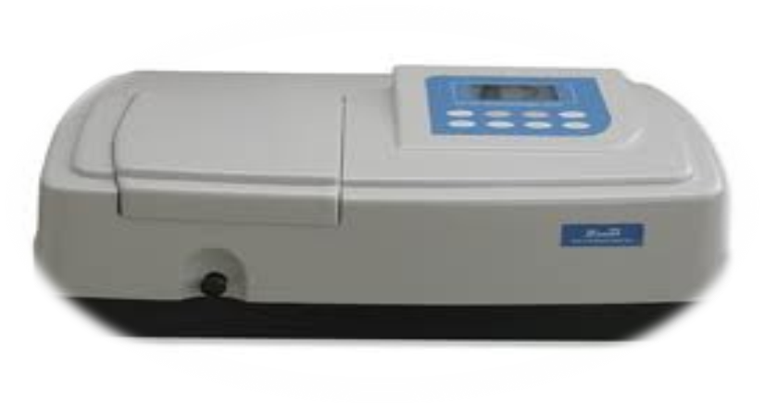
SPECTROPHOTOMETRY

Slide 2
Determines concentration of a substance in solution by Measures light absorbed by solution at a specific wavelength by using spectrophotometer

Slide 3
It contain:
Light source (Lamp)
Optical filters or prism
cuvette
Photocell or photomultiplier tube (detector)

Slide 4
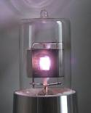
Light source (Lamp)
The most common spectrophotometers are used in the UV and visible regions of the spectrum .
Visible region = tungsten or tungsten-halogen
UV light = deuterium or hydrogen lamp
wavelength | color
400 and under | ultraviolet
400-450 | violet
450-500 | blue
500-570 | green
570-590 | yellow
590-620 | orange
620-650 | red
750 and over | infrared

Slide 5
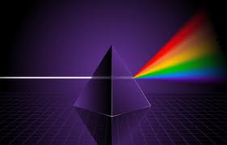
Optical filters/prisms
To limit light to a certain wavelength.
Monochromator can isolate a specific wavelength of white light and allow it to pass through the solution being analyzed

Slide 6
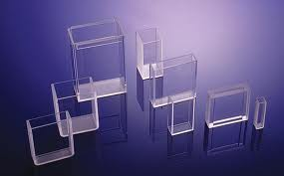
sample cuvettes
Visible range = glass cuvette.
UV range = quartz cuvette.

Slide 7
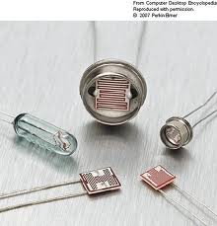
Photocell
To detect transmitted light

Slide 8
Application
qualitative : ( λ max)
The wavelength at which the maximum absorbance .
quantitative : Determination of conc. By
- beer’s lambert law A = abc.
-matching point.
-calibration curve.

Slide 9
qualitative
Absorbance spectrum
A

Slide 10
beer’s lambert law
quantitative
A = abc
Where
A = absorbance(unit less)
a = absorptivity of the compound under standard conditions
b = cell length (cm)
c = concentration of the compound

Slide 11
(a) Unit depends on sample concentration.
If sample concentration unit is
g/L a= absorptivity a=A/b c L. g−. cm−
Mole/L £ = molar absorptivity £=A/b c L. mole− . cm−
g% (g/100ml) ᶜᶬ A 1% EXTENSION COEFFICIENT = g%− . cm−
£= a X molecular weight of sample.
ᶜᶬ A 1% = a X 10
ᶜᶬ A 1% = £ X 10/ molecular weight.

Slide 12
Matching point
For standard (known) Ast = a b cst
For sampl (unkown) As = a b cs
a, b are constant so
Ast = Cst
As = Cs
Conc. Of sample = standard conc. X sample A
standard A

Slide 13
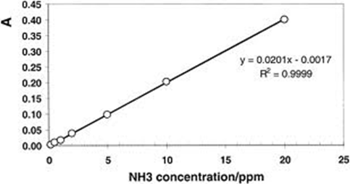
Calibration curve
A plot of absorbance A of serial dilution of standards against their concentration.
Used to determination the concentration of sample.
The curve will be linear with limited conc. But at high conc. Deviation will occur thus should be use the linear part only .

Slide 14
procedure
from solution A prepare five serial dilutions by transferring 10, 20, 30, 40, 50 mls into 100 ml volumetric flask .
To each flask add 2 ml of 0.5 N H2SO4 and complete to 100with distilled water.
Label each flask.
Prepare a blank 2ml H2SO4 and complete to 100 with distilled water.
Measure the five prepared serial dilution at determined λ max

Slide 15
Plot the absorbance vs. concentration ( calibration curve ).
Read the absorbance of unknown solution .
Determine the concentration of the unknown solution from the curve.
Calculate a of sample.
Calculate £ of sample.
Calculate ᶜᶬ A 1% of sample .

Slide 16
Serial V
v¯=100ml
experiment
C=0.0128g%
Determination potassium dichromate concentration by spectrophotometry
Stock solution conc. = 1.6 mg/ ml
A | concentration | Solution (ml)
 | C X V =C¯ X V¯ | 10
 |  | 20
 |  | 30
 |  | 40
 |  | 50
 | From curve | Unknown

Slide 17
problems
1- calculate the conc. Of methyl testosterone in ethanolic solution in which absorbance in 1 cm cell at λ max =241 nm was found to be 0.890 . The ᶜᶬ A 1% in B.p is given as 540 at λ max 241.
Notes:
b c the conc. = 0.89 /540X1 =1.6 X 10¯₃ gm/100ml A= ᶜᶬ A 1

Slide 18
2- calculate the conc. In ug ml¯ of a solution of tryptophane (M.wt=204.2) in 0.1 M Hcl giving an absorbance at its λ max 277 nm of 0.613 in a 4 cm cell .the molar absorptivity is 5432 at λ max.
Notes:
A=∑bc
0.613= 5432 X4 Xc →c= 2.82 X10¯5 mole /l→c= 2.82 X10 ¯5 X 204.2 gm/l →c=0.00576g/l =5.76 ug/ml

