Slide 1
Stat 223 Introduction to the Theory of Statistics

Slide 2
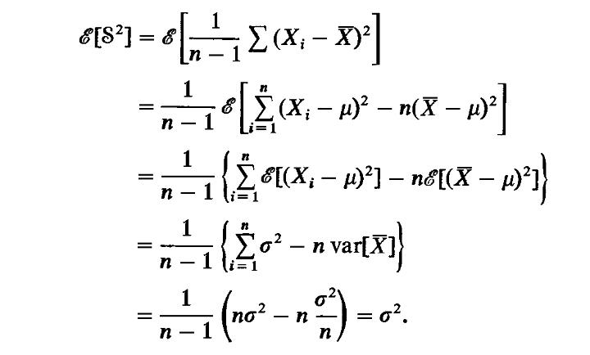
Proof:

Slide 3
