Slide 1
Stat 223 Introduction to the Theory of Statistics

Slide 2
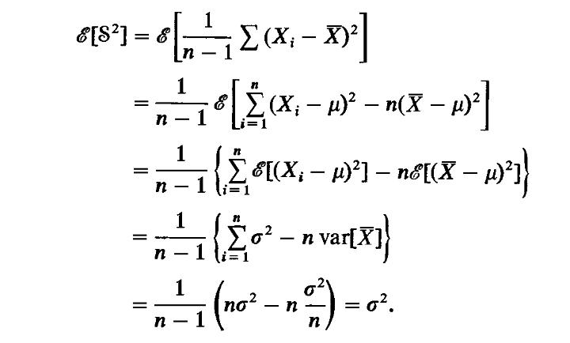
Proof:

Slide 3
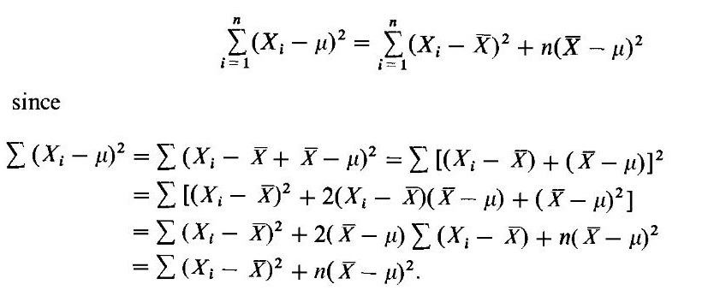

Slide 6
Order Statistic (p251-p254)

Slide 9
Exponential Family (p312-p314) one parameter exponential family:

Slide 10
k parameter exponential family:

Slide 11
The joint distribution of the exponential family

Slide 12
Exponential Family (p312-p314)
Example 1:
Example 2:

Slide 13
Example 3:

Slide 14
Homework: Does the following density function belong to the exponential family?

