Slide 1
E-Marketing/7E Chapter 5
Ethical and Legal Issues

Slide 2
Chapter 5 Objectives
After reading Chapter 5, you will be able to:
Compare and contrast ethics and law.
Discuss the implications of ethical codes and self-regulation.
Identify some of the main privacy concerns within traditional and digital contexts.
Explain some of the important patent, copyright, trademark, and data ownership issues related to the internet.
Highlight key ethical and legal concerns related to online expression.

Slide 3
Software Infringement
Copyright infringement occurs when people download copyrighted software without a license, loan copyrighted software without a license, or install software on more computers than allowed.
Counterfeiting occurs when illegally copied software is duplicated and distributed to others without consent of the copyright owner.
Globally, over 40% of the software sold is an infringing version.

Slide 4
Software Infringement, cont.
Microsoft uses the following remedies:
Proposes intellectual property legislation.
Files civil lawsuits.
Creates noninfringement technologies such as digital rights management (DRM) security programs embedded in software CDs.
Microsoft believes that education is the best weapon against piracy. Do you agree?

Slide 5
Overview of Ethics and Legal Issues
Ethics and law are integrally related.
Ethics frequently concerns the values and practices of those who have expert knowledge of a specific field.
Law is also an expression of values, but created so that citizens will be familiar with their rights and obligations.
Laws governing the internet are at a disadvantage because they may be nearly obsolete by the time of passage.

Slide 6
Ethics and Ethical Codes
Modern technology presents challenges to marketing ethics. Critical issues include:
Ownership of intellectual property.
The role of privacy in a virtual world.
Freedom of expression.
Uses of data and methods of collection.
Status of children who log onto digital networks.

Slide 7
The Problem of Self-Regulation
Recent U.S. administrations have left the development of the internet to the free operation of the market.
Supporters of self-regulation stress the private sector’s ability to identify and resolve problems.
Critics argue that incentives for self-regulation are insufficient and true deterrence cannot be achieved.
Recent policy-making activities indicate that governments are asserting themselves in internet regulation and control in areas such as privacy, data protection and fraud prevention.

Slide 8
Privacy
The concept of privacy encompasses both ethical and legal aspects.
There is constant debate regarding privacy and it has proved to be an elusive concept, both ethically and legally.
No specific privacy provision within the Constitution.
Within society, privacy interests compete with concerns for safety, economics, and need for association with others.

Slide 9
Privacy Within Digital Contexts
Online advertising firms such as DoubleClick have traditionally recorded users’ clickstreams to form user profiles for marketing purposes.
Controversy arose in 2000 when DoubleClick acquired consumer names, addresses, and buying histories and planned to combine offline data with clickstream data, a plan later withdrawn.
Web sites such as Facebook and Google have been involved in numerous privacy cases and class actions.

Slide 10
Privacy Within Digital Contexts, cont.
Nearly every major Web site collects personally identifiable information, but just over half specify on the site how the information will be used.
Cookies, Java applets, and intelligent agents are ubiquitous applications that function without a user’s knowledge or control.

Slide 11
Privacy Debates And Policy
Children’s Online Privacy Protection Act (COPPA) requires that Web sites establish procedures that protect children online and involve parents.
While federals laws relating to internet privacy remain in debate, many offenses can be addressed by conventional statutes:
Fair Credit Reporting Act.
Electronic Communication Privacy Act.
In 2012 the government developed an official framework to improve users’ privacy rights, the Consumer Privacy Bill or Rights.

Slide 12
International Privacy Issues
The European Union (EU) has developed the most comprehensive privacy legislation.
The EU and the U.S. reached agreement in 2000 on safe harbor provisions to protect EU citizen data.
There is also growing interest in personal data protection in Asia, especially Hong Kong, Japan, South Korea and Singapore.
The U.S. Federal Trade Commission has identified the following norms for the ethical use of consumer information: notice, consent, access, security, and enforcement.

Slide 13
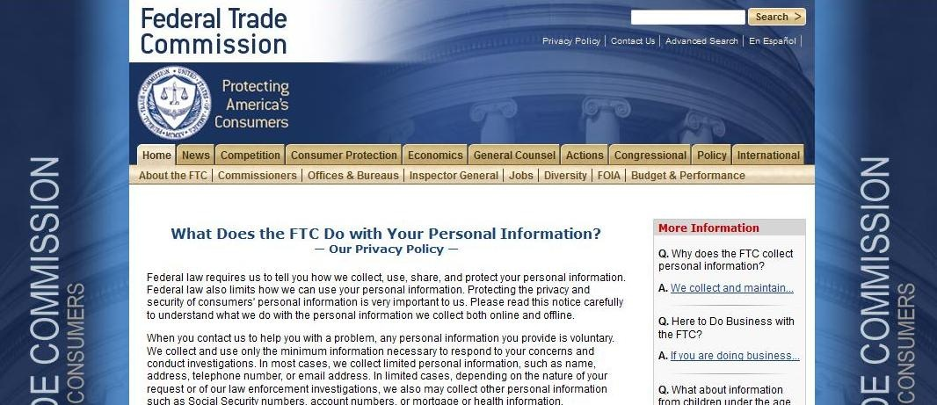
FTC Online Privacy Policy

Slide 14
Digital Property
The law protects intangible or intellectual property through 3 basic mechanisms:
Patent law is centered on inventions.
Copyright law addresses rights to publish, duplicate, or alter expressions of ideas.
Trademark law is concerned with brands and source identifiers in the marketplace.

Slide 15
Patents
Applying patent law to computing is a continually developing field.
Patents prevent competitors from doing the same thing a different way.
Patent protection has been claimed for reverse online auctions, secure credit card processing, and methods for reading Web site ads.
The U.S. Patent Office has decided to increase the rigor of reviewing applications for software-related protection.

Slide 16
Copyright
Copyright is the primary means of protecting most expression on the internet.
Doctrine of Fair Use
Ability to copy protected material for education and news reporting.
Doctrine of First Sale
Limits the ability of copyright holder to obtain profit after the initial time at which the material is sold.

Slide 17
Copyright, cont.
The No Electronic Theft (NET) Act was signed into law in 1997.
Confers copyright protection for computer content and imposes sanctions for infringement.
The 1998 Digital Millennium Copyright Act (DMCA) contains several provisions.
Protects ISPs from acts of user infringement.
Criminalizes the circumvention of software protections.
Complies with international standards for copyrighted material.

Slide 18
Trademarks
Trademark law is the area of intellectual property governing source identifiers for goods or services.
Under the federal Lanham Act, trademarks may be registered and protected under the act.
Trademark law as been applied to the internet naming system of domain names.
Similarities in names may result in trademark infringement claims.
A trademark violation, cybersquatting, involves the registration of domains that resemble or duplicate existing ones.
Metatags, keywords, links and frames have also been sources of trademark infringement claims.

Slide 19
Licenses
Licenses are an increasingly popular method of intellectual property protection.
Licenses allow the buyer to use the product but restrict duplication or distribution.
Licenses may be two basic types:
Shrinkwrap or break-the-seal licenses.
Clickwrap licenses where the user is required to click to accept the terms.
Legal trend favors enforcement of software licenses.

Slide 20
Data Ownership
Legal and ethical debates about data access and ownership questions abound.
Online technologies such as click data and spidering raise concerns about data ownership.
A movement is growing to protect data related to facts, namely specially compiled databases or sui generis data.

Slide 21
Online Expression
Mass distribution of unsolicited email or spam has been the subject of much complaint.
Regulation raises issues of freedom of expression and voluntary opt-in or opt-out.
CAN-SPAM Act of 2003 created a comprehensive, national framework for email marketing.
Expression directed to children remains a highly visible issue within online law and ethics.
Computer Decency Act

Slide 22
Emerging Issues
Online governance and ICANN
The Internet Corporation for Assigned Names and Numbers (ICANN) was formed in 1998 to resolve conflicts related to domain naming.
Jurisdiction is the ability of a court or other authority to gain control over a party.
Traditionally based on physical presence.
Treaties may provide for international resolution and enforcement.

Slide 23
Emerging Issues, cont.
Fraud is the use of deception and false claims to obtain profit.
The internet provides opportunities for novel deceptions.
Spoofing is the use of e-mail or Web sites to impersonate individuals or corporations.
The FTC, FBI, and state agencies have increased their efforts to track and prosecute fraudulent online conduct.

Slide 24
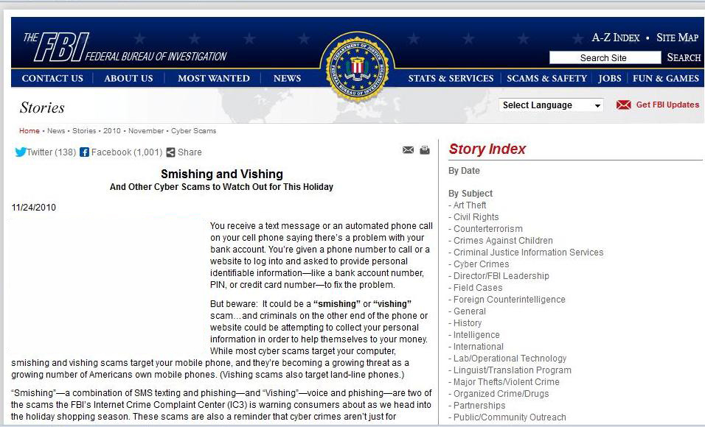
FBI Warns Against Cyber Scams

Slide 25
All rights reserved. No part of this publication may be reproduced, stored in a retrieval system, or transmitted, in any form or by any means, electronic, mechanical, photocopying, recording, or otherwise, without the prior written permission of the publisher. Printed in the United States of America.
Copyright © 2014 Pearson Education, Inc.
Publishing as Prentice Hall

