Slide 1
E-Marketing/7E Chapter 8
Segmentation, Targeting,
Differentiation, and Positioning
Strategies

Slide 2
Chapter 8 Objectives
After reading Chapter 8, you will be able to:
Outline the characteristics of the three major markets for e-business.
Explain why and how e-marketers use market segmentation to reach online customers.
List the most commonly used market segmentation bases and variables.

Slide 3
Chapter 8 Objectives, cont.
Outline several types of internet usage segments and their characteristics.
Describe two important coverage strategies e-marketers can use to target online customers.
Define differentiation and positioning and give examples of online companies using them.

Slide 4
The 1-800-Flowers Story
Jim McCann started 1-800-Flowers as a traditional retailer in New York City in 1976.
In 1995, he extended the brand to the internet and offer 24/7 worldwide delivery.
He used SAS data mining software to identify customer segments for better targeting.
The software analyzed the clickstreams and purchasing patterns of the firm’s 21 million customers.

Slide 5
The 1-800-Flowers Story, cont.
1-800-Flowers can respond to the segment of one person and their purchasing patterns.
The Web site’s Facebook page has nearly 500,000 likes, nearly 14,000 people talking about the site, and over 20,000 Twitter followers.
Over half of its 4.6M online customers are repeat buyers.
Why do you think better segmentation and targeting has lead to increased customer satisfaction?

Slide 6
Segmentation & Targeting Overview
Marketing segmentation is the process of grouping individuals or businesses, according to similarities in use, consumption, or benefits of a product or service.
Market targeting is the process of selecting market segments that are most attractive to the firm.
Targeting segments can include accessibility, profitability and growth potential.

Slide 7
Three Markets
Three important markets sell to and buy from each other:
Business Market: Marketing of products for use in the business operation, as components, or for resale.
Government Market: Federal, state, county, city, and other agencies.
Consumer Market: The consumer market involves marketing goods and services to end consumers.

Slide 8
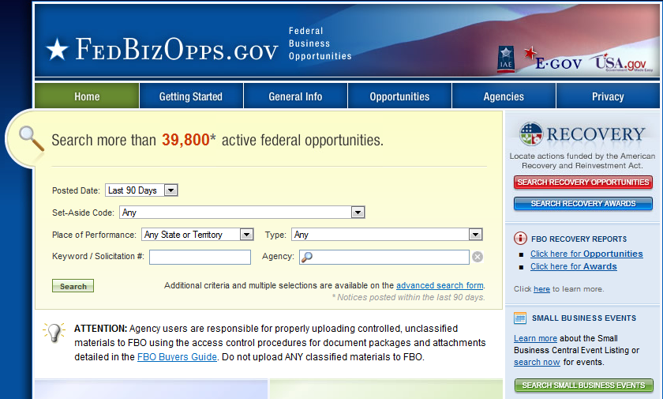
U.S. Government Federal Business Opportunities

Slide 9
Market Segmentation Bases and Variables
Marketers create segments to identify and reach the right people at the right time.
Demographics
Geographic location
Psychographics
Behavior with regard to the product
Claritas PRIZM System can also combine bases, such as geodemographics (geography and demographics).

Slide 10
Geographic Segments
Product distribution strategy is a driving force behind geographic segmentation.
Countries may be segmented based on internet usage.
China has 513M users.
U.S. has 245M users.
Geographic markets may also be evaluated by rates of global Facebook and search engine adoption, language spoken, and other variables.

Slide 11
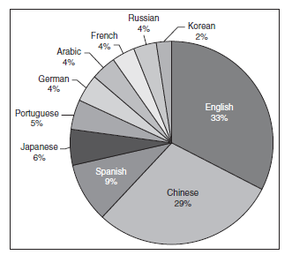
Top Internet Languages

Slide 12
Demographic Segments
In developed nations, users are much like the mainstream population demographically.
Two market segments have recently caught the interest of e-marketers.
Millennials: 60 million people born between 1979 and 1994, over 95% use the internet.
Kids: Under 11 segment will more than double to 25 million by 2015.

Slide 13
Psychographic Segments
User psychographics include:
Personality
Values
Lifestyles
Activities
Interests
Opinions

Slide 14
Interest Communities
Exhibit 8.7 lists 10 important types of online communities, including social networking.
Ways to target online communities:
Provide online discussion groups, bulletin boards, and events or through company-owned social network pages.
Advertise on another firm’s community site.
The firm can join the communities and listen and learn from others.

Slide 15
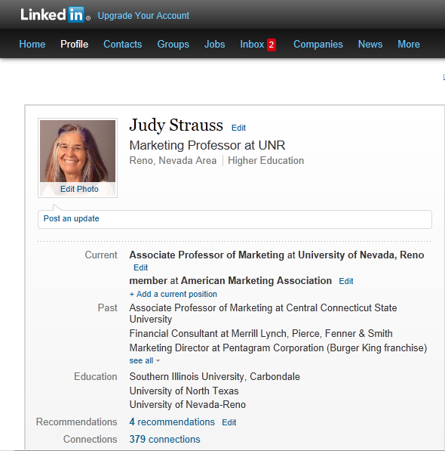

Slide 16
Attitudes and Behaviors
Psychographic information helps e-marketers define and describe market segments.
Some marketers believe that a segment’s attitudes toward technology can help determine buying behavior.
Forrester Research measures attitudes toward technology with a system called Technographics, which identified 10 consumer segments in the U.S. (Exhibit 8.9).

Slide 17
Influentials
Influentials are individuals who are opinion leaders online. They include:
Online journalists, such as Arianna Huffington of The Huffington Post.
Industry opinion leaders, such as Brian Solis, author, speaker, analyst, and blogger.
Influential social network authors, such as Lady Gaga.

Slide 18
Behavior Segments
Two common segmentation variables are benefits sought and product usage.
Marketers using benefit segmentation to form groups of consumers based on the benefits they desire from products.
Marketers often segment by light, medium, and heavy product usage.
Marketers can segment users as brand loyal, loyal to a competitive product, switchers, and nonusers.

Slide 19
Benefit Segments
To determine benefits sought, marketers can look at what people actually do online.
Online activities include connect, create, learn, enjoy, trade, and give.
Marketers also check popular Web sites.
Microsoft, Google, and Yahoo! are consistently among the top Web sites in most countries.

Slide 20
Usage Segments
Marketers can segment according to technology-use characteristics such as smartphone, tablet, or PC and which browser they use.
Mobile access: 55% of cell phone owners connect to the internet using smartphones.
90% of smartphone users have taken an action, such as booking a hotel, after searching.

Slide 21
Online engagement level
Forrester categorizes social media users according to usage segments that are highly engaged online:
Creators who gather other people’s content, upload or share it.
Conversationalists.
Critics.

Slide 22
Targeting Online Customers
E-marketers select a targeting strategy.
Which targets to serve online.
Which locations.
Other factors.
Two targeting strategies are well-suited for the internet.
Niche marketing.
Micromarketing (individualized targeting).
The internet’s big promise is individualized targeting.

Slide 23
Differentiation Online
Differentiation is what a company does to the product to convince the market that the product has specific advantages.
A company can differentiate its offering along many dimensions, including:
Product innovation
Mass customization
Service differentiation
Channel differentiation
Site atmospherics
User generated content

Slide 24
Online Positioning Bases
Positioning is a strategy to create a desired image for a company and its products in the minds of a chosen user segment.
The e-marketer’s goal is to build a position on one or more bases that are relevant and important to the consumer.
Firms can position based on technology, benefits, user category, or competitive position.
The brand story must be told from the customer’s viewpoint.

Slide 25
All rights reserved. No part of this publication may be reproduced, stored in a retrieval system, or transmitted, in any form or by any means, electronic, mechanical, photocopying, recording, or otherwise, without the prior written permission of the publisher. Printed in the United States of America.
Copyright © 2014 Pearson Education, Inc.
Publishing as Prentice Hall

