Slide 1
E-Marketing/7E Chapter 12
E-Marketing Communication:
Owned Media

Slide 2
Chapter 12 Objectives
After reading Chapter 12, you will be able to:
Define integrated marketing communication.
Explain how marketers use the AIDA model and the hierarchy of effects model.
List the five traditional marketing communication tools and distinguish between traditional media and social media.
Identify the differences in control and reach among owned, paid, and earned media.

Slide 3
Chapter 12 Objectives, cont.
Discuss why companies use content marketing.
Describe the most commonly used owned media and their benefits for marketing.
Explain how and why marketers use search engine optimization.
Highlight some of the metrics marketers can use to evaluate owned media performance.

Slide 4
Will it Blend?
Blendtec , a supplier of commercial blenders to Starbucks and others, produced a video in which the CEO blended unusual products such as a garden rake and a golf club.
The video, uploaded to YouTube, received 3.9M views in an 8-month period and 8.2M views since 2010.
The Will It Blend? Campaign clearly shows the product benefits in a humorous and engaging way and the value of connecting with consumers online.
Will It Blend? is a favorite of nearly 10,000 registered YouTube visitors. Is it also one of yours?

Slide 5
Integrated Marketing Communication (IMC)
IMC is a cross-functional process for planning, executing, and monitoring brand communications.
The goal is to profitably acquire, retain, and grow customers.
IMC strategy requires a thorough understanding of target markets, the brand, its competition, and other internal and external factors.

Slide 6
IMC Goals And Strategies
The AIDA and “think, feel, do” (hierarchy of effects) models help guide selection of online and offline MarCom tools to meet their goals.
The models suggest that consumers first become aware of a product before they develop feelings and purchase it.
The models can help marketers select appropriate communication objectives and strategies, such as:
Build brand equity.
Elicit a sales response.

Slide 7
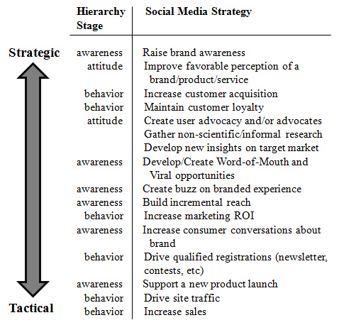
Social Media Strategies & Tactics

Slide 8
Traditional Marketing Communication Tools
The five key marketing communication tools are also called the promotion mix:
Advertising
Public relations
Sales promotion
Direct marketing
Personal selling
Marketers often discuss IMC in terms of senders and recipients, media type, and owned, paid and earned media.

Slide 9
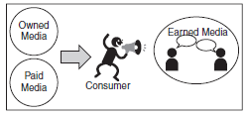
Owned, Paid & Earned Media
Owned media carry communication messages from the organization to internet users on owned channels.
Paid media are properties owned by others who are paid to carry promotional messages.
Earned media are when individual conversations become the channel.

Slide 10
Company Web site
Blog
Support forum/community
Podcast
E-mail, text messaging
Online event
Sales promotion offers
Virtual world
Online games
Gifting
Branded mobile apps
QR codes
Location-based marketing
Social network, microblog
SEO – natural/organic
customers
Digital coverage from
traditional media
Viral marketing
Wikis
Ratings and reviews
Social recommendations
E-mail
Social site discussion
Community discussion
Widgets & social apps
Location-based services
Collaborative content
OWNED
detractors
CONTENT
fans
PAID
EARNED
Display ads
Sponsorships
Classified ads
Product placement
Social media ads
Mobile ads
SEO: Paid search
prospects

Slide 11
Owned Media
Primary goals are to
Engage consumers with positive brand content.
Entice them to pass along content to others.
Exercise CRM (customer relationship management).
All owned media can be considered content marketing.

Slide 12
Web Site
There were an estimated 555 million Web sites at the end of 2011.
The Web site is a door into a company and must provide inviting, organized, and relevant content.
Microsites are Web sites designed for a narrow purpose.

Slide 13
Web Site Landing Pages
A landing page is a unique page that appears after a user clicks on a link associated with a Web site.
Companies create many different landing pages that match key words, current offers, ads, and more.
A/B testing is when there are two versions of a Web page and the company conducts A/B tests to optimize clickthrough rates and conversion to purchase.

Slide 14
Blogs
There were more than 181M blogs at the end of 2011.
CEOs, consultants and thought leaders create blogs to disseminate views, promote books, etc.
Marketers use blogs to draw users to their Web sites and need to decide:
Which platform to use?
Who will do the writing?
How often will they post?
What is the purpose of the blog?

Slide 15
E-Mail
E-mail remains the most important communication technique for building customer relationships.
75.4% of marketers invest in e-mail campaigns.
E-mail has advantages over postal direct mail.
No postage or printing charges.
Immediate and convenient avenue for direct response using hyperlinks.
Can be automatically individualized.
E-mail difficulties include spam filters and finding and maintaining appropriate e-mail lists.

Slide 16
Text Messaging
Short Message Services (SMS), commonly known as text messaging, are up to 160 characters of text sent over the internet with a cell phone or smartphone.
Marketers can build relationships by sending permission-based information when and where consumers want to receive it.
Should be short, personalized, interactive, and relevant.

Slide 17
Sales Promotion Offers
Online sales promotions can build brands, databases, and support sales.
Most do not build long term customer relationships.
Offers are short-term incentives that facilitate the movement of products to the end user. They include:
Coupons
Sampling
Contests, sweepstakes
Virtual worlds
Online games & gifting

Slide 18
Sales Promotion Offers, cont.
Many companies create branded mobile applications and widgets that support social interactions.
45% of companies had branded apps and another 31% planned them in 2012.
Marketers are placing QR codes on physical objects, such as ads, but the outlook is not positive.
Use of two-dimensional mobile tags in retail stores is growing.

Slide 19
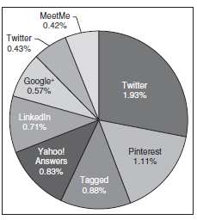
Social Networks
90% of companies with over 100 employees participate in social media.
Marketers must realize that social networks are not purely for selling.
Communicating with and learning from users are important goals.
Social network share of visits (FB and YouTube had 58.8% and 24.6% respectively).

Slide 20
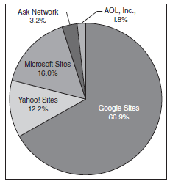
Search Marketing
Search marketing is marketing via search engines.
Complex art and science to drive qualified visitors to a Web site and convert them to customers.
Search engine market shares in Oct. 2012.

Slide 21
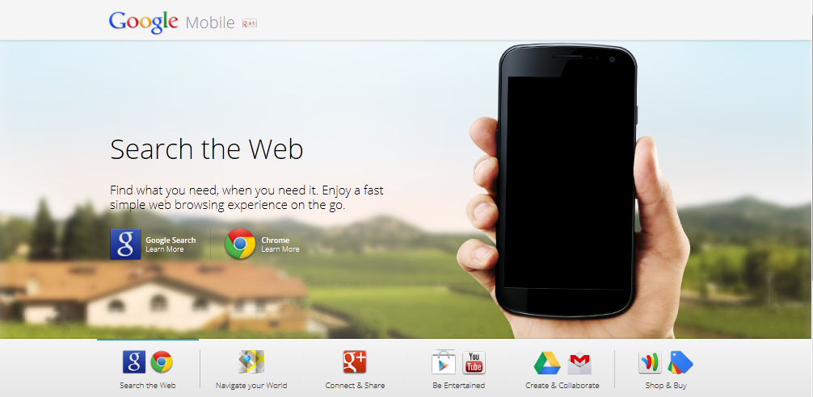
Google Leads With Local Search

Slide 22
Natural Search
Natural search (organic search) involves optimizing a Web site so it will appear near the top of search engine results.
When Web sites are optimized for content and meta tags that hold keywords, search engines know how to categorize the site.
Principles of SEO (search engine optimization) include:
Spread fresh content all over the Web.
Design for relevance and popularity.
Optimize content.
Adjust site to changing search algorithms.

Slide 23
Vertical Search
Vertical search is site-specific search on specialized topics, such as travel or books that helps users find what they are looking for quickly.
Hotels, for example, would want to be listed on a vertical search site such as TripAdvisor.
Vertical search site examples include:
ZoomInfo
LinkedIn
CareerBuilder

Slide 24
Owned Media Performance Metrics
Marketers use Web analytics for company-owned Web sites and blogs.
For owned media, sales promotions, and direct marketing, there are also appropriate metrics.
Podcasts: number of downloads and length of time listening.
Branded mobile apps: number of downloads, updates and actions.
Visits to sales promotion game sites.
Communication opt-in from content participants
Number of email messages read or forwarded to a friend.

Slide 25
All rights reserved. No part of this publication may be reproduced, stored in a retrieval system, or transmitted, in any form or by any means, electronic, mechanical, photocopying, recording, or otherwise, without the prior written permission of the publisher. Printed in the United States of America.
Copyright © 2014 Pearson Education, Inc.
Publishing as Prentice Hall

