Slide 1

Studio 4.
Project Planning and
Literature Review
GE105
Introduction to Engineering Design College of Engineering
King Saud University
Summer 2017

Slide 2
Project Planning
Contents:
Literature Review
Group Activity

Slide 3
Project Planning

Slide 4

Studies report that nearly half of all projects initiated are not completed because of:
Assigning tasks to the wrong individuals
Poor Planning of Tasks
Failure to Implement the tasks
Poor Estimation of the difficulty or risks or resources
Bad Management
You do not manage time
You manage your commitments
The Main Reason For Failure: You Don’t Start Soon Enough

Slide 5
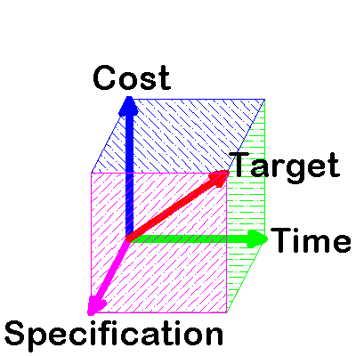
Project Parameters
Project Parameters
Quality
Cost*
Time
Target
GE105 project
YOUR TIME
Specifications
Budget*
Schedule
Due Date
Notes:
Parameters: معايير
Specifications: مواصفات
Triple Constraint Theory
Projects are constrained by three variables:
specification
time
resources
These are not mutually exclusive
Errors or overruns in one are likely to have knock-on effects on the others
* What is the difference between Cost and Budget? (Budget: is what you are allowed to spend, Cost: the price of the final product)

Slide 6


Phases of Project Planning
Define the project’s scope* (including literature review given at the end of these slides)
Develop the project’s plan
Implement the plan
Control the process
Complete the project
What is a project plan?
Can be as simple as a list of sequences for a small project
Can be more complex with charts, tables, costings etc. for a larger project
4
Notes:
* i.e. what must you do to achieve target (just a list)

Slide 7
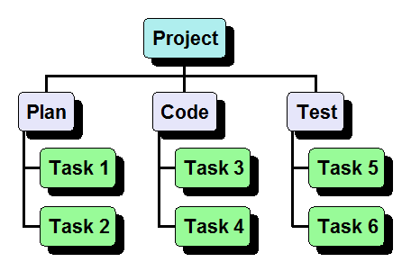
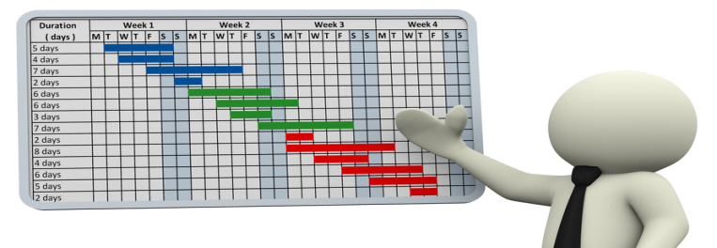
Develop the Project’s Plan
Break Down Project
Tasks (WBS)*
Task 1 – 20hrs
Task 2 – 10hrs – FS 1
Task 3 – 15hrs – FS 1
Task 4 – 25hrs – FS 2
Time Estimation &
Dependencies
Review & adjust
Task | Hrs | Who
Act. 1 | 10 | Ali
Act. 2 | 7 | Ahmed
Act. 3 | 13 | Omar
Assign Tasks
Develop Gantt Chart
Notes:
Planning is an iterative process. Some projects won’t require a proposal
* WBS: work breakdown structure

Slide 8
Work Breakdown Structure (WBS)
A hierarchical representation of activities
It starts with the major project tasks to be accomplished
It breaks the project tasks into actionable* pieces of work, segmenting elements into appropriate sublevels
Number of levels depends on project complexity
Notes:
* Usually this means that such actions are designed to be performed by a single person within a ‘reasonable’ amount of time (e.g. week – ten days)

Slide 9
Task Dependencies
Dependencies are the relationships between activities
“Finish to Start (FS)” example
Task B cannot begin until
Task A is complete
Examples of other dependency types:
Start-Start (SS): have to start at the same time
Finish-Finish (FF): have to end at the same time
Unconstrained: the task can start at any time
A
B
Notes:
The most common type of linkage is Finish to Start

Slide 10
Network Charts
Task 1 – 20hrs
Task 2 – 10hrs – FS 1
Task 3 – 15hrs – FS 1
Task 4 – 25hrs – FS 2
Task 5 – 12hrs – FS 1,2
Task 6 – 20 hrs – FS 4,2
Task 7 – 10 hrs – FS 6
Note: FS=Finish to Start
Task 1
Task 2
Task 4
Task 6
Task 5
Task 3
Task 7

Slide 11
Responsibility Matrix
Creates accountability by assigning each task to the person with the right skill
Task | Hours Needed* | Who
Activity 1 | 10 | Ali
Activity 2 | 7 | Ahmed
Activity 3 | 13 | Abdullah
Notes:
* Q: how can you assess how much time a task needs? Usually, this comes with experience, and from reading other projects

Slide 12

Gantt Chart Basics
Generated from Network Chart
In a single page, it graphically shows :
    Timeline for each task
    Dependencies of tasks
    Progress towards project completion
May include initials of the responsible for each task
  “Milestone" events marked with a special symbol
Notes:
* Note, student must be familiar with -and show- all 4 planning stages: WBS, Network Chart, Responsibility Matrix, Gantt Chart

Slide 13
Gantt Chart Example*
Task | Wk1 | Wk2 | Wk3 | Wk4 | Wk5 | Wk6 | Wk7
Literature Review
Requirement Analysis
Human Factors
Problem Formulation
Progress Report
Concept generation
Creative Design
Design evaluation
Final Report
Notes:
* Note, you can –possibly– change task color to match person (and include a key to the colors to match the person)

Slide 14


Project Planning Summary
Create WBS to identify activities
Estimate time durations
Note dependencies between tasks
Assign the right person to the right task
Schedule activities using a Gantt chart
Put plan into action
Document, document, document !

Slide 15
Literature Review

Slide 16

Purpose of a literature review
Find out what others did and avoid duplication of efforts
Learn from achievements/failures of other engineers
Better identify and estimate the risk in achieving the tasks
Highlight gaps and under-researched areas
Find ideas about approaches and methods which had not occurred to you
Learn how you might classify and present your own data
Notes:
(last bullet) Indeed, after a literature search and review the focus of the research may change or be slanted somewhat differently.

Slide 17
Literature Review model
Example: you may be researching the academic performance of Saudi students in higher education
Higher education
Saudi students
Academic performance
Notes:
This is the kind of figure (Venn diagram) that is useful to bear in mind if you are carrying out an on-line search. You can enter as many subject keywords as you think are relevant for each component of your topic. The search engine will combine the subject terms for you when you perform your search.

Slide 18


Where do you search?
Internet
  Use keyword searches in Google Scholar: http://scholar.google.com/
Digital Libraries
  Need to use accurate keywords to identify relevant articles
Libraries
  Look through the list of journals and browse the books on the shelves to find relevant ones

Slide 19
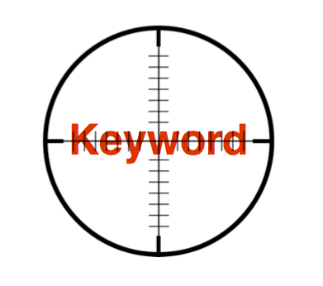
Basic Steps
Identify a coherent set of keywords
Concise and exhaustive
Example:
(Saudi students OR Saudi education OR Saudi learning) AND
(academic performance OR academic achievement )
AND
(higher education OR colleges OR universities)
Search your sources for relevant publications (Identify search time-span)

Slide 20

Compile and sort the collected material
Extract a list of references
Refer to references whenever contents are used
Include this list of references in your final document
Write your literature review
Always acknowledge the source of information
Do NOT copy word-for-word from a reference
Adhere to ethical norms and avoid plagiarism; This issue will be looked at very seriously throughout the course

Slide 21
Group Activity

Slide 22

Project Planning Class Activity
Create a work breakdown structure for your project and an initial Gantt Chart
Watch the following video for ideas: https://youtu.be/ADK58IRPKh8
Decide on the appropriate keywords for your projects’ literature review
Notes:
Also check out How to make a Basic Gantt Chart in Microsoft Excel: https://youtu.be/-oD50HSBBBI

