Slide 1
Swaps
Interest Rate Swaps
Commodity Swaps

Slide 2
Swaps
Interest rates/Commodity prices could change over time , investors may consider entering a swap
To get constant rate/price (Swap rate/price) on their investments.

Slide 3
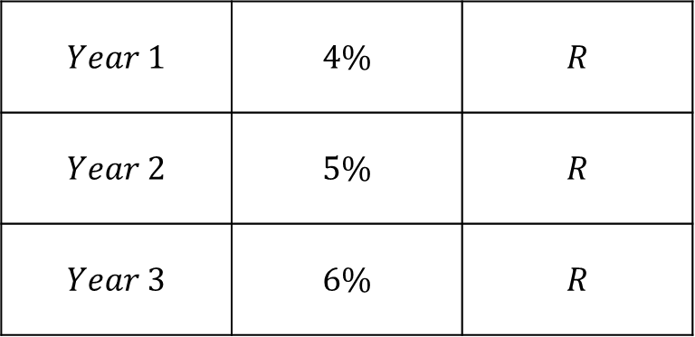
Interest Rates Swaps
Floating / Changing
Rates
Constant / Swap
Rates
$$Year 1$$ | $$4\%$$ | $$R$$
$$Year 2$$ | $$5\%$$ | $$R$$
$$Year 3$$ | $$6\%$$ | $$R$$

Slide 4

Interest Rates Swaps
PV of Interest payments
By changing rates
PV of Interest payments
By the Swap rate
$$=$$

Slide 5

Example
$$3−year loan of 50,000,000 to be paid once after three years but interest is paid annually$$
$$with s_{1}=4\% , s_{2}=5\% , s_{3}=6\%.$$
$$Interest payments:$$
$$f_{0,1}∙50,000,000 in year 1$$
$$f_{1,2}∙50,000,000 in year 2$$
$$f_{2,3}∙50,000,000 in year 3$$
PV of Interest payments
By changing rates
$$Note:50,000,000 is called notional amount$$

Slide 6
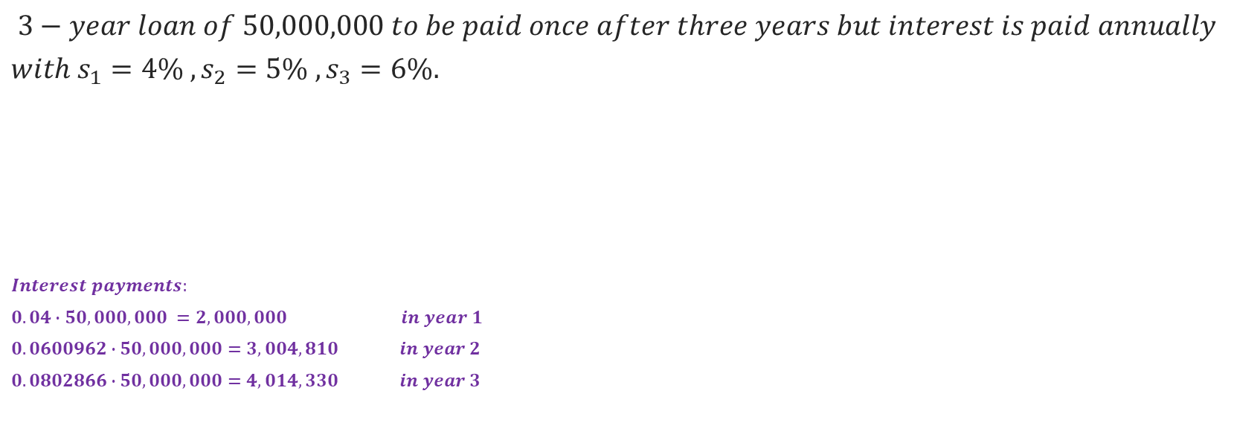
Example
$$3−year loan of 50,000,000 to be paid once after three years but interest is paid annually$$
$$with s_{1}=4\% , s_{2}=5\% , s_{3}=6\%.$$
$$Interest payments:$$
$$0.04∙50,000,000 =2,000,000 in year 1$$
$$0.0600962∙50,000,000=3,004,810 in year 2$$
$$0.0802866∙50,000,000=4,014,330 in year 3$$
PV of Interest payments
By changing rates
$$Note:50,000,000 is called notional amount$$

Slide 7
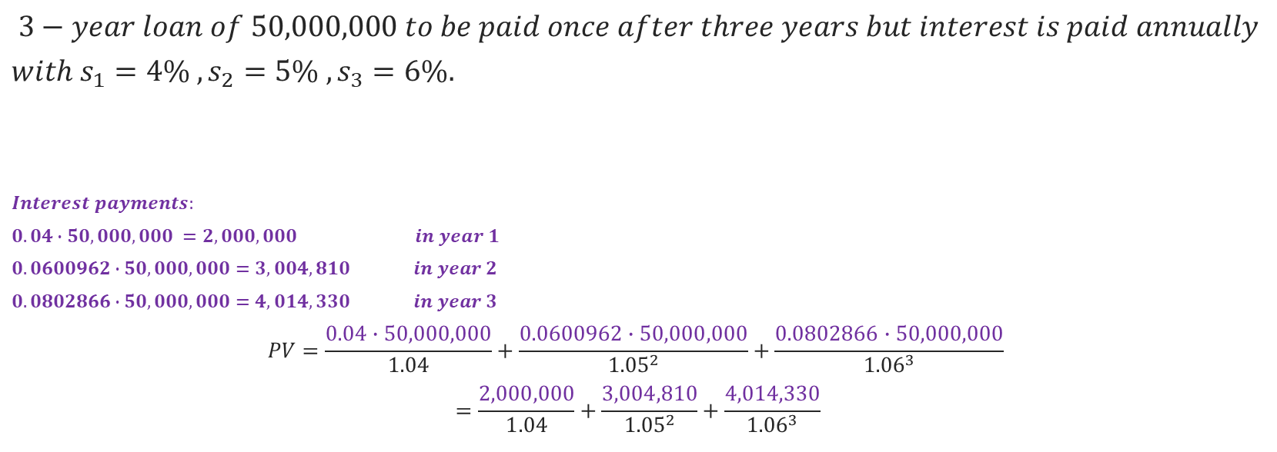
Example
$$3−year loan of 50,000,000 to be paid once after three years but interest is paid annually$$
$$with s_{1}=4\% , s_{2}=5\% , s_{3}=6\%.$$
$$Interest payments:$$
$$0.04∙50,000,000 =2,000,000 in year 1$$
$$0.0600962∙50,000,000=3,004,810 in year 2$$
$$0.0802866∙50,000,000=4,014,330 in year 3$$
$$PV=\frac{0.04∙50,000,000}{1.04}+\frac{0.0600962∙50,000,000}{{1.05}^{2}}+\frac{0.0802866∙50,000,000}{{1.06}^{3}}$$
$$=\frac{2,000,000}{1.04}+\frac{3,004,810}{{1.05}^{2}}+\frac{4,014,330}{{1.06}^{3}}$$
PV of Interest payments
By changing rates

Slide 8
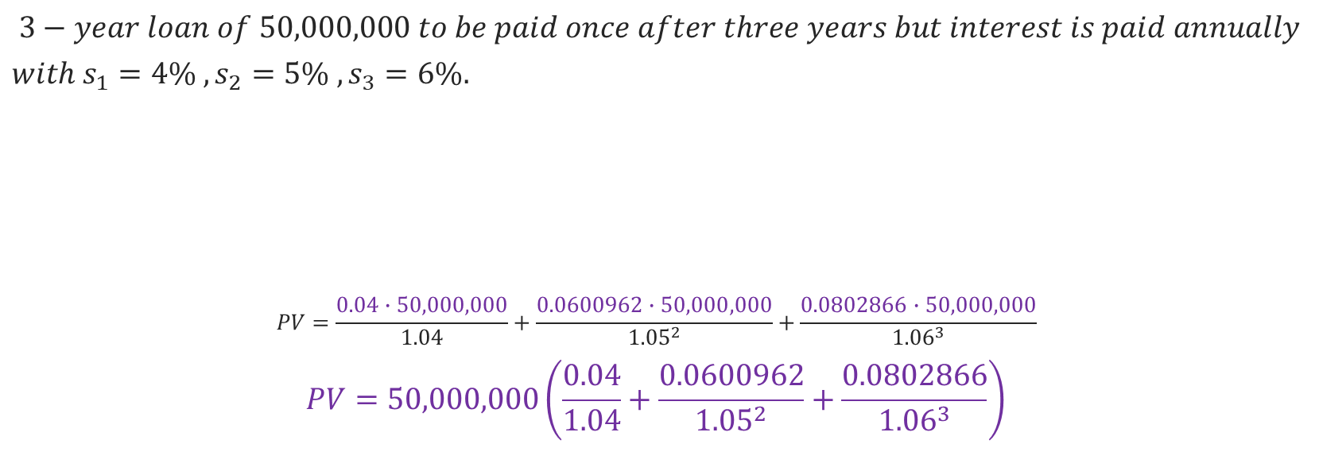
Example
$$3−year loan of 50,000,000 to be paid once after three years but interest is paid annually$$
$$with s_{1}=4\% , s_{2}=5\% , s_{3}=6\%.$$
$$PV=\frac{0.04∙50,000,000}{1.04}+\frac{0.0600962∙50,000,000}{{1.05}^{2}}+\frac{0.0802866∙50,000,000}{{1.06}^{3}}$$
$$PV=50,000,000\left(\frac{0.04}{1.04}+\frac{0.0600962}{{1.05}^{2}}+\frac{0.0802866}{{1.06}^{3}}\right)$$
PV of Interest payments
By changing rates

Slide 9

Example
$$3−year loan of 50,000,000 to be paid once after three years but interest is paid annually$$
$$with s_{1}=4\% , s_{2}=5\% , s_{3}=6\%.$$
$$Interest payments:$$
$$R∙50,000,000 in year 1$$
$$R∙50,000,000 in year 2$$
$$R∙50,000,000 in year 3$$
PV of Interest payments
By the Swap rate
$$Note:50,000,000 is called notional amount$$

Slide 10

Example
$$3−year loan of 50,000,000 to be paid once after three years but interest is paid annually$$
$$with s_{1}=4\% , s_{2}=5\% , s_{3}=6\%.$$
$$Interest payments:$$
$$R∙50,000,000 in year 1$$
$$R∙50,000,000 in year 2$$
$$R∙50,000,000 in year 3$$
$$PV=\frac{R∙50,000,000}{1.04}+\frac{R∙50,000,000}{{1.05}^{2}}+\frac{R∙50,000,000}{{1.06}^{3}}$$
$$PV=50,000,000\left(\frac{R}{1.04}+\frac{R}{{1.05}^{2}}+\frac{R}{{1.06}^{3}}\right)$$
PV of Interest payments
By the Swap rate
$$Note:50,000,000 is called notional amount$$

Slide 11
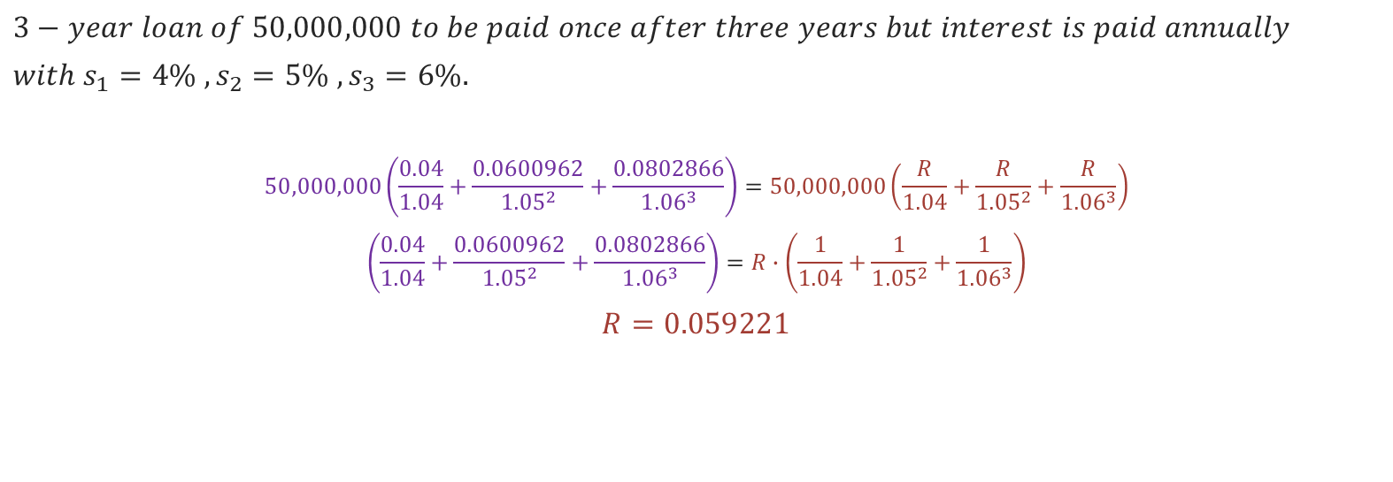
Example
$$3−year loan of 50,000,000 to be paid once after three years but interest is paid annually$$
$$with s_{1}=4\% , s_{2}=5\% , s_{3}=6\%.$$
$$50,000,000\left(\frac{0.04}{1.04}+\frac{0.0600962}{{1.05}^{2}}+\frac{0.0802866}{{1.06}^{3}}\right)=50,000,000\left(\frac{R}{1.04}+\frac{R}{{1.05}^{2}}+\frac{R}{{1.06}^{3}}\right)$$
$$\left(\frac{0.04}{1.04}+\frac{0.0600962}{{1.05}^{2}}+\frac{0.0802866}{{1.06}^{3}}\right)=R∙\left(\frac{1}{1.04}+\frac{1}{{1.05}^{2}}+\frac{1}{{1.06}^{3}}\right)$$
$$R=0.059221$$
$$Note:50,000,000 is called notional amount$$

Slide 12

Example (Faster Approach)
$$We can work as we have a bond with F=1 , C=1 ,P=1 , r=R$$
$$P=Fr∙a_{n}+Cv^{n}$$
$$1=1∙R∙\left(\frac{1}{1.04}+\frac{1}{{1.05}^{2}}+\frac{1}{{1.06}^{3}}\right)+1∙\frac{1}{{1.06}^{3}}$$
$$R=0.059221$$
Careful not to forget this term

Slide 13
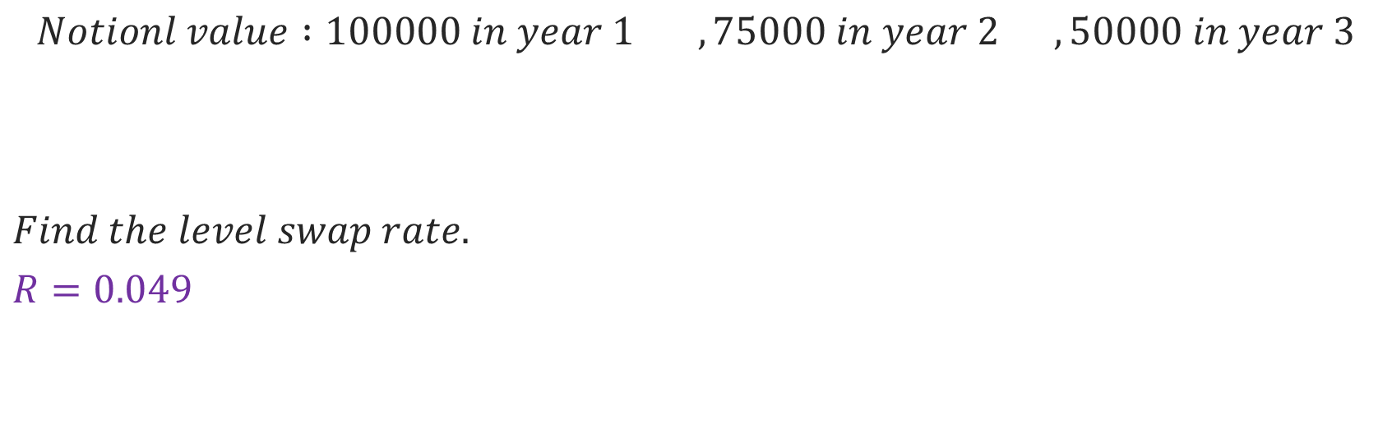
Example (Faster Approach can NOT be used)
$$Notionl value :100000 in year 1 , 75000 in year 2 , 50000 in year 3$$
$$Find the level swap rate.$$
$$R=0.049$$
$$Year$$ | $$1$$ | $$2$$ | $$3$$
$$Spot Rate$$ | $$4.00\%$$ | $$4.50\%$$ | $$5.25\%$$
$$Note:notional amounts are diffirent$$

Slide 14



Remark : Forward Contract
$$Is a contract to purchase assets in the future.$$
$$t=0$$
$$t=T$$
Enter a Forward Contract
Pay the Forward price and Receive Asset

Slide 15

Commodity Swaps
$Same notion of the interes rate swap applies here.$
$Commodity swaps are financially settled.$
$An investor enters a commodity swap when in need to repeatedly purchase$
$$a product but want to lock in the changing prices.$$

Slide 16
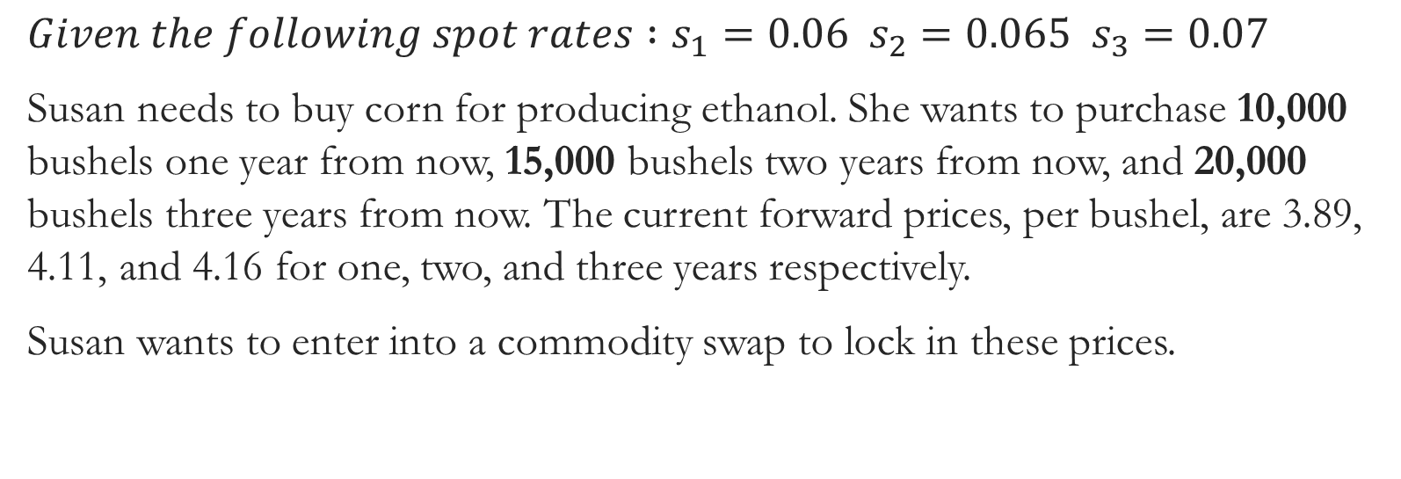
Commodity Swaps- Example
$$Given the following spot rates :s_{1}=0.06 s_{2}=0.065 s_{3}=0.07$$
Susan needs to buy corn for producing ethanol. She wants to purchase 10,000 bushels one year from now, 15,000 bushels two years from now, and 20,000 bushels three years from now. The current forward prices, per bushel, are 3.89, 4.11, and 4.16 for one, two, and three years respectively.
Susan wants to enter into a commodity swap to lock in these prices.
$$Note:10,000 and 15,000 and 20,000 are called notional amounts$$

Slide 17
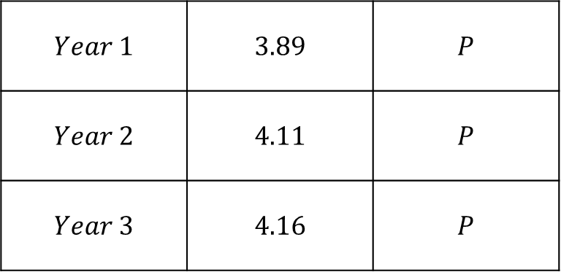
Commodity Swaps
Floating / Changing
Prices
Constant / Swap
Price
$$Year 1$$ | $$3.89$$ | $$P$$
$$Year 2$$ | $$4.11$$ | $$P$$
$$Year 3$$ | $$4.16$$ | $$P$$

Slide 18
Commodity Swaps
PV of payments
By changing/forward prices
PV of payments
By the Swap price
$$=$$

Slide 19
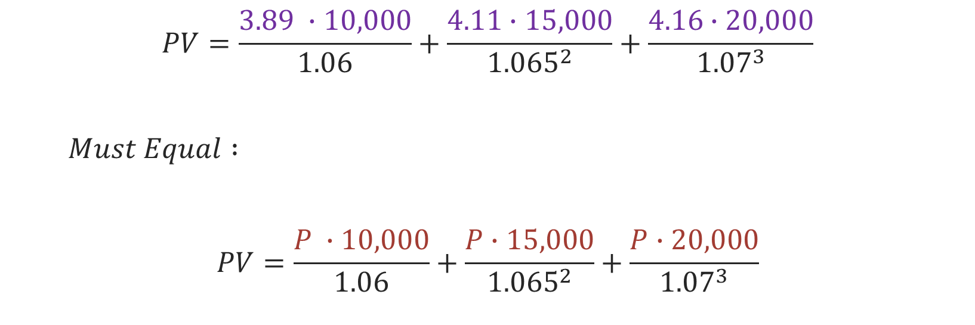
Commodity Swaps-Example
$$PV=\frac{3.89 ∙10,000}{1.06}+\frac{4.11∙15,000}{{1.065}^{2}}+\frac{4.16∙20,000}{{1.07}^{3}}$$
$$Must Equal :$$
$$PV=\frac{P ∙10,000}{1.06}+\frac{P∙15,000}{{1.065}^{2}}+\frac{P∙20,000}{{1.07}^{3}}$$

Slide 20
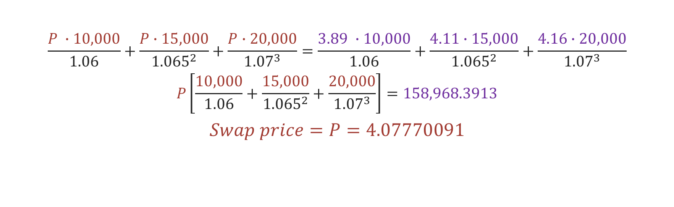
Commodity Swaps-Example
$$\frac{P ∙10,000}{1.06}+\frac{P∙15,000}{{1.065}^{2}}+\frac{P∙20,000}{{1.07}^{3}}=\frac{3.89 ∙10,000}{1.06}+\frac{4.11∙15,000}{{1.065}^{2}}+\frac{4.16∙20,000}{{1.07}^{3}}$$
$$P\left[\frac{10,000}{1.06}+\frac{15,000}{{1.065}^{2}}+\frac{20,000}{{1.07}^{3}}\right]=158,968.3913$$
$$Swap price=P=4.07770091$$

Slide 21
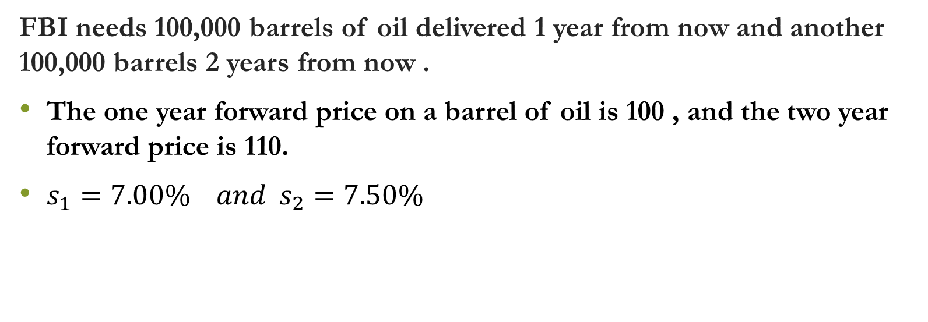
Commodity Swaps-Example 2
FBI needs 100,000 barrels of oil delivered 1 year from now and another 100,000 barrels 2 years from now .
The one year forward price on a barrel of oil is 100 , and the two year forward price is 110.
$s_{1}=7.00\% and s_{2}=7.50\%$

Slide 22
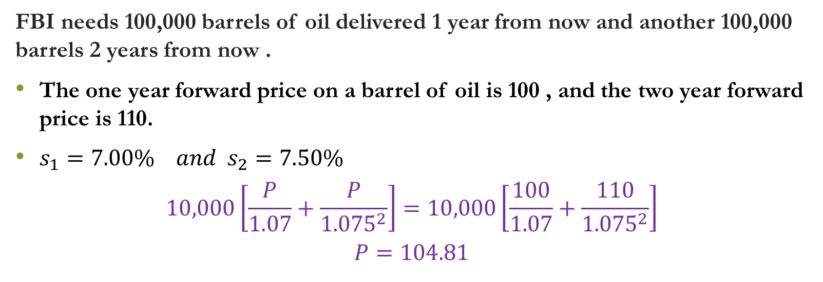
Commodity Swaps-Example 2
FBI needs 100,000 barrels of oil delivered 1 year from now and another 100,000 barrels 2 years from now .
The one year forward price on a barrel of oil is 100 , and the two year forward price is 110.
$s_{1}=7.00\% and s_{2}=7.50\%$
$$10,000\left[\frac{P}{1.07}+\frac{P}{{1.075}^{2}}\right]=10,000\left[\frac{100}{1.07}+\frac{110}{{1.075}^{2}}\right]$$
$$P=104.81$$

Slide 23


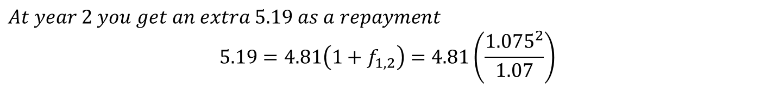
Commodity Swaps-Example 2
Cashflow Diagram
Notice :
You Pay 104.81
You Pay 104.81
You Get 100
You Get 110
$$t=1$$
$$t=2$$
$$At year 1 you pay an extra 4.81 as a loan to the swap counterparty$$
$$At year 2 you get an extra 5.19 as a repayment$$
$$5.19=4.81\left(1+f_{1,2}\right)=4.81\left(\frac{{1.075}^{2}}{1.07}\right)$$

